Slide 1



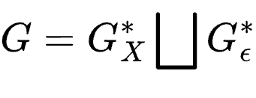
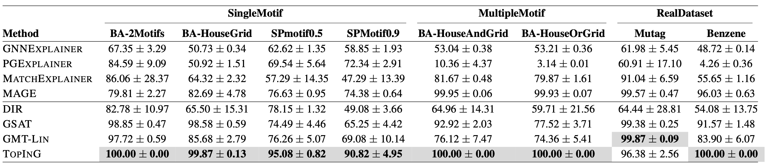
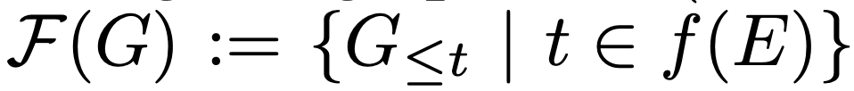
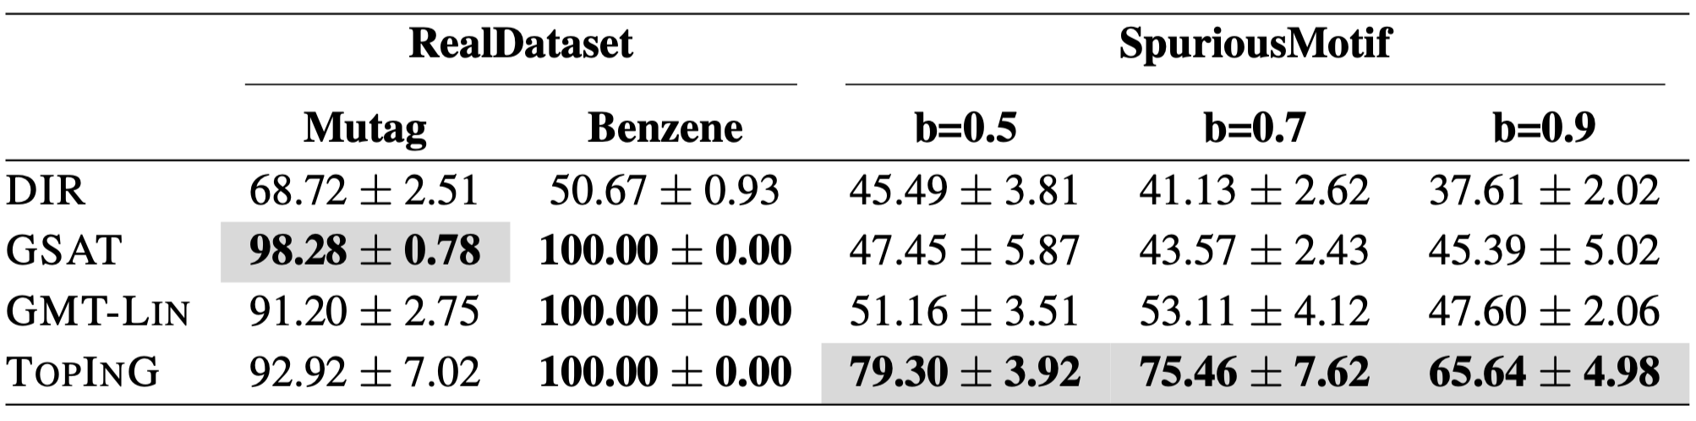
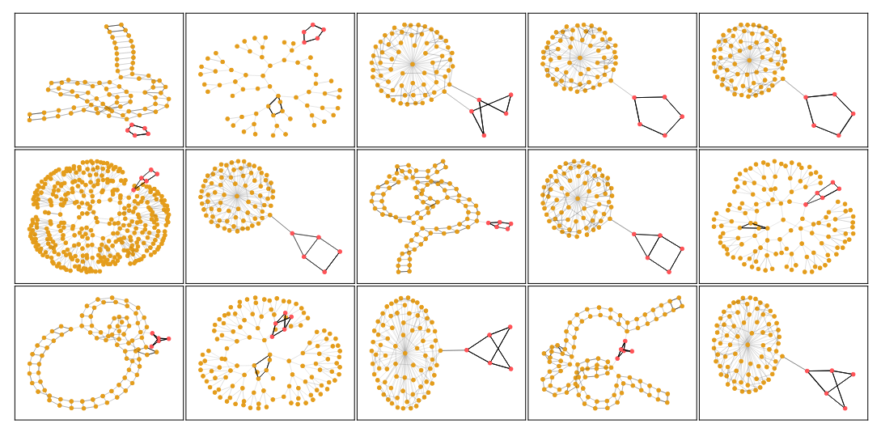
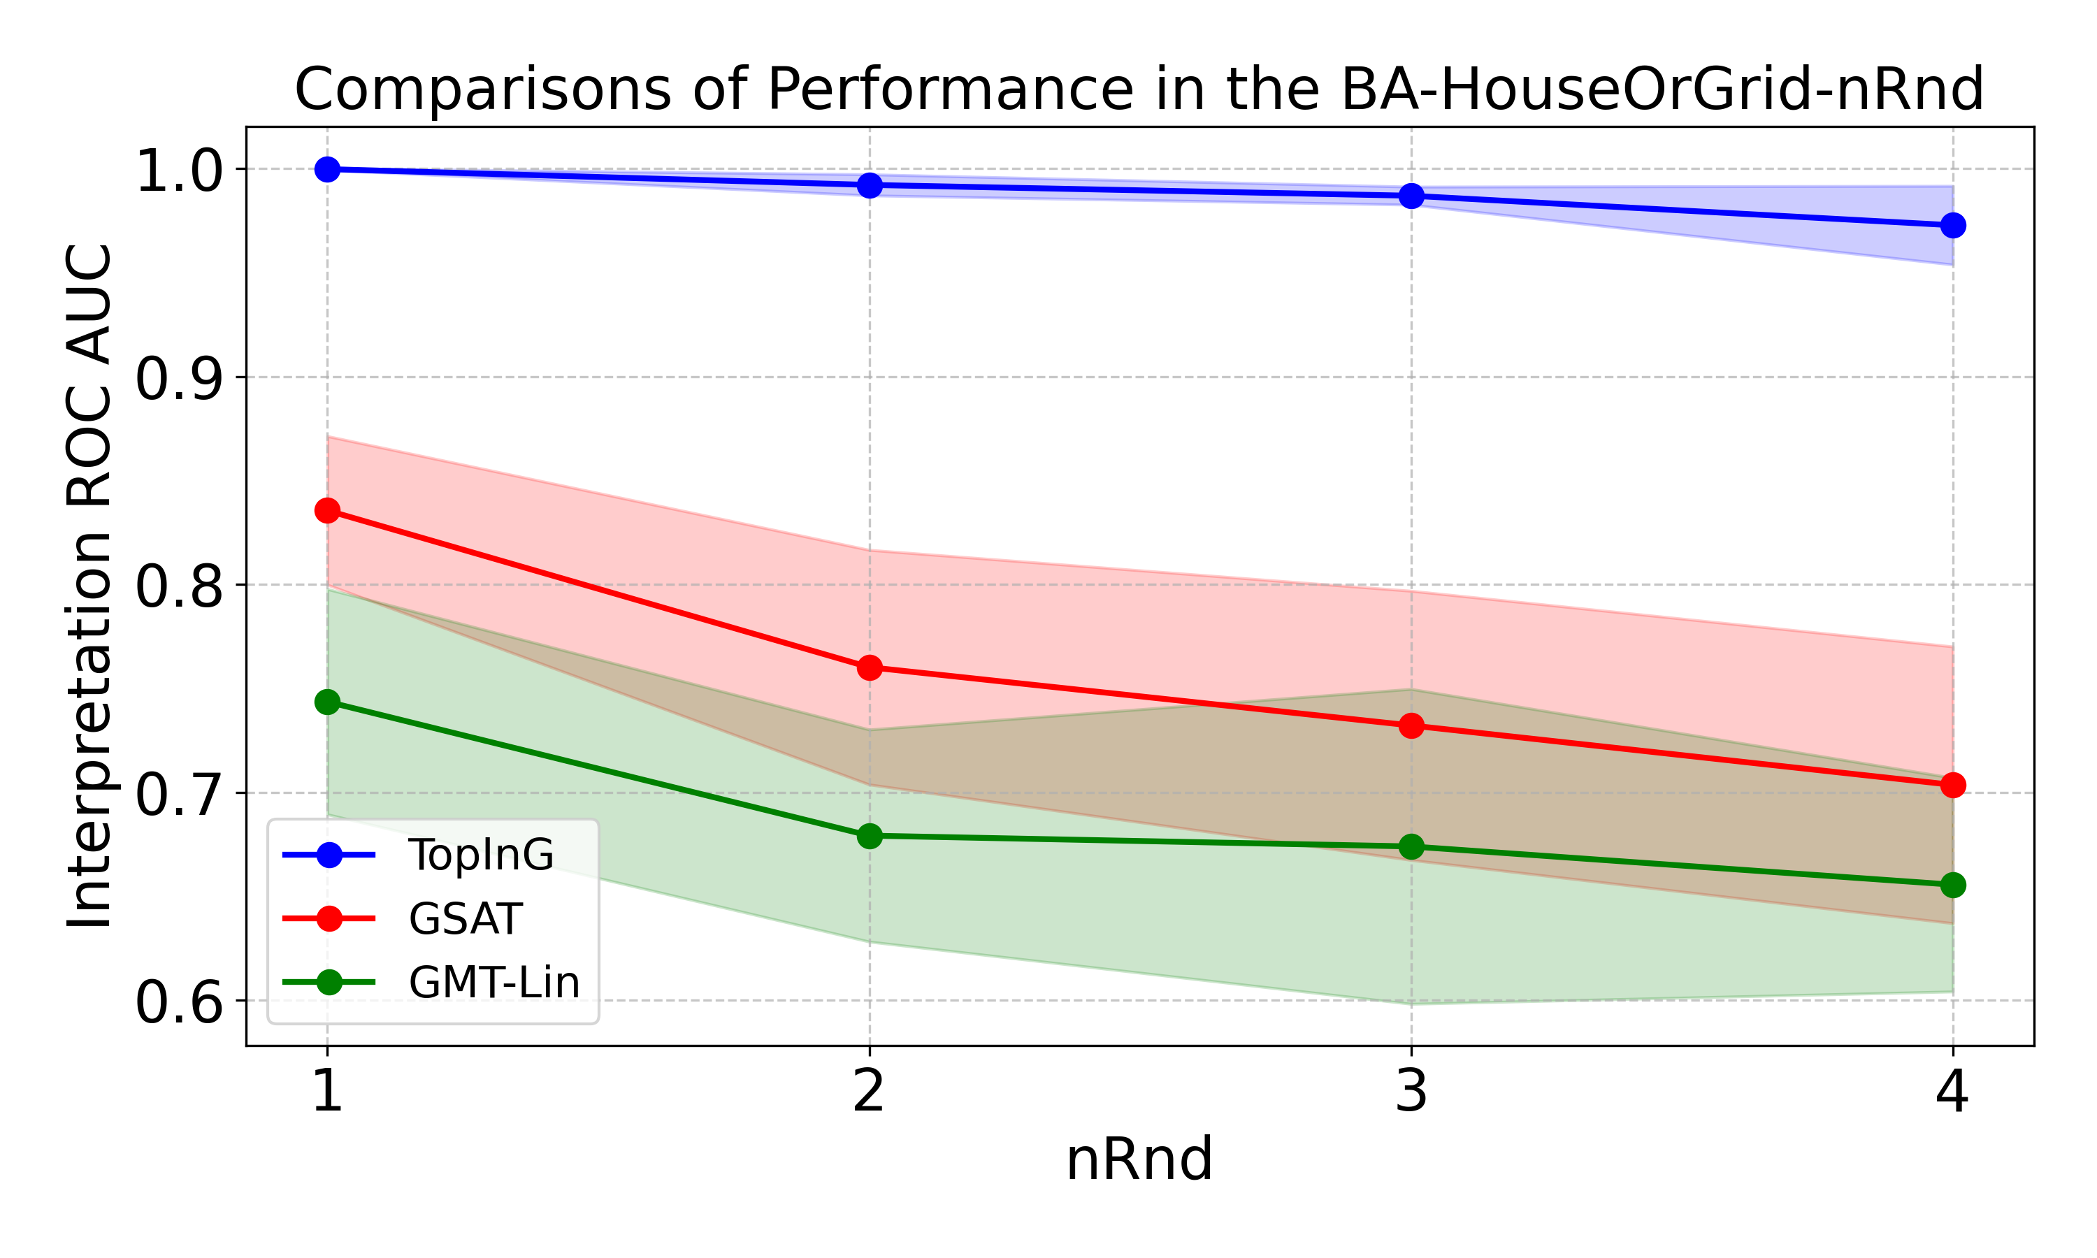
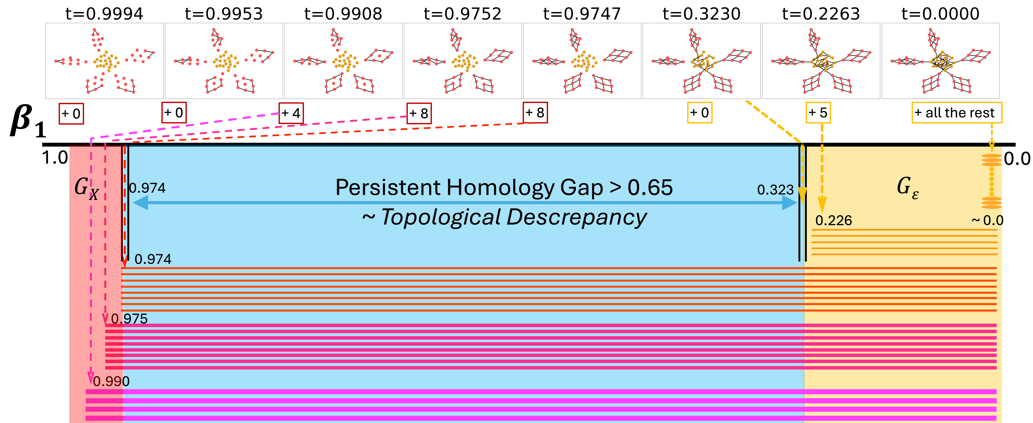
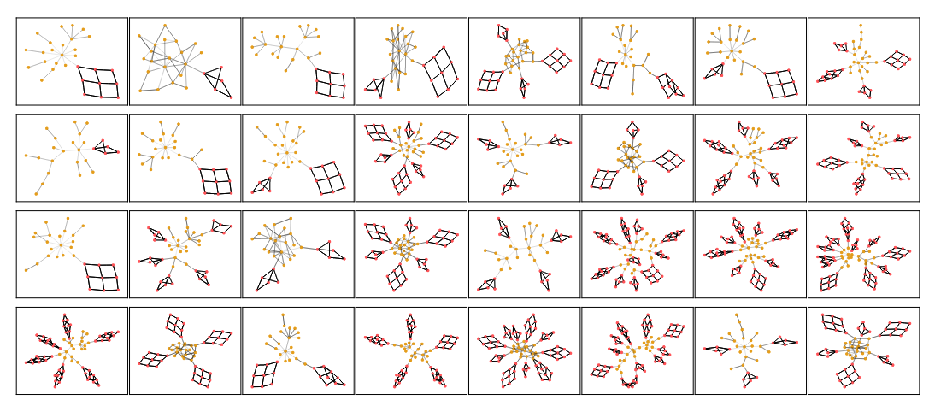
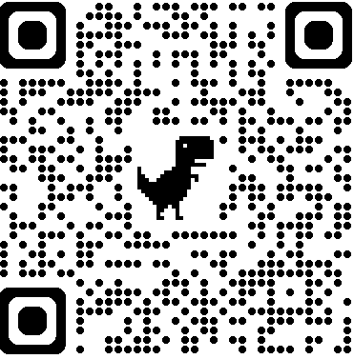
TopInG: Topologically Interpretable Graph Learning via Persistent Rationale Filtration
¹Cheng Xin*, ²Fan Xu*, ²Xin Ding, ¹Jie Gao and ²Jiaxin Ding
¹Rutgers University, ²Shanghai Jiao Tong University
Problem and Contributions
Method
Experiments
Problem: Learn a model simultaneously predict the label and identify a rational subgraph.
TopInG integrates TDA into GNNs for interpreting graphs by learning rationale filtration.
Propose a new loss, topological discrepancy, measuring statistical difference on topological invariants --- persistent homology.
Provide theoretical guarantees and a tractable approximation of our model.
Experiments show TopInG improves performance on multiple benchmark datasets up to 20%+.
Main Idea: modeling an underlying graph generating process determined by an ordering consistent with the partition i.e.:
Persistent Homology: on a graph filtration a persistent homology is a chain of induced homology vector spaces connected by linear maps
Intuitively, using topological discrepancy to enlarge persistent topological gap
Table 1: Interpretation Performance (AUC) on benchmark datasets.
Table 2: Prediction Accuracy (Acc) on benchmark datasets.
Challenges
Theory
Visualization
Trade-off between Prediction & Interpretation
Spurious correlations beyond rationale subgraph
[New] Variform Rationale Subgraphs
A tractable lower bound; upper bound by a functional Gromov-Hausdorff distance
A B C
Theoretical Guarantee: optimized by ground truth rationale subgraphs
Project Page
SCAN ME
https://jackal092927.github.io/publication/TopInG_ICML2025
C. Xin and J. Gao acknowledge funding from IIS-22298766, DMS-2220271, DMS-2311064, CRCNS2207440, CCF-2208663 and CCF-2118953.
F. Xu and J. Ding were supported by NSF China under Grant No. T2421002, 62202299, 62020106005, 62061146002.

