Slide 1
A Crash course in SQL Server Query Plans
What they are
How to get them
What they can tell you

Slide 2
About me
Jack Alvrus – AIS
Full stack developer, occasional architect
Have used SQL Server since version 6.5
Forced by circumstances to be come SQL query tuning expert

Slide 3
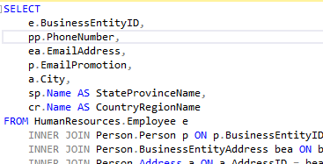
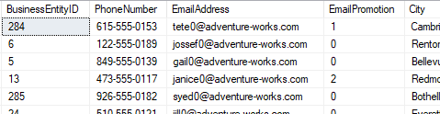
How sql works
Magic Happens

Slide 4
What is a query plan and why do you need to know?
What?
The operations that are used to execute a SQL statement
Why?
Improve performance
Diagnose functional problems

Slide 5
How is a query plan created?
Created by the query optimizer
Tries to come up with the “best” plan
Resulting plan influenced by
The database schema (tables, indexes, foreign keys, etc.)
The distribution of values in data (“density”, “cardinality”)
Determined using statistics

Slide 6
How to get a query plan
Permission is required (grant showplan to [user])
Management Studio (SSMS)
Query Window
Activity Monitor - Recent Expensive Queries
SQL Server Profiler / SQL Trace / Extended Events
Dynamic management view sys.dm_exec_query_plan
Get from plan cache or a running query

Slide 7
How to View a Query Plan
Serialized as XML, so can be saved as a file
View XML directly
SSMS graphical viewer
Generate plan from SQL in query window (connection required)
Load XML files into viewer (connection not required)
Use a third-party tool

Slide 8
Examples

Slide 9
Cost in Query Plans
Unit-less number which does not represent any physical quantity
Separate quantities for I/O and CPU
Used by the optimizer to select “best” query plan
Determined based on statistics and assumptions made by optimizer
Best uses:
Quickly find performance-critical nodes
Understand what the optimizer is thinking

Slide 10
A Note about Statistics
Used by optimizer to understand distribution of values
Incorrect statistics are a major cause of performance problems
When analyzing queries on a test system, it is critical to use data that realistically represents production
Amount
Distribution of values

Slide 11
Examples

Slide 12
Conclusion
Statistics, Statistics, Statistics
Go forth and explore

