Slide 1
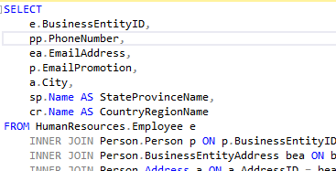

How sql works
Magic Happens

