Slide 1



UNIVERSITY OF WASHINGTON FOOTBALL ANALYSIS
By Jack Arbuckle, Reuben Dayal, and Ian Pezzella

Slide 2
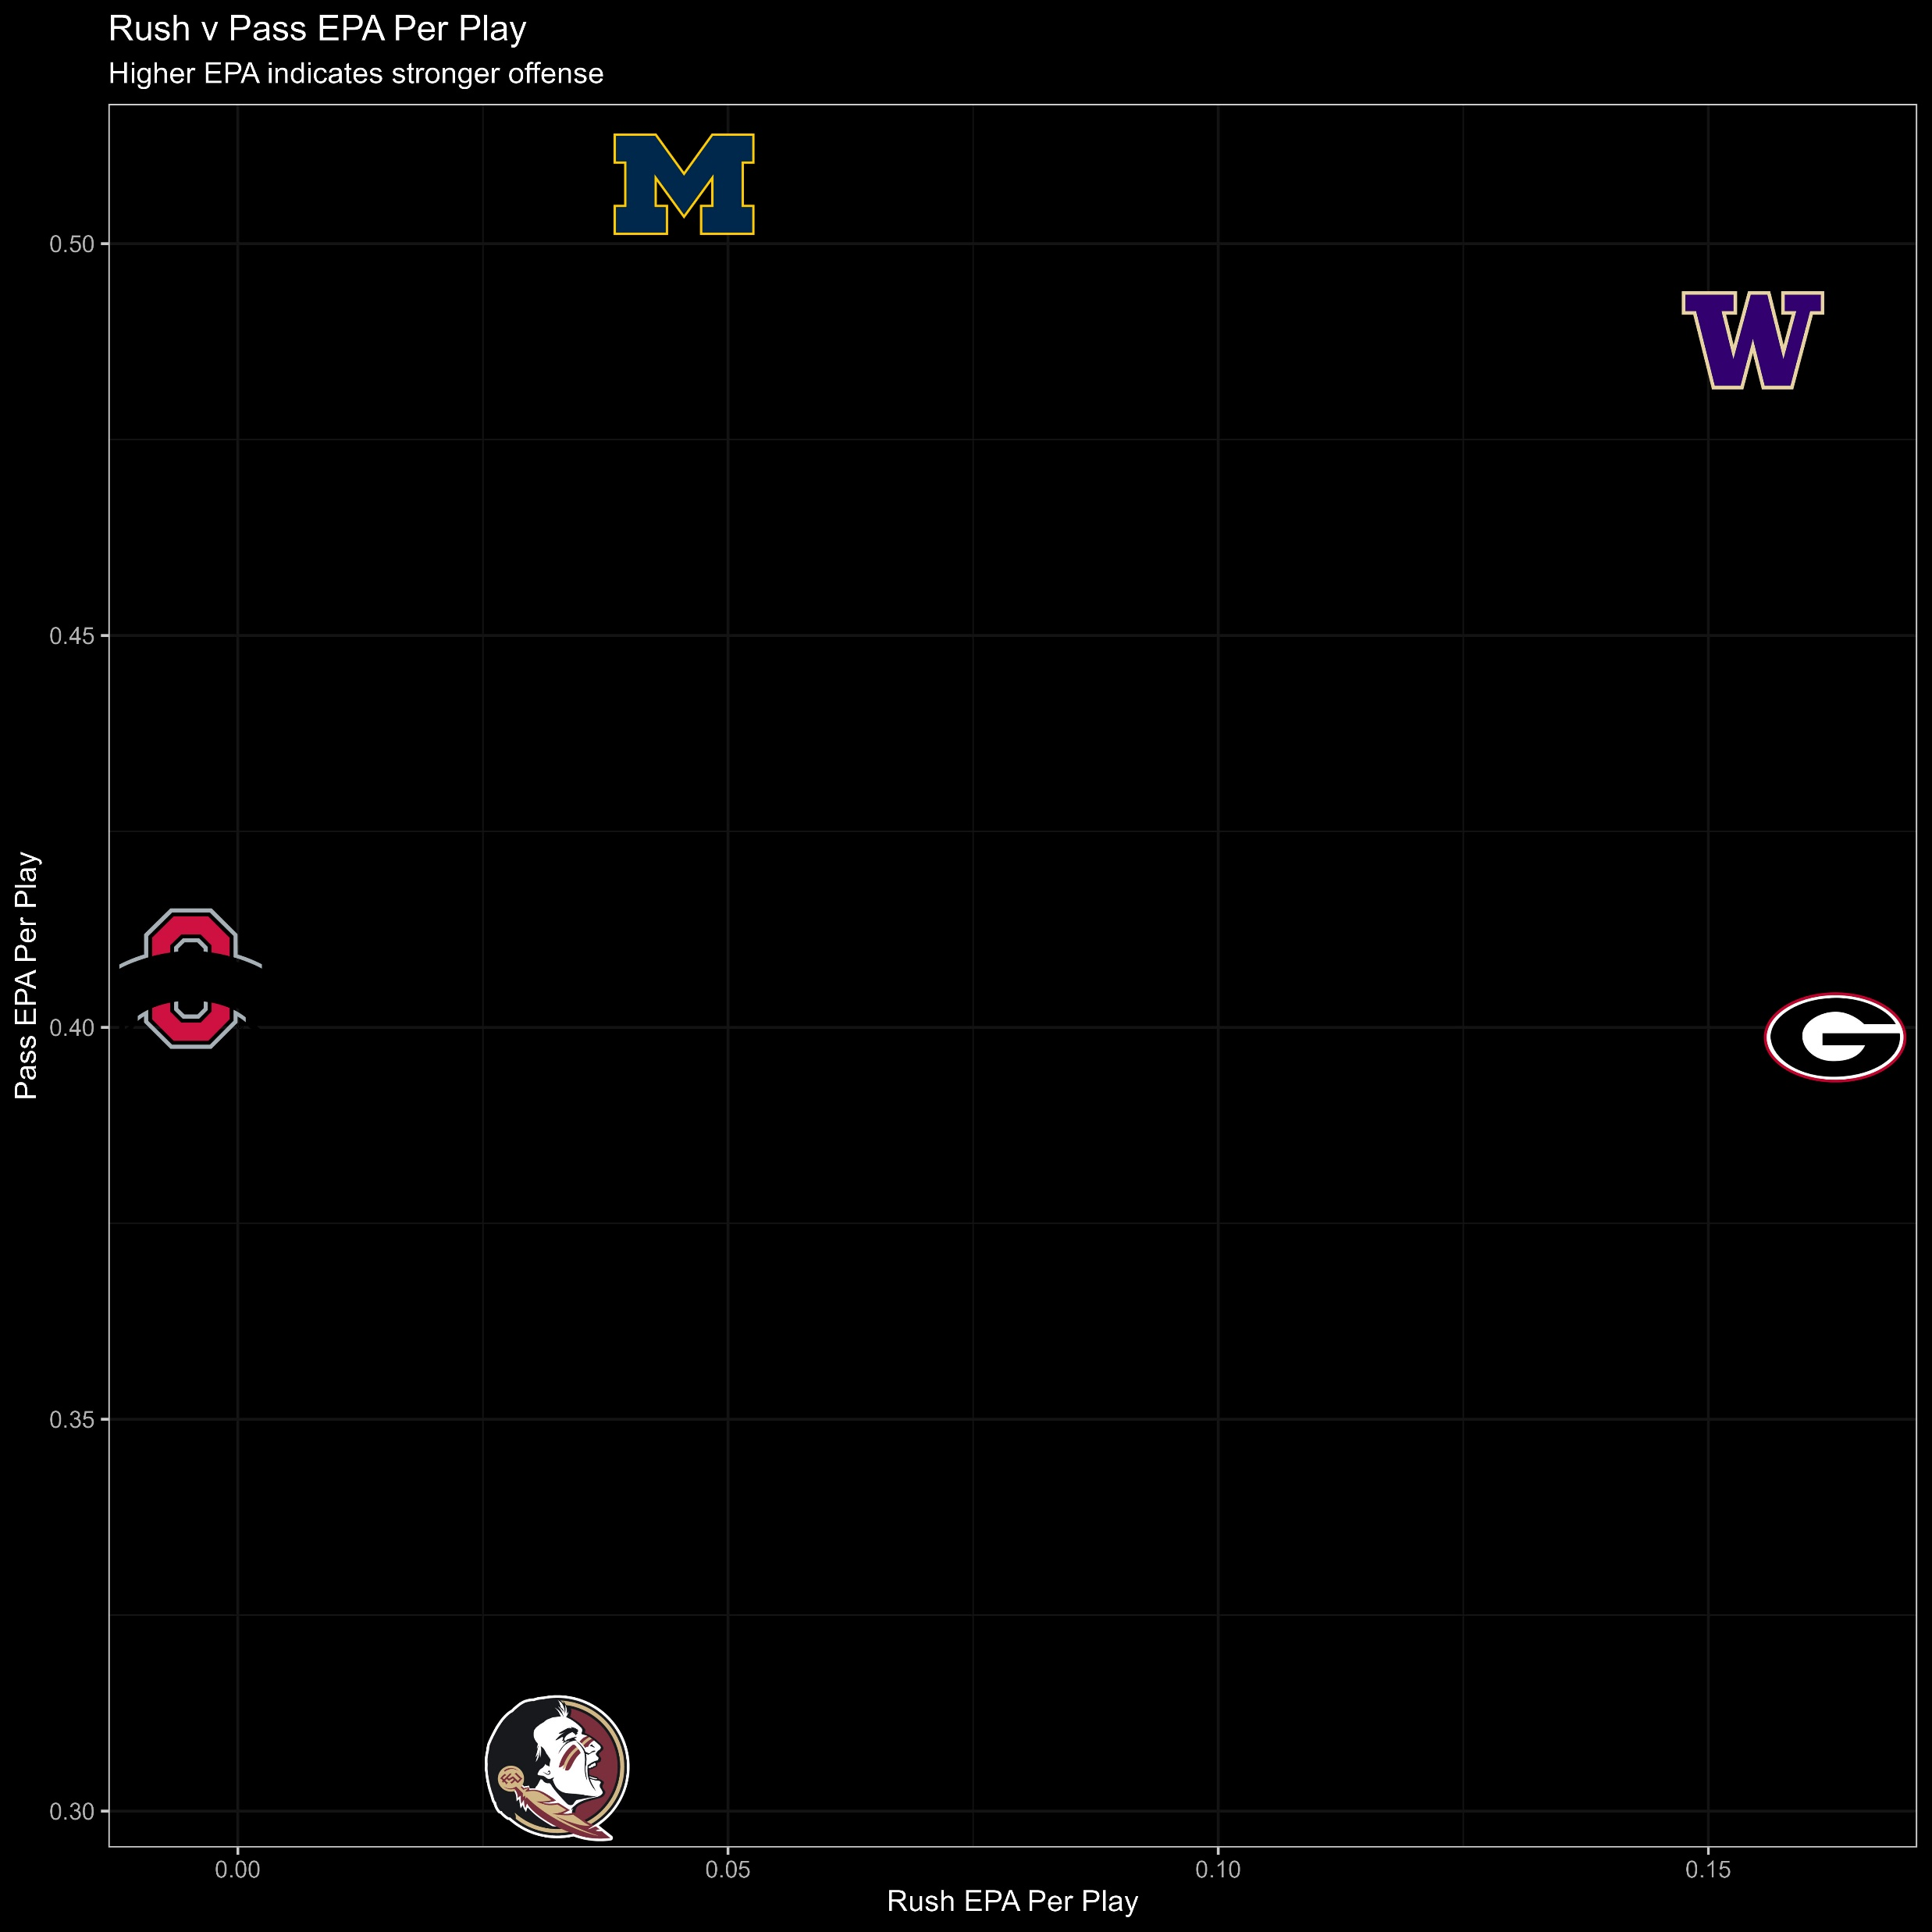
RUSH VS PASS EPA PER PLAY (OFF)
Washington looks to have the strongest overall offense
Other teams look to have more imbalanced attacks
Georgia is strongest in the run game
Michigan is strongest in the passing game
Washington plays in more high scoring games

Slide 3
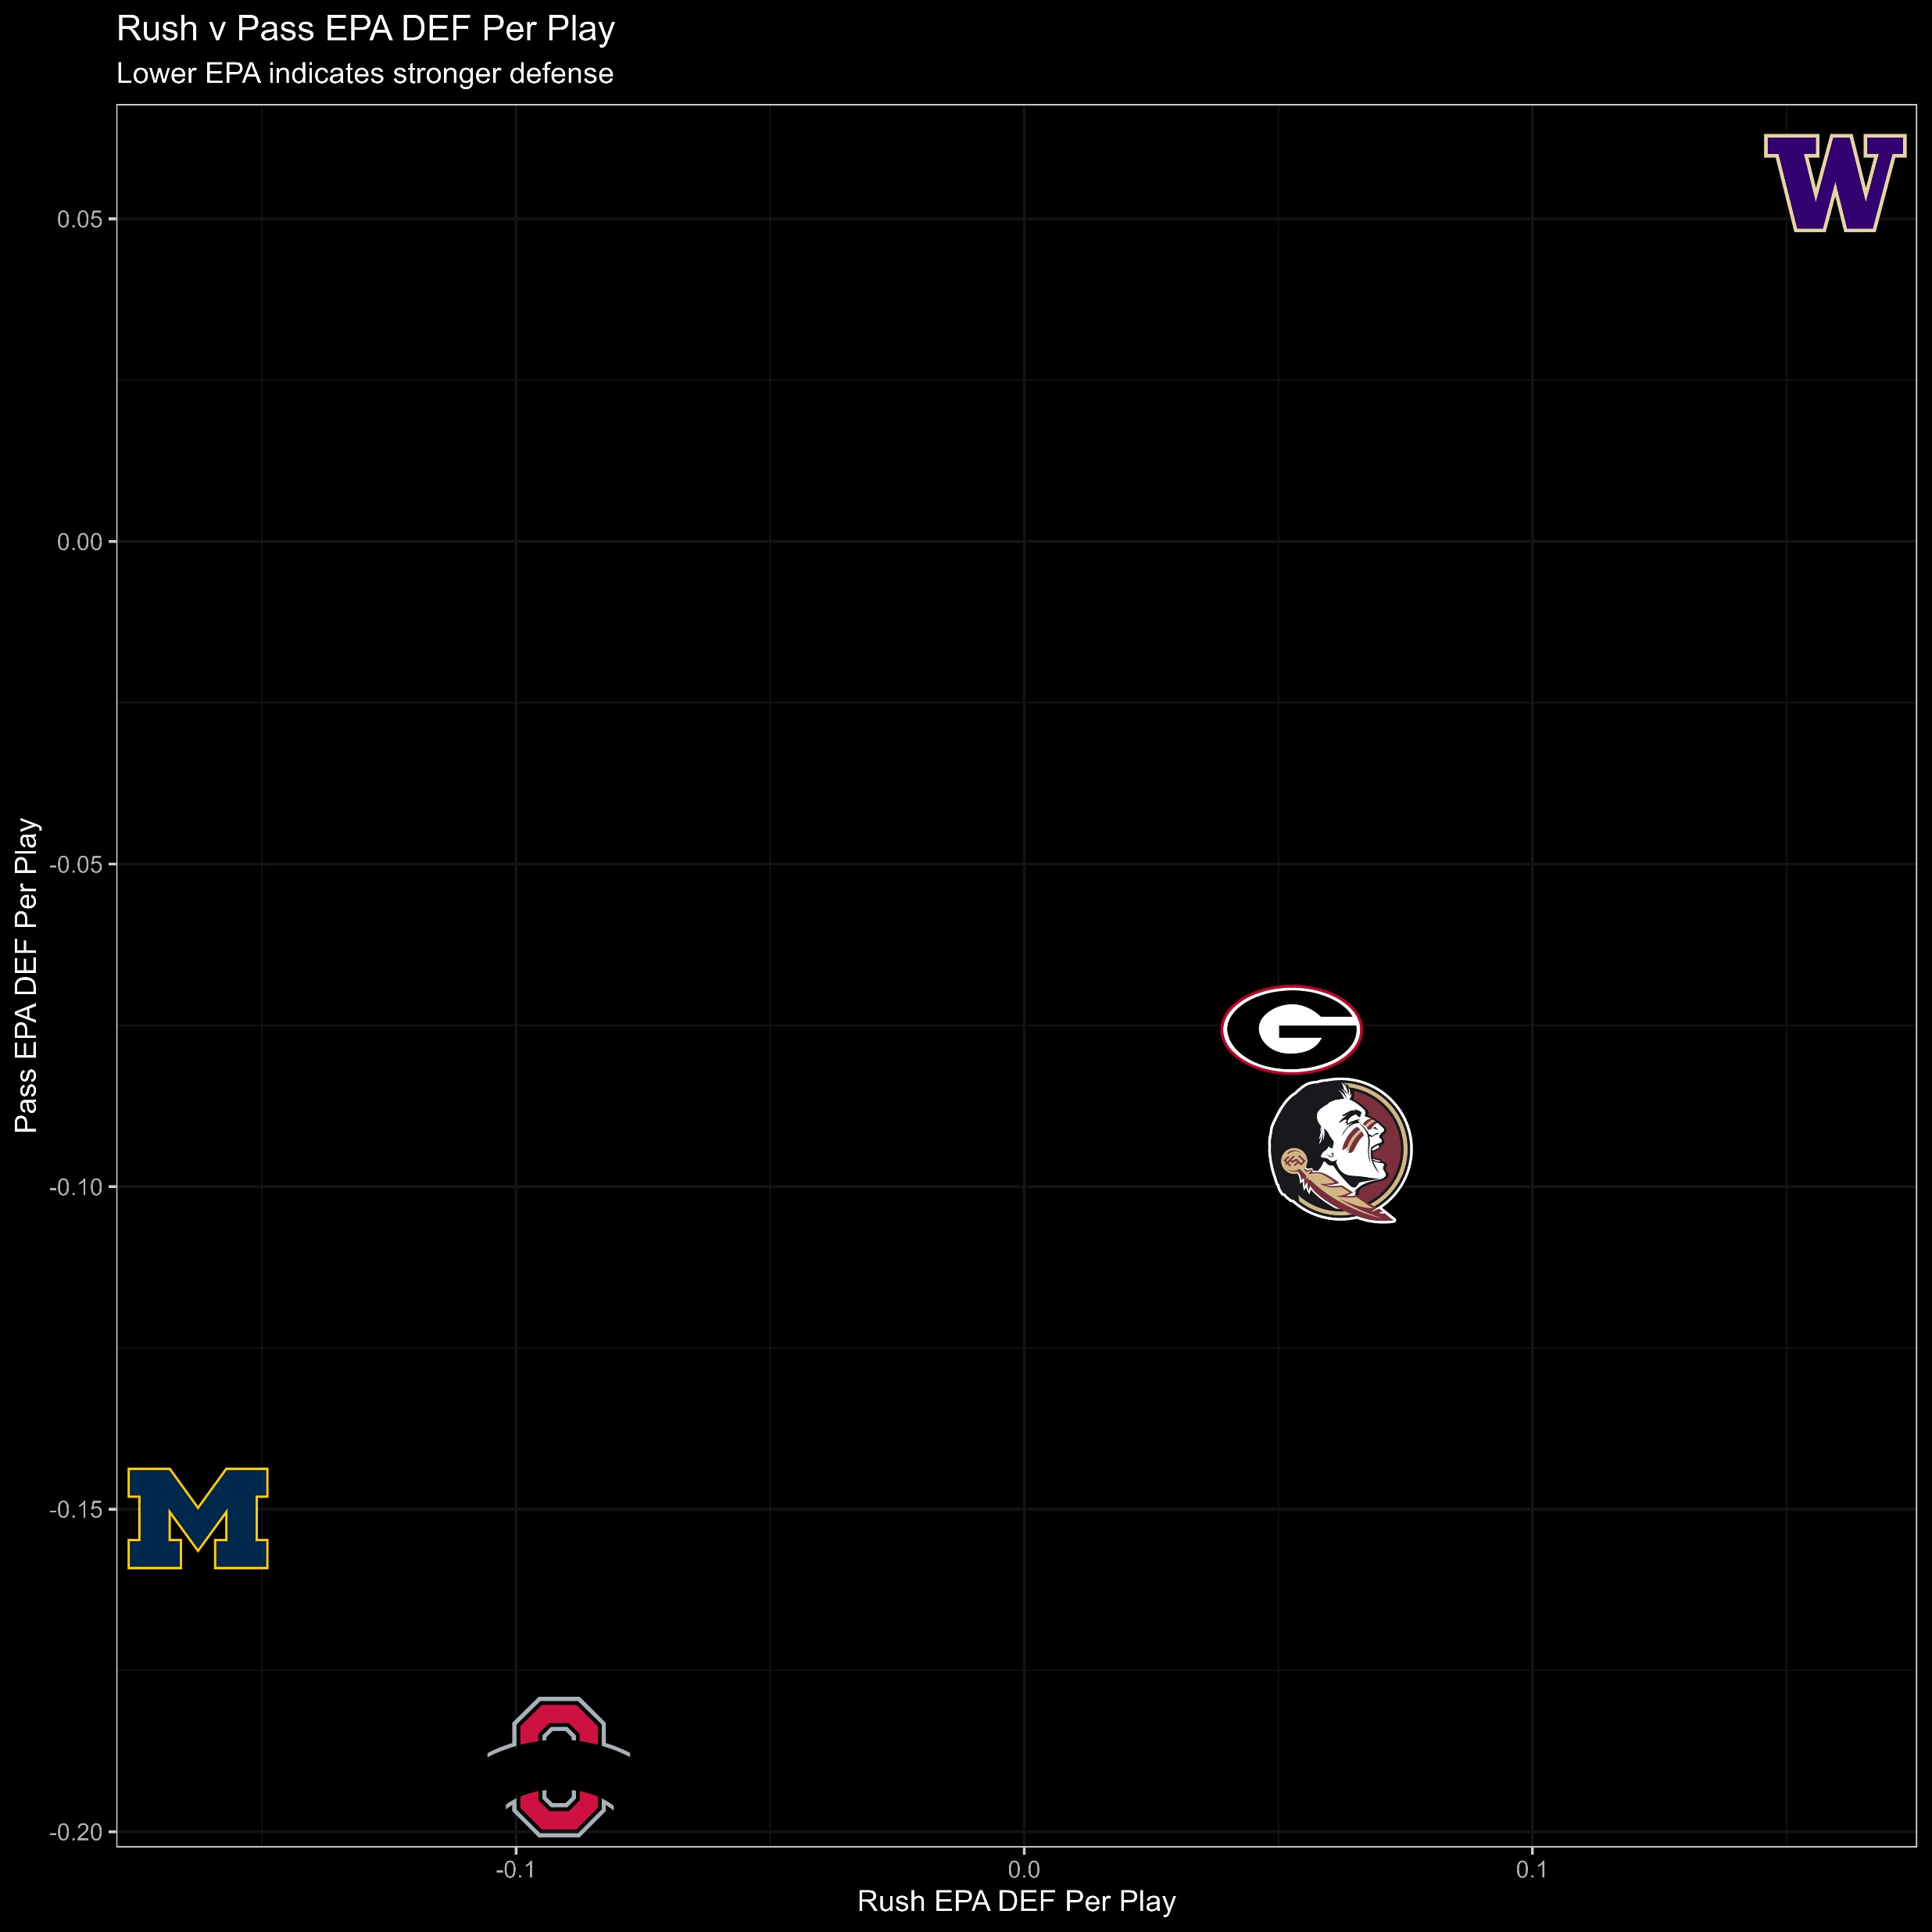
RUSH VS PASS EPA PER PLAY (DEF)
Washington has the worst defense for both passing and rushing
Big Ten Schools
Defense is key
Lower Scoring Games
By this measure it would look like Washington has far and away the worst defense compared to the other top teams

Slide 4
INITIAL THOUGHTS/QUESTIONS
Do the previous visualizations indicate that Washington has the best offense and worst defense out of the top five teams?
Opponents’ offensive and defensive metrics must be looked at and compared in order to create an accurate depiction
Looked at top opponents’ EPA on OFF and DEF

Slide 5
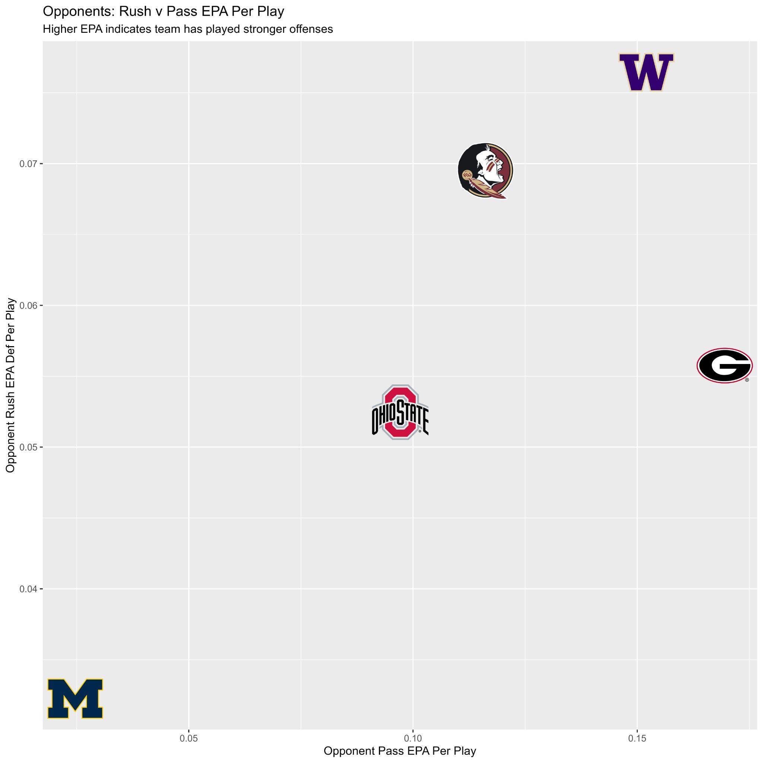
OPPONENTS EPA FOR OFFENSE
Washington has played the strongest offenses
PAC 12
Their defense is not as weak as depicted by normal EPA
Michigan has played the weakest offensive teams
BIG 10
Their defensive EPA rating is skewed in their favor

Slide 6
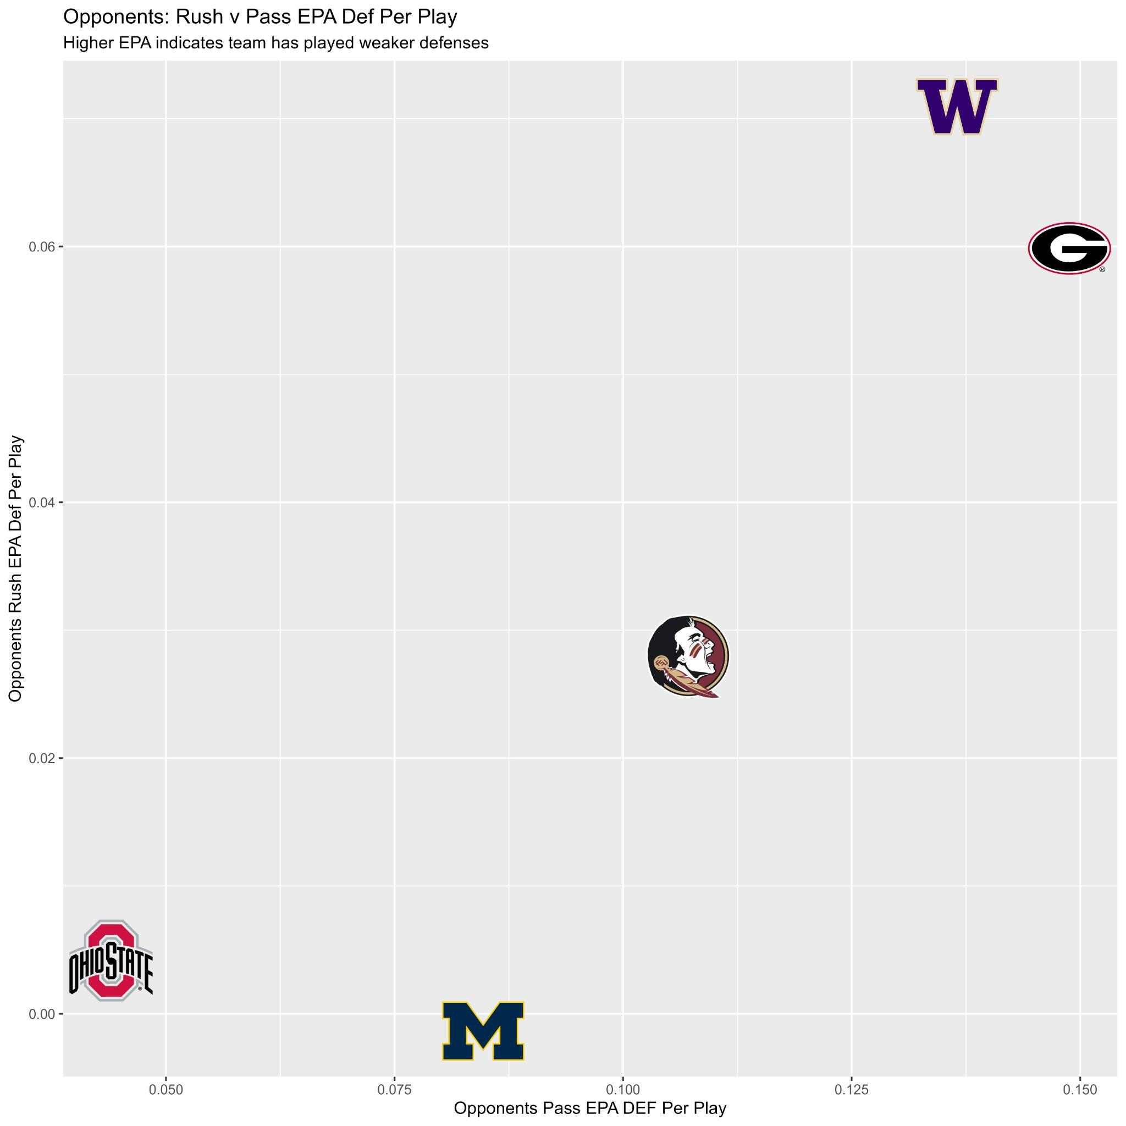
OPPONENTS EPA FOR DEFENSE
Washington and Georgia have played the weakest defenses
Their Off EPA could be higher due to this factor
Ohio State and Michigan have played strongest defenses
Could be making their offensive EPA look worse compared to the rest of the top teams

Slide 7
WEIGHTING THE EPA BASED ON OPPONENTS EPA
Created a formula to take the EPA of each of the top opponents into account
Looks to create an unbiased measure that is easily comparable
Formula:
weighted_passing_off = 10*((1/(0.5+opp_pass_epa_per_play_def))*(pass_epa_per_play+0.5))
weighted_rushing_off = 10*((1/(0.5+opp_rush_epa_per_play_def)) * (rush_epa_per_play+0.5))
weighted_passing_def = 10*((1/(0.5+opp_pass_epa_per_play)) * (pass_epa_per_play_def+0.5))
weighted_rushing_def = 10*((1/(0.5+opp_rush_epa_per_play)) * (rush_epa_per_play_def+0.5))

Slide 8
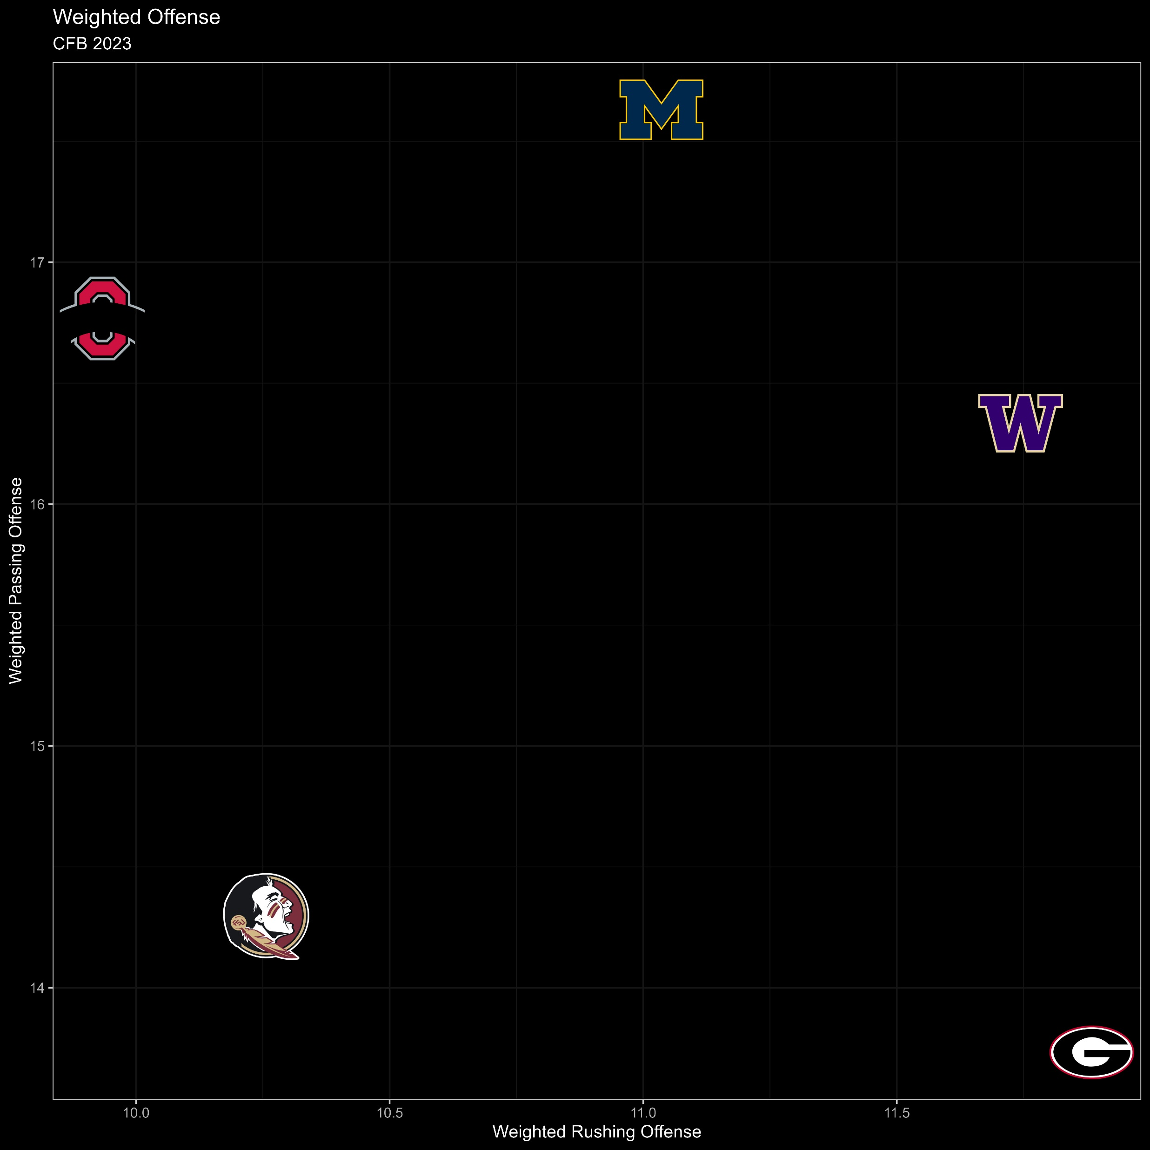
Weighted Offense
Even when accounting for strength of schedule, Washington still has a strong overall offense.
Georgia has the best run game, but the worst passing game
Michigan has the best passing game and an average run game
Florida State seems to have the worst overall offense by this metric
Ohio State has a strong passing game but the worst rushing attack
Marvin Harrison Jr
Best WR prospect

Slide 9
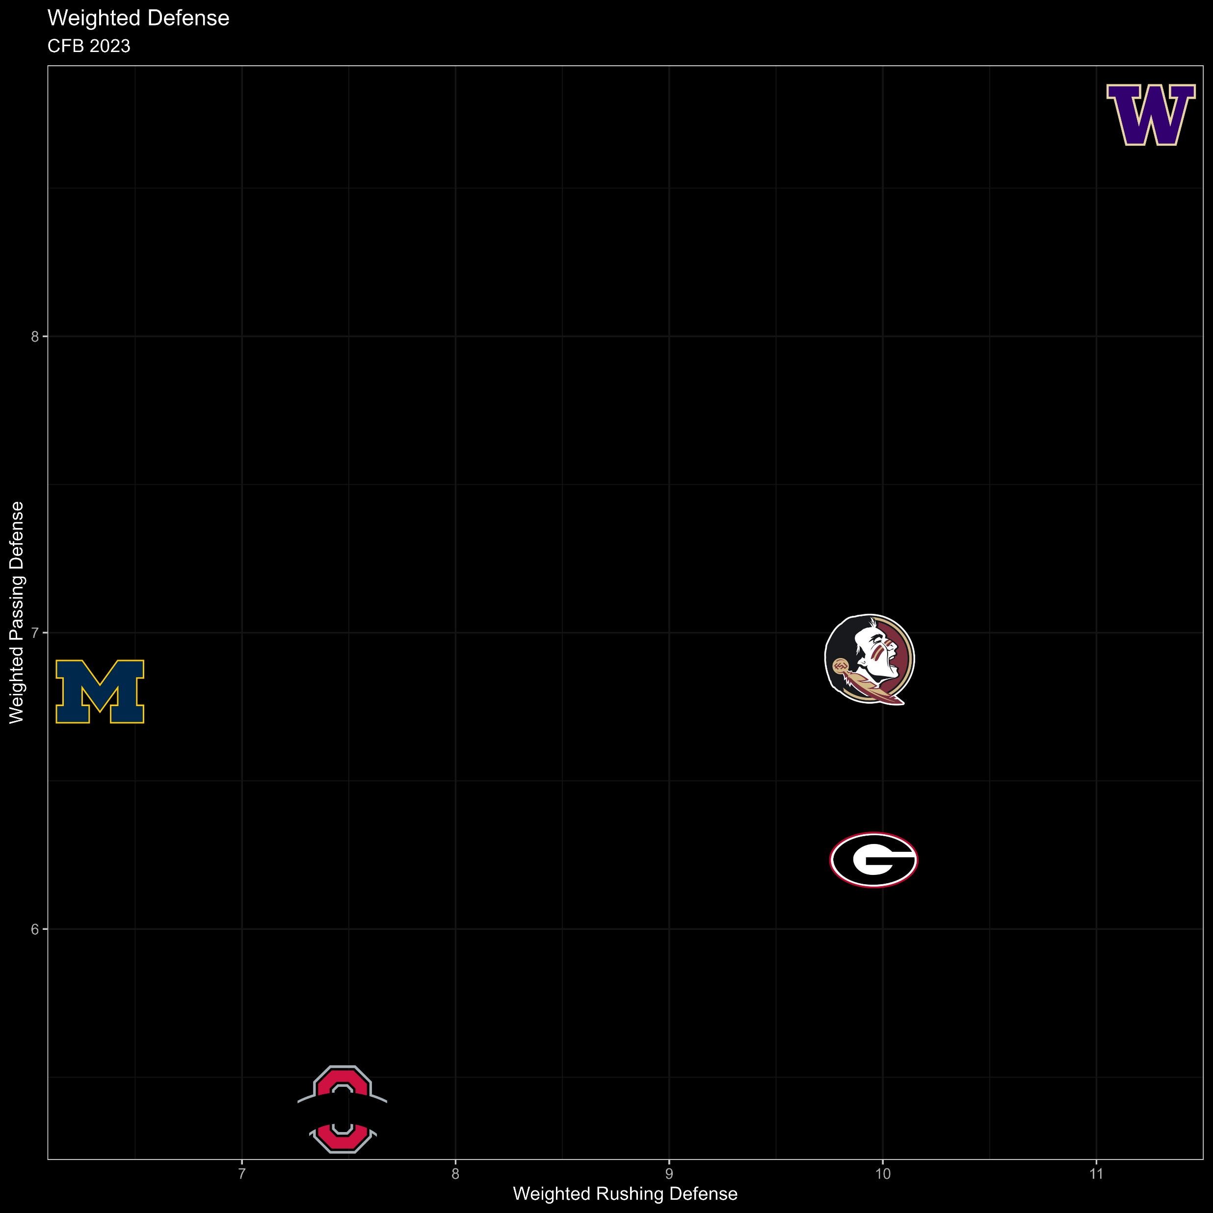
Weighted Defense
After accounting for strength of schedule, Washington still has, by far, the worst defense
PAC 12 - offense heavy, high scoring
Ohio State and Michigan have the best defenses
BIG 10 - defense heavy, low scoring
Ohio State has the best pass defense
Michigan has the best run defense

Slide 10
FINAL WEIGHT
Looked to compare how Washington would do against each of the teams individually
Multiplied the Offensive Passing and Rushing Weighted Measures by the Weighted Defense of the opponent
Formula:
1: Washington 2: Georgia
Wash_Passing_Off = 10*(weighted_passing_off[1] * weighted_passing_def[2])
Wash_Rushing_Off = 10*(weighted_rushing_off[1] * weighted_rushing_def[2])
UGA_Passing_Off = 10*(weighted_passing_off[2] * weighted_passing_def[1])
UGA_Rushing_Off = 10*(weighted_rushing_off[2] * weighted_rushing_def[1])

Slide 11
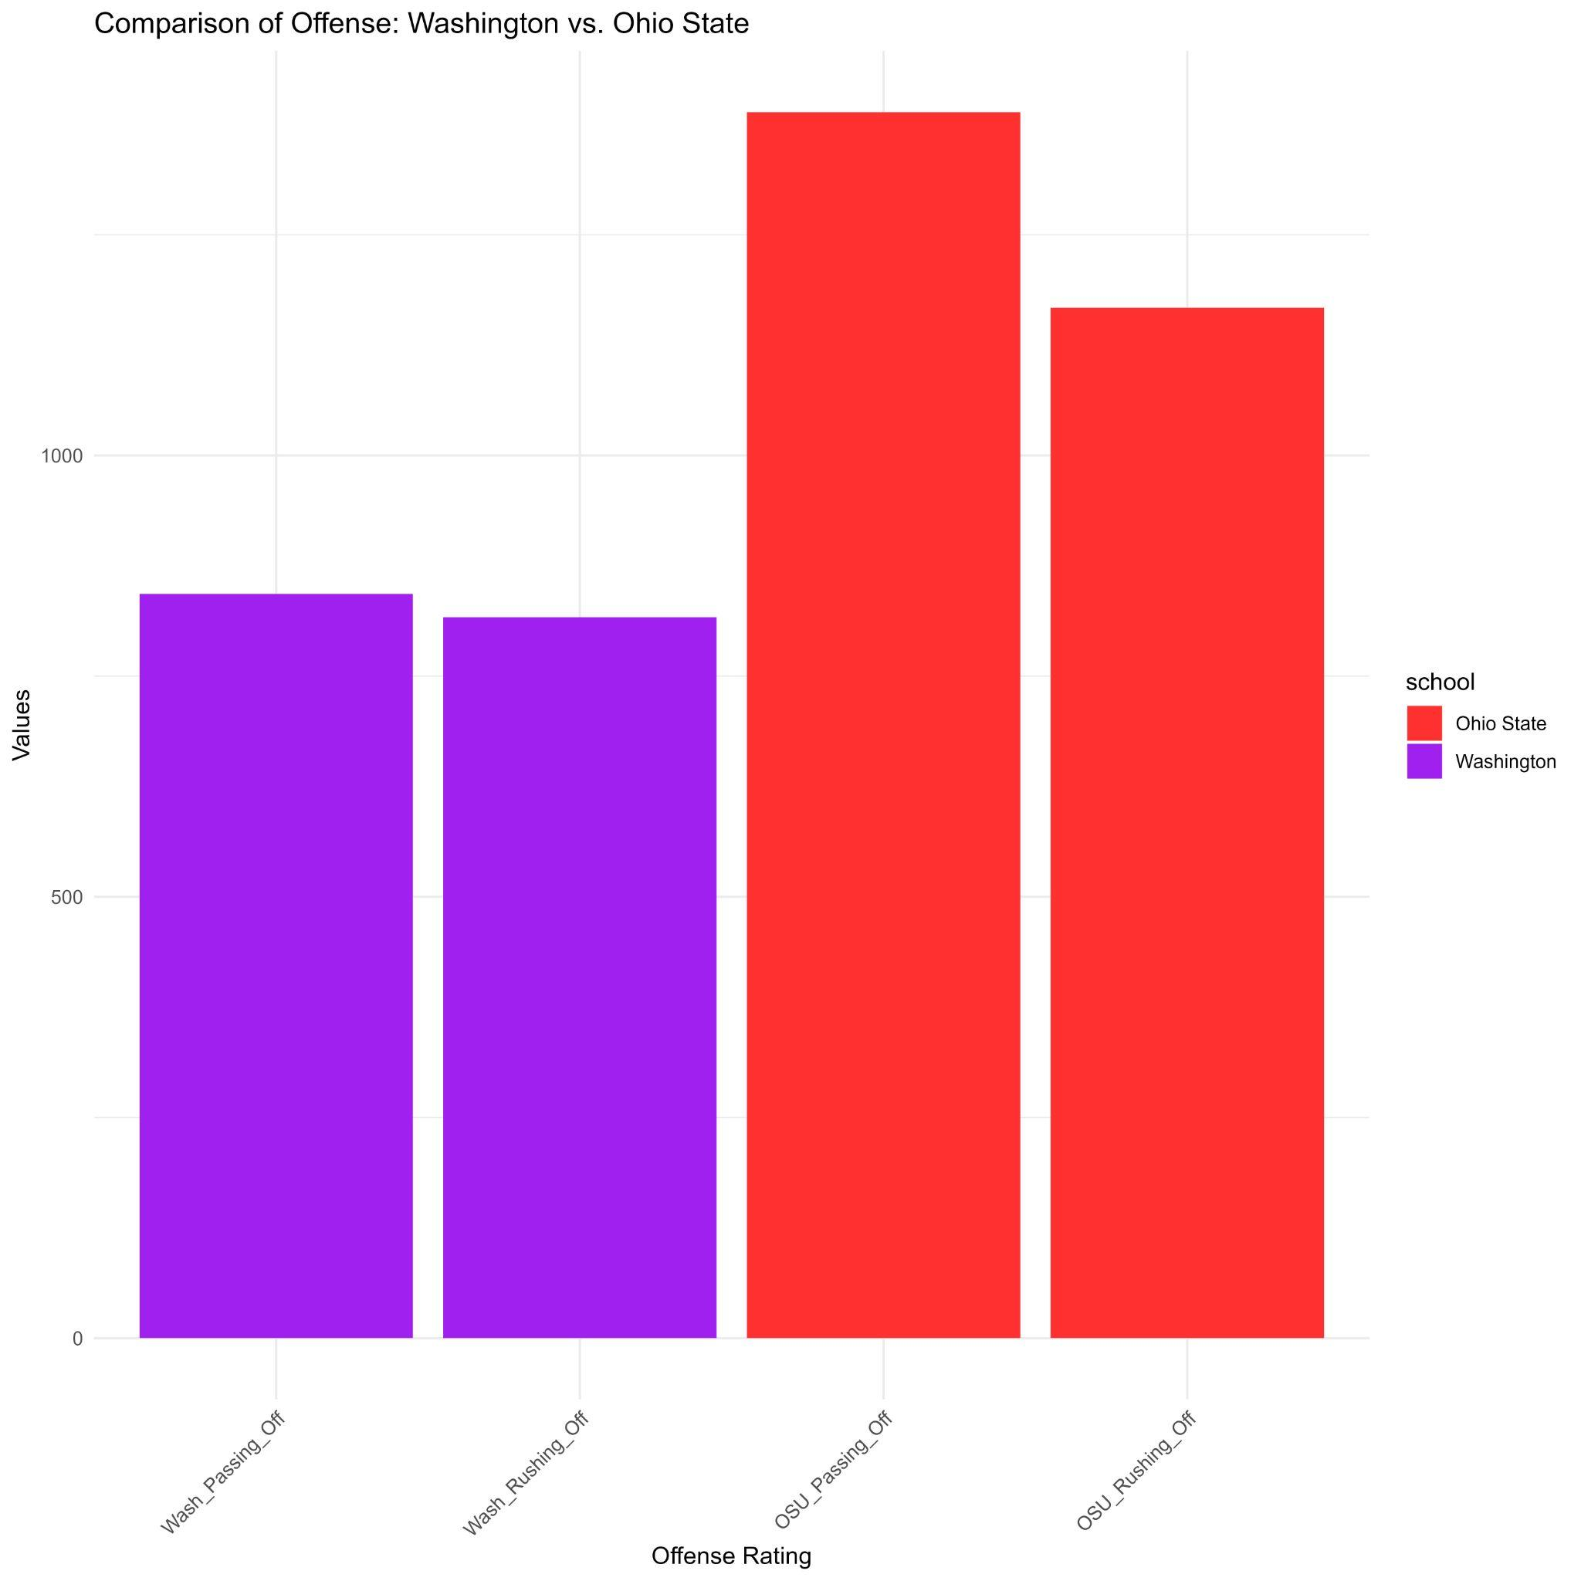
WASHINGTON VS OHIO STATE
Ohio State has a significantly better passing and rushing offense than Washington
Ohio State’s strength seems to be passing
Marvin Harrison Jr
Washington’s offense has a more balanced attack

Slide 12
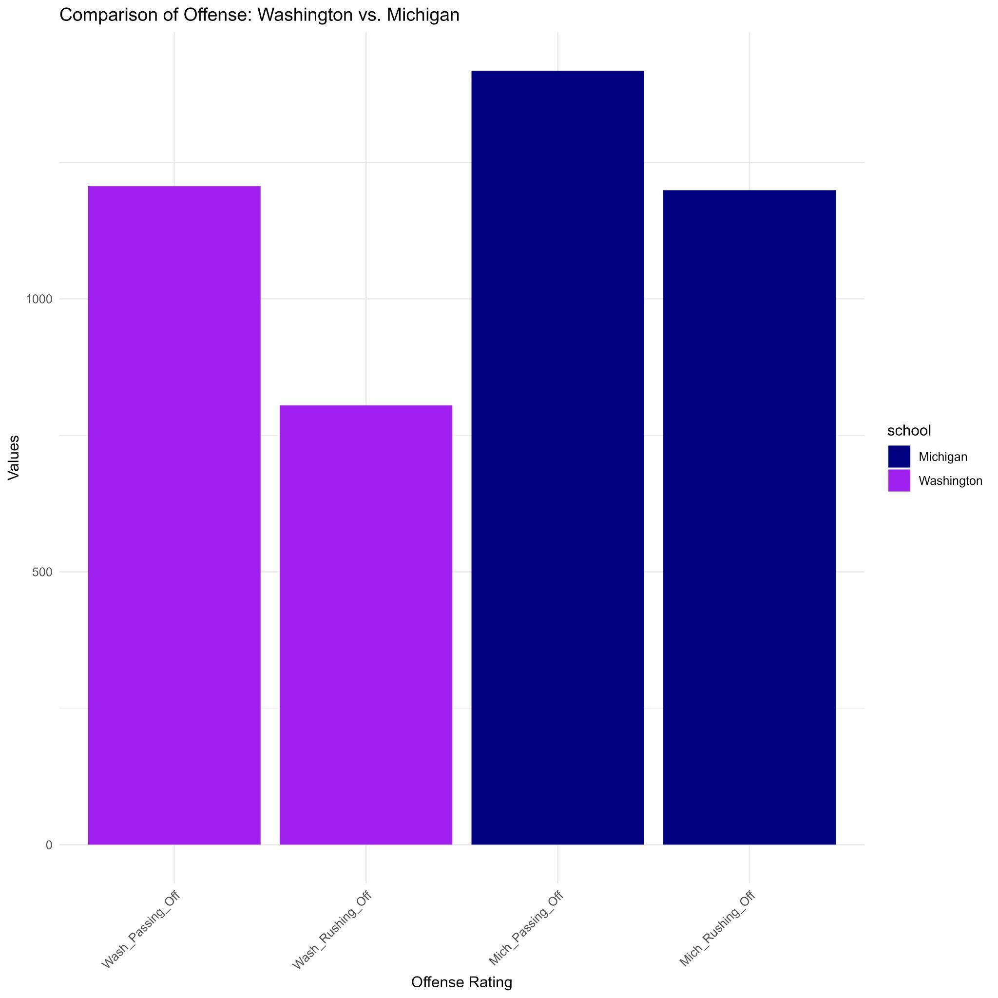
WASHINGTON VS MICHIGAN
Washington has a similar offensive split to Michigan
Stronger passing game than run game
Interesting considering Michigan has one of the best RBs in the country
Could be that passes for Michigan are more of a “surprise” which leads to more success
Washington’s split makes sense as they have a Heisman candidate at QB in Michael Penix Jr

Slide 13
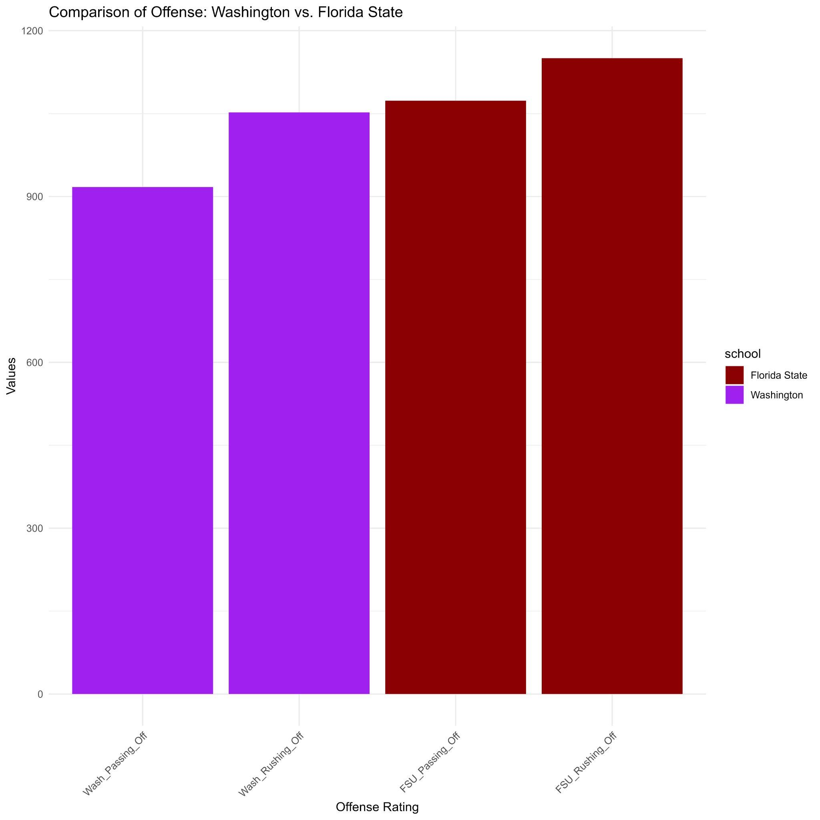
WASHINGTON VS FLORIDA STATE
Washington’s most even match up
Washington’s passing game was the weakest here compared to other teams, but their run game saw a significant improvement
Will Jordan Travis’ recent injury affect this data?

Slide 14
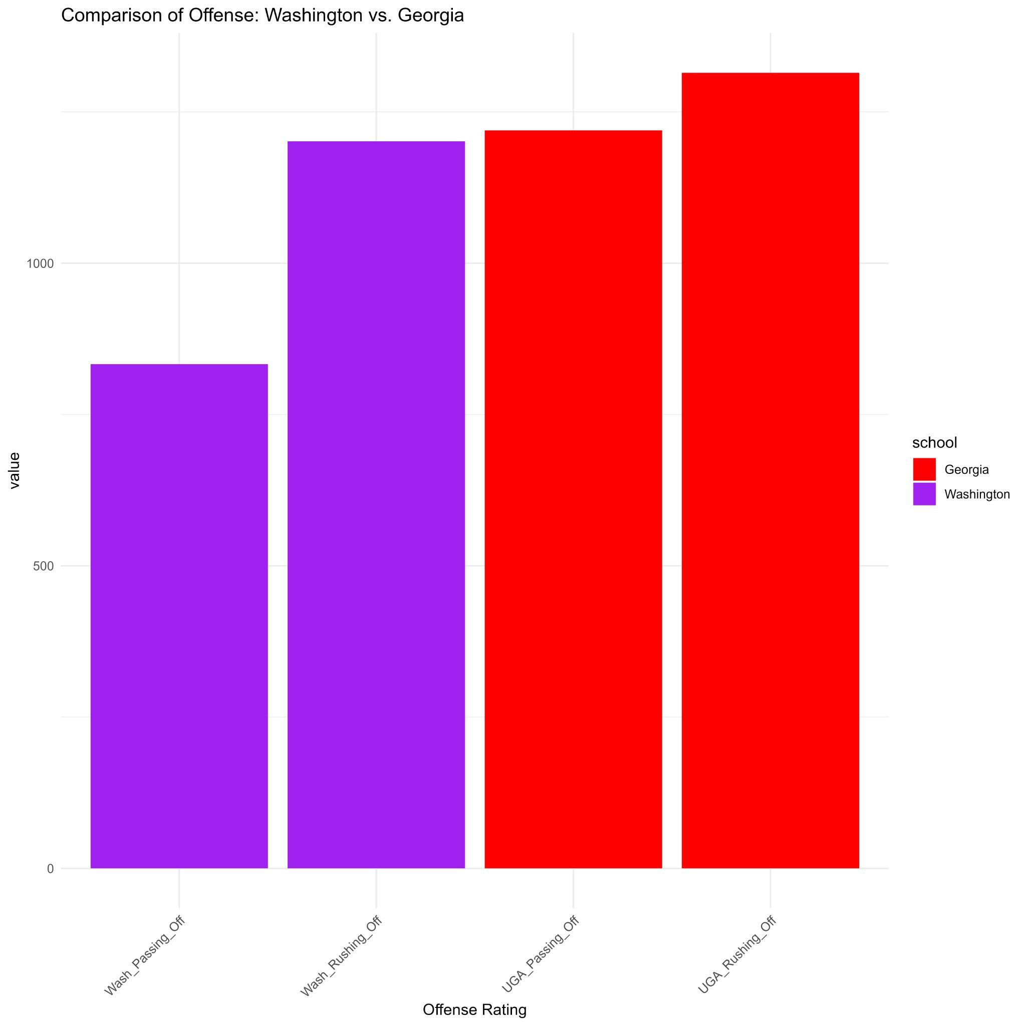
WASHINGTON VS GEORGIA
Washington’s passing offense is a significant weakness against Georgia
Washington needs to stop Georgia’s dominant run game in this matchup
Can Penix’ individual greatness close the gap in passing offense effectiveness for Washington?

Slide 15
FINAL RECOMMENDATIONS
Washington would match up better against Florida State and Georgia better than Ohio State and Michigan
Washington defense is really poor compared to all the schools but especially the BIG ten schools of Ohio State and Michigan
Washington is improving other teams’ offensive weights while other schools are lowering Washington’s offensive weights
Washington looks as though they will get beat by all of the other top teams
Offensive is Washington’s strong suit but may end up getting clamped by some of these defensive powerhouses

