Slide 1
Project 4: S-Mart Sales Predictor
John Clos, Jack Cohen, Sharon Colson and Uchenna Nwagbara

Slide 2
The Team
Briefly introduce yourself and your colleagues.

Slide 3
Introduction
Describe the products or services your company provides at a high level.
Example:
Trey Research offers complete solutions for strategic market planning, from global business intelligence reports to targeted market analysis.

Slide 4
Business Opportunities
State the customer’s needs and requirements as you understand them.
Example:
Contoso, Ltd. has several new products in research and development that are scheduled to go to market in FY [Date].
Now is the time:
to identify the target market for these products.
to understand how to best brand and position them.
to identify competitors and benchmark their success.
Also consider ongoing support to help you respond to changes in your market.

Slide 5
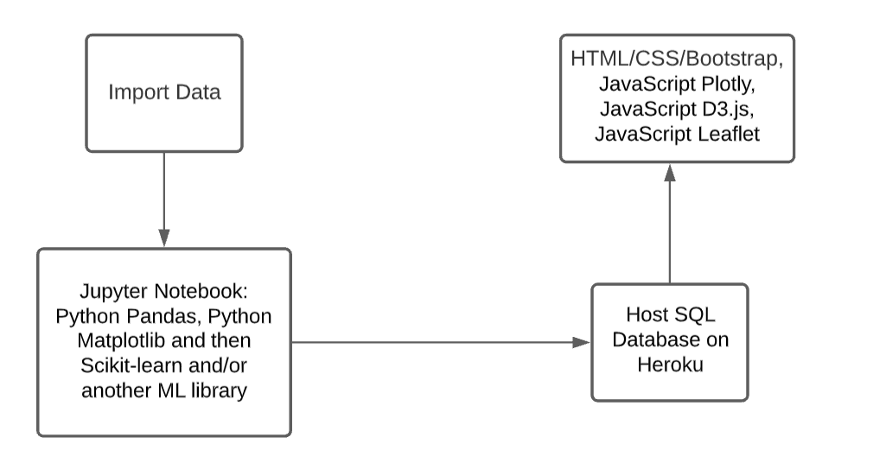
System Architecture

Slide 6
Our Products and Services
List the products or services your company provides that will help the customer achieve their objectives.
Example:
Using a variety of research methodologies, Trey Research can provide support in the following areas:
Market entry strategies
Product and brand launch
Competitive intelligence data
Market analysis,
review and monitoring

Slide 7
Cost Comparison
Point out financial benefits to the customer.
Compare costs of your product or service with one or more competitors.
Custom Research Service | Trey Research Cost* | Company A Cost*
Market entry analysis | X | X
Industry benchmarking | X | X
Pricing and brand analysis | X | X
Forecasting and planning | X | X
Subscription Research Service | X | X
Consumer industry market reports | X | X
Online global business intelligence database | X | X
* Cost of custom research service depends on project scope

Slide 8
Our Strengths
Durable goods
Electronics
Healthcare
Foods
Consumer Goods and Services
Global Data
Research Network
Benchmarking
Brand intelligence
Trends
Industry and Technology Markets
Finance
B2B Services
Machinery
Media
Trade

Slide 9
Key Benefits of Product or Service
Summarize the key benefits provided by the product or service you are promoting.
Example:
Investment in market research is an investment in your product’s success!
Know your customer
Know your competition
Timing is everything
Track and adjust

Slide 10
Drawbacks
Outline the drawbacks of the current model
Submit a research proposal
Then, we’ll submit a proposal for your evaluation.
Begin the research
When the proposal is approved, we will assemble an experienced team to conduct your research and analyze the findings.
Provide ongoing support
We will continue to work with you after we deliver your report so you get the most value out of the research findings.

Slide 11
Next Steps
Outline the next steps for ordering or purchasing your products or services.
Example:
To commission research from Trey Research:
Define the project
First, we’ll meet with you to define your project.
Submit a research proposal
Then, we’ll submit a proposal for your evaluation.
Begin the research
When the proposal is approved, we will assemble an experienced team to conduct your research and analyze the findings.
Provide ongoing support
We will continue to work with you after we deliver your report so you get the most value out of the research findings.

Slide 12
Contact Information
Provide contact information for key personnel from your company.
Provide e-mail and Web site information, if appropriate.

