Slide 1
Project 4: S-Mart Sales Predictor
John Clos, Jack Cohen, Sharon Colson and Uchenna Nwagbara

Slide 2
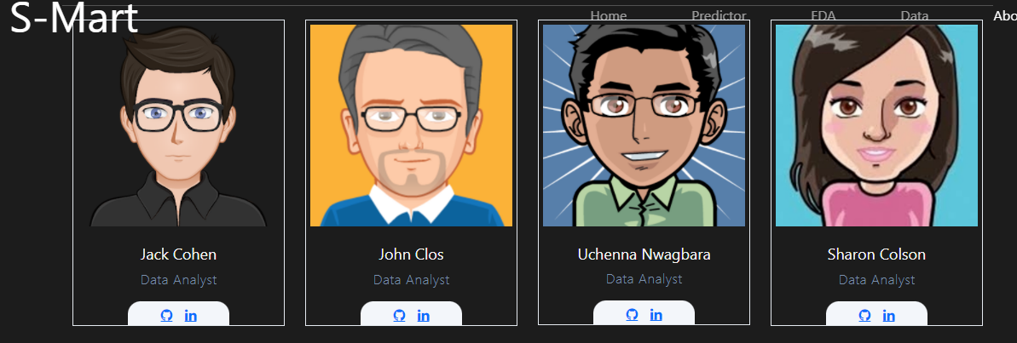
The Team

Slide 3
Introduction
S-Mart: Shop Smart, Shop S-Mart
For S-Mart, setting the right price for a given product is critical.
If price too low, profit per unit will be too low
If price too high, the units sold will be too low and product will be wasted
To maximize profits, the business needs to find the optimum price.
Using sales data, we’ve built a model to predict and compare units sold and revenue for all nine locations.
Using this model, we can ensure our locations are properly stocked and staffed for the coming week's sales.

Slide 4
Business Opportunities
State the customer’s needs and requirements as you understand them.
Example:
Contoso, Ltd. has several new products in research and development that are scheduled to go to market in FY [Date].
Now is the time:
to identify the target market for these products.
to understand how to best brand and position them.
to identify competitors and benchmark their success.
Also consider ongoing support to help you respond to changes in your market.

Slide 5
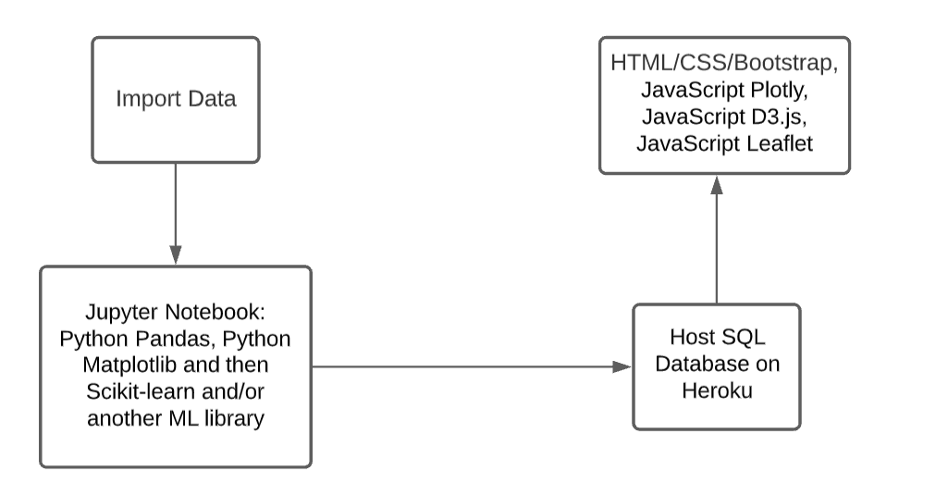
System Architecture

Slide 6


Our Model and Hyper-tuning
Gradient Boosting Regressor
After Hyper-tuning

Slide 7
Cost Comparison
Point out financial benefits to the customer.
Compare costs of your product or service with one or more competitors.
Custom Research Service | Trey Research Cost* | Company A Cost*
Market entry analysis | X | X
Industry benchmarking | X | X
Pricing and brand analysis | X | X
Forecasting and planning | X | X
Subscription Research Service | X | X
Consumer industry market reports | X | X
Online global business intelligence database | X | X
* Cost of custom research service depends on project scope

Slide 8
Our Strengths
Durable goods
Electronics
Healthcare
Foods
Consumer Goods and Services
Global Data
Research Network
Benchmarking
Brand intelligence
Trends
Industry and Technology Markets
Finance
B2B Services
Machinery
Media
Trade

Slide 9
Key Benefits of Product or Service
The model predicts based on:
Product
Store
Week of year
Base price
Actual price
It is simple and easy to retrain

Slide 10
Drawbacks
We were limited in the amount of data that we had

Slide 11
Next Steps
Find more data and retrain

Slide 12
Contact Information
Provide contact information for key personnel from your company.
Provide e-mail and Web site information, if appropriate.

