Slide 1

Data integration on the run
or: How I built a semistructured data integration tool in less than 24 hours
Giacomo Bergami
jackbergus@gmail.com
Notes:
In order to develop something concerning data integration, you must either crazy…
Or me.

Slide 2
<results>
<result id=”1”>
This is the first content
</result>
<result id=“2”>
This is <b>another</b> content!
</result>
</results>
Semistructured Data
Tree data structure
(XML)
There are many applications of semi structured data:
HTML enriched with semantic data (RDFa)
E.g. TEI (Text Encoding Initiative) representing (old) texts with annotations
Represents No-SQL data (Graph databases, Document based)
There is a Turing Complete language for handling such data in XML: XSLT
There are ”Relational algebras” based upon such documents (even if they haven’t been implemented yet)
As a natural consequence, XML data is the most supported format providing enriched data (SOAP, HTTP Requests/Replies).

Slide 3

Use casE
An “expert system” has a set of documents $D$ of the same “type” (medical reports, bills, biographies) rendered as “Hypertexts” or “semi-structured”
An user whant to aggregate information of the same ”type” represented in different shapes.
The following ones are the proposed possible scenarios:
We want to extract from each document $d_{i}∈D$ all the relevant informations, and discard the non-relevant one (the user has a lot of documents to scream, it eases the scanning process)
We want to summarize each relevant document in $D$ in order to grasp a general view of our data.

Slide 4
Document 1
Document 2
We want to extract
The same “type” of
Knowledge from both
Documents. How could
We “join” them? (They
have a different ”shape”)
Query q
Please note that this Query is not an “XPath” one, but searches for the semantic annotations at each level

Slide 5

Document 1
Document 2
Query q
We could provide two different results:
For each document, $d_{i}$ extract the sub-document $δ_{i}$ matching exactely with $q$
Aggregate the information of each $δ_{i}$ into a final document $Δ$
DEMO

Slide 6
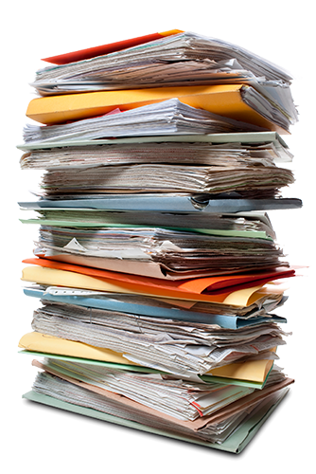
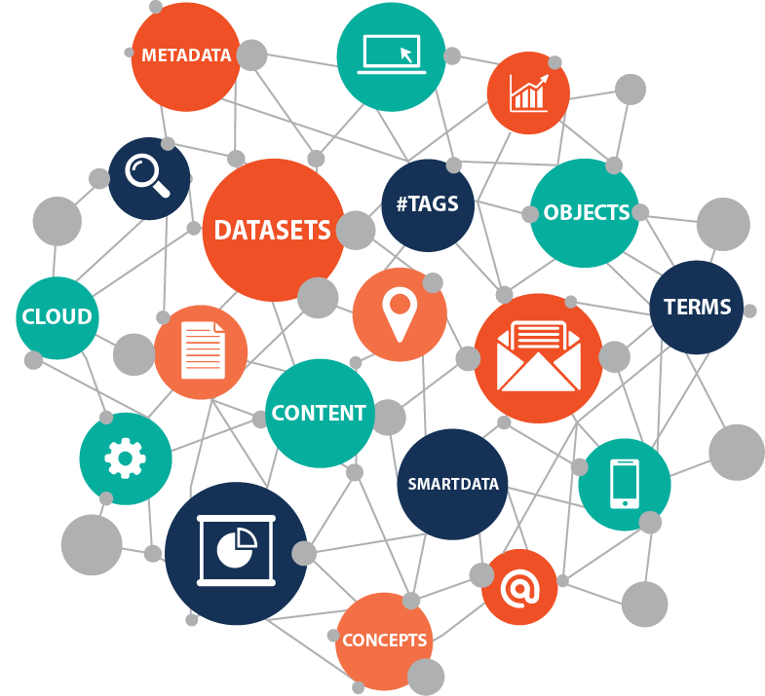
Final Reports
Ontology

