Slide 1
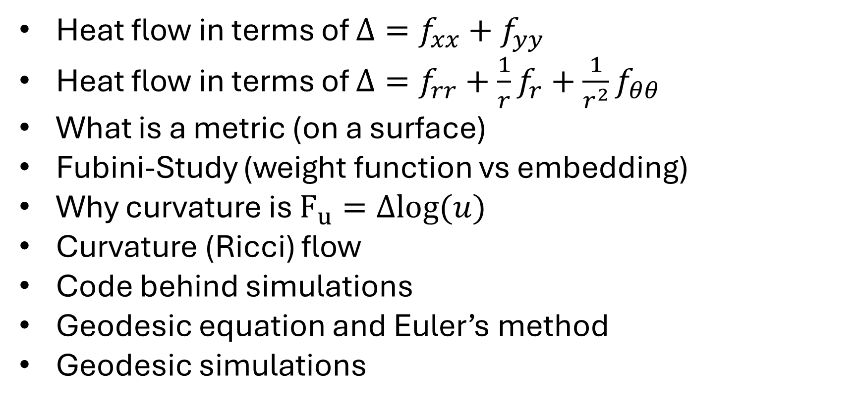
Outline
Heat flow in terms of $Δ=f_{xx}+f_{yy}$
Heat flow in terms of $Δ=f_{rr}+\frac{1}{r}f_{r}+\frac{1}{r^{2}}f_{θθ }$
What is a metric (on a surface)
Fubini-Study (weight function vs embedding)
Why curvature is $F_{u}=Δlog⁡(u)$
Curvature (Ricci) flow
Code behind simulations
Geodesic equation and Euler’s method
Geodesic simulations

