Slide 1
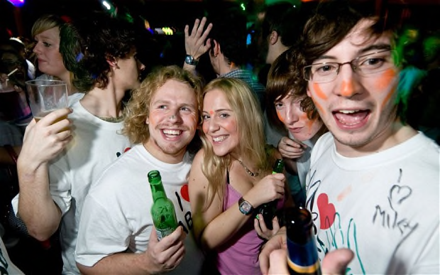
SU-rvival
>> What will you do next?
The Student Union Survival Game Start Now!!!
Enjoy and Good Luck!!!

