Slide 1
Model-Based RL
Reinforcement Learning
School of Data Science
University of Virginia
Last updated: July 18, 2025

Slide 2
Agenda
> Model-Free RL
> Model-Based RL
> World Models

Slide 3


Model Free vs. Model-Based
So far we have looked at model-free approaches
There was no transition model
Instead, we sample next state by running action in environment:

Slide 4
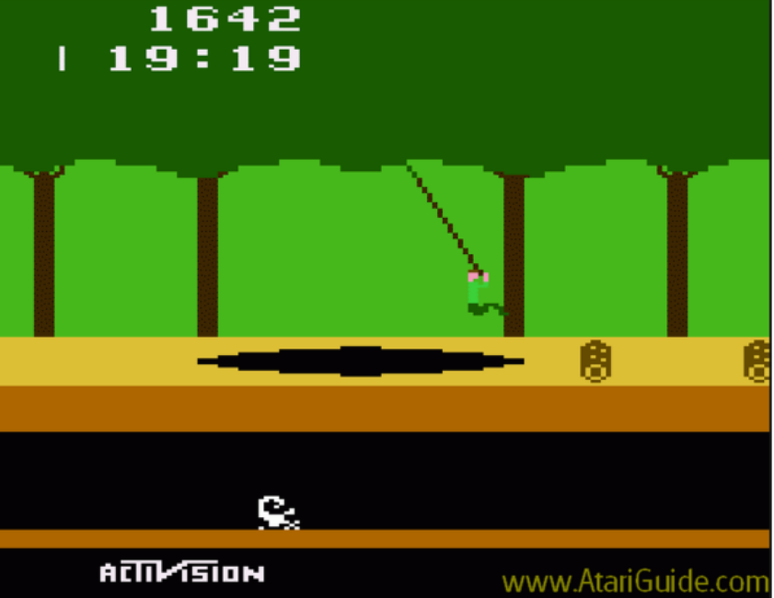
Reminder about Model-Free RL
In some cases, we devised toy rules
In other cases, we ran a simulator

Slide 5
Reminder about Model-Free RL
In some cases, we devised toy rules
In other cases, we ran a simulator
Of course, a simulator might use a model
But the RL agent doesn’t know or learn the model

Slide 6
Disadvantages of Model-Free RL
> Lower sample efficiency: without a model, agent only learns from experience

Slide 7

Disadvantages of Model-Free RL
> Lower sample efficiency: without a model, agent only learns from experience
> Can’t plan ahead: it is not possible to simulate rollouts and learn from them

Slide 8
Disadvantages of Model-Free RL
> Lower sample efficiency: without a model, agent only learns from experience
> Can’t plan ahead: it is not possible to simulate rollouts and learn from them
> Adaptability is challenging: if environment / reward function changes, a lot of experience
is required for learning

Slide 9
Disadvantages of Model-Free RL
> Lower sample efficiency: without a model, agent only learns from experience
> Can’t plan ahead: it is not possible to simulate rollouts and learn from them
> Adaptability is challenging: if environment / reward function changes, a lot of experience
is required for learning
> Lack of interpretability: value functions and policies can be black boxes

Slide 10
Model-Based RL
Q: Given model-free RL limitations, why don’t we always use a model?

Slide 11
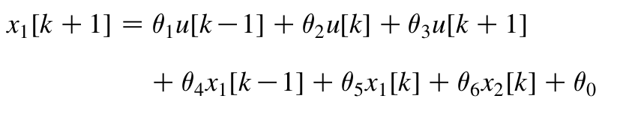
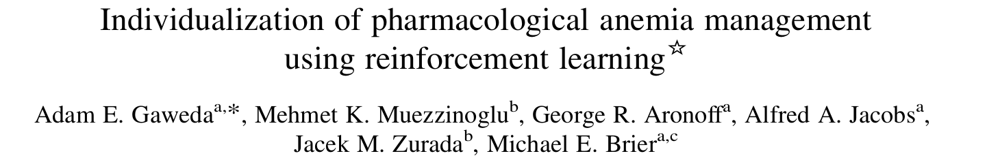
Model-Based RL
Q: Given model-free RL limitations, why don’t we always use a model?
A: Because developing an accurate model can be hard.

Slide 12
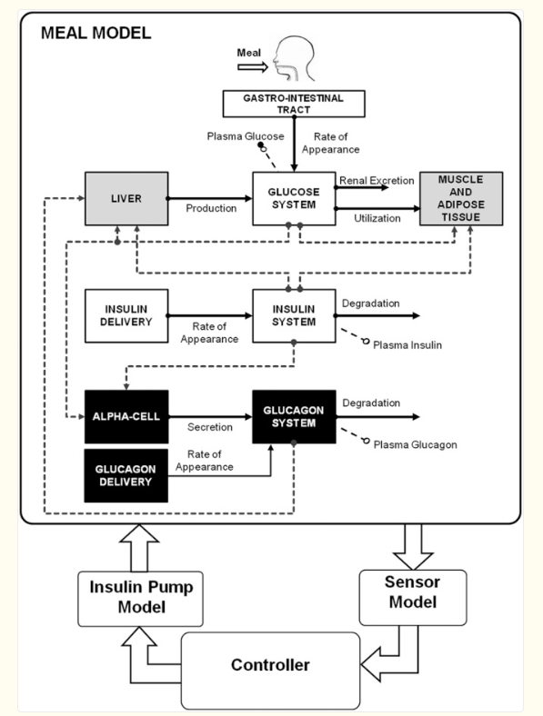
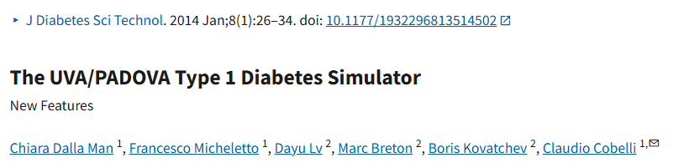
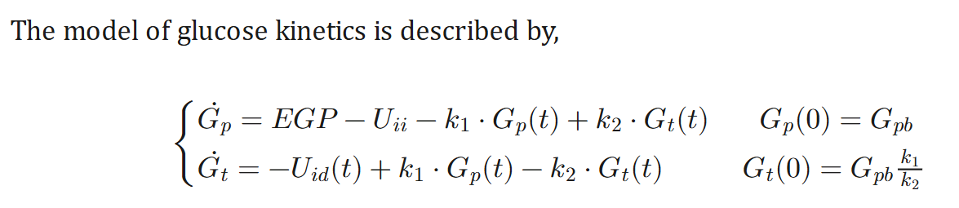
Model-Based RL: Diabetes Simulator

Slide 13
World Models

Slide 14

World Models
A world model (David Ha, Jürgen Schmidhuber, 2018) is a learned model of the dynamics:
Useful for:
> Predicting next state
> Planning
> Imagining possible futures without taking the actions in real environment.
Critical when it would be dangerous or costly to try the actions in real world.

Slide 15
World Models – Classic Model
From Ha & Schmidhuber paper, architecture has three parts:
VAE (encoder) | Compress high-dim obs (e.g., images) into a low-dim latent space
MDN-RNN | Learn to predict next latent state, given current latent state, action
Controller | “Small” policy network that decides actions in latent space

Slide 16
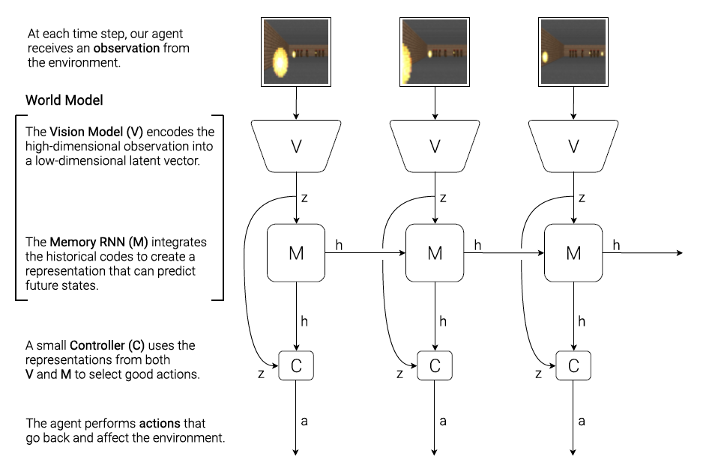
World Model with Images
David Ha, Jürgen Schmidhuber, 2018

