Slide 1
Extensions to Q-Learning 2:
Dueling Deep Q-Network
Reinforcement Learning
School of Data Science
University of Virginia
Last updated: June 23, 2025

Slide 2
Dueling Networks
Deep RL before this paper used conventional architectures (CNN, LSTM)
Focus here is new architecture better suited to model-free RL
Dueling architecture separates state values and action advantages
Paper: Dueling Network Architectures for Deep Reinforcement Learning. Wang et. al.

Slide 3
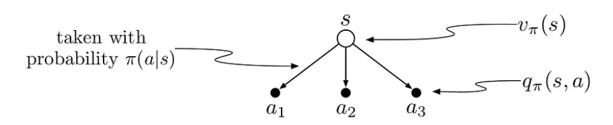
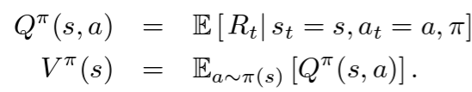
Value and Advantage Function Definitions
Relationship of value functions:

Slide 4

Value and Advantage Function Definitions
Relationship of value functions:
The advantage function isolates effect of action taken
V(s) measures how good it is to be in state s
A(s,a) measures relative importance of each action
Sometimes, the action doesn’t matter

Slide 5
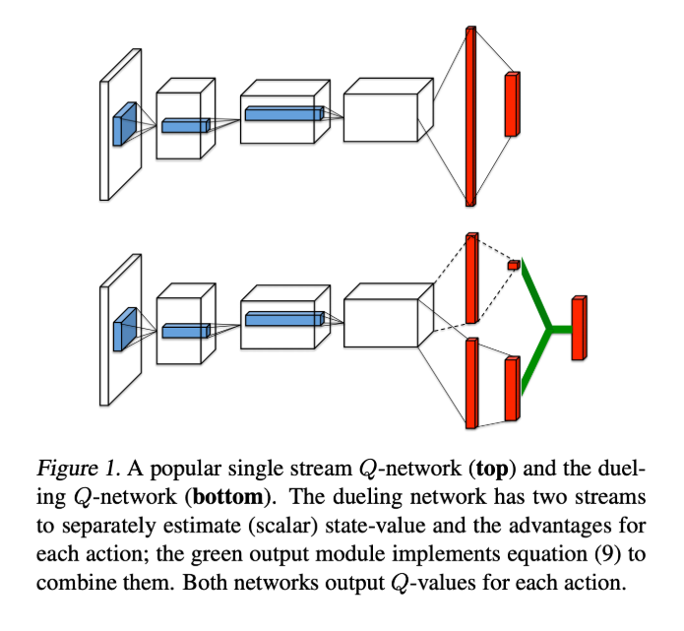
Dueling Architecture
Separate streams for value and advantage functions
Common convolution feature
Top figure is Q-network
Bottom figure is dueling Q-network
Value and advantage streams are combined
For each network, outputs are Q(s,a)

Slide 6
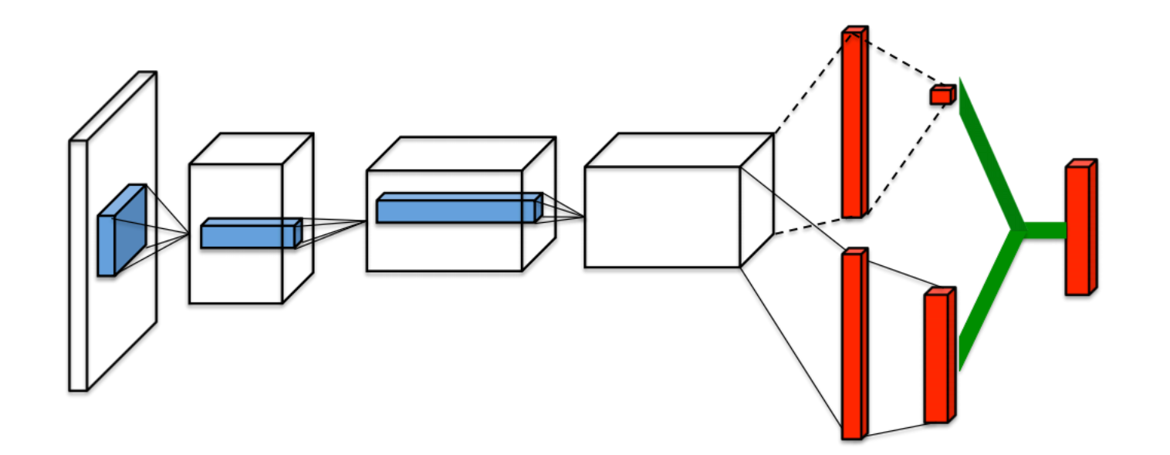
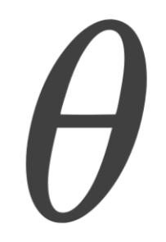
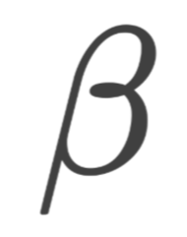
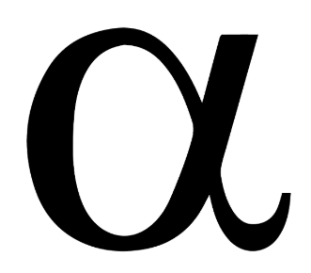
Dueling Architecture, contd.
Value, V(s)
Action Values, Q(s,a)
Advantages, A(s,a)
Parameters:
Shared weights
Value stream weights
Advantage stream weights

Slide 7
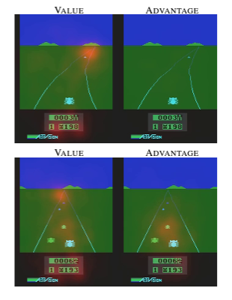
Value and Advantage Function Saliency
Figure shows saliency map for two time steps
Value stream pays attention to horizon and score
Advantage stream: when no cars are on road, action
doesn’t matter (no attention paid)
When cars are on road, advantage stream pays attention
to car in front (bottom right)

Slide 8
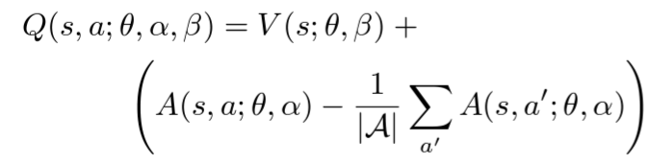
Identifiability
Given Q = V + A, we cannot recover V and A uniquely
(adding any c to V, and subtracting c from A, leaves Q unchanged)
Add a constraint: subtract the average advantage from A:
For actions with above average advantage, the second term in (*) will be positive
For action with greatest advantage, (*) term will be largest across all actions

Slide 9
Review of Dueling Architecture Code
We can see an implementation of Dueling Q-Network here:
Paper: Reinforcement Learning for optimal sepsis treatment policies (2017)
Authors: Raghu, Komorowski, Ahmed, Celi, Szolovits, Ghassemi
GitHub repo: https://github.com/aniruddhraghu/sepsisrl/blob/master/continuous/q_network.ipynb
See section:
# advantage and value streams

Slide 10
Implementation
Our two streams (V, A) for Q are part of the model architecture
Training step runs the same as a standard Q-network: backpropagation

Slide 11
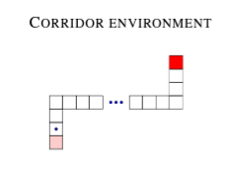
Evaluation
Sets up simple environment called corridor.
Redness of state signifies reward
Can move up, down, left, right, or no move.
ε-greedy policy, measure performance by squared error (SE) of Q-value estimates vs. true action values
Single and Duel networks use MLP with three layers
For duel network, after first hidden layer, network branches off to two streams

Slide 12
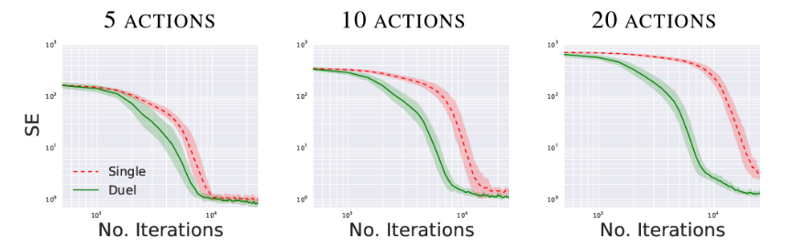
Evaluation, contd.
Dueling network converges faster than Single
More pronounced as |A| increases
As |A| increases, SE is lower for Dueling network. It performs better.

Slide 13

Summary
We studied a novel architecture for Q function
Decomposes Q into value V and action advantage A streams
(we subtract average advantage for identifiability)

Slide 14

Summary
We studied a novel architecture for Q function
Decomposes Q into value V and action advantage A streams
(we subtract average advantage for identifiability)
Advantage function measures incremental importance over V(s):
Dueling network converges faster than usual DQN, Double Q-Network
Errors shown to be lower for Atari games

