Slide 1
Sample Applications of Reinforcement Learning
Reinforcement Learning
School of Data Science
University of Virginia
Last updated: August 28, 2025

Slide 2
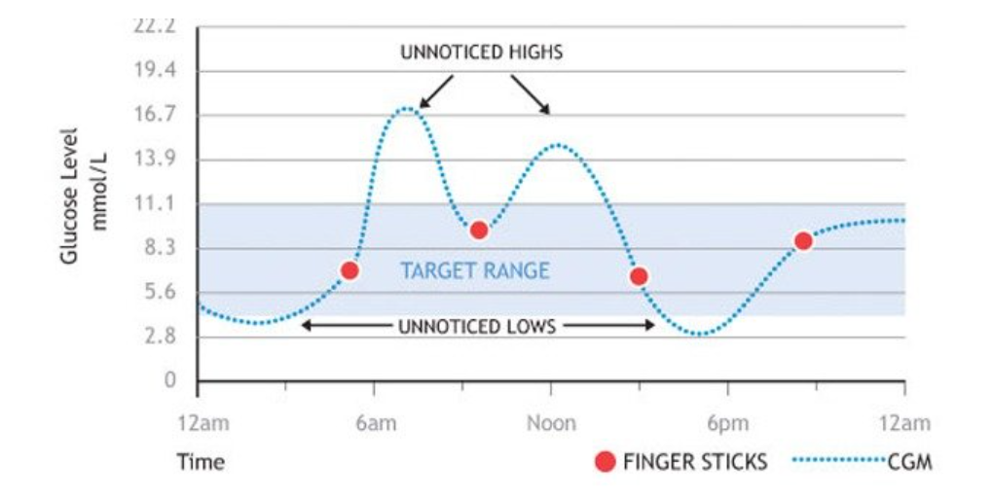
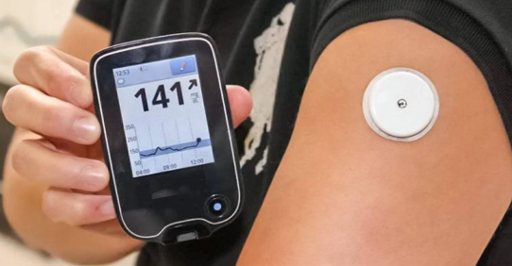
Medicine
Dynamic Treatment Regimes (DTR) to manage clinical values in a range
Applications for diabetes (graph below), anemia, sepsis, chronic kidney disease mineral bone density

Slide 3
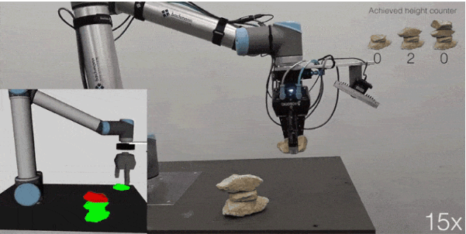
Robotics
Control a robot in continuous space with continuous actions

Slide 4
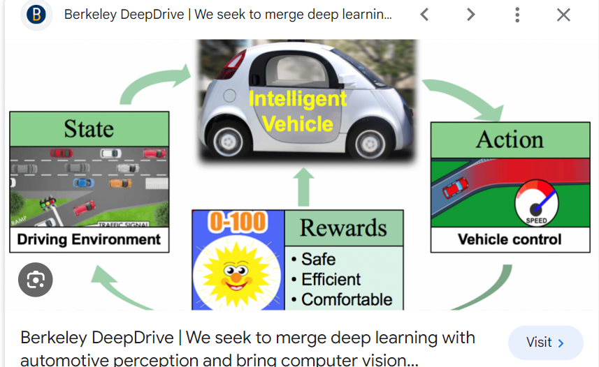
Autonomous Vehicles
Teach vehicles how to navigate safely and efficiently

Slide 5
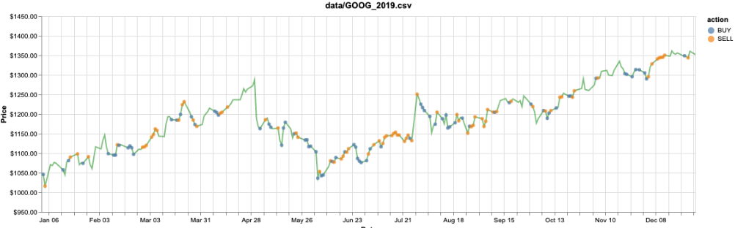
Finance
Develop trading algorithms that maximize risk-adjusted return

Slide 6
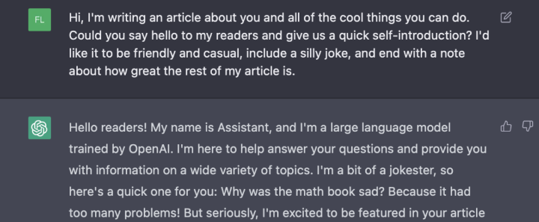
Chatbots
Improve chatbots with feedback from users (Reinforcement Learning with Human Feedback, or RLHF)

