Slide 1
QA Golf Club Tee Booking
By Jack healy

Slide 2
Contents
Requirements
Architecture
Project Tracking
Testing
Risk Assessment
Live Application
Bugs and Future Improvements
Questions

Slide 3
Requirements
Online Tee Booking
CRUD application
Create Bookings
Read Bookings in the account
Update Bookings
Delete Bookings

Slide 4
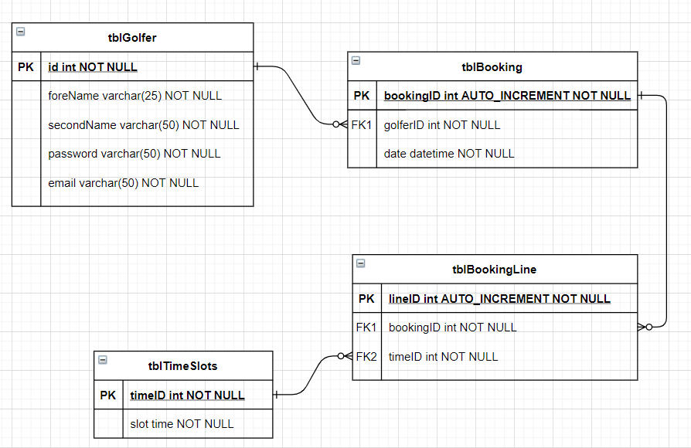
Architecture (Database)

Slide 5
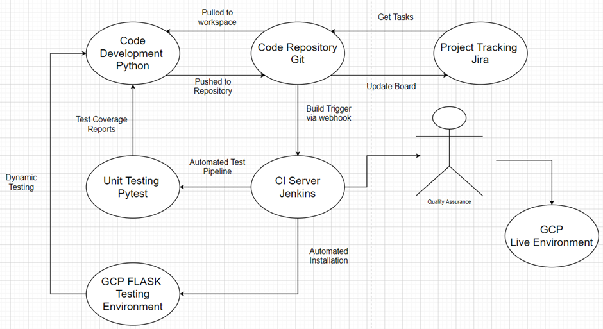
Architecture (CI Pipeline)

Slide 6
Project Tracking

Slide 7
Testing

Slide 8
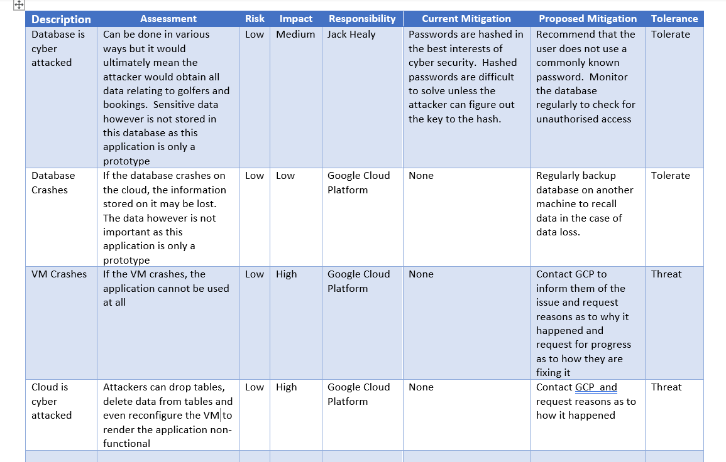
Risk Assessment

Slide 9
Live Application

Slide 10
Bugs and Future Improvements
Bookings cannot be updated onto the database.
Once bookings are made, the slot is not made unavailable which enables different users to book the same slot.
While creating a booking, you can only select one slot per booking rather than several slots.
The user can book the same slot twice
The timesheet page to show the user who booked certain slots
To add some CSS to improve the usability
The application to allow the user to pick different dates along with their tee time rather than only have slots based on 1 day.

Slide 11
Questions?

