Slide 1
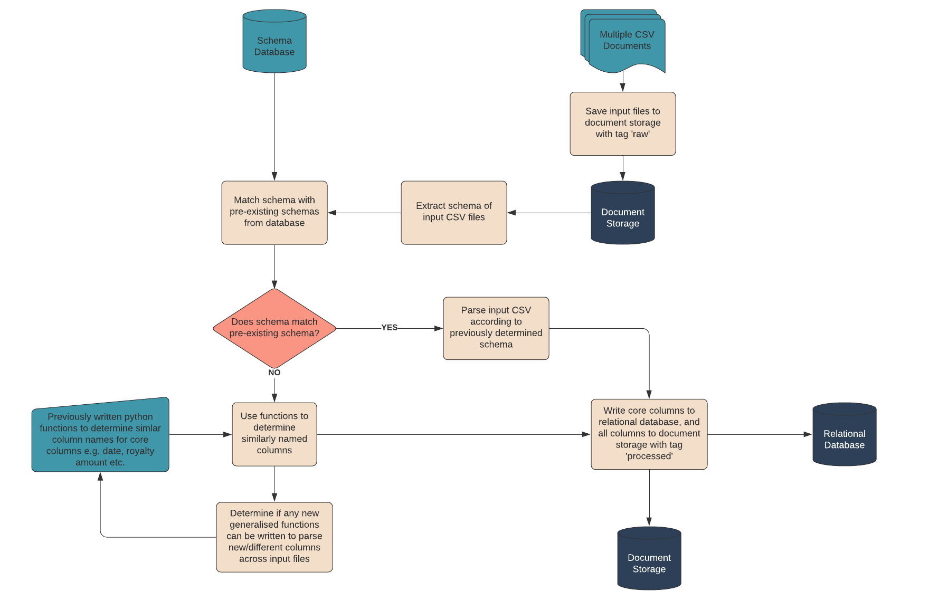
Music Royalties CSV Workflow Design
I have designed a simple work flow process to extract data from various different formats of csv files.
The assumption behind the process is that the vast majority of music royalty statements will follow very similar patterns, as, after all, they are attempting to show the same data.
The basis behind the process is to build up a library of schema types and their corresponding sources.
When a new schema type is encountered, functions will be used to determine the required columns.
For example, I envisage that every royalty statement will have a royalty payment column and a date column. Either the column headings or the information in the columns will follow specific patterns, which can be recognised, ensuring the correct data is parsed.
Generic music royalty statement csv parser

