Slide 1
REPLICATION PROJECT
"Targeted Treatment Assignment Using Data from Randomized Experiments with Noncompliance"
Susan Athey, Kosuke Inoue & Yusuke Tsugawa · AEA Papers and Proceedings · 2025
Replication by Jack Chepin
GSE 552 · May 2026

Slide 2
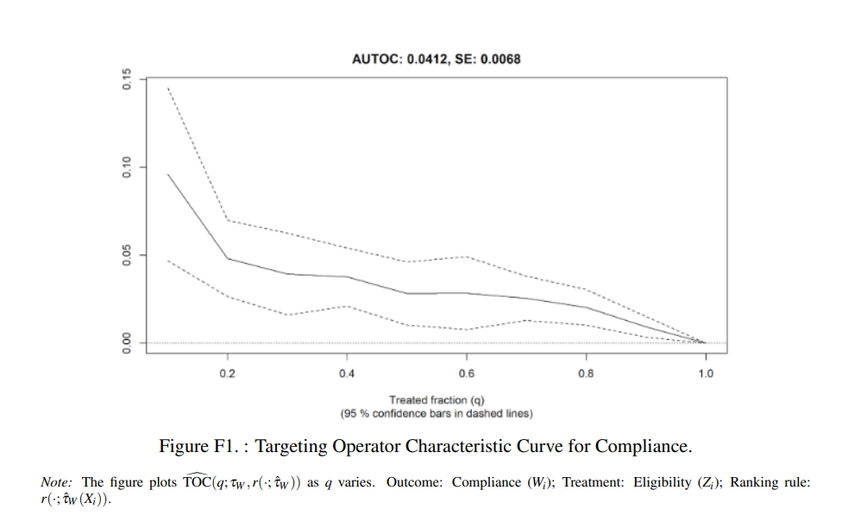
Research Question
When a government program has imperfect compliance, who should be offered it?
Should we prioritize people most likely to benefit — or most likely to actually enroll?
Equation (1) — Conditional Local Average Treatment Effect (CLATE):
τ_CL(x) = τ_Y(x) / τ_W(x)
τ_Y(x) = Conditional ITT (outcome CATE) τ_W(x) = Compliance CATE
Replication targets: Equation (1) + Figure F1 (TOC curve for compliance)
Athey, Inoue & Tsugawa (2025) · Jack Chepin

Slide 3
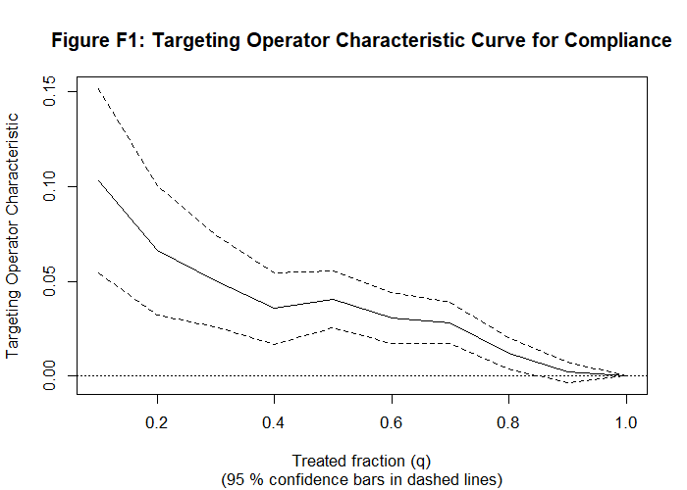

Estimation Technique
Instrumental Forest
Causal Forest
Estimates the CLATE — τ_CL(x) = τ_Y(x) / τ_W(x) Jointly estimates numerator and denominator with same weights, giving an apples-to-apples ratio. Used for: Equation (1)
Used for: Figure F1 TOC curve
Maximize treatment effect heterogeneity
Key property: Honest estimation — each prediction never uses its own outcome data (out-of-bag)
Athey, Inoue & Tsugawa (2025) · Jack Chepin

Slide 4
Why This Method Is Needed
Traditional subgroup analyses
Only test a few groups (age, gender) — miss complex covariate interactions
Causal Forest
Seeks to make splits maximally different
-Find subgroups where treatment differs
Athey, Inoue & Tsugawa (2025) · Jack Chepin

Slide 5
Data: Oregon Health Insurance Experiment (OHIE)
2008 Medicaid lottery — randomized access for low-income Oregon adults. In-person interviews 1–2 years later.
Variable | Description | Value
N | Final sample (after exclusions) | 12,208
Z (Instrument) | Lottery eligibility | Mean = 0.522
W (Treatment) | Medicaid enrollment | Mean = 0.311
Y (Outcome) | No medical debt (binary) | Mean = 0.453
X (Covariates) | Pre-treatment characteristics | 23 variables
Data Notes
▸ Missing baseline data imputed using missRanger (random forest imputation)
▸ Exclusions: missing treatment/demographics + transgender individuals
Athey, Inoue & Tsugawa (2025) · Jack Chepin

Slide 6
What I Replicated
Equation (1)
Figure F1
CLATE via Instrumental Forest
TOC Curve for Compliance
τ_CL(x) = τ_Y(x) / τ_W(x) Mean CLATE for debt ≈ 0.125 Estimated using instrumental_forest() in grf
Targeting Operator Characteristic curve ranked by estimated compliance CATE AUTOC = 0.0412 (SE = 0.0068) Estimated using rank_average_treatment_effect()
GitHub: github.com/jackcghu/replication-athey-2025
Athey, Inoue & Tsugawa (2025) · Jack Chepin

Slide 7
Replication Results
Metric | Replicated | Paper (Athey et al. 2025)
AUTOC | 0.0414 | 0.046
Standard Error | (0.0087) | (0.007)
Mean CLATE | 0.1253 | ≈ 0.15
N | 12,208 | 12,208
Difference of 0.0046 in AUTOC — well within sampling variation. ✓
Both results are directionally identical and substantively equivalent to the original paper.
Athey, Inoue & Tsugawa (2025) · Jack Chepin

Slide 8
What Do the Results Mean?
0.125
Among people who enrolled because of the lottery, Medicaid reduced the probability of medical debt by ~13 percentage points.
Mean CLATE
0.041
Targeting high-compliance individuals yields real, meaningful gains over random assignment when offering Medicaid eligibility.
AUTOC
Athey, Inoue & Tsugawa (2025) · Jack Chepin

Slide 9
Replication Challenges
1. Missing Data Handling
na.omit() dropped 5,400 rows (12,208 → 6,816). Paper specifies missRanger imputation in Appendix A.5 — easy to miss, large effect on results.
2. Variable Name Mapping
Covariates described in prose, not as variable names. Required careful cross-referencing between dataset columns and paper description.
Athey, Inoue & Tsugawa (2025) · Jack Chepin

Slide 10
Conclusion
1
Preprocessing decisions matter as much as estimation decisions — document everything
2
GRF results are highly reproducible when the sample is correctly constructed
3
Compliance heterogeneity (τ_W) is more precisely estimated than benefit heterogeneity (τ_CL)
4
Targeting by compliance is beneficial for both delivery and eligibility decision problems
AUTOC 0.0414 vs 0.0412 · Mean CLATE 0.1253 vs ~0.15 · N = 12,208 ✓
Athey, Inoue & Tsugawa (2025) · Jack Chepin

