Slide 1

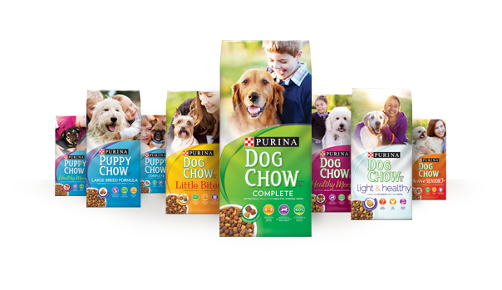







^{Facebook Data Insights}
Listen to the what the world’s largest focus group, Facebook’s 1.5 Billion users, have to say about Purina and the animal food industry.
INTRODUCING FACEBOOK TOPIC DATA
Anonymous & aggregated Insights about specific activities, events, brand names, and other subjects that people are sharing on Facebook
TEXT ANALYSIS
DEMOGRAPHICS
Privacy-safe aggregate analysis of text e.g. Serious Ailment
Gender: Male
Age Range: 25-34
Region: Texas
CONTENT
CONTENT
Analyze
URLs shared
across Facebook
LINKS
SENTIMENT
CONTENT
Purina took my dog from me one year ago today… RIP Skip
Negative
Neutral
Positive
CONTENT
TOPIC ANALYSIS
ENGAGEMENT
Automatic classification
of related topics e.g. Purina
Engagement and Demographics around Likes, Comments and Shares
1

Slide 2
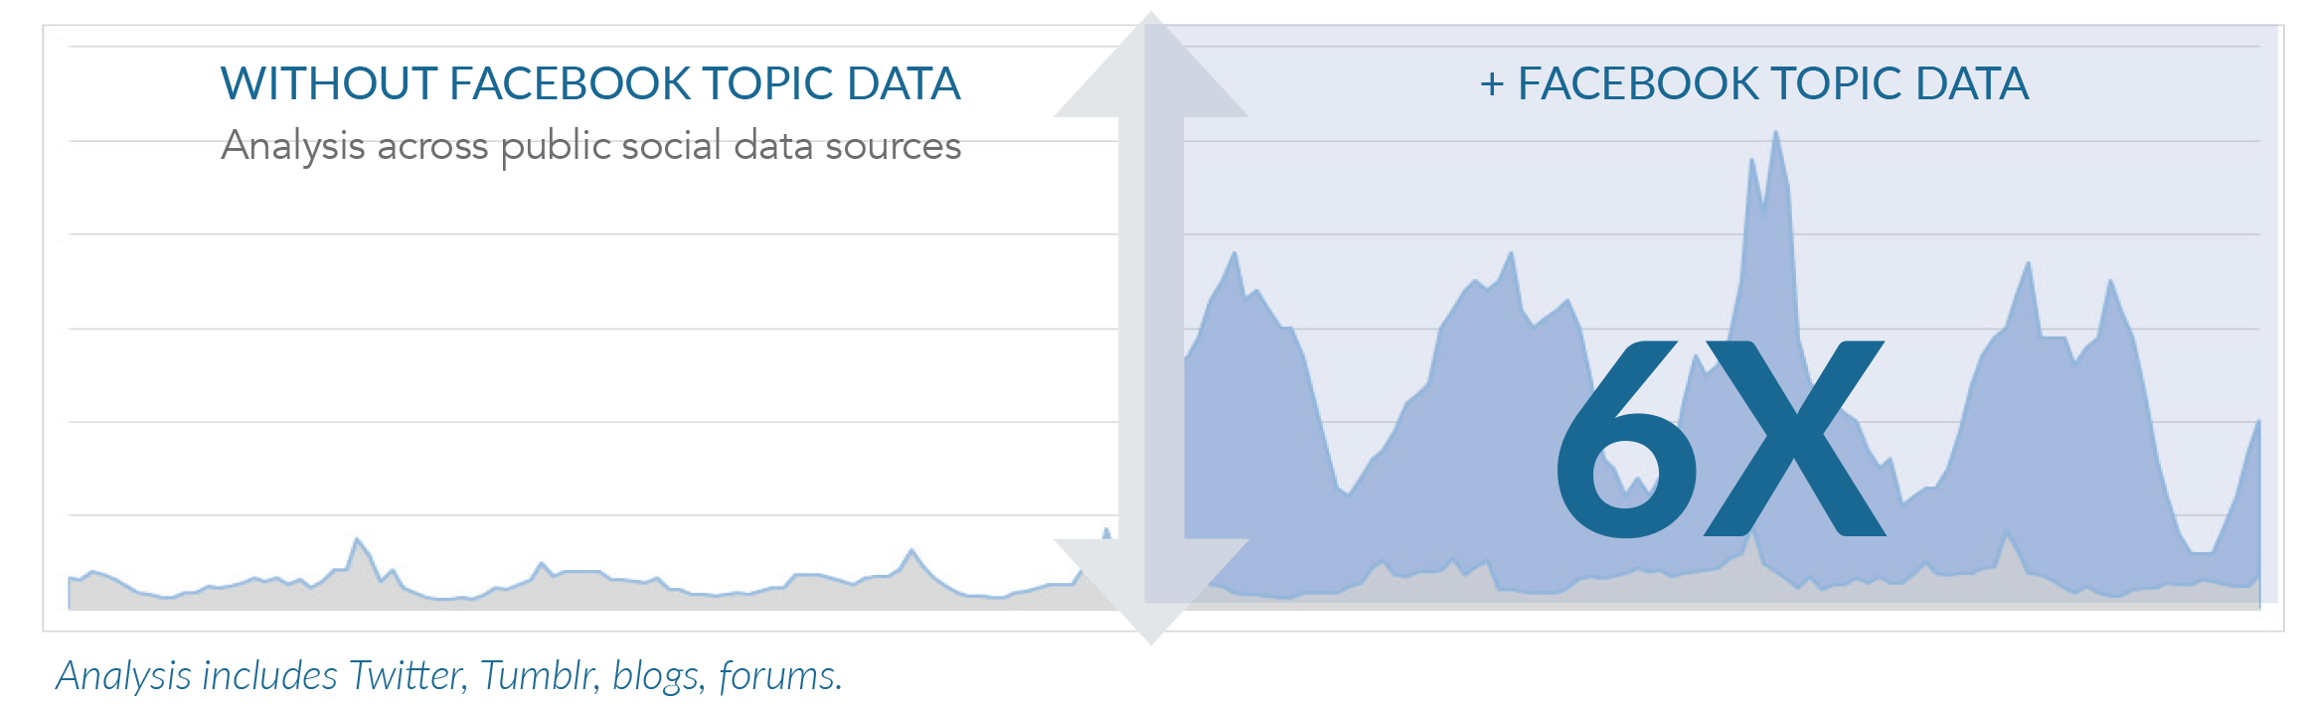

MAKE BETTER DECISIONS WITH INSIGHTS FROM 1.49 BILLION PEOPLE
Example: Analysis of automotive brand
^{PAGES VS TOPIC DATA COMPARISON}
TOPIC DATA
~70,000
Topic data expands your insights.
Facebook Pages
The audience that is engaging with your brand across Facebook.
What is driving brand recommendation, purchase, advocacy or churn.
Content that goes viral on Facebook
about your brand.
Audience reaction to multi-channel
marketing campaigns.
Comparison of volumes of engagement relating to an automotive brand across 7-day period.
~1,000
Brand – related Post and Engagement across all of Facebook
Posts and Engagement on your own Facebook Pages

Slide 3
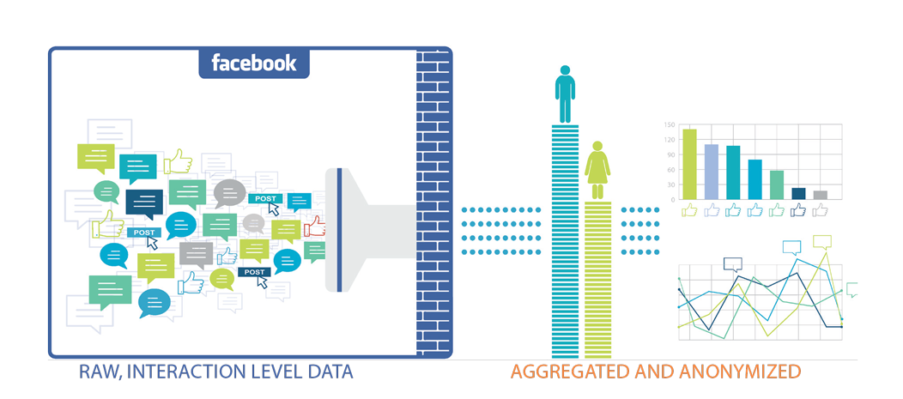




HOW COMPANIES ARE USING TOPIC DATA
Example: Analysis of automotive brand
BRAND • PRODUCT
CONTENT • LINKS
INDUSTRY • TOPIC
AUDIENCE
Brand Analytics
Content & Media Analysis
Industry & Topic Research
Market research to inform creative & campaigns
Brand Reputation Management
Campaign Analysis
Competitive Analysis
Influential Media Analysis
Topic Analysis
Content Discovery
Industry Benchmarking
Topic-Specific Analysis
Vertical Applications (e.g. TV)
Creative & Campaign Design
Audience Affinity Analysis
Audience Discovery/Expansion

Slide 4

Dog Food Industry Word of Mouth Analysis
^{Search Keywords & Details}
KEYWORDS
The ﬁlter listened to any Facebook post, comment, like, or share that mentioned a keyword(s) relative to Purina or its industry
INTERACTIONS
520.3k interactions were analyzed from 1/15/2016- 1/18/2016
KEY LEARNINGS
Insightpool uncovered key insights pertaining to both demographics for inﬂuencers driving the conversation around the animal food industry, as well as topical learnings to guide Purina’s strategy.
^{Demographics Info}
AGE
The leading age segment was 25-34 year-olds (25%) followed closely by 35-44 (21%) & 18-24 (19%).
GENDER
78% of the conversation came from females
REGION
The 5 top regions where the influencers were from were Texas, California, England, Distrito Federal, and Florida.
SUMMARY
The average Intel inﬂuencer is a 25-34 year-old female from Texas.

Slide 5
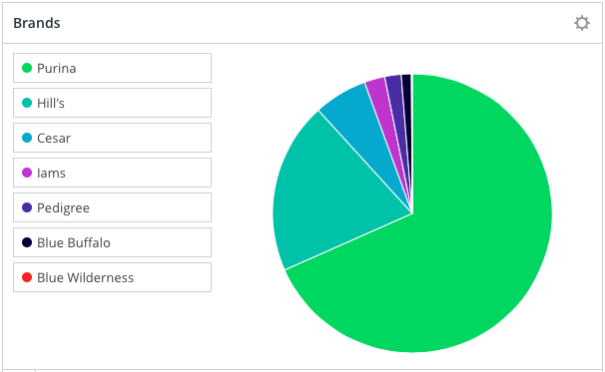
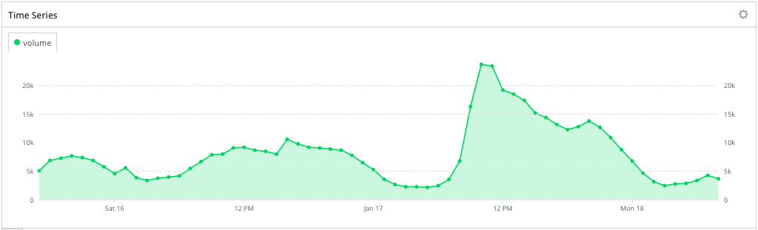
^{Industry Analysis}
There were a total of 520.3k interactions that made up the industry WOM over the span of the past 4 days. 190,000 interactions out of the industry WOM associated animal food with a specific brand. Of those interactions, Purina (68%) drove the majority of the conversation. IAMS made up an alarmingly low 2% of the industry conversation despite their disproportionate piece of the actual market share.
Upon further analyzing the demographic data, Insightpool discovered that the conversation surrounding Purina is skewed 5% more towards females. Insightpool delivered similar insights for each brand.
Brands and Their Associated Demographic Nuances
Purina 68%- 38% 18-24
Hill’s 28%- #1 Region: California
Cesar- 6%- 100% User content(as opposed to brand page)
IAMS 2%- Top Regions: NC, OR, NY, CA, OH
Pedigree 2%- N/A
Blue Buffalo- 1%- N/A
^{Timing of Interactions}
^{Animal Food}
INSIGHTS
Though the time range of the recording was limited, Insightpool saw some trends developing in terms of timing of interactions. The weekend saw a sudden peak in interactions at 10:00 AM EST on Sunday, Jan 17th. This peak was made up of predominantly negative sentiment around Purina coming from Mexico.

Slide 6
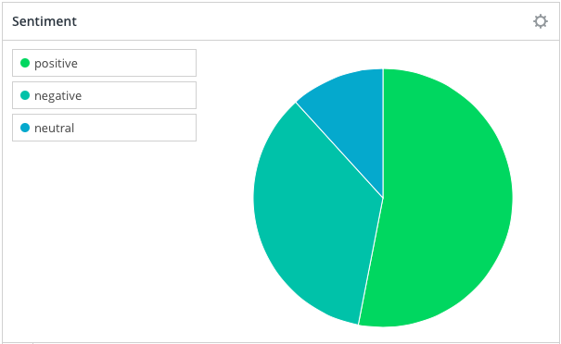
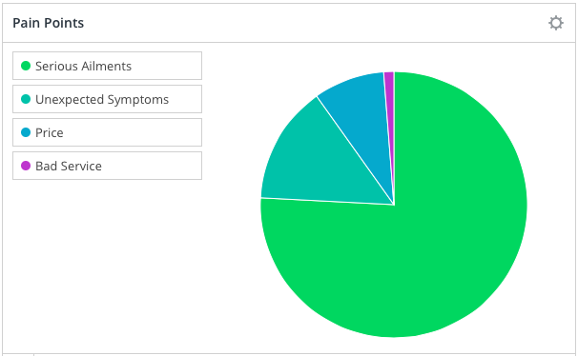
Topical Analysis
#1 Sentiment
Positive (53%)
Source of Negative:
Purina
Observation
The negative sentiment of the industry was skewed by the negative sentiment specifically around Purina from Mexico.
Sentiment
#1 Pain Point
(73%)
Number of Mentions
24,300
Observation
76% of dog food complaints came from serious ailments that occurred after eating the food.
Pain Points

Slide 7
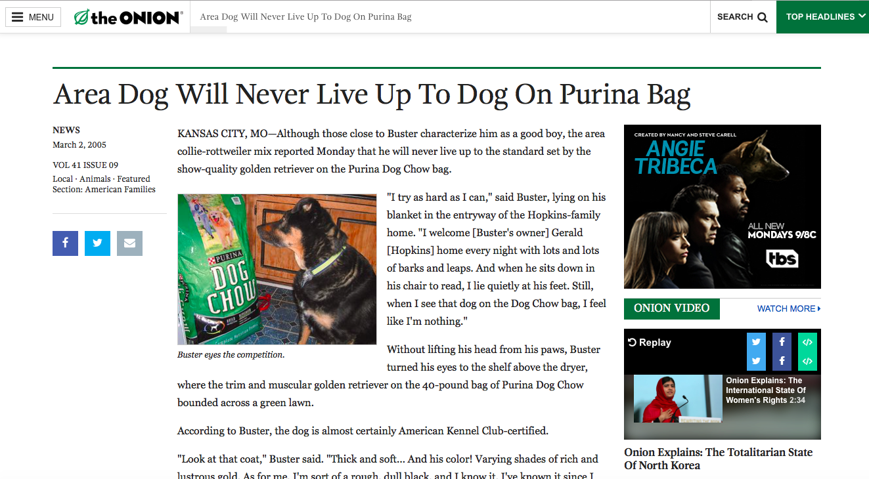
^{Top Link Shared}
#1 Link
http://www.theonion.com/article/area-dog-will-never-live-up-to-dog-on-purina-bag-1755
Number Link Shares
400
Suggestions
In this case, humorous content is most effective for increasing WOM market share by way of brand awareness.
The Onion: ‘Area Dog Will Never Live Up To Dog On Purina Bag’
^{INSIGHT REVIEW}
INSIGHT #1
The average Intel inﬂuencer is a 25-34 year-old female from Texas.
INSIGHT #2
Purina (68%) drove the majority of the conversation. IAMS made up an alarmingly low 2% of the industry conversation despite their disproportionate piece of the actual market share. The Purina audience was predominantly 18-24 year-olds.
INSIGHT #3
Though the time range of the recording was limited, Insightpool saw some trends developing in terms of timing of interactions. The weekend saw a sudden peak in interactions at 10:00 AM EST on Sunday, Jan 17th. This peak was made up of predominantly negative sentiment around Purina coming from Mexico.
INSIGHT #4
The negative sentiment of the industry was skewed by the negative sentiment specifically around Purina from Mexico. 76% of dog food complaints came from serious ailments that occurred after eating the food.
INSIGHT #5
Humorous content was most effective for increasing WOM market share by way of brand awareness.

