Slide 1
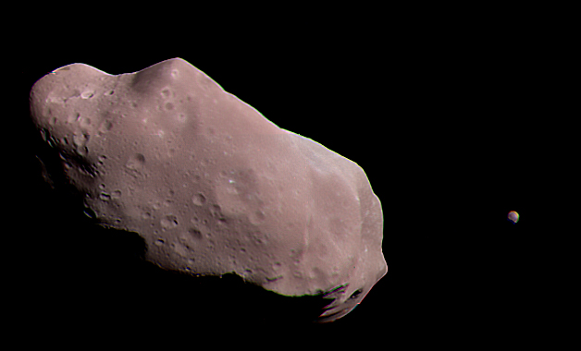
Data Analysis of the Osculating Orbital Elements of Asteroids
Jackson Copeland
University of Arkansas Department of Geosciences
Image: Asteroid 243 Ida with its moon Dactyl. Credit: NASA/JPL

Slide 2
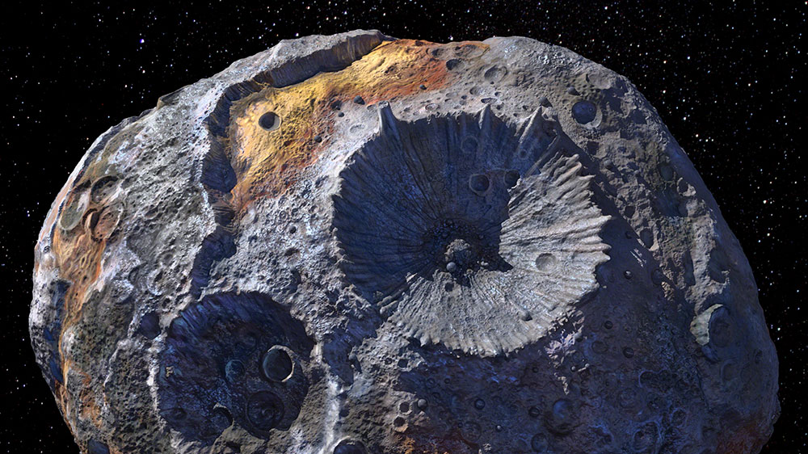
Introduction
Asteroids are minor bodies which orbit the Sun and are too small to be considered planets. They are the remnants of collisional processes that dominated the early Solar System.
There are currently 1,113,527 known asteroids.
The cumulative mass of all asteroids is less than the mass of the Moon.
Broadly categorized into three groups: C-, S-, and M- types: Chondrite, stony, and metallic.
Asteroids have tremendous potential for resource extraction as well as revealing details of solar system formation.
Background: Artist’s depiction of the M-type asteroid 16 Psyche. Credit: NASA/JPL-Caltech/ASU

Slide 3
Research Goals
Investigate whether analysis of asteroid orbits and physical characteristics can reveal useful information about the evolution of the Solar System.
Discover characteristics of the present-day Solar System and the interactions of its bodies.
Formulate a conceptual understanding of the composition of the Solar System.
Characterize potential biases in the available data.
Core Questions:
How does the distribution of asteroids vary with distance?
What is the relationship between asteroid size and other parameters? (e.g. rotational period, semimajor axis, presence of a satellite.)
Are there statistically significant differences between asteroids of differing types, sizes, or orbital radii?
What are potential sources of bias in the dataset?

Slide 4
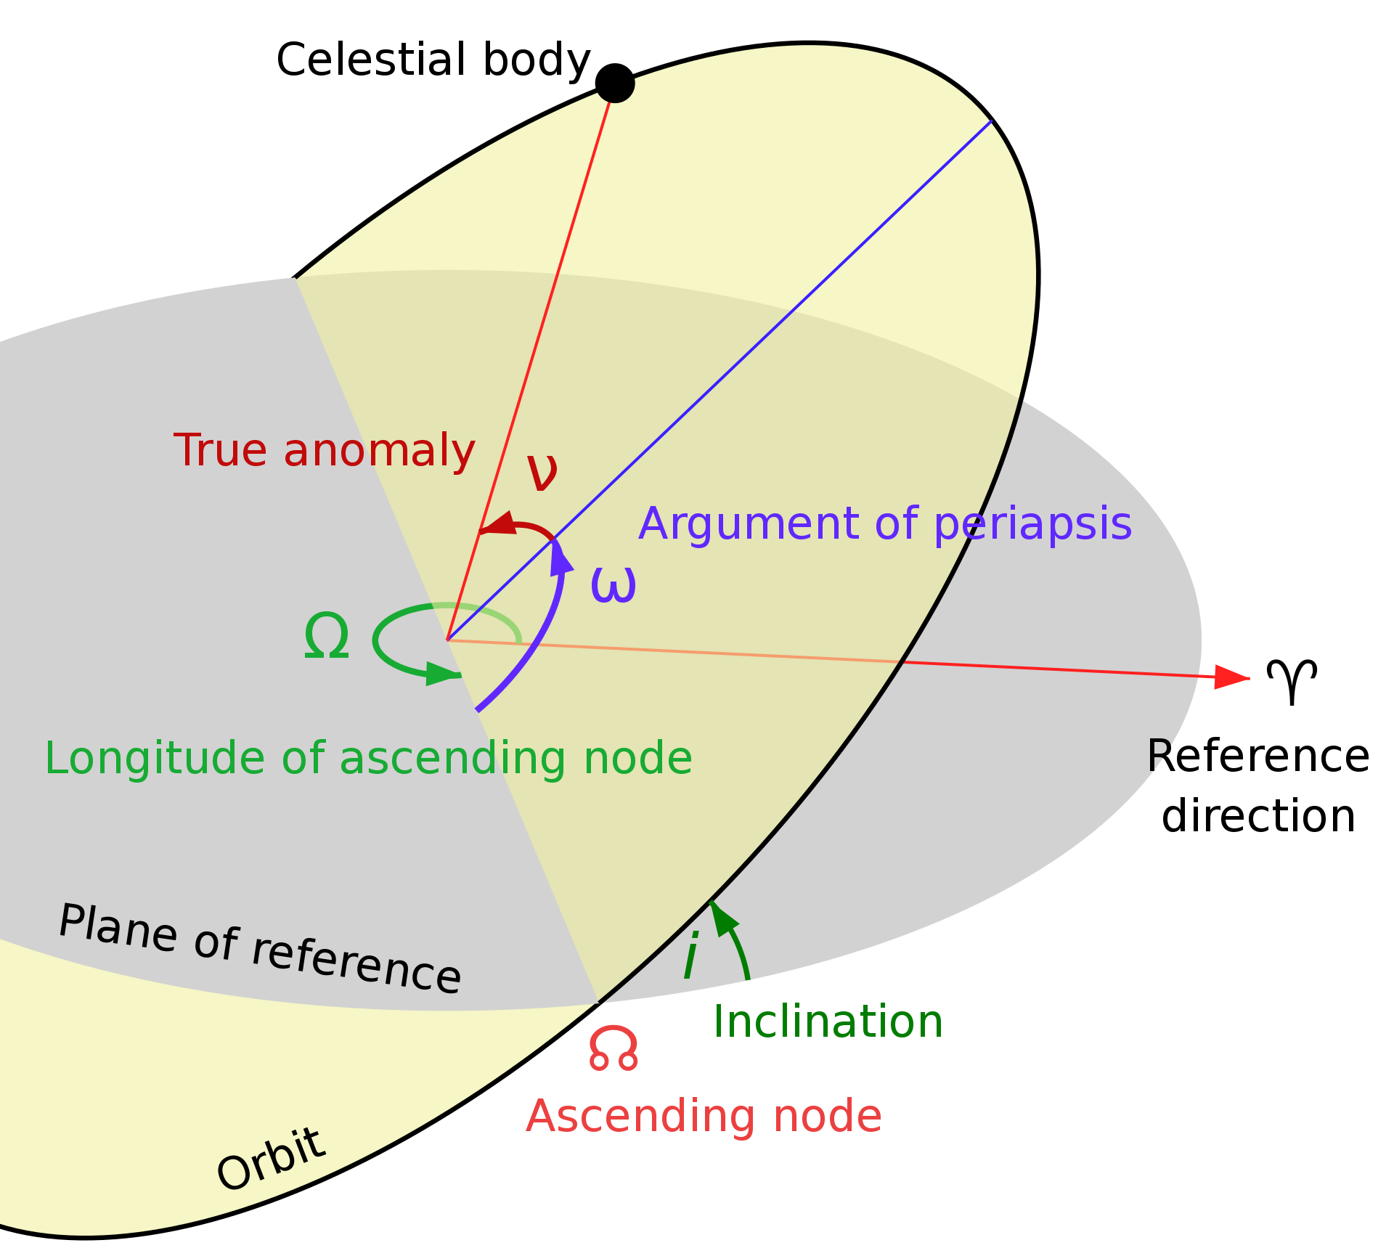

Introduction (cont.)
Keplerian orbital elements are six parameters that define an orbit:
Semimajor axis ($a$) – The longest radius across the orbital plane.
Eccentricity ($e$) – Measure of how elongated an orbit is.
Inclination ($i$) – The angle between the orbital plane and a reference plane.
Longitude of the ascending node ($Ω$) – The angle between some reference direction and the upward-moving intersection of the orbital plane with the reference plane.
Argument of periapsis ($ω$) – The angle between the ascending node and periapsis.
Osculating vs. Proper orbital elements
Credit: Wikipedia

Slide 5

Dataset Description
The dataset used for the present study were obtained using NASA/JPL’s Small Body Database Query search tool at https://ssd.jpl.nasa.gov/tools/sbdb_query.html.
There are a total of 1,171,606 entries in the dataset. Parameters used:
Semimajor axis
Eccentricity
Inclination
$\left\{\begin{aligned}Magnitude \\ Albedo\end{aligned}\right. →$Used to calculate diameter if size data not provided.
Diameter
Rotational period

Slide 6
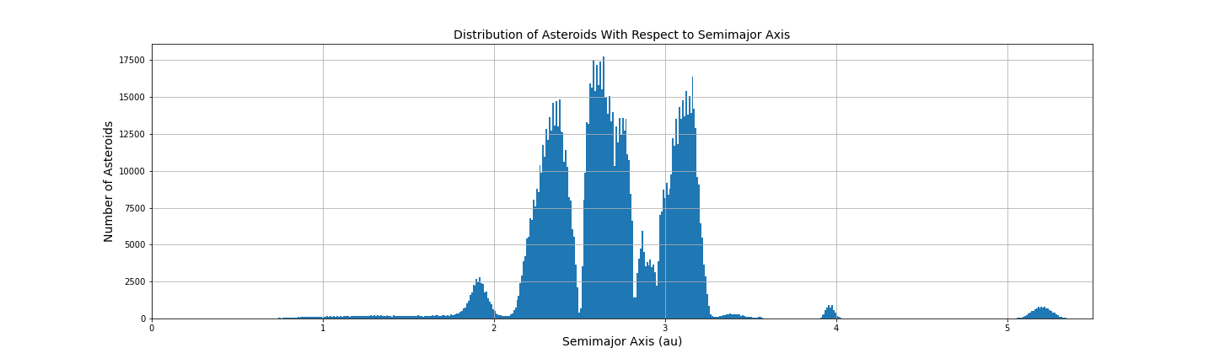
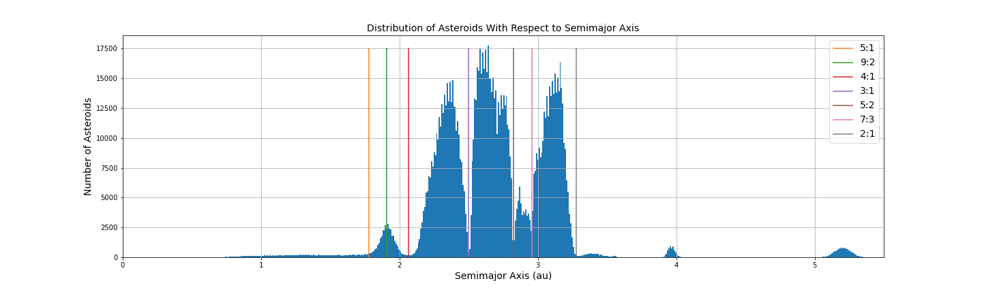
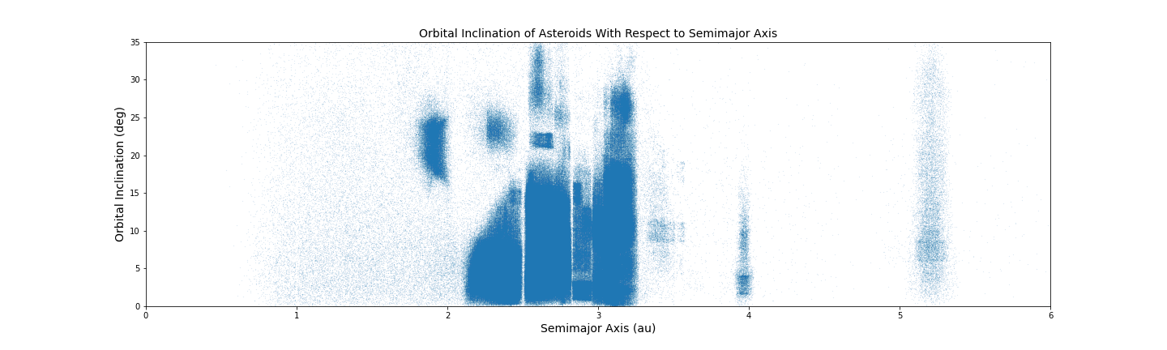
Statistical Methods
Histogram showing the number of asteroids with respect to distance from the Sun.
Kirkwood Gaps.
Plot of orbital inclination with respect to distance from the Sun.
Asteroid “families.”

Slide 7
Statistical Methods
Eccentricity refers to elongation of orbits.

