Slide 1

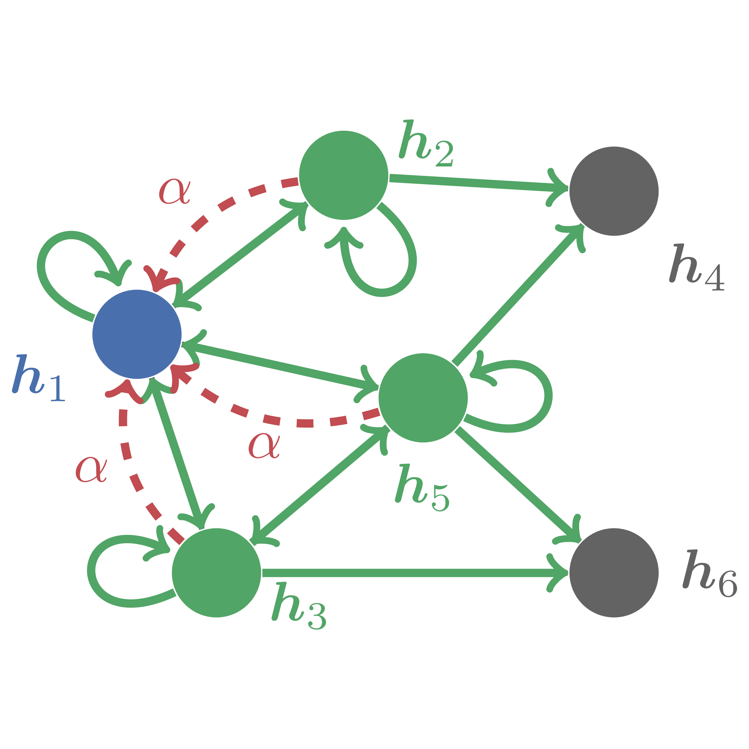
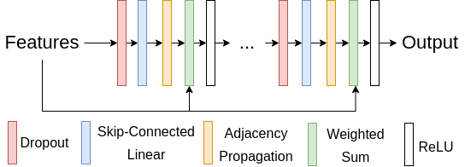
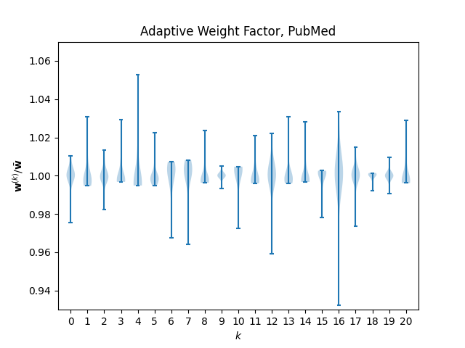
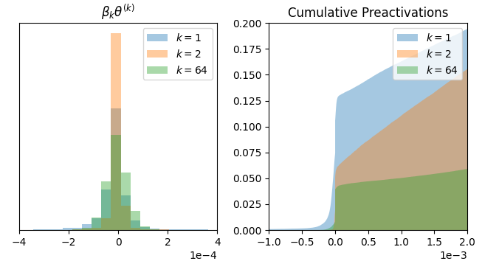









It’s PageRank All the Way Down
Simplifying Deep Graph Neural Networks
dom.jack@unimelb.edu.au sarah.erfani@unimelb.edu.au jeffrey.chan@rmit.edu.au sutharshan.rajasegarar@deakin.edu.au calecki@unimelb.edu.au
PageRank
Deep Adaptive GNN
Simple and Deep GCNs (GCN2)
PPR-MLP
Shallow
MLP
Deep Adaptive Propagation
Approximate PageRank Propagation
Shallow
MLP
$$logits= \sum_{k=0}^{K}{diag\left(w^{\left(k\right)}\right){\hat{A}}^{k}Z},$$
$$w^{\left(k\right)}={\hat{A}}^{k}Zs$$
$$X^{(k+1)}=σ\left(\left[αX^{\left(0\right)}+\left(1−α\right)\hat{A}X^{\left(k\right)}\right]φ^{\left(k\right)}\right),$$
Model | Cora-Full | PubMed | Reddit | MAG-Scholar
APPNP | 62.8 | 76.9 | - | -
PPR-GO | 61.0 | 75.2 | 26.6 | 69.3
PPR-MLP | 62.97 ± 0.86 | 76.00 ± 2.27 | 26.28 ± 1.49 | 73.94 ± 1.90
$$φ^{\left(k\right)}=\left(1−β_{k}\right)I+β_{k}θ_{k},$$
$$x^{(k+1)}=αx^{(0)}+\left(1−α\right)\hat{A}x^{(k)}$$
$$σ\left(x\right)=Relu\left(x\right)=max(x, 0)$$
$$\lim_{i→∞}{x^{(k)}}=α{[1 −(1−α)\hat{A}]}^{−1}x^{(0)}$$
$$T_{PR}=α{[1 −(1−α)\hat{A}]}^{−1}$$
Model | ogbn-arxiv
SIGN | 65.68 ± 0.06
PPR-MLP | 66.21 ± 0.19
SIGN XL | 66.06 ± 0.19
PPR-MLP XL | 66.55 ± 0.28
APPNP
Shallow
MLP
Approximate PageRank Propagation
 | APPNP | DAGNN | SS-DAGNN | MLP-PPR (DAGNN) | GCN2 | SS-GCN2 | MLP-PPR (GCN2)
Cora | 82.84 ± 0.50 | 84.15 ± 0.56 | 84.32 ± 0.64 | 84.71 ± 0.31 | 85.23 ± 0.57 | 85.15 ± 0.43 | 85.05 ± 0.29
CiteSeer | 69.41 ± 0.63 | 73.18 ± 0.50 | 73.08 ± 0.51 | 73.49 ± 0.75 | 73.14 ± 0.40 | 72.61 ± 1.17 | 72.86 ± 0.59
PubMed | 80.34 ± 0.08 | 80.62 ± 0.49 | 80.59 ± 0.47 | 80.47 ± 0.17 | 80.32 ± 0.51 | 80.03 ± 0.33 | 79.84 ± 0.25

