Slide 1
It’s PageRank All the Way Down
Simplifying Deep Graph Neural Networks
dom.jack@unimelb.edu.au
sarah.erfani@unimelb.edu.au
jeffrey.chan@rmit.edu.au
sutharshan.rajasegarar@deakin.edu.au
calecki@unimelb.edu.au
Notes:
Good afternoon everyone. My name is Dominic Jack and today I'll be presenting work conducted at the University of Melbourne in collaboration with researchers from RMIT and Deakin universities looking at PageRank and graph neural networks.

Slide 2
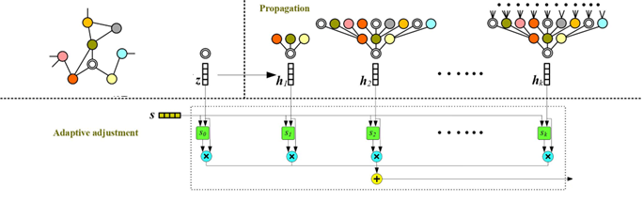
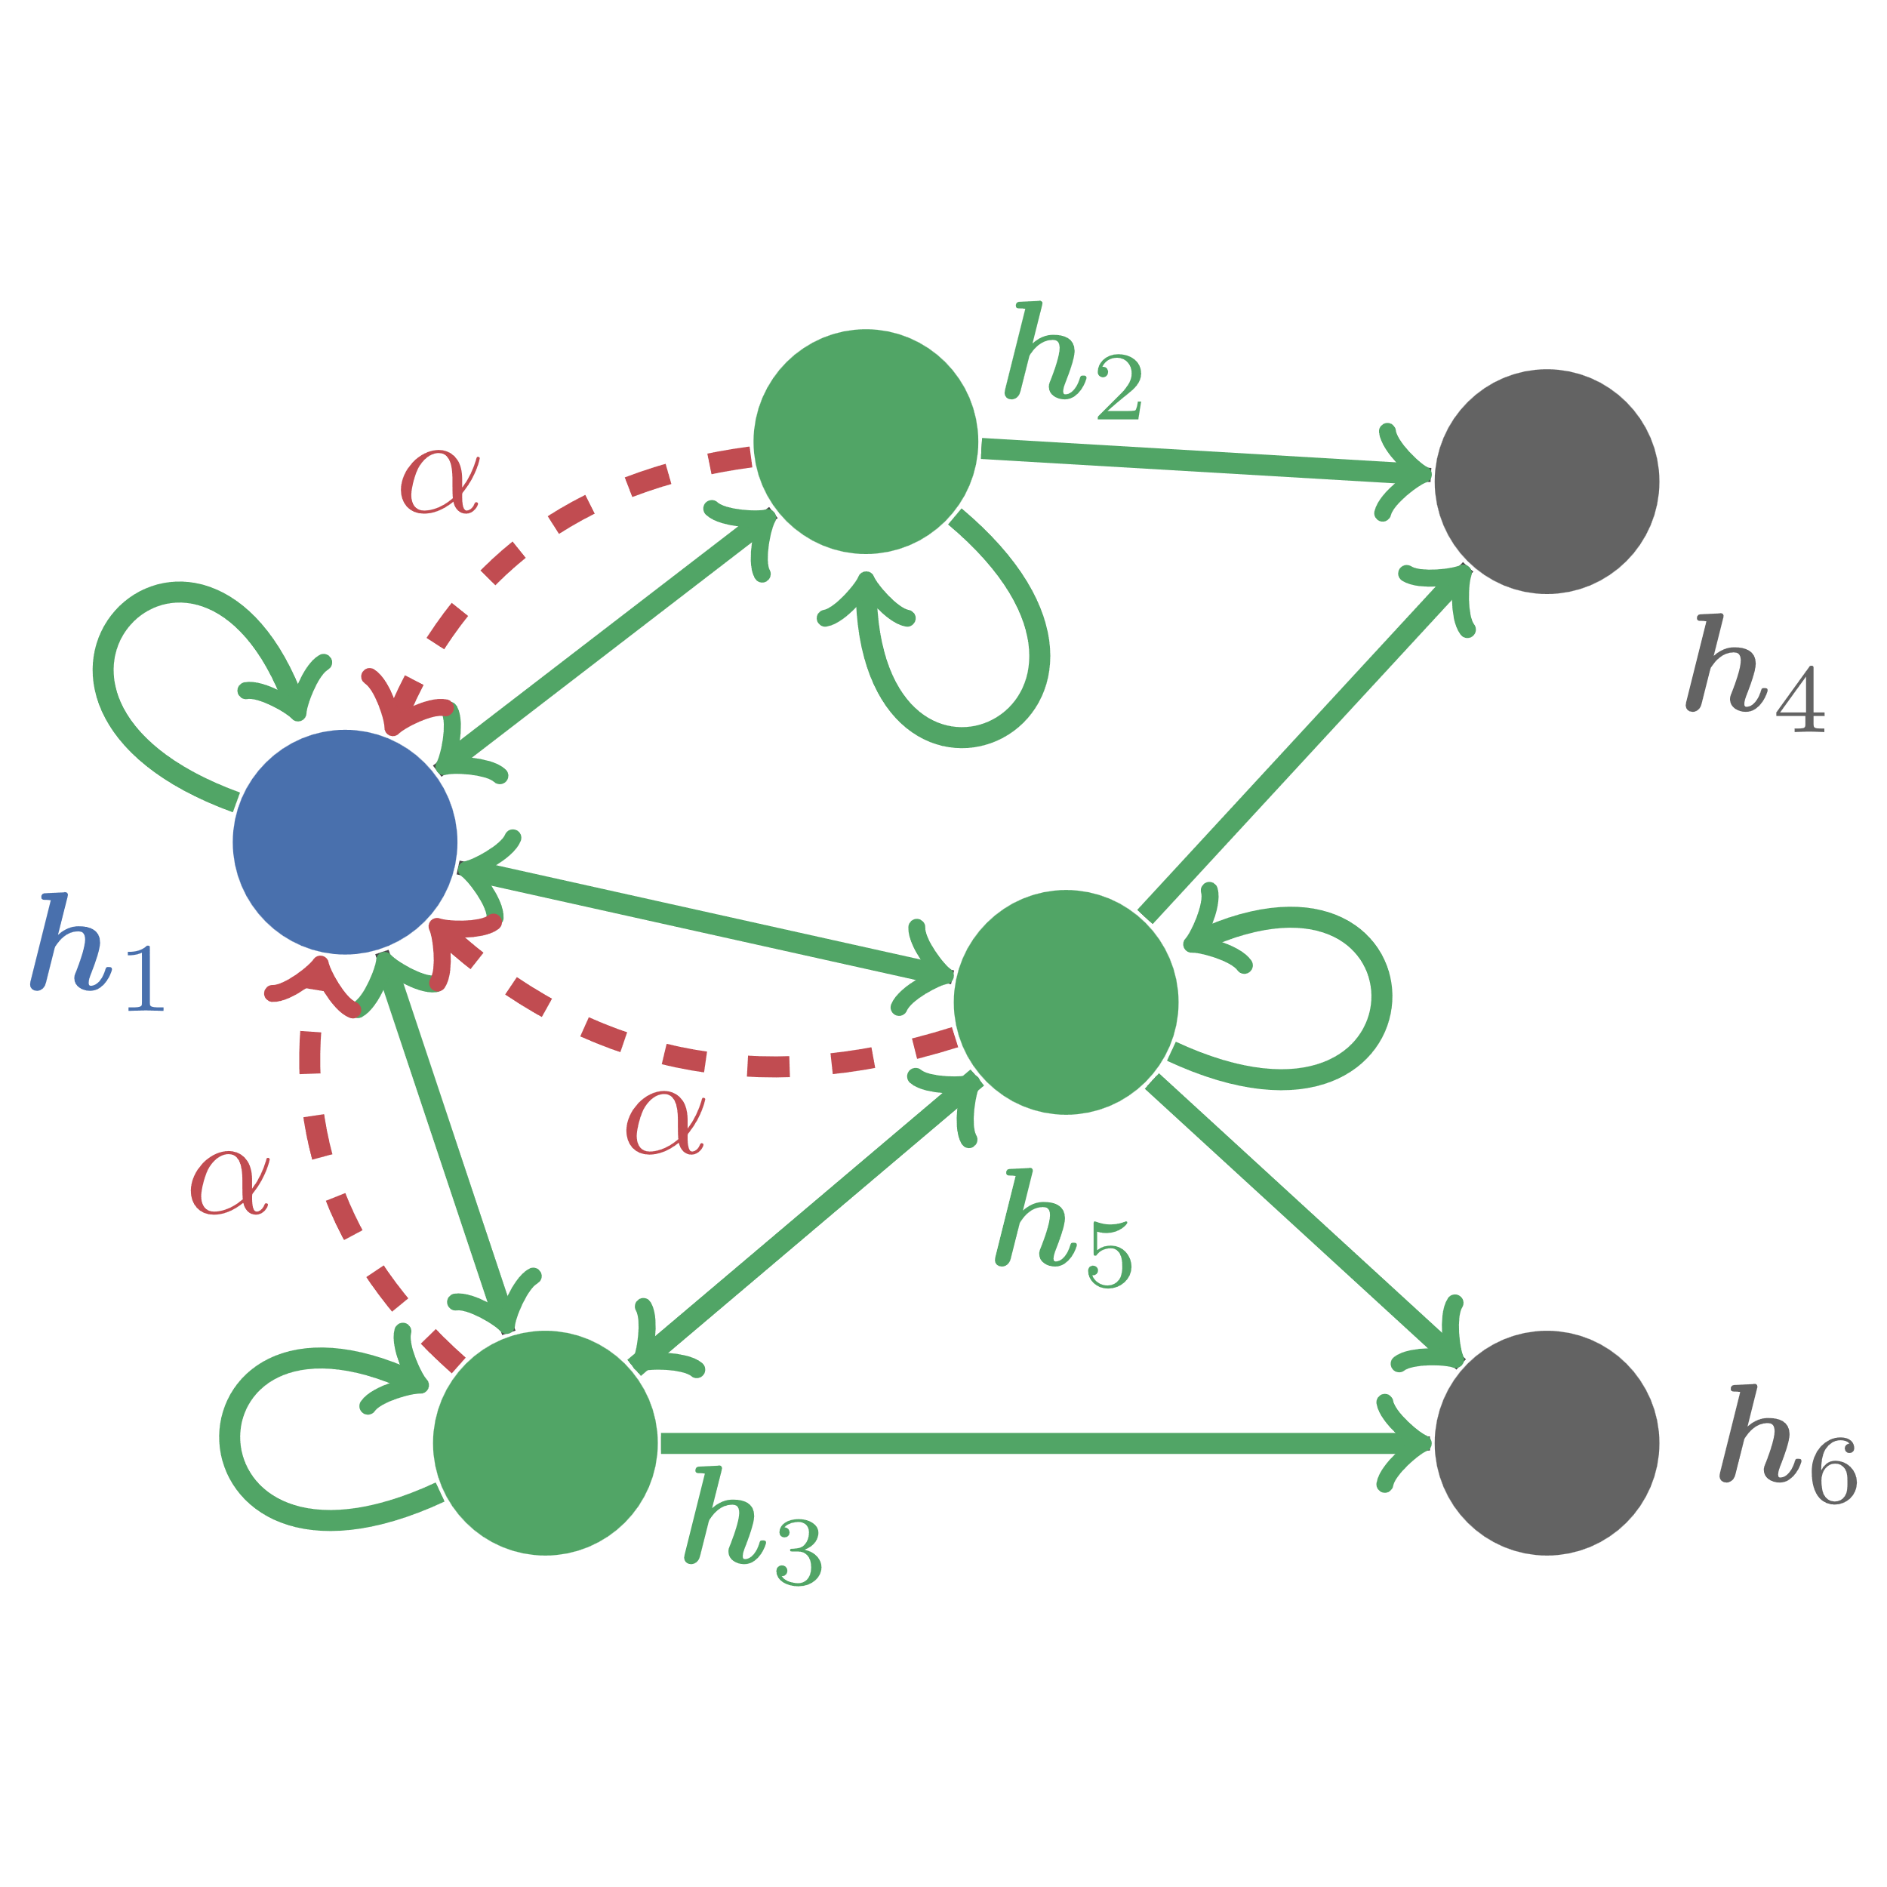
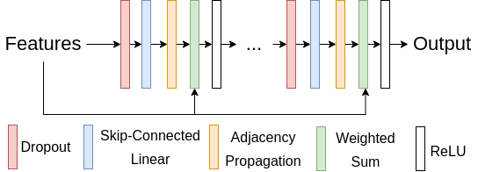
Overview
≈
Deep GNN Propagations
PageRank Propagation
Notes:
To summarise our work, we argue that a number of deep graph neural networks are really just shallow GNNs that use personalized PageRank. This talk will be broadly split into two: firstly I'm going to justify this statement, and then I'll discuss how we can leverage this information to make simpler and more efficient GNNs.

Slide 3


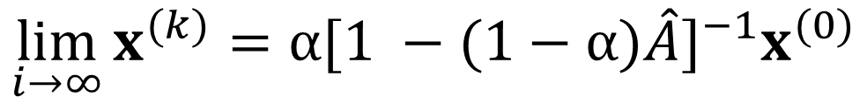
PageRank
$$x^{(k+1)}=αx^{(0)}+\left(1−α\right)\hat{A}x^{(k)}$$
$$\lim_{i→∞}{x^{(k)}}=α{[1 −(1−α)\hat{A}]}^{−1}x^{(0)}$$
$$T_{PR}=α{[1 −(1−α)\hat{A}]}^{−1}$$
PageRank: $x^{(0)}$ is a standard basis vector
Personalized PageRank: $x^{(0)}$ is a personalized probability distribution
Page et al. The pagerank citation ranking: Bringing order to the web, Technical report, Stanford InfoLab, 1999
Notes:
Before that though I just want to give a quick introduction to personalized PageRank for those unfamiliar. PageRank was developed by Larry Page and Sergey Brin of Google fame in the late 90s to rank website importance. Conceptually, a page's score corresponds to the probability of a web surfer visiting a page assuming it follows outbound hyperlinks randomly and occasionally teleports to a randomly sampled webpage with probability $\alpha$. If we let $A$ be a normalized version of the graph's adjacency matrix and $x_0$ be the teleport distribution then it can be expressed iteratively where $x_0$ is the teleport distribution, and when solved to convergence it can be expressed as the solution to a linear system. We refer to this scaled inverse matrix as the PageRank transition matrix.
The base PageRank algorithm uses a standard basis vector for $x_0$, while Personalized PageRank is a generalization where the random page teleported to is sampled from a non-uniform distribution. If we do not require the output to be a valid probability density function, we can generalize this further by considering $x_0$ to be an arbitrary feature vector with one element per node.

Slide 4
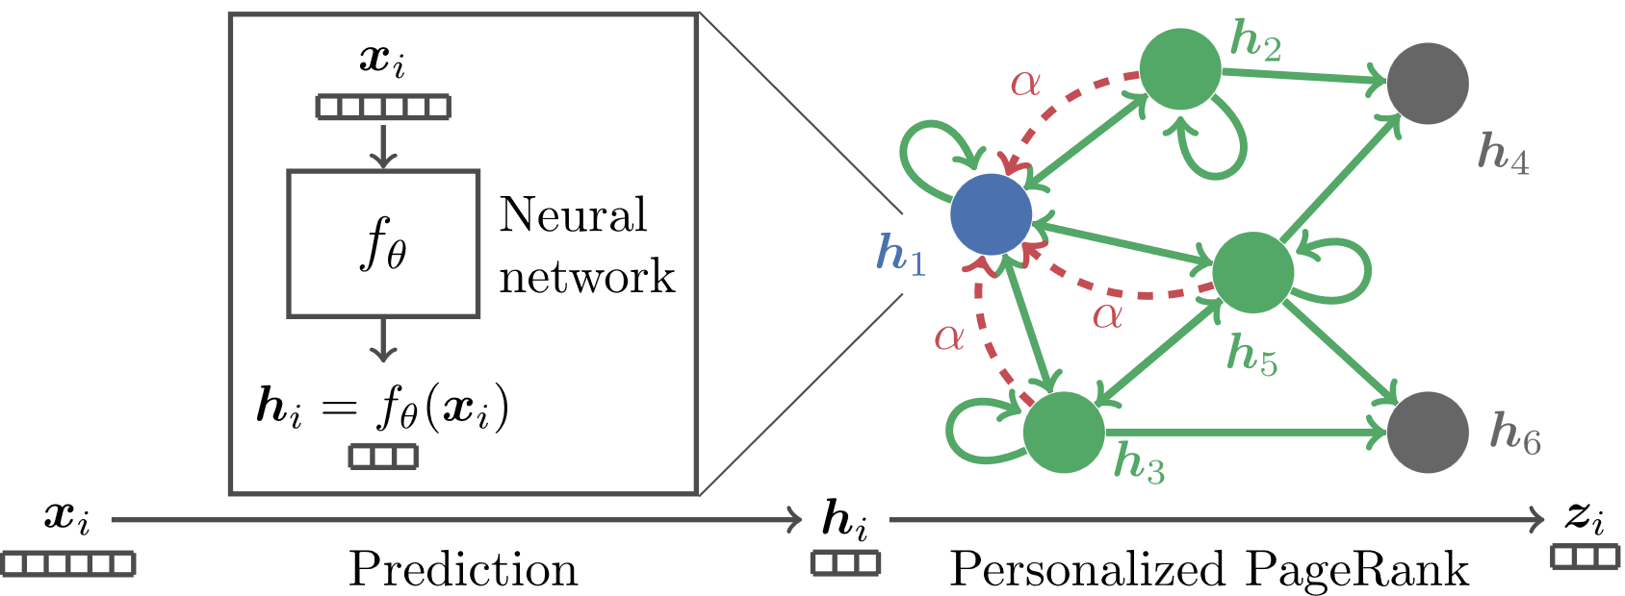
Personalized Propagation of Neural Predictions (A)PPNP
Shallow
MLP
(Approximate) PageRank Propagation
Gasteiger et al. Predict then Propagate: Graph Neural Networks meet Personalized PageRank, ICLR 2019
Notes:
However you represent it symbolically, personalized PageRank provides us a mechanism by which information can be propagated around a graph, and there have been a number of approaches that have leveraged this in graph neural networks. Gasteiger etal were the first that we're aware of that used personalized PageRank in graph neural networks with their Personalized Propagation of Neural Prediction models, or PPNP. These models were made up of a shallow MLP followed by a recursive page rank propagation.

Slide 5
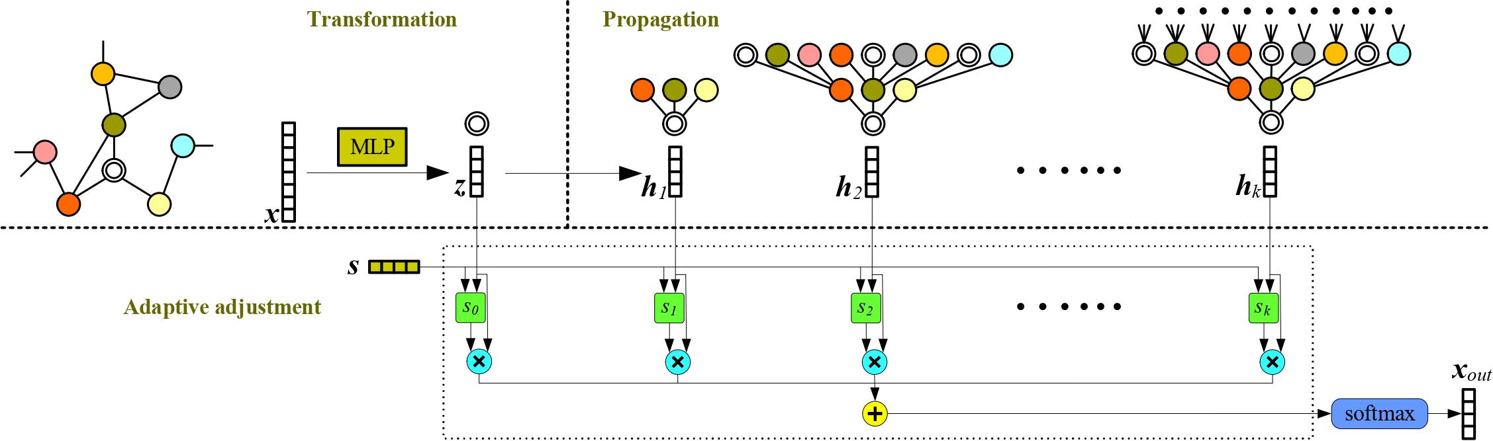
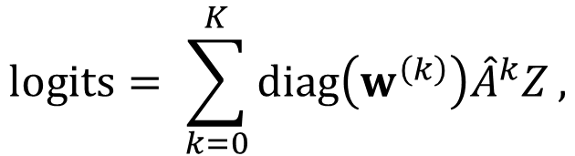

Deep Adaptive GNNs DAGNN
$$logits= \sum_{k=0}^{K}{diag\left(w^{\left(k\right)}\right){\hat{A}}^{k}Z},$$
$$w^{\left(k\right)}={\hat{A}}^{k}Zs$$
Shallow
MLP
Deep Adaptive Propagation
“… it utilizes an adaptive adjustment mechanism that can adaptively balance the information from local and global neighborhoods for each node.”
Liu et al. Towards Deeper Graph Neural Networks, KDD 2020
Notes:
More recently there have been a number of deep GNN models that have acheived better performance on benchmark datasets, and that's where our work begins.
Deep Adaptive Graph Neural Networks, or DAGNNs were proposed by Liu etal. They have a somewhat similar structure to APPNP in that there's this initial MLP followed by a propagation step, but the propagation step has learned components, making the whole network strictly speaking a deep GNN. Formally, they used a power series, where the coefficients were learned transformations of the associated terms. The authors claim their model "utilizes an adaptive adjustment mechanism that can adaptively balance the information from local and global neighborhoods for each node, thus leading to more discriminative node representations." We beg to differ. When I look at this, I see a term that converges towards the dominant eigenvector of $A$. Improvements may come from adaptivity in early layers, or from the depth, but we couldn't see how adaptivity at depth was possible.

Slide 6
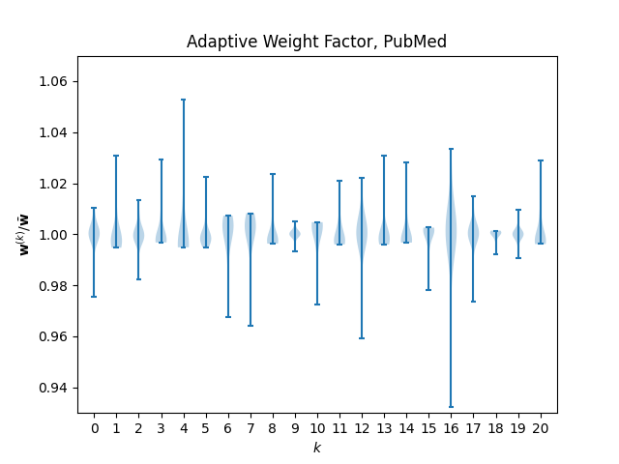



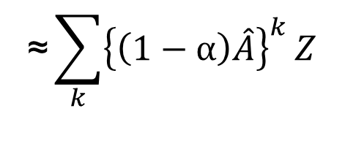
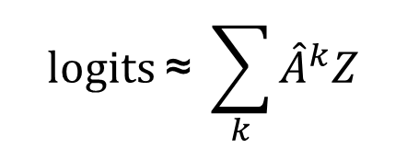
Deep Adaptive GNNs DAGNN
$$logits \text{≈} \sum_{k}{{\hat{A}}^{k}Z}$$
$$\text{≈} {\left[1 −\hat{A}\right]}^{−1}Z$$
$$\text{≈}\sum_{k}{{\left\{\left(1−α\right)\hat{A}\right\}}^{k}}Z$$
$$\text{≈} {\left[1 −\left(1 −α\right)\hat{A}\right]}^{−1}Z$$
$$\text{≈} α^{−1}T_{PR}Z$$
Notes:
So we trained up a model and looked at the values that came out, and sure enough, not only was there very little variation for later layers, there was very little adaption at all. Here we have the distribution over all nodes of the adaptive weights after normalizing by the average over the layer index. All values are within 7% of the average over $k$.
The obvious question then becomes can we remove these adaptive factors entirely, and what would that mean algebraically? Well if we look at our power series without the adaptive features, some of you might recognize this as the Maclauren series for 1/(1-x). Unfortunately, this only converges for values with magnitude less than 1, and our normalized adjacency matrix is known to have dominant eigenvalue of exactly 1. If we apply a very small decay factor to each term of the power series however - say, (1 - alpha) - then the series does converge. More specifically, it converges to a scaled version of the personalized page rank propagation matrix.

Slide 7
DAGNN Comparison
 | APPNP | DAGNN | SS-DAGNN | MLP-PPR
Cora | 82.84 ± 0.50 | 84.15 ± 0.56 | 84.32 ± 0.64 | 84.71 ± 0.31
CiteSeer | 69.41 ± 0.63 | 73.18 ± 0.50 | 73.08 ± 0.51 | 73.49 ± 0.75
PubMed | 80.34 ± 0.08 | 80.62 ± 0.49 | 80.59 ± 0.47 | 80.47 ± 0.17
Coauthor/CS | - | 92.63 ± 0.53 | 92.82 ± 0.34 | 93.29 ± 0.37
Coauthor/Physics | - | 94.03 ± 0.41 | 93.83 ± 1.12 | 93.93 ± 0.59
Amazon/computer | - | 83.70 ± 1.45 | 83.49 ± 1.12 | 82.88 ± 1.29
Amazon/photo | - | 91.32 ± 1.31 | 91.26 ± 1.37 | 90.68 ± 1.40
Notes:
So we went ahead and ran some experiments. Here DAGNN is the base model, SS-DAGNN is the same thing but without the adaptive factors. We also trained a model where we replaced the power series with a scaled PPR propgation which we called MLP-PPR, and another model PPR-MLP which was the same as MLP-PPR except we applied propagation before the MLP. We used exactly the same hyperparameters as the original implementation. For our PPR implementations we used an alpha value that gave our propagation similar spectral properties to the SS-DAGNN propagation. The results are shown here, along with results published in the original APPNP paper. To be clear, the macro architecture of our MLP-PPR model was identical to APPNP - the only differences were in the hyperparameters which we copied from DAGNN.
To summarize, there was virtually no difference between our shallow static variants or our MLP-PPR model compared to the original. There was a significant improvement over APPNP, but this must be attributable to the hyperparameter choices and other technical training details, not the model architecture itself.

Slide 8


Simple and Deep Graph Convolutional Networks GCN2
GCN2 Propagation
$$X^{(k+1)}=σ\left(\left[αX^{\left(0\right)}+\left(1−α\right)\hat{A}X^{\left(k\right)}\right]φ^{\left(k\right)}\right),$$
$$φ^{\left(k\right)}=\left(1−β_{k}\right)I+β_{k}θ_{k},$$
$$σ\left(x\right)=Relu\left(x\right)=max(x, 0)$$
Chen et al. Simple and deep graph convolutional Networks, ICLR 2020
Notes:
But we were not done there. "Simple and deep graph convolutional networks" by Chen \etal proposed "a GCN model with initial residual and identity mappings". I'll be referring to these models as GCN2. Unlike DAGNN and APPNP, these models didn't decouple variable transformation from propagation, but rather build up very deep convolutional models similar to ResNets popularized in image processing. That sounds very different to the models we've discussed so far, but if you look at GCN2's convolution layer, the similarities are fairly clear. GCN2 models are clearly just the recursive PageRank update with extra steps. Of course, these extra steps are learned variable transformations and relu activations - the fundamental building blocks of all neural networks, so we can't just dismiss them as playing a negligible role.
Or can we? Let's take a closer look, starting with the variable transformation. This phi matrix isn't just a matrix of learned parametes. Rather, it's a convex combination of the identity matrix and a matrix of learned parameters, where the weighting is heavily skewed towards the identity matrix, particularly at later layers. It's also notable that the weight decay applied to these learned parameters was significantly higher than that applied to the initial and final linear layers in the model architecture. This puts significant pressure on these values to be small in magnitude, even before rescaling.
If we assume the variable transformation is having negligible effect on propagated values, it follows that the relu activation also does very little. Looking closely, the $x_0$ and $x_k$ feature matrices are both outputs of rectified linear units so must be non-negative, so the only source of negative values is the learned parameters. If these are having a negligible effect, then the there will be very few negative pre-activation values, hence the relu will have little effect.

Slide 9
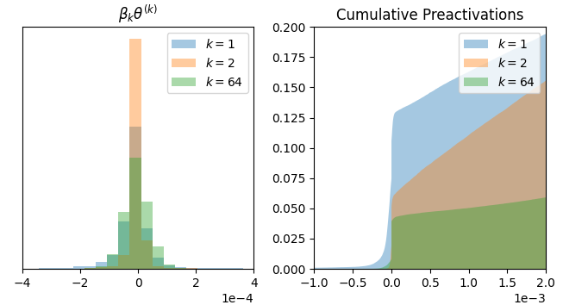
Simple and Deep Graph Convolutional Networks GCN2
Notes:
So we train a model and interrogated the parameters and pre-activation values, and this is exactly what we found. On the left we have scaled parameter values for the first, second and final propagation layer, and on the right we have the pre-activation values. Please note the x-scaled in each case. The histogram shows almost all scaled values have a magnitude less than $2 * 10^-4$, while on the right we see precisely how few values are affected by the relu activation, and by how little. For context, the activated value cumulative distribution looks identical except these tails are cropped at zero.

Slide 10
GCN2 Comparison
 | APPNP | GCN2 | SS-GCN2 | MLP-PPR
Cora | 82.84 ± 0.50 | 85.23 ± 0.57 | 85.15 ± 0.43 | 85.05 ± 0.29
CiteSeer | 69.41 ± 0.63 | 73.14 ± 0.40 | 72.61 ± 1.17 | 72.86 ± 0.59
PubMed | 80.34 ± 0.08 | 80.32 ± 0.51 | 80.03 ± 0.33 | 79.84 ± 0.25
Notes:
So just as with DAGNN, we repeated the experiments conducted by the GCN2 authors on semi-supervised datasets. We trained two variants: one that removed the variable transformation and non-linearity in each propagation layer but otherwise left the model unchanged which we called SS-GCN2, and another that replaced all convolution layers with PPR propagation, which again we called MLP-PPR. The only change we made to hyperparameters was to increase the dropout rate used in the MLP-PPR model by 0.1 to account for the fact that GCN2 uses dropout at each stage of their propagation which we can't do with PPR propagation. The results are shown here, and as expected there's not a whole lot of difference.

Slide 11
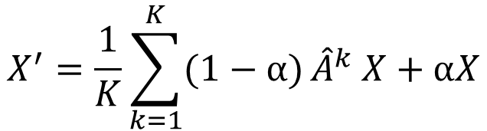
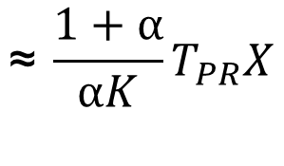
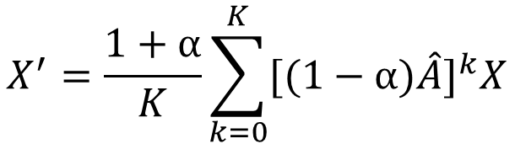
Simple Spectral Graph Convolution SSGC
SSGC Propagation
Original Implementation
$$X^{′}=\frac{1}{K}\sum_{k=1}^{K}{(1−α)}{\hat{A}}^{k} X+αX$$
$$X^{′}=\frac{1+α}{K}\sum_{k=0}^{K}{{[(1−α)\hat{A}]}^{k}X}$$
$$\text{≈} \frac{1+α}{αK}T_{PR}X$$
“… the APPNP expansion is very different to the SSGC expansion.”
Zhu and Koniusz, Simple Spectral Graph Convolution, ICLR 2021
Notes:
Lastly, an honourable mention has to go to Zhu and Koniusz in their work "Simple Spectral Graph Convolution". They proposed a model that uses this propagation. Now if you're struggling to see how that's PageRank, then don't worry, it's not. The authors even include an explicit comparison with APPNP, concluding, and I quote "that the APPNP expansion is very different to the SSGC expansion". The only problem is, that's not what they used for their experiments. At least, it's not the original implementation that they released shortly after publication. There was a subtle bug in the original implementation that meant they actually used this, and hopefully we all recognize that as just a scaled truncated Maclauren series for the PageRank matrix. Now I'm not suggesting anything nefarious here - the bug was quite subtle, it was addressed publicly and has since been fixed, and the conclusions are largely unchanged. We do think it's worth noting though as just another example of unidentified PageRank propagation popping up in recent GNN literature.

Slide 12

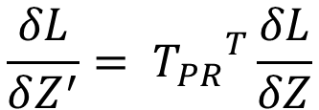

Why Bother?
MLP-PPR (APPNP)
Low rank approximation
Shallow
MLP
PageRank Propagation
$A^{−1}$ $\text{≈} VΛ^{−1}V^{T}$
More sophisticated olvers
conjugate gradient
PPR-specific solvers
Laplacian solvers
Precomputation
- one PageRank vector per label
PPR-MLP
PageRank Propagation
Shallow
MLP
Efficient back propagation
$$Z^{′}= T_{PR}Z$$
$$\frac{δL}{δZ^{′}}= {T_{PR}}^{T}\frac{δL}{δZ}$$
Notes:
Now at this point you might be asking, what's the point of all this? We've done some algebraic gymnastics and mental flexing, and maybe it gives us warm gooey feeling inside when we make connections between seemingly different works, but what are the tangible benefits this understanding give us? We demonstrate two. Firstly, when it comes to implementation, knowing we need to compute a personalized page rank matrix opens up a whole range of efficient implementations, rather than the power series or recursive definitions used in these papers we've discussed. We explored using low rank approximations and conjugate gradient solvers, but that really only scratches the surface. There are a whole host of optimized implementations for computing page rank vectors including linear-time solvers for inverse systems of laplacian-like matrices. We can also perform back-propagation using the same solver, resulting in a much more memory efficient implementation compared to series-based methods where each term in the series needs to be stored to be used in back-propagation. The other obvious thing to do is to pre-compute the page rank matrix. This is only feasible in certain situations, since the inverse isn't sparse like the adjacency matrix - but for semi-supervised node classification problems where labelling is sparse, we only need to compute a page rank vector for each label, not every single node.
Another thing we can do now that our propagation mechanism doesn't have any learned components is tweak the architecture by reversing the order of the transformation and propagation. This allows us to pre-compute the propagated input features offline, then train the MLP as we would any other MLP, allowing for trivial subgraph batching and making the approach highly scalable. We call these PPR-MLP models.

Slide 13
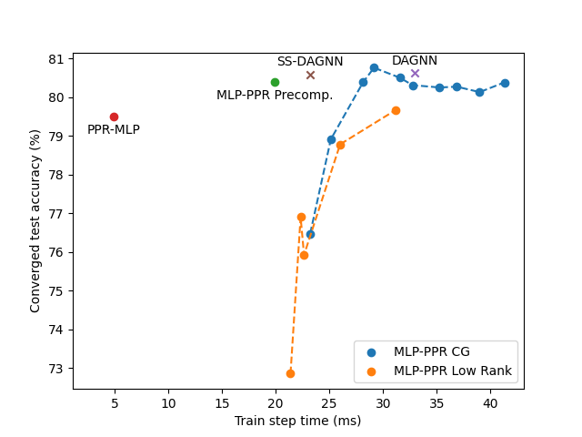
Alternative Implementations
Notes:
Here we show the training accuracy and step time for our models compared to DAGNN. It turns out the low rank approach does quite poorly. We would expect as we increased the rank towards the number of nodes this would eventually approach the same performance, but that largely defeats the purpose of using a low rank approximation. These different points are for our models using a conjugate gradient solver with differing tolerance values, and we see that we plateau quite quickly. This peak value corresponds to a tolerance of 0.1. Both our static implementation and our precomputed MLP-PPR model perform comparably but faster than the original DAGNN, and the PPR-MLP trains significantly faster at the cost of a minor performance regression. It's worth noting that all these models were trained with hyperparameters from the DAGNN paper which were the result of a coarse hyperparameter seach. Our MLP-PPR variants are designed to be algebraicly similar so we would expect these hyperparameters to be essentially optimal still, but the same can't be said for our PPR-MLP model. GCN2 model timings aren't shown in this figure, but they're way out here with 260ms and 393ms for the static and dynamic variants respectively.

Slide 14
Scalable GNNs PPR-MLP vs PPR-Go
PPR-MLP
PPR-Go
PageRank Propagation
Shallow
MLP
Shallow
MLP
Sparsified PageRank Propagation
Model | Cora-Full | PubMed | Reddit | MAG-Scholar-C
APPNP | 62.8 | 76.9 | - | -
PPR-GO | 61.0 | 75.2 | 26.6 | 69.3
PPR-MLP (ours) | 62.97 ± 0.86 | 76.00 ± 2.27 | 26.28 ± 1.49 | 73.94 ± 1.90
Bojchevski et al. Scaling graph neural networks with approximate pagerank, KDD 2020
Notes:
We also conducted experiments to evaluate the performance of our scalable PPR-MLP models on larger datasets. Firstly, we compared against PPRGo, an approach similar to APPNP but with some tweaks geared towards efficiency and scalability. Specifically, they replace PageRank propagation with a precomputed sparsified approximation. We replicated experiments from the PPRGo, using the same model hyperparameters and training procedure. Our PPR-MLP model performed comparably or better in each case.

Slide 15




Scalable GNNs PPR-MLP vs SIGN
SIGN
PPR-MLP
$$f_{1}(A)$$
$$f_{2}(A)$$
Shallow
MLP
PageRank Propagation
Shallow
MLP
$$f_{3}(A)$$
$$f_{10}(A)$$
Model | ogbn-arxiv
SIGN | 65.68 ± 0.06
PPR-MLP (ours) | 66.21 ± 0.19
SIGN XL | 66.06 ± 0.19
PPR-MLP XL (ours) | 66.55 ± 0.28
Rossi et al. SIGN: Scalable inception graph neural networks, ICML 2020
Notes:
We also compared against the popular Scalable Inception Graph Networks by Rossi \etal which uses the same idea of pre-computing propagations then training an MLP. Instead of PageRank propagation they use the concatenation of 10 simpler propagations. For these models we used the concatenation of the raw inputs and their pagerank-propagated version. We used identical hyperparameters to the official implementation, training both a small and large model. Despite having 5 times fewer inputs and using hyperparameters tuned for the original input set, our models slightly out-performed the originals in both cases.

Slide 16
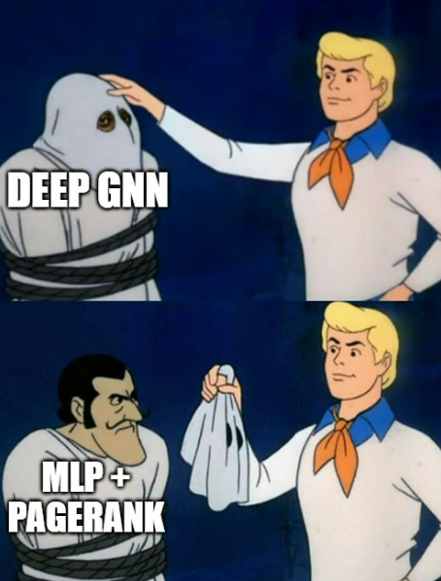
Conclusion
MLP-PPR (APPNP)
Shallow
MLP
PageRank Propagation
PPR-MLP (Scalable)
PageRank Propagation
Shallow
MLP
Notes:
So to conclude, we showed that a couple of deep graph neural networks popular in the literature, are qualitatively equivalent to an MLP followed by PageRank propagation on semi supervised transitive tasks. This is the same macro architecture proposed in APPNP, and improvements of these more sophisticated architecture have nothing to do with their depth or adaptivity but rather everything to do with technical implementation details like hyperparameter choices and training regimes. We subsequently showed that removing the unhelpful learned components resulted in models that performed just as well while training faster. We also showed that simply reversing the order of the MLP and propagation resulted in networks that out-performed other attempts at optimizing PageRank models and other propagate-then-transform models. Thank you for your attention.

