Slide 1
The Tech Industy in Los Angeles City and County
Joao de Paula

Slide 2
About
PHOTO BY TYLER MERBLER
Los Angeles, CA has a population of 3.98M people with a median age of 35.6 and a median household income of $54,432. Between 2015 and 2016 the population of Los Angeles, CA grew from 3.97M to 3.98M, a 0.11% increase and its median household income grew from $52,024 to $54,432, a 4.63% increase.

Slide 3
Slide with Bullets
Bullet 1
Bullet 2
Bullet 3

Slide 4
Slide with R Output
summary(cars)
## speed dist ## Min. : 4.0 Min. : 2.00 ## 1st Qu.:12.0 1st Qu.: 26.00 ## Median :15.0 Median : 36.00 ## Mean :15.4 Mean : 42.98 ## 3rd Qu.:19.0 3rd Qu.: 56.00 ## Max. :25.0 Max. :120.00

Slide 5
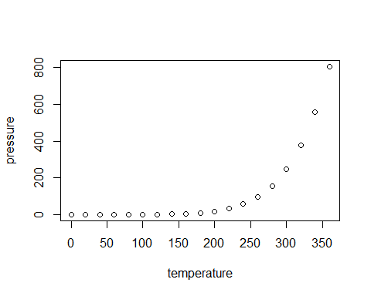
Slide with Plot

