Slide 1
Image Classification with Convolutional Neural Networks
Jack Neilson
1506801

Slide 2
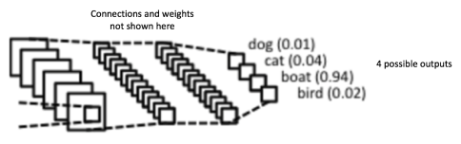
What is it?
Technique to classify images in to pre-determined groups
Compares a kernel to each part of the image to find a convolved feature
Multiple layers of neurons
Final result is some number [0,1] at the end neurons
https://ujwlkarn.files.wordpress.com/2016/08/screen-shot-2016-08-06-at-12-34-02-am.png?w=484&h=152

Slide 3
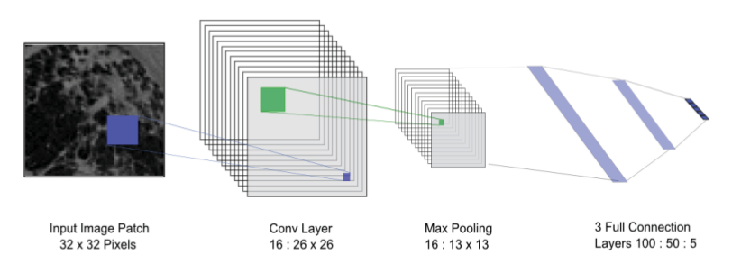
Why bother?
Difficult problem to solve as involves use of non-direct comparisons
No easy way to ask “is there an <x> in this picture?”
Many practical uses in medicine, engineering
“Medical Image Classification with Convolutional Neural Network” – Qing Li, Weidong Cai, Xioagang Wang et. al. c.2014

Slide 4
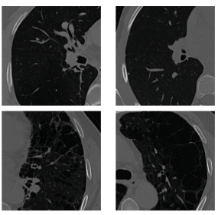
Approach 1
“Medical Image Classification with Convolutional Neural Network”
Uses a CNN to classify whether an image of a lung is normal or has one of several disorders
Only a single convolutional layer – more interested in texture than image features
Works well in domain but very specific. Can’t easily be applied to other domains without lots of training.
“Medical Image Classification with Convolutional Neural Network” – Qing Li, Weidong Cai, Xioagang Wang et. al. c.2014
First two are normal, second two have emphysema

Slide 5
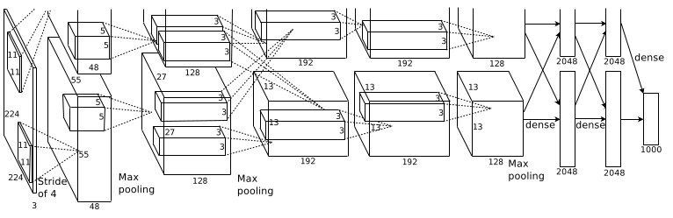
Approach 2
“ImageNet Classification with Deep Convolutional Neural Networks”
Uses newly developed techniques to improve accuracy against massive data sets (15 million images, 22,000 categories!)
Need to mitigate against “overfitting” - model fits too closely to training set, misses general trend
Trains on multiple GPUs, allowing for parallelisation
“ImageNet Classification with Deep Convolutional Neural Networks” - Alex Krizhevsky, Ilya Sutskever, Geoffrey E. Hinton c. 2017

Slide 6
Conclusion
Important but difficult problem to solve
Lots of new techniques being developed – ReLU, dropout
Success rates constantly improving, almost at human level (0.3% error) on small data sets

Slide 7
References
“ImageNet Classification with Deep Convolutional Neural Networks” - Alex Krizhevsky, Ilya Sutskever, Geoffrey E. Hinton c. 2017
“Medical Image Classification with Convolutional Neural Network” – Qing Li, Weidong Cai, Xioagang Wang et. al. c.2014
“An Intuitive Explanation of Convolutional Neural Networks” - https://ujjwalkarn.me/2016/08/11/intuitive-explanation-convnets/

