Slide 1
Pencil-and-Paper Neural Networks
Prof. Kevin Crisp
St. Olaf College

Slide 2
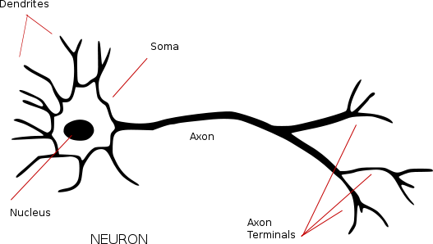
The Biological Neuron
A neuron can be conceived as a simple device that
produces an output only when the net input is
sufficiently intense.
INPUT
OUTPUT
https://commons.wikimedia.org/wiki/Neuron#/media/File:Neuron_-_annotated.svg

Slide 3
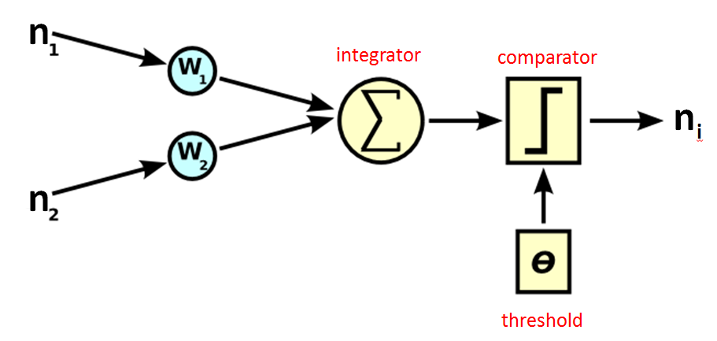
The Artificial Neuron
Thus, an artificial neuron consists of two parts:
an integrator that sums dendritic inputs from other neurons,
and a comparator that compares the sum to a threshold value.
INPUT
OUTPUT
https://commons.wikimedia.org/wiki/Neuron#/media/File:Computer.Science.AI.Neuron.svg

Slide 4
The Integrator
There may be many synaptic inputs onto a single neuron’s dendrites.
At any moment, only some of these (nj) will be active and firing.
Furthermore, individual synapses can be strong or weak, and their strength (wj; weight) can change with learning.
For binary artificial neurons (firing: nj=1; not firing: nj=0), the output of the integrator is the sum of the weights of the firing synapses.
INPUT
https://commons.wikimedia.org/wiki/Neuron#/media/File:Computer.Science.AI.Neuron.svg
Notes:
n(j) is the activation state (1 = firing; 0 = not firing) of the presynaptic inputs (n1 and n2). w(i,j) is the weight (strength) of the synapse from neuron j onto neuron i.

Slide 5
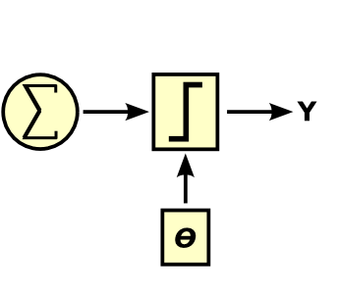
The Comparator
The comparator compares the sum it receives from the integrator to a threshold value and produces a binary response:
ni = 1 if the sum >= threshold
(the artificial neuron is firing)
ni = 0 if the sum < threshold
(the artificial neuron is not firing)
integrator
comparator
n
OUTPUT
i
threshold
https://commons.wikimedia.org/wiki/Neuron#/media/File:Computer.Science.AI.Neuron.svg
Notes:
Often, the threshold is a function rather than a constant. In other words, it may not be the same value for all neurons in the network or at all times in the simulation.

Slide 6
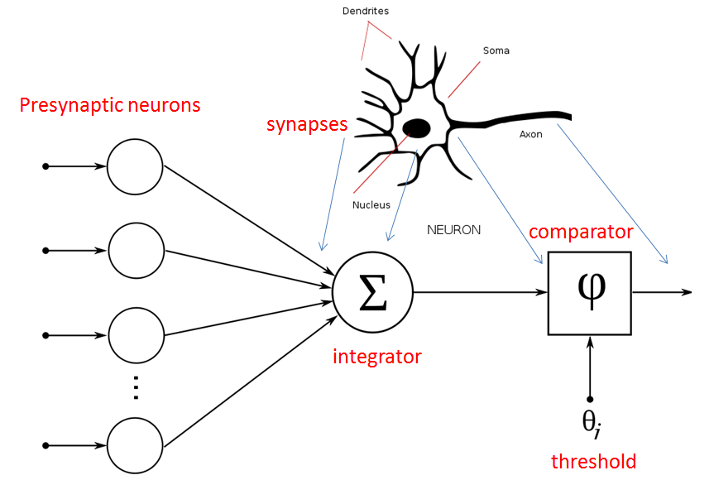
The McCulloch-Pitts Neuron
INPUT
OUTPUT
https://commons.wikimedia.org/wiki/Neuron#/media/File:NeuronModel_deutsch.svg
Notes:
McCulloch WS, Pitts WH (1943) A logical calculus of the ideas immanent in nervous activities. Bulletin of the Mathematical Biophysics 5:115-133

Slide 7
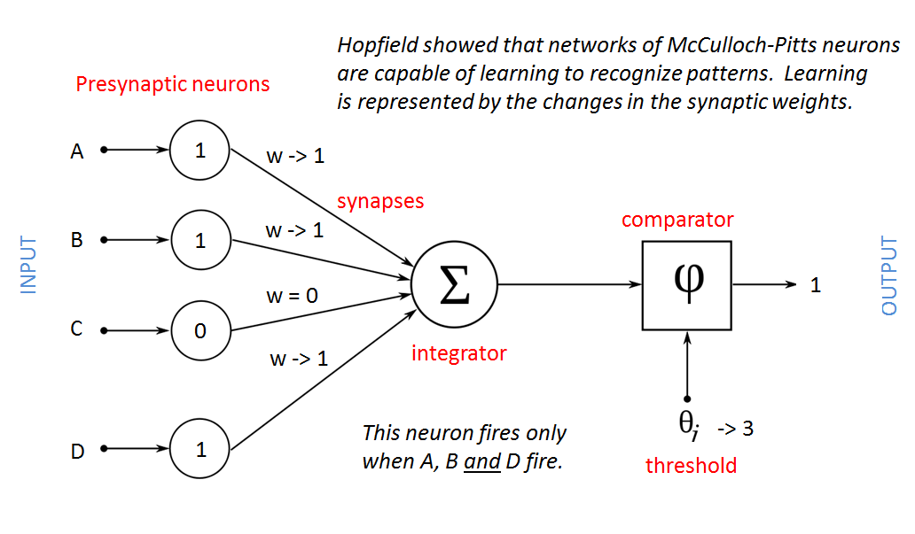
Learning in Hopfield Networks
https://commons.wikimedia.org/wiki/Neuron#/media/File:NeuronModel_deutsch.svg
Notes:
Hopfield JJ (1982) Neural networks and physical systems with emergent collective computational abilities. PNAS 79: 2554-2558

Slide 8

A Very Simple Example
Imagine a squirrel has cached nuts in a yard for winter.
Trees in the yard serve as landmarks.
A neural network uses the positions of trees to recall where nuts are cached.
https://en.wikipedia.org/wiki/Squirrel#/media/File:Squirrel_Eating_a_peanut.jpg

Slide 9
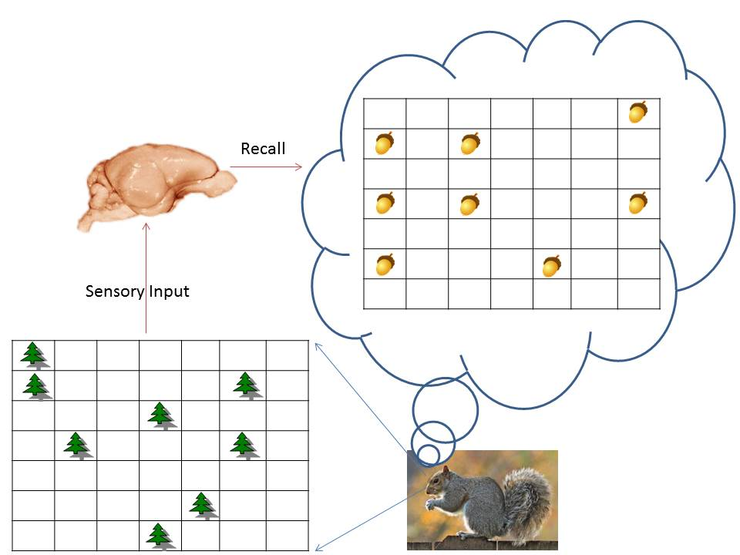
OUTPUT
INPUT

Slide 10
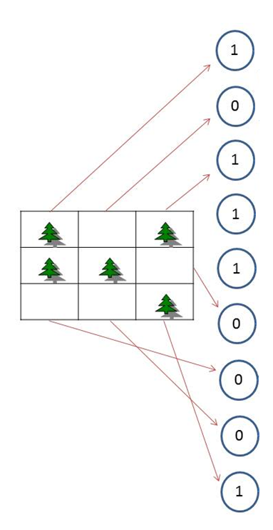
The input “map” is represented as the activation states of a layer of presynaptic neurons called the input layer.
Each input layer neuron fires (n = 1) if a tree is present in its corresponding field.
If no tree is present in a neuron’s receptive field, that input layer neuron does not fire (n = 0).
INPUT

Slide 11
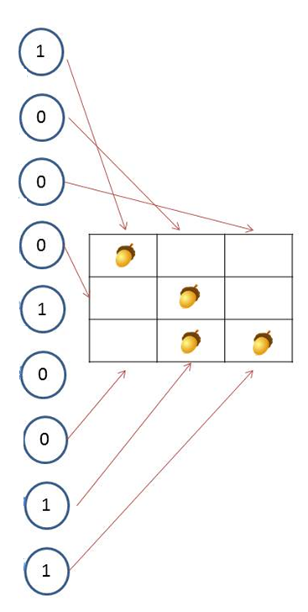
The output “map” is represented as the activation states of a layer of postsynaptic neurons called the output layer.
Each output layer neuron fires (n = 1) if a nut is present in its corresponding field.
If no nut is present in a neuron’s receptive field, that input layer neuron does not fire (n = 0).
OUTPUT

Slide 12
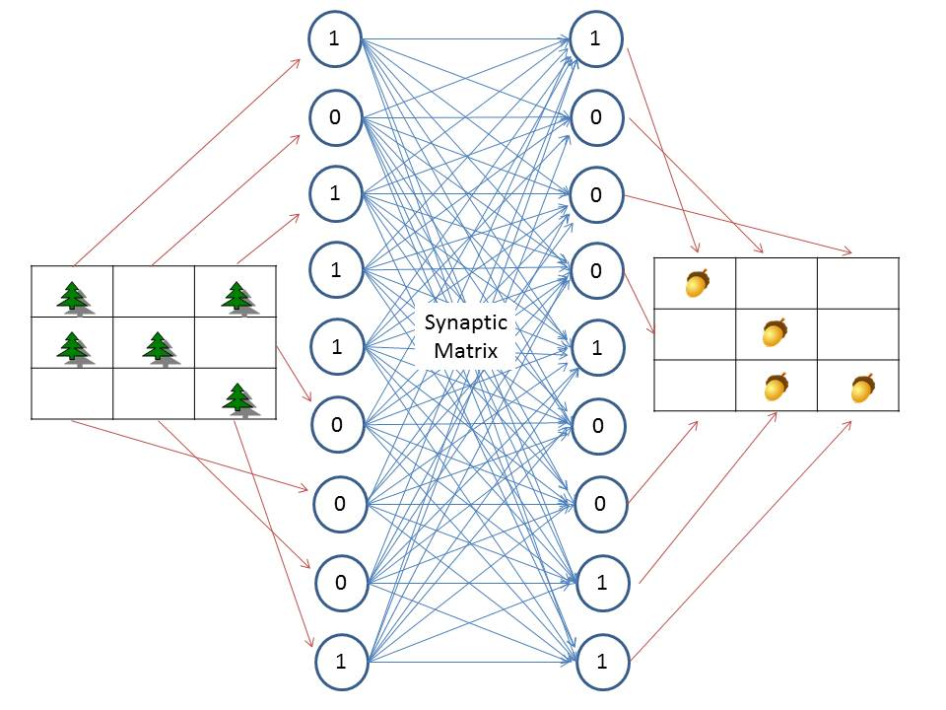
Each input layer neuron is connected to each output layer neuron.
OUTPUT
INPUT

Slide 13
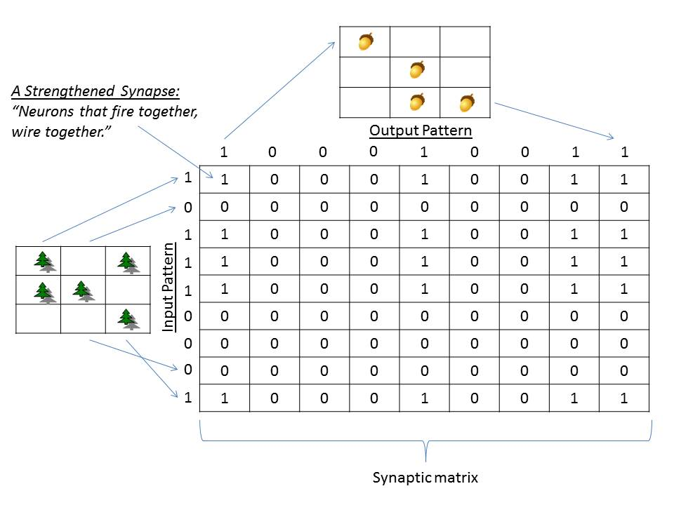
The synaptic matrix consists of the weights of every input layer neuron onto every
output layer neuron.
OUTPUT
INPUT
Notes:
Hebb’s Rule in this case means that if an input layer neuron and an output layer neuron are active at the same time, the synapses between them becomes strengthened.

Slide 14
A Simple Learning Rule
For every synapse:
if the presynaptic cell and postsynaptic cell are both firing (1), the synapse between them should be strengthened (0->1).
Note that if there are four trees in a map, that means there are four strong synapses onto each “nut” neuron.
This redundancy in the distributed representation allows neural networks to recognize patterns even when inputs are missing or noisy.

Slide 15
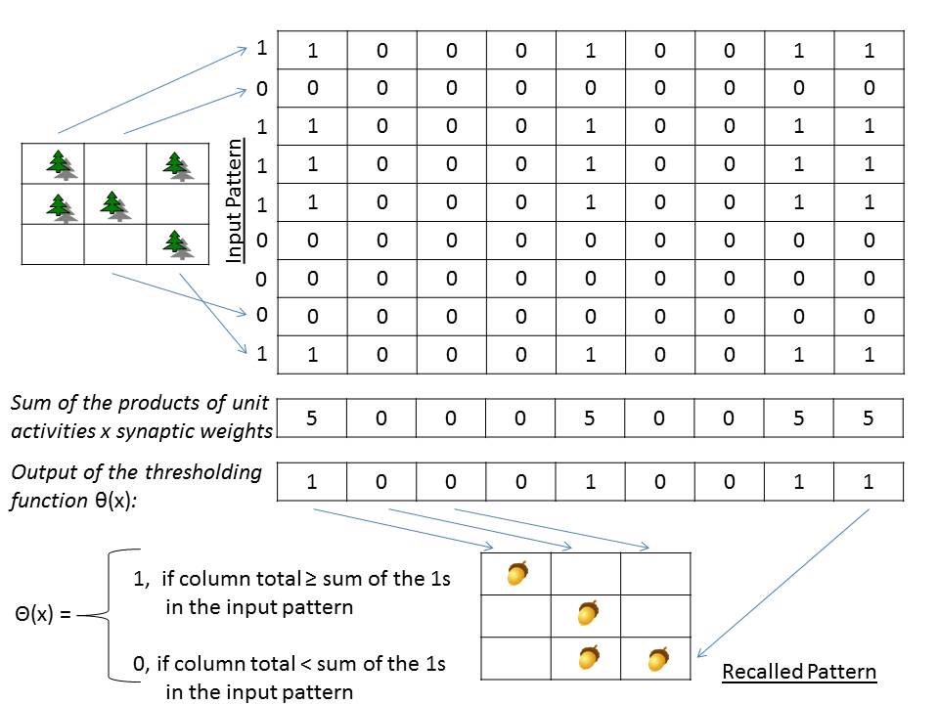
To simulate recall, count the number of 1’s in each column that correspond to 1’s in
the input pattern.
INPUT
integrator

Slide 16
Whenever a column sum is greater or equal than the number of 1’s in the input pattern,
the corresponding output layer neuron fires.
INPUT
integrator
comparator
OUTPUT

Slide 17
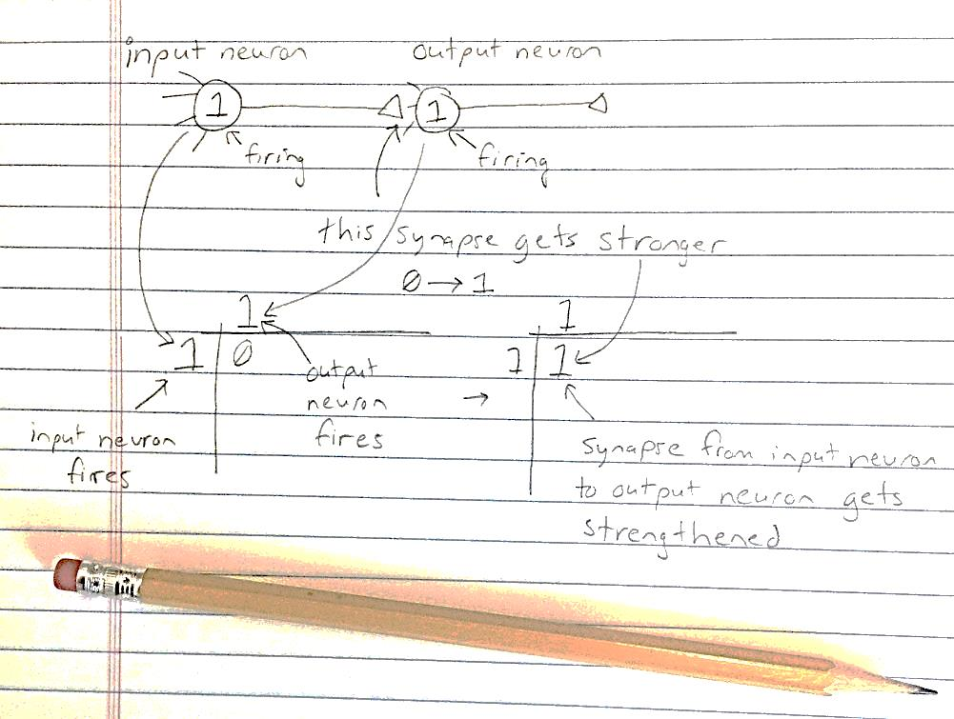
Pencil-and-Paper Neural Networks
Input layer neurons are represented by ones and zeros to the left of the synaptic matrix.
Output layer neurons are represented by ones and zeros at the top of the synaptic matrix.
If an input layer neuron is firing at the same time as an output layer neuron, the synapse is strengthened.

Slide 18
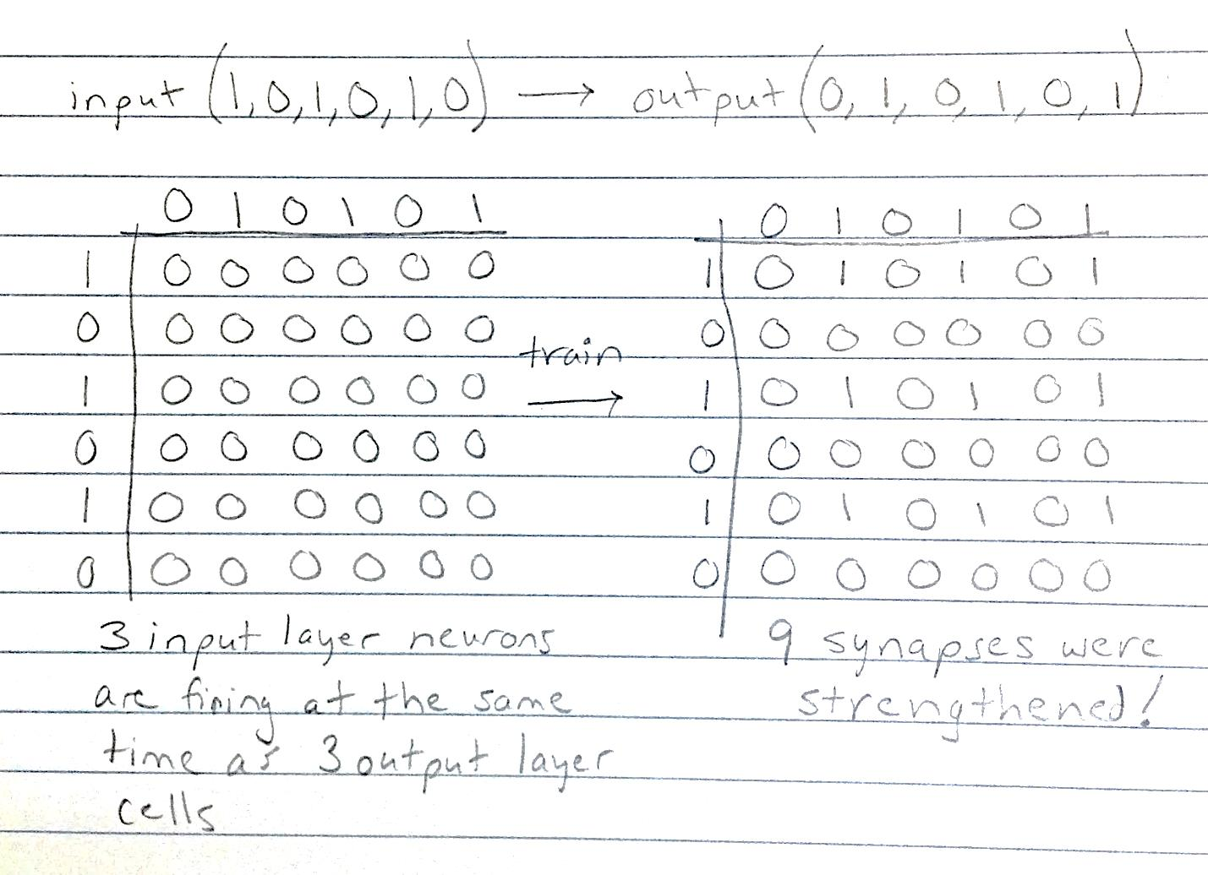
Pencil-and-Paper Neural Networks
A network consisting of 6 input layer neurons and 6 output layer neurons
is trained to associate the input “101010” with the output “010101”.

Slide 19
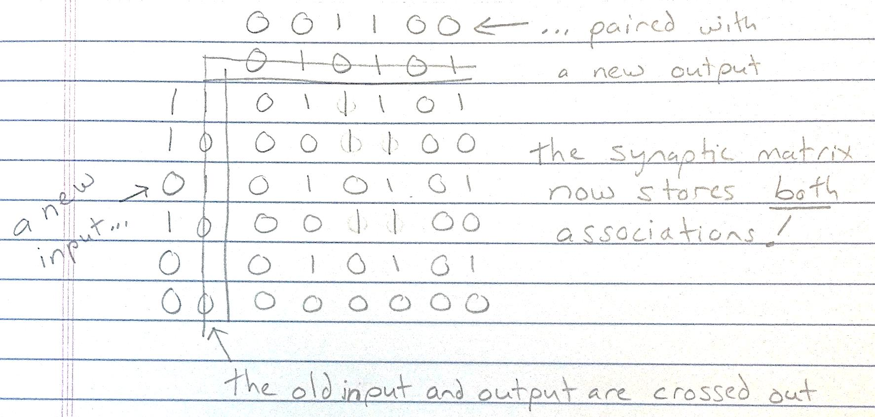
Pencil-and-Paper Neural Networks
The same network is now trained with a second association (“110100” with “001100”).
Note that synapses are never weakened, or the network forgets what it learned before.

Slide 20
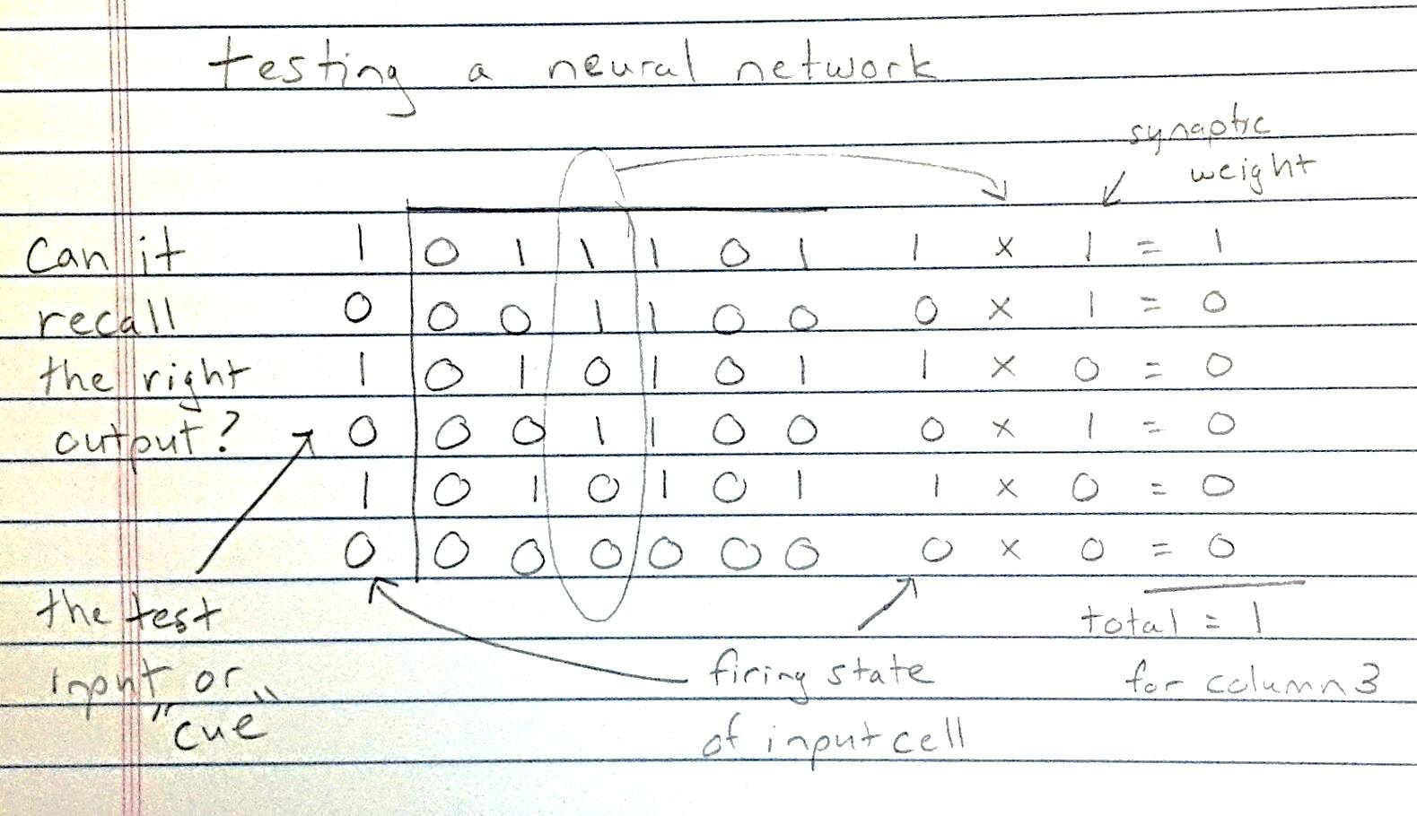
Pencil-and-Paper Neural Networks
This process is repeated
for each column.
Now that the network has learned a second association, can it still remember the first?

Slide 21
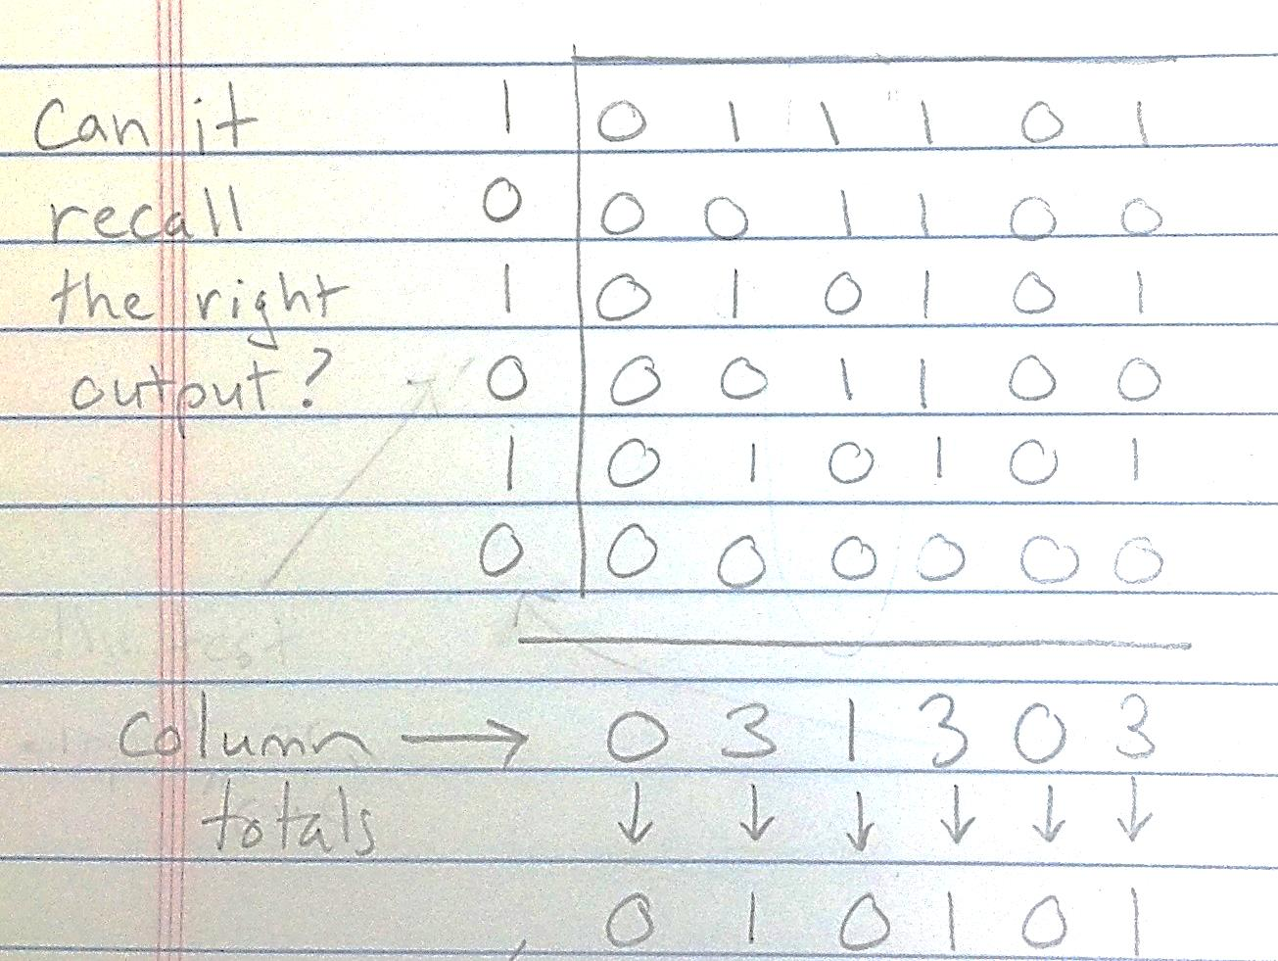
Pencil-and-Paper Neural Networks
When all column sums have been calculated, the thresholding function is applied.
The output neuron corresponding to the column fires if the total is greater than the lesser
of: the number of ones in the current input, or the number of ones in the original input.
Notes:
This is a variant on the Wilshaw strategy; Wilshaw DJ, Buneman OP, Longuet-Higgins HC (1969) Non-holographic associative memory. Nature 2222: 960-962.

Slide 22
Exercises
While completing the lab exercises, you will:
Train neural networks with multiple associative “memories”.
Test the information capacity of artificial neural networks.
Test the ability of networks to recall associations accurately even when the input cue is partial or noisy.
Explain mistakes your networks make in terms of the distinctiveness of the patterns you taught it!

