Slide 1

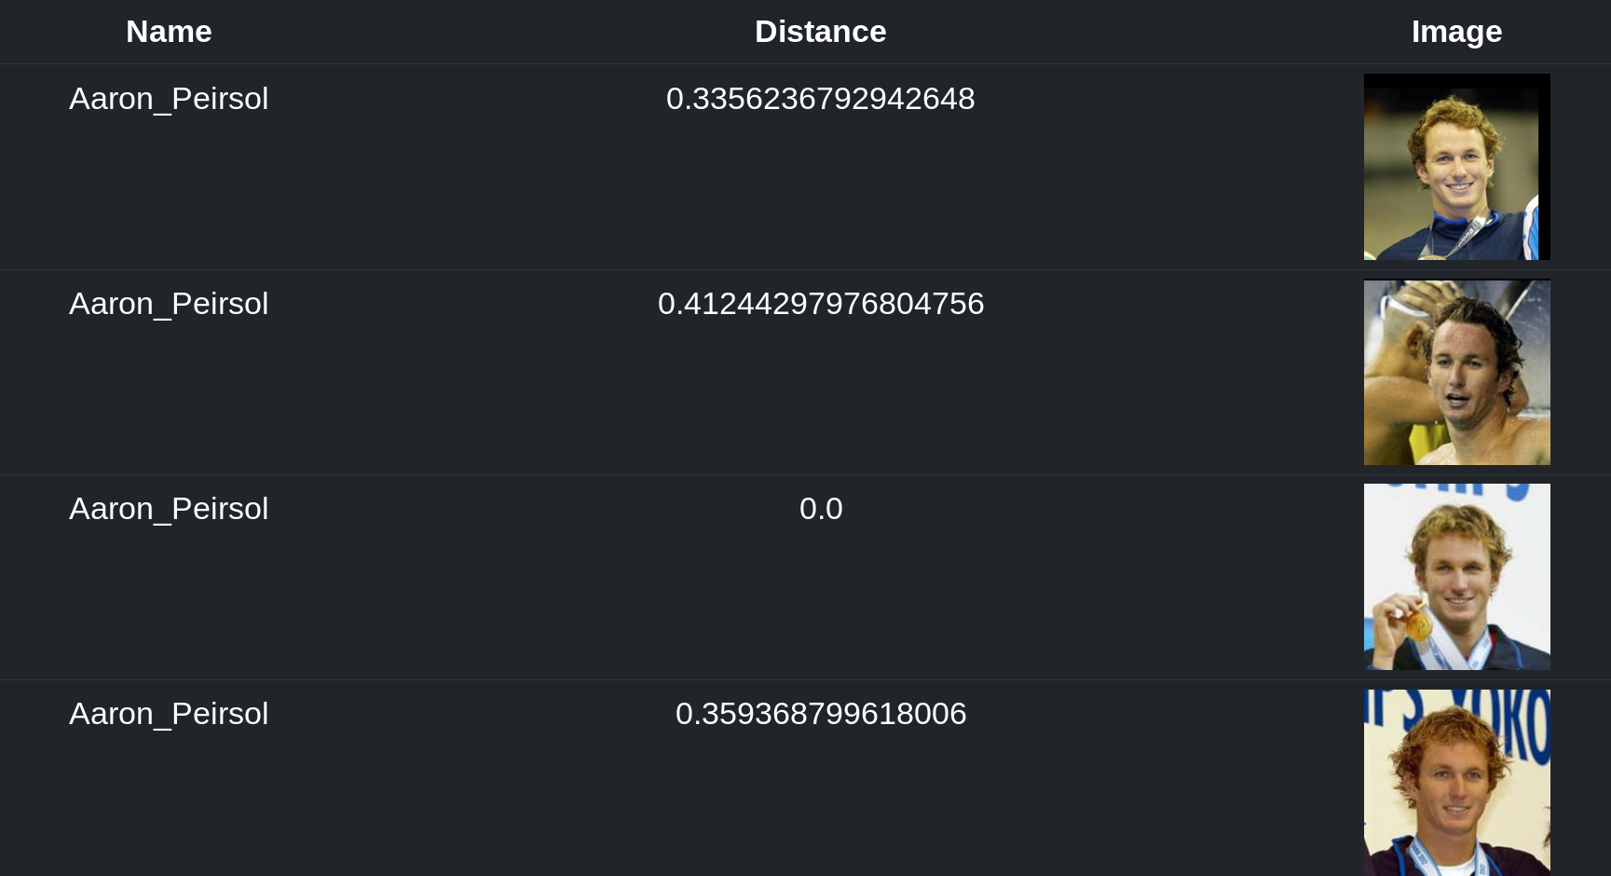
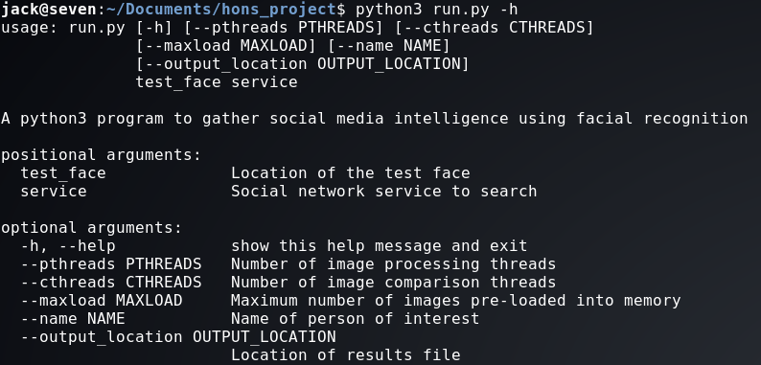
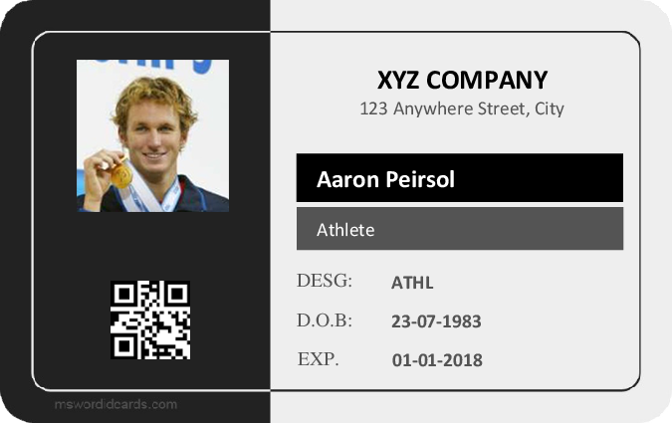

Using Facial Recognition to Gather Social Media Intelligence
Jack Neilson; 1506801
Abstract
Methods and Materials
Social Media Intelligence (SOCMINT) is a relatively unexplored source of intelligence, examining data contained within social media profiles. It is a subset of Open Source Information, where data on a subject is gathered using publicly available resources. Many see it as a vital aspect of modern information gathering – both the US FBI and the UK MOD have invested heavily in tools to utilize SOCMINT (Antonius and Rich, 2013)
There are very few examples of facial recognition being applied to SOCMINT to assist in gathering or analysis. It is therefore my aim to develop a tool will assist human operators in gathering social media intelligence by searching a database of faces to find potential matches to a face in a test image.
Rather than search against actual social networks with real people, a database of test profiles was generated using the Labeled Faces in the Wild data set (Huang et. al., 2007), the Essex Face Recognition data set (Hond and Spacek, 1997), and the Security Camera Face data set (Grgic, Delac and Grgic, 2009). The tool used to search the data set was developed using Python version 3, using the face-recognition module with dlib as the underlying face recognition implementation. It includes a requirements.txt file to allow for easy installation of all pre-requisites using pip, and is used from the command line. A small demo file has been included that watches for results, and creates a HTML page that may be viewed for visualisation purposes.
The software was tested using data sets with different compression algorithms (JPG vs PNG), untrained data sets, data sets containing infra-red images, and data sets that were restricting by a piece of personally identifying information.
Table 1. Results when using searching with the test image Aaron_Peirsol_0001.jpg, restricted with the term “Aaron*”.
Introduction
Discussion
Social media intelligence has been shown to have many uses, from detecting potential insider threads (Kandias and Stavrou, 2015) to increasing the effectiveness of prior knowledge attacks. The second point is particularly relevant, as it allows an adversary with no privileged information (OSINT only) to potentially gain access to networks or sensitive information by means of a spearphishing or social engineering attack.
Click here to insert your Discussion text. Type it in or copy and paste from your Word document or other source.
This text box will automatically re-size to your text. To turn off that feature, right click inside this box and go to Format Shape, Text Box, Autofit, and select the “Do Not Autofit” radio button.
To change the font style of this text box: Click on the border once to highlight the entire text box, then select a different font or font size that suits you. This text is Calibri 30pt and is easily read up to 4 feet away on an A0 poster.
Zoom out to 100% to preview what this will look like on your printed poster.
Figure 2. The “help” message that shows all positional and optional arguments that may be used with the program.
Results
The software performed excellently on both the untrained data set and the restricted data set, achieving 100% accuracy with 0 false positives over 5 tests in both cases. Of particular note is the restricted data set – by massively reducing the number of images to compare, the average length of each search was reduced to just 25 seconds.
When searching across a data set with a different compression algorithm, the same results were noted. However, the distance between two otherwise identical images was non-0, suggesting that the compression algorithm may produce some baseline error in comparison.
Figure 1. An example of a fake ID card that could be created with a person of interest’s name, date of birth and picture. Created by template from msword.dcards.com.
Conclusions
Although the usefulness of social media intelligence has been established, gathering and analysing it may not be as easy as it first appears. The problem for would-be analysts is the sheer amount of data contained within social media platforms – for example, 250 million photos are added to Facebook every day (Omand et. al., 2012).
To find useful information about a single person of interest in such a large data set is extremely challenging. Success rates increase dramatically if some starting point is known, such as a first name, a date of birth, or in this case the person’s face. These factors may also be used in combination to increase accuracy and search speed.
Click here to insert your Conclusions text. Type it in or copy and paste from your Word document or other source.
This text box will automatically re-size to your text. To turn off that feature, right click inside this box and go to Format Shape, Text Box, Autofit, and select the “Do Not Autofit” radio button.
References
Antonius, N. and Rich, L. (2013), ‘Discovering collection and analysis techniques for social media to improve public safety’, 3, 42.
Kandias, M. and Stavrou, V. (2015), ‘Personal traits analysis as a means to predict insiders’.
Omand, S. D., Bartlett, J. and Miller, C. (2012), ‘Introducing social media intelligence (socmint)’, Intelligence and National Security 27(6), 801-823.
Huang, G., Ramesh, M., Berg, T. and Learned-Miller, E. (2007), ‘Labeled Faces in the Wild: A Database for Studying Face Recognition in Unconstrained Environments’.
Hond, D. and Spacek, L. (1997), ‘Distinctive Descriptions for Face Processing’.
Grgic, M., Delac, K. and Grgic, S. (2011), ‘SCFace – surveillance cameras face database’.

