Slide 1
Research Methods
Honours Project Talk
Patrik Holt
4 November 2016
“All scientific knowledge is uncertain”
Richard Feynman 1998
1

Slide 2
Science, Method & Proof
Some important statements:
  Science is method, not a belief system or religion
  Method exists in all human activities
  To observe, measure and to explain is a human trait
  Evidence and evidence based practice
    Show me your evidence
    How do you know?
  Only Maths has PROOF – everything else is uncertain

Slide 3
Methods in Computing Science
Formal Methods (Theoretical Computer Science)
Experimental (In many CS areas)
Build and Test (Trial and error prototyping)
Computer Simulation (Process)
Modelling (Often linked to experimental)

Slide 4
Formal Methods
Maths and Logic
Software proof
Theoretical computation
Algorithm complexity

Slide 5
Experimental
Classic Scientific methods
Can be use across Computing Science
  Simulation
  Modelling
Big role in Usability Engineering

Slide 6
Build and Test
Trial and Error Prototyping - Does it fly?
  A “build” research methodology consists of building an artifact — either a physical artifact or a software system — to demonstrate that it is possible.
  To be considered research, the construction of the artifact must be new or it must include new features that have not been demonstrated before in other artifacts.
  Not I CAN build but CAN I build?
Used at some point in all software development

Slide 7
Simulation
Can be used to study any natural object, process or phenomena
Simulated universe, oil field, brain, economics
Often overlaps with Modelling and uses Experiments

Slide 8
Modelling
Defining an abstract model for a real system
ACT-R and CogTool
Often overlaps with all other methods

Slide 9
Honours Projects
Nature and aims of your project
  Theoretical or Simulation or Modelling, etc.
Most if not all projects involve
  Capturing requirements
  Evaluating UX (formative and summative)
  Testing of code
  Other types of testing and comparisons
  There is always a question to be answered!

Slide 10
“Proof”
We want reliable data
We apply the scientific method
With science we can make “reliable” statements
We can never prove anything!!!
Forms of proof and the scientific method

Slide 11
Proof
Of course the earth is flat!
Seeing is Believing
  Early humanity relied on 1:1 mapping for proof
Dogma
  Proof comes from a higher authority
The Law
  Judges, Panels and Juries – Guided
Mathematics
  A direct proof proceeds linearly from premises to conclusion
  An indirect proof (reductio ad absurdum) assumes the falsehoods of the desired conclusion and shows that to be impossible
Do not test guilt but doubt
Hypothesis testing

Slide 12
Proof: The Scientific Method
Previous
research
THEORY
Hypotheses
Experiments
Results
Hypothetico-Deductive Method
Key is formulation of testable hypotheses and rigorous experimental controls
Hypotheses are accepted or rejected on basis of probabilities
Deductive: From general to specific – General theory to specific testable hypotheses
Observation
Theoretical Inference
Research
Hypothetico-Inductive Method
We have observations, infer models which can be tested through research such as experimentation
Inductive: From specific observations to general theory (goes beyond the observations)
Medicine; Neuropsychology of the brain; Usability of software
Often science starts with Inductive and moves to Deductive

Slide 13
The process of science
Induction
  Forming the hypotheses from general observations
Deduction
  Making very specific predictions based on the hypotheses
Observation
  Collecting data that tests the hypotheses
Verification
  Testing against further observations

Slide 14
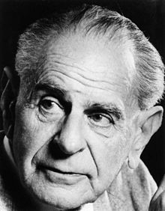
Hypothetico-Deductive Methods & Hypotheses
Hypothesis testing is by rejection
  Positive hypothesis
    A ≠ B
  Null hypothesis
    A–B=0
We are interested in testing the positive hypothesis
We actually test the null hypothesis
  Null hypothesis is rejected and the positive hypothesis is accepted by default
  From Maths: An indirect proof assumes the falsehoods of the desired conclusion and shows that to be impossible
Sir Karl Popper

Slide 15
Problem
H_{pos:} Object will fall to the ground due to gravity
H_{01:} Object will rise up H₀₂ or will hover
Is this a testable hypothesis?
Simple Sciences: Physics, Chemistry …
  Easier to formulate hypotheses
Complex Sciences: Psychology, Biology, HCI …
  Harder to formulate hypotheses
“The problem of formulating Hypotheses”

Slide 16
Hypotheses and Theory
Hypotheses MUST test theory
  Comparing two things and saying
    “A is bigger than B” is not acceptable
Hypotheses must be firmly linked to theory
Hypotheses must be TESTABLE statements
  Testable means a meaningful null hypothesis that can be tested
It is OK if you can’t formulate a hypothesis
  Adopt an Inductive Approach

Slide 17
Experiments are the core of science
The word “experiment” is often loosely used to mean “trying something out” – not correct
  Only Hypothetico-Deductive counts as experimental (?)
  In Inductive you can still apply the rigour normally seen in “experiments”
“Experiment” is a statistical term
Experimental Design is
  Independent and dependent variables
  Controls and procedures
  Factorial statistical models

Slide 18
Experimental results
Results from experiments are probabilistic
  If p then q under certain conditions, r, s or t
“Causality” is rarely mentioned - grave risk of error
The problem of “scientific proof”
  “Nothing can be proved scientifically”
  You can provide probabilistic evidence that a proposition is true
  Proof is deductive (maths)
  Experiments are not methods of proof
  Experiments are controlled methods of bringing evidence to bear on the probable truth or falsity of relational propositions

Slide 19
“Computer science … is not actually a science.
It does not study natural objects. Neither is it … mathematics. Rather, computer science is like engineering – it is all about getting something to do something …”
Richard Feynman 1996

Slide 20
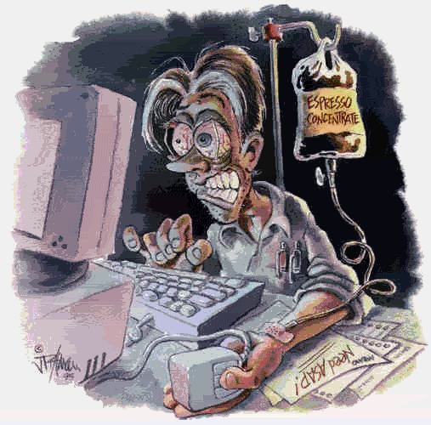
Foolish promises …
I am happy to provide more lectures on methods
I am happy to advise individuals about methods in their projects
  Usability and UX Evaluations
  Experimental designs and Stats

