Slide 1
Project management, project specification and Ethics form
Lecture 2
Professor Patrik Holt

Slide 2
Detailed Project Proposal Form
1.1 Problem to be solved
Detailed problem to be solved or research
Refining the research question or problem is being specific enough so that the method(s) that you will use in your project can solve the problem
Not too broad or general
The key to this is BEING SPECIFIC: Narrow down the method or technology you will use, narrow down the group that the question refers to (localize a general question) If the project is still ‘too big’, can you think of a way to work on a part of the problem?

Slide 3
1.1 Detailed research -question/problem continued
Avoid using words that cannot be measured, by you, without a huge research budget e.g. 'effects on society', 'effects on business'.
Example: The initial question "Does cloud computing effect business" needs narrowing down (for a start the answer is yes)
What is meant by cloud computing? Or 'effect'? Or 'business', in this question? Refining this first question will involve narrowing it down to something you, personally, can measure.
A refined version of this question might be: "Does implementing a cloud based voting system improve the speed of decision making in a small company in Aberdeen?”

Slide 4
1.2 Keywords
Include up to 6 keywords separated by a semi-colon; what keywords are appropriate to describe your project in an online database like Google Scholar? Keywords should include the general research area and the specific technologies you will be working with.
Example. A project that proposes a novel way of visualising large amounts of twitter feed data may have the keywords: Data visualisation; twitter; hashtags; database design; graphics libraries.
1.3 Project title
The project title is a statement based on your detailed research question.
For example, the research question 'to what extent does a mobile application reduce the number of errors made in class registers at RGU in comparison to current paper based registers' may be stated in the project title: "A Wi-Fi driven mobile application for large group registers using iBeacons".
Interactive Augmented Reality Property Brochures to Enhance User Ux

Slide 5
1.4 Client, Audience and Motivation:
Why is this project important?
To whom is this project important?
A project must address a question/problem that generates a small piece of new knowledge/solution. This new knowledge/solution must be important to a named group or to a specific client (such as a company, an academic audience, policy makers, people with disabilities) to make it worthwhile carrying out.
This is the motivation for your project. In this section you should address who will benefit from your findings and how they will benefit.

Slide 6
1.4 Client, Audience and Motivation:
Example:
If you intend to demonstrate that a mobile application that automates class registers at RGU will be more efficient than paper based registers –
the group who would be interested in knowing/applying these findings would be both academic and administrative staff at RGU and they would benefit by time saved and a reduction in their administrative workload.
If you are making a business case for an organization explain how the organisation will benefit from your findings.

Slide 7
1.5 Project Plan
1.5 Project Plan
This is the project plan as to how you will go about achieving the objectives of the project. It must include the methods you plan to use such as for example experiments, applications or software demonstrators, process models, surveys, analysis of generated data …

Slide 8
Example: In the class register example above "to what extent does a mobile application reduce the number of errors made in class registers at RGU in comparison to current paper based registers" - the research plan may involve:
1) Collecting and analysing paper based registers in a given class on five occasions.
2) Identifying the error rate average on these occasions
3) Designing and implementing a mobile application that automatically records attendance in class.
4) Deploying the application in the class on five occasions.
5) Identifying the error rate average of the mobile application on these occasions.
6) Comparison of data and summary of findings.

Slide 9
2.1 Abstract
2.1 Abstract
An abstract is a short summary of the project that enables others to know if your report is relevant to them without reading the whole report.
It is usually written retrospectively so that it can include findings and results.
It is fully expected that you will rewrite your abstract when you come to write your final paper. For now, you should write an abstract of about 250 words that define the project described in section one.
Before writing your abstract you MUST read some abstracts from conference or journal papers on Google Scholar or from portal.acm.org (to understand their style)
Then provide your own abstract that outlines what your question is and what you 'did' to answer it.

Slide 10
1.5 Mini Literature Review
2.2 Initial/Mini Literature Review (500 words maximum)
A literature review is a select analysis of current existing research, which is relevant to your topic, showing how it relates to your investigation.
It explains and justifies how your investigation may help answer some of the questions or gaps in this area of research.
A literature review is not a straightforward summary of everything you have read on the topic and it is not a chronological description of what was discovered in your field. Use your literature review to:
• compare and contrast different authors' views on an issue • criticise aspects of methodology, note areas in which authors are in disagreement • highlight exemplary studies • highlight gaps in research • show how your study relates to previous studies

Slide 11
2.3 Relevant professional, social, ethical, security and legal issues to the project
http://www.bcs.org/upload/pdf/cop.pdf
2.4 Bibliography (key texts for your literature review)
Please provide references, in correct Harvard style, for at least three key texts that have informed your literature review.
If you are implementing an application, select texts, which demonstrate how other researchers have tackled similar implementations?
The references should be recent and sufficiently technical or academic.
Your markers will be looking for you to identify technical reports, conference papers, journal papers, and recent textbooks.

Slide 12
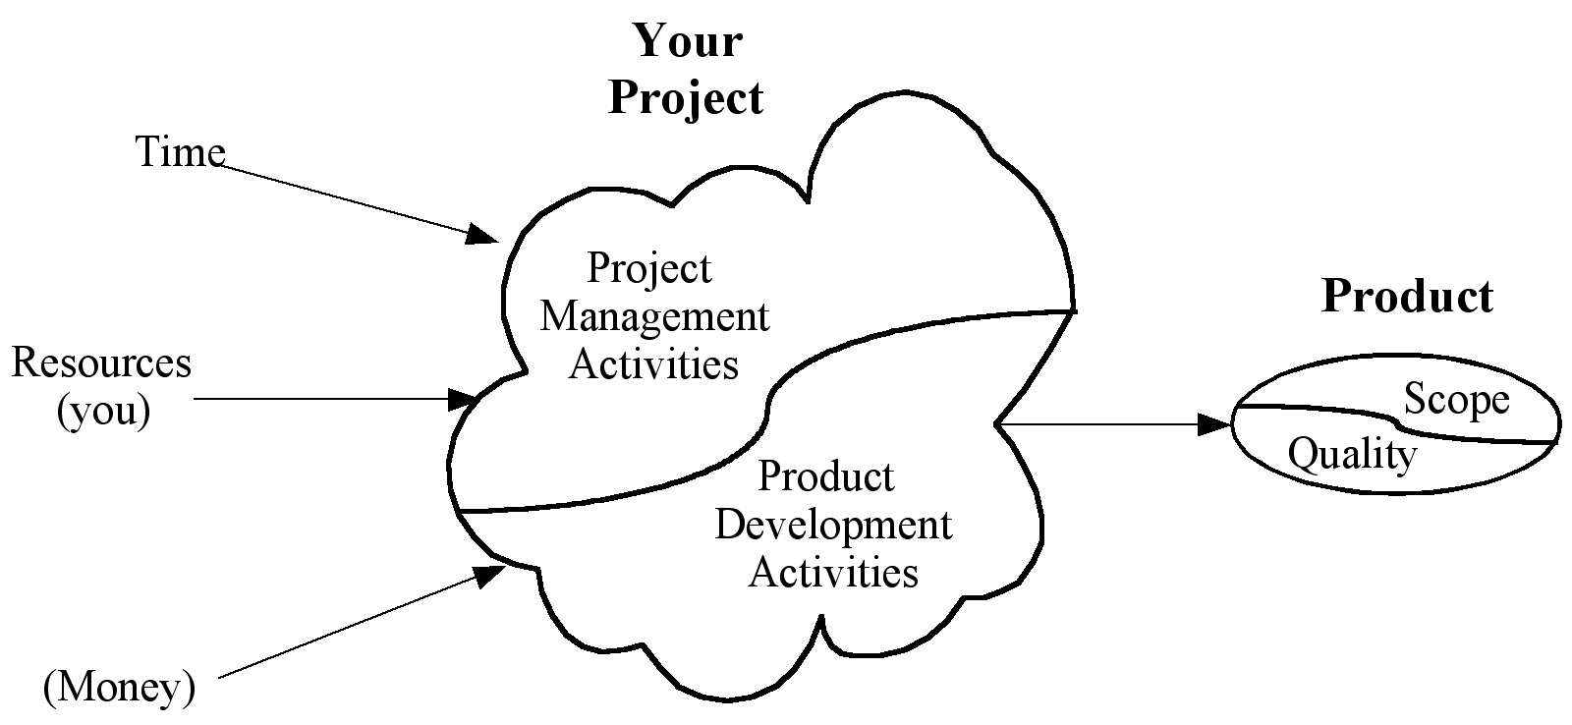
The project process
Copyright © 2005 Christian W Dawson
Project management activities: planning, controlling, checking progress, milestones monitor deliverables, risk management – 10% of the overall effort
Project development activities: actual work on the project

Slide 13
Definition
Define your aims
Set your objectives – SMART (specific, measurable, appropriate, realistic, time-related)
Example 1: Complete a literature search and literature review of existing stock market prediction techniques
Is it SMART?
Example 2: Develop GUI for entering class registers.
Is it SMART?

Slide 14
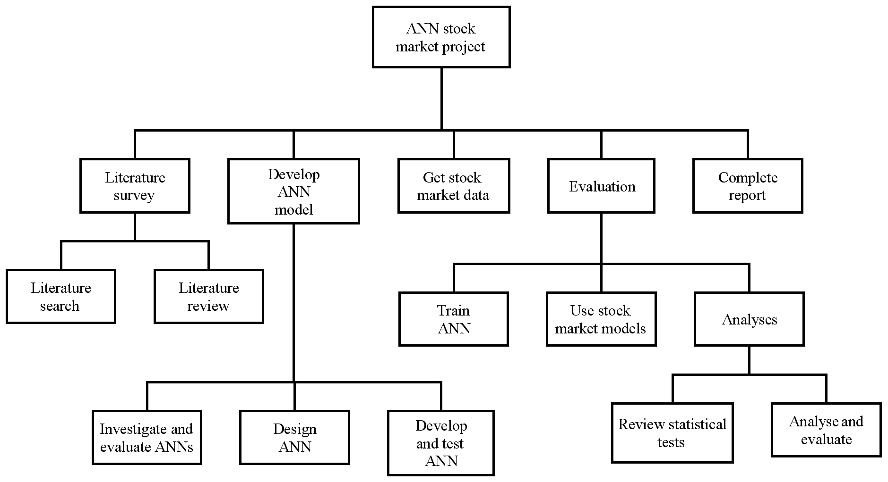
Example of project breakdown structure
Copyright © 2005 Christian W Dawson

Slide 15
Time estimation
Literature search – 3 weeks
Literature review – 4 weeks
Requirements gathering – 3 weeks
Requirements modeling – 3 weeks
Design – 4 weeks
Implementation – 6 weeks
Testing – 2 weeks
Evaluation – 2 weeks
Report completion – 3 weeks
Total effort – 30 weeks

Slide 16
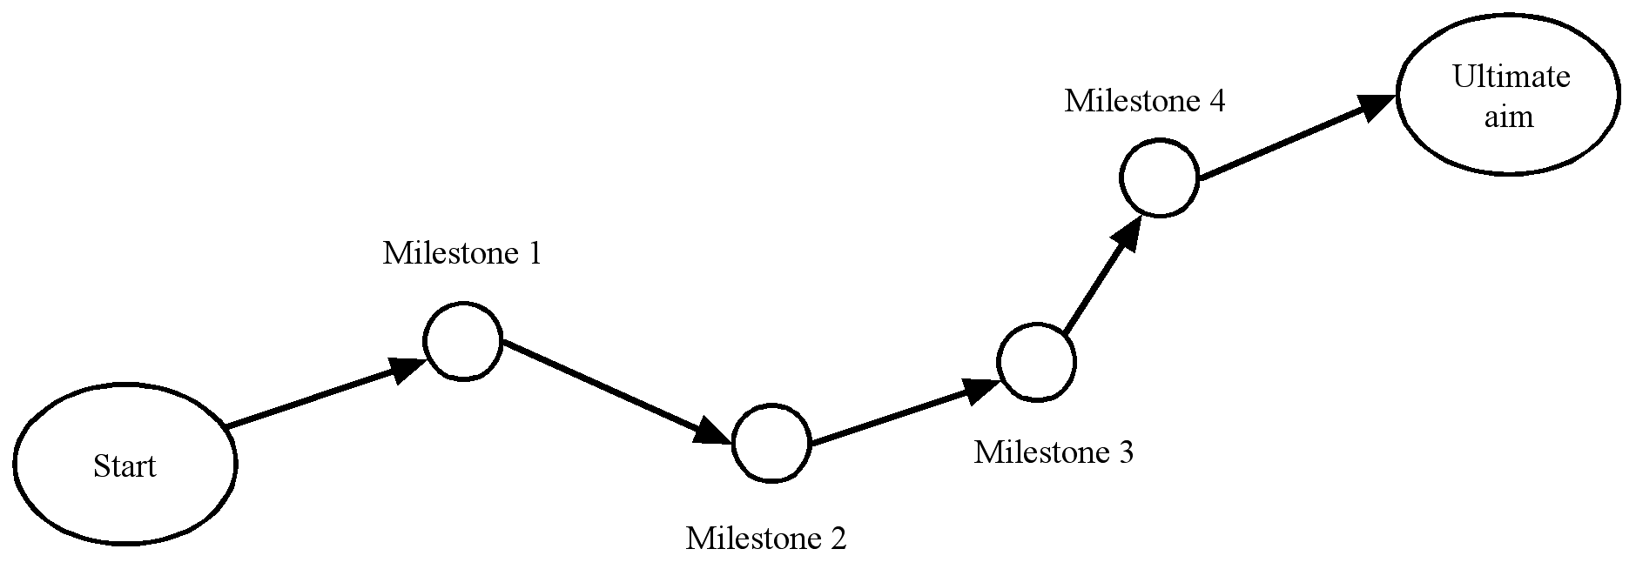
Identify milestones
Copyright © 2005 Christian W Dawson

Slide 17
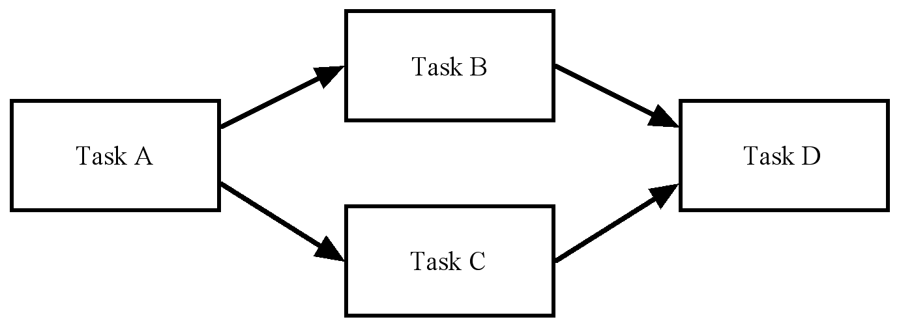
Example activity-on-the-node diagram
Copyright © 2005 Christian W Dawson

Slide 18
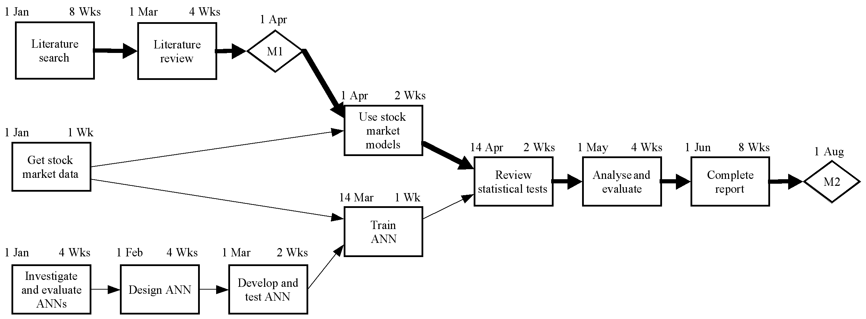
Example activity network
Copyright © 2005 Christian W Dawson

Slide 19
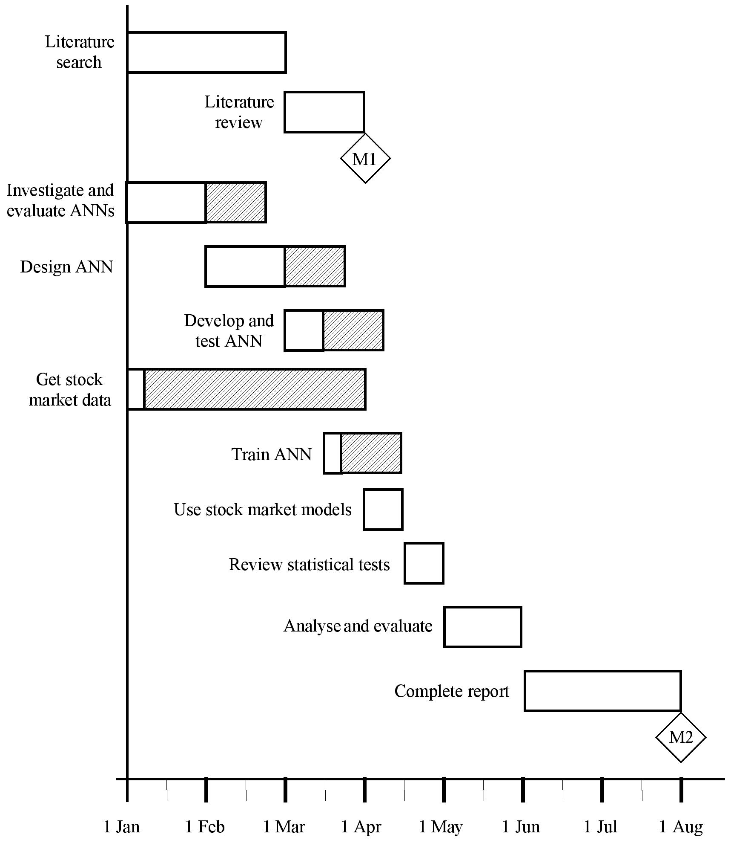
Scheduling: Gantt chart
Copyright © 2005 Christian W Dawson

Slide 20
Identify Risk
Event – driven: e.g. loose data, get sick
Evolving – underestimating time
Technical – software, hardware
Non-technical – losing a client, illness
Risk triggers – missing a milestone

Slide 21
Assess impact of risks
Risk impact = likelihood x consequence
Turner (1993) proposes measure
likelihood as three point scale Low -1 /Medium - 2/High - 3
Consequence five-point scale Very low -1/Low -2/Medium-3/High-4/Very high-5
You can use Red Amber Green grading
Any impact for example that is less than 5 is green, between 5 and 10 amber and between 10 and 15 red
You need to address the red critical risks

Slide 22
Alleviate critical risks
Avoidance – reduce chances of the risk to occur – if you do not know a particular programming language and you are not confident to learn a new one then is better to use some language you know; instead developing something from scratch you may reuse a library; making back-up of your project work
Deflection – pass the risk onto someone else or something else
Contingency – acceptance that the risk is going to occur e.g. likely to overrun in your project, plan to complete earlier

Slide 23
Control risks
Checkpoints in project progress
Checking for risk triggers
Invoke contingency plans
Monitor critical risks
Updating risk register
Discuss with supervisor

Slide 24
References and bibliography
Dawson, C., (2015) Projects in Computing and Information Systems 3rd edn:A Student's Guide, Person Ed.
Every, P., (2015) Awesome Projects

