Slide 1
Arts & Crafts with AWS Glue
ETL Workshop

Slide 2
Amazon Web services Featuring Glue
ETL Tutorial

Slide 3










Amazon Web Services
Amazon S3
Redshift
Glue
Athena
DynamoDb
IAM
Lambda
CloudFormation
VPC
QuickSight
Notes:
Logos all around, say Amazon Web Services provides many tools to deal with your data

Slide 4
AWS Glue
What is Glue?

Slide 5
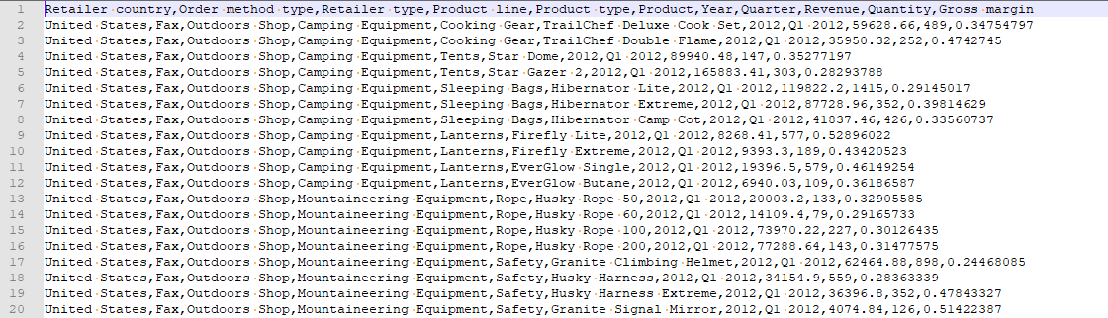
AWS Glue
Amazon Web Services tool to Extract, Transform, and Load(ETL)
Used to prepare and load data for business analytics
Data
AWS Glue
Redshift
QuickSight
Notes:
One of these tools is Glue, which will be the focus of our talk

Slide 6
ETL
Extract: Pull data from a source
Files
Database
Reporting Tool
Transform: Modify the data to fit your needs
Add new columns like data source or timestamp
Remove unwanted data
Alter data with calculations
Load: Store in your database

Slide 7
Why use Glue?
Serverless
Easily scalable
Cost Effective
Only pay when being used, where Matillion and Informatica charge hourly or yearly
Matillion: $1.74 per hour (at cheapest), Informatica $2.16 per hour, Glue $0.44 per DPU-Hour
Code based (Python or Scala) so you can do anything you can program
Easy integration with other AWS tools
Automatic error handling and logging

Slide 8
Glue Tutorial
Prerequisites : Clone git repository https://github.com/jackdsilverman/aws-glue-tutorial.git
Unzip Workbench-Build123.zip
S3 bucket for storing the file
Athena table to access data in file
Glue connection
Glue job
Redshift connection
Redshift tables
Run glue job
QuickSight

Slide 9
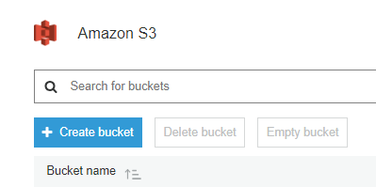
Create S3 Bucket

Slide 10
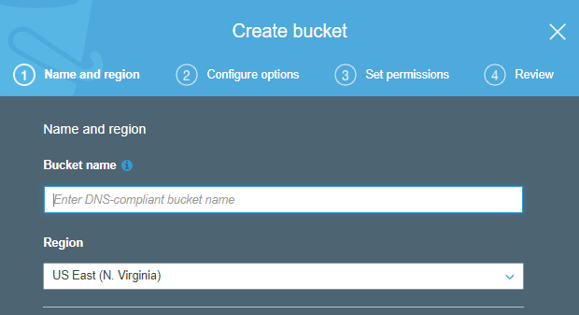
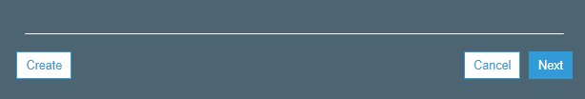
Give your s3 bucket a name
Use glue-tutorial-<initiails>
Create S3 Bucket
Your bucket name needs to be unique because these are accessible across all regions and by potentially everyone
Specify the region

Slide 11
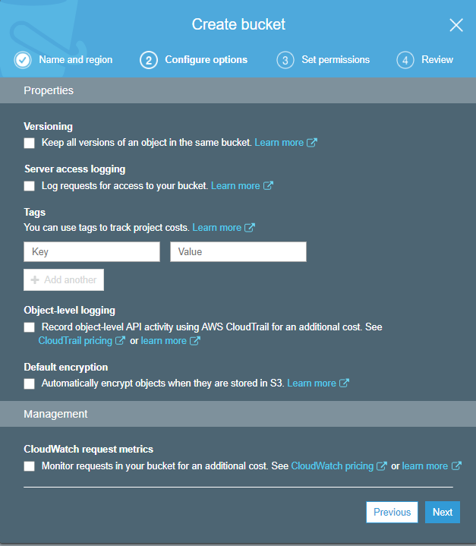
Create S3 Bucket

Slide 12
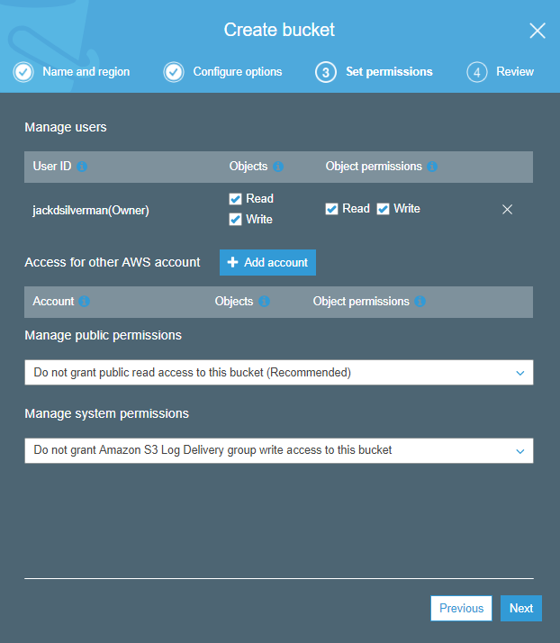
Create S3 Bucket
This gives the account of the object that is being added the ability to see and download this file
Adds the account’s number to an access control list that the bucket and item use to grant permissions on the object
Option to make this bucket to be publicly accessible.
It is recommended that it is not because that is more secure
You can add other AWS accounts to be able to have access to this object

Slide 13
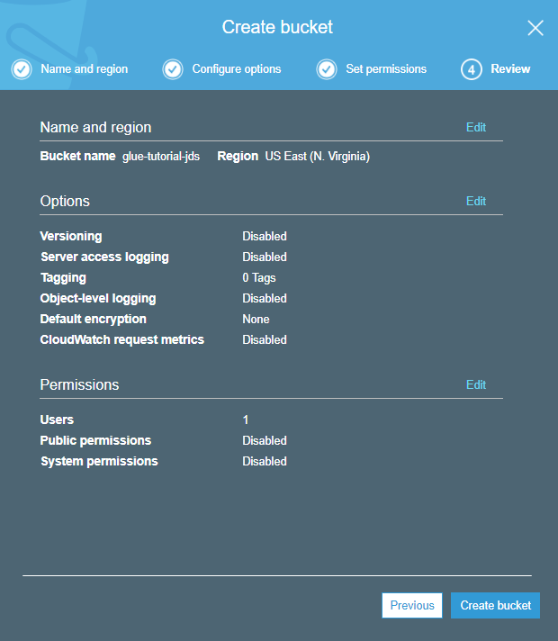
Create S3 Bucket
Review your settings

Slide 14
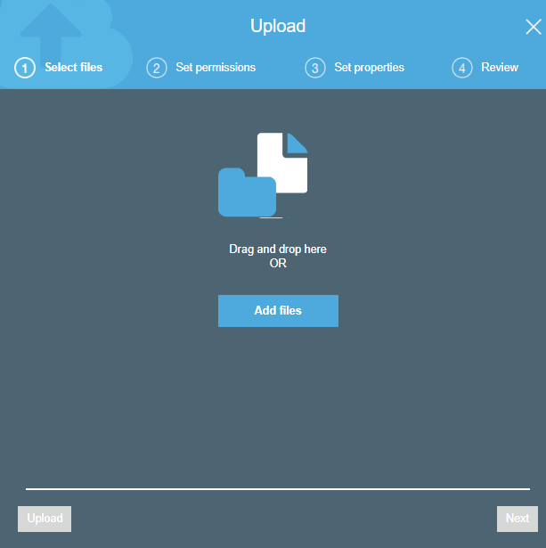
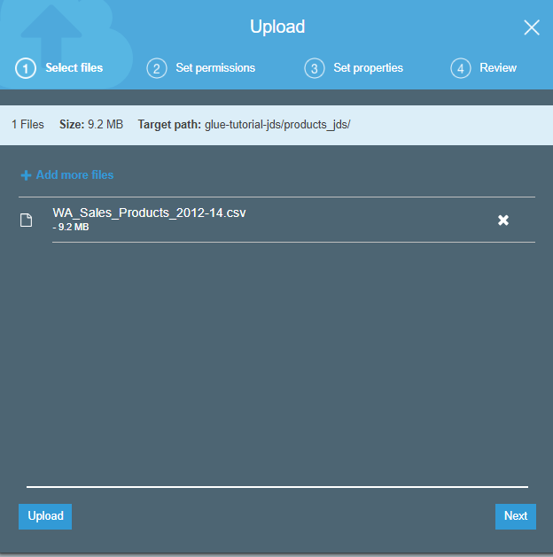
Add Data File to S3
Add file from repository called “WA_Sales_Products_2012-14”

Slide 15
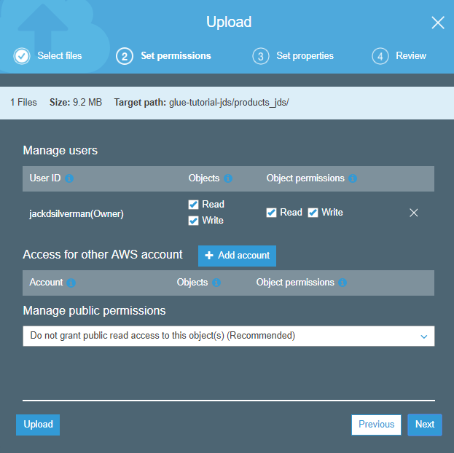
Add Data File to S3
This gives the account of the object that is being added the ability to see and download this file
Adds the account’s number to an access control list that the bucket and item use to grant permissions on the object
You can add other AWS accounts to be able to have access to this object
More Permissions

Slide 16
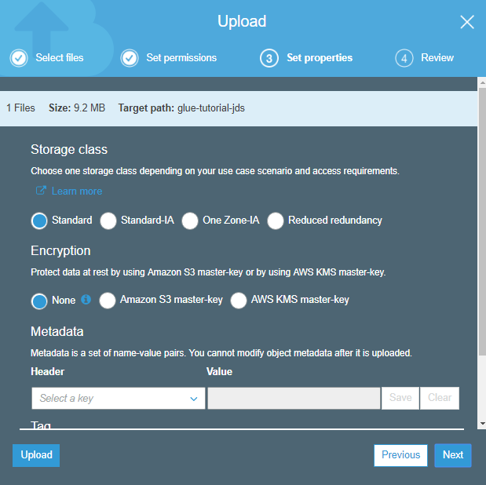
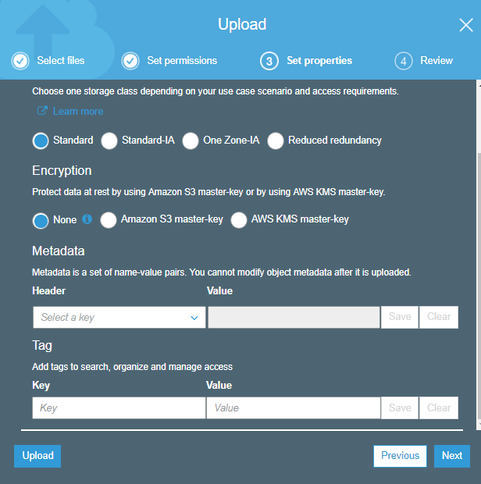
Add Data File to S3
Type of storage that you want to use
If you want to add encryption to your object
Metadata if you want add
Add tags as necessary

Slide 17
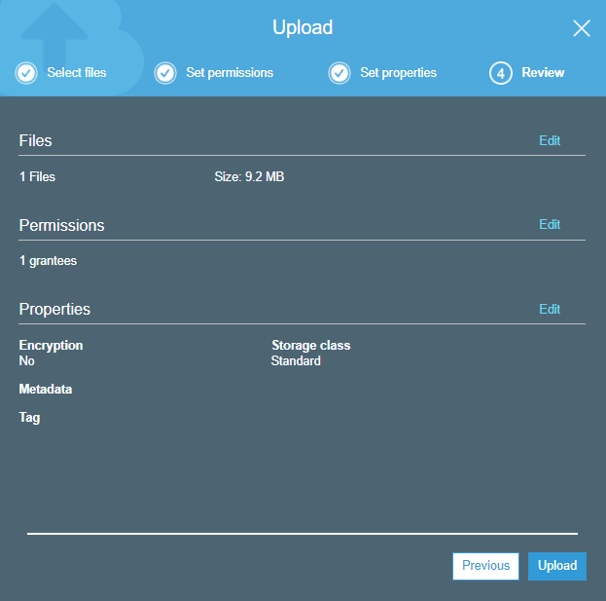
Add Data File to S3
Review your settings

Slide 18
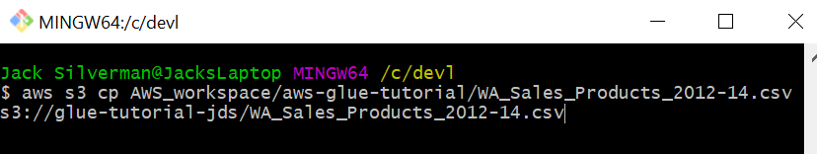
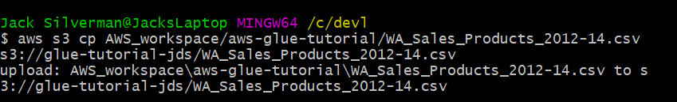
Add Data File to S3 via AWSCLI
This command specifies the resource
Specifies the location of the object on the local drive
This specifies the command performed within the resource
Specifies the bucket the file will go to and with the name that it will have
aws s3 cp AWS_workspace/aws-glue-tutorial/WA_Sales_Products_2012-14.csv s3://glue-tutorial-jds/WA_Sales_Products_2012-14.csv

Slide 19
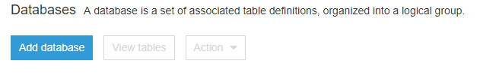
Create Glue Database
In the Glue Console click on Databases
Create a new Database

Slide 20
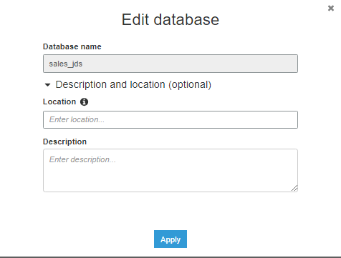
Create Glue Database
Give your database a name
“glue-tutorial-<initials>”
This location must be an s3 location and it specifies database files and metastore (optional)

Slide 21
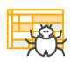
Glue Crawler
Scans data to create metadata about the data
Determines column names and data types
Creates a Glue Table
Creates an Athena Table

Slide 22
Create Glue Crawler
Click on add tables to create a table
Create a table using a crawler

Slide 23
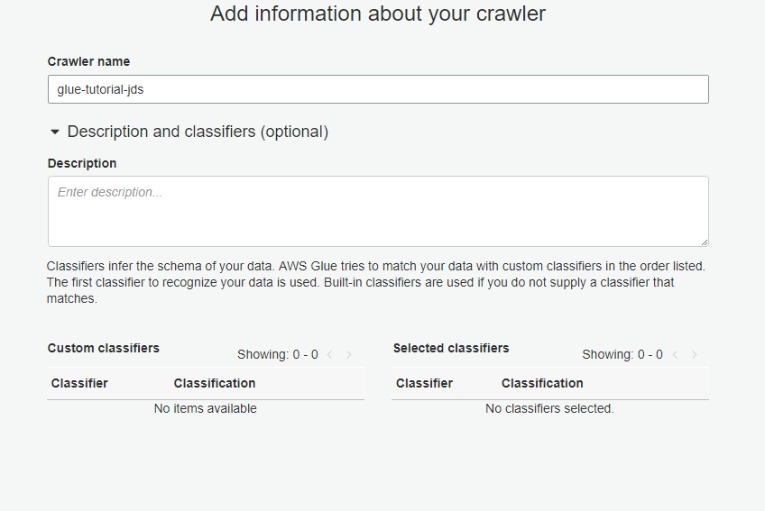
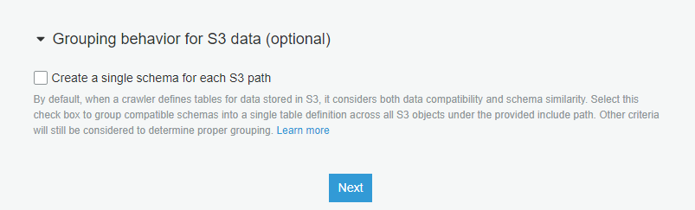
Create Glue Crawler
Give your crawler a name, glue-tutorial-<initials>
Give your job a description

Slide 24
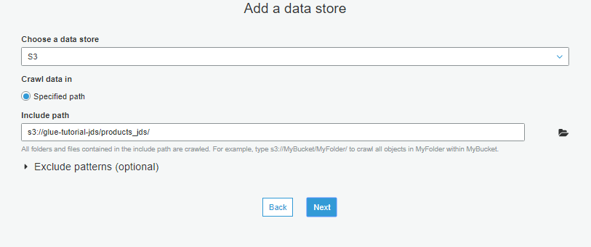
Create Glue Crawler
Choose where the table is going to look for data
Specify the path for the table to search for in s3

Slide 25
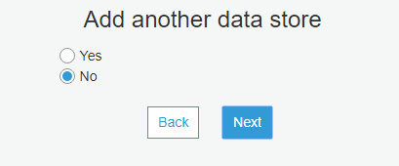
Create Glue Crawler
We do not want to add another source of data

Slide 26
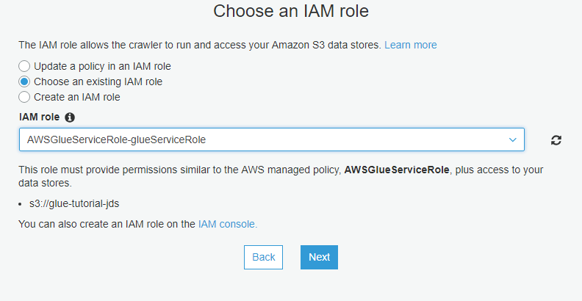
Create Glue Crawler
Give the table a role so that it has the permissions necessary to perform its tasks

Slide 27
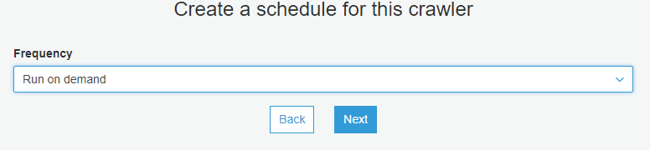
Create Glue Crawler
Your crawler can run on either a timed schedule or on demand

Slide 28
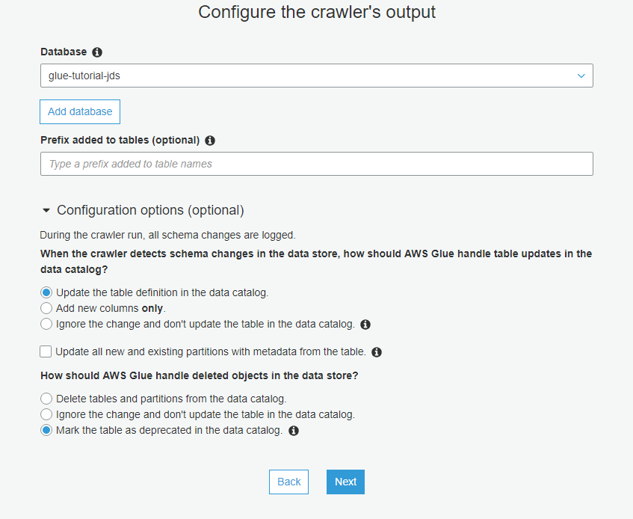
Create Glue Crawler
Choose the database you created for the database your table will live in
The crawler will update the table if there is a change in the data and in the redshift table
This will leave the table where it is but mark it as deprecated

Slide 29
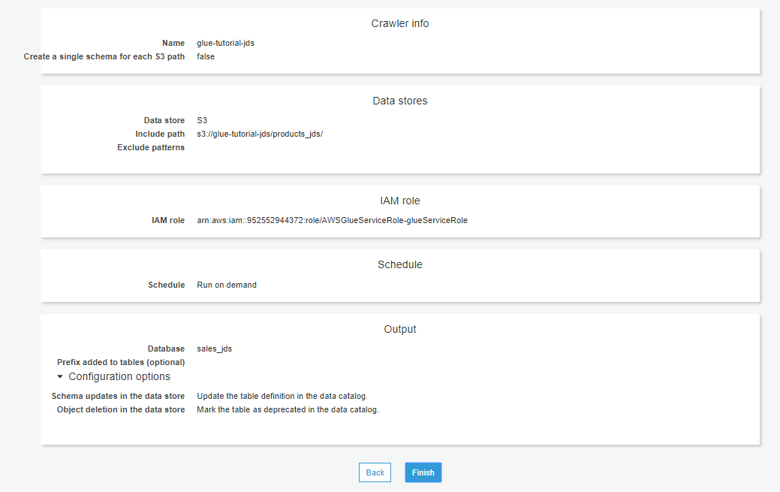
Create Glue Crawler

Slide 30
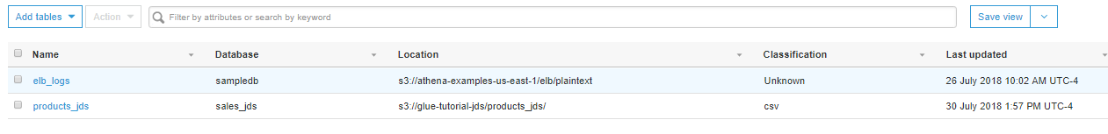
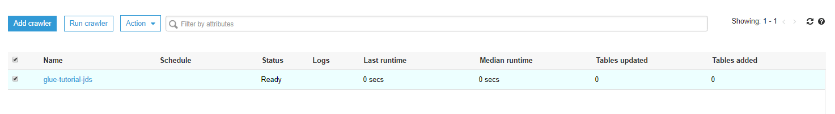
Run the crawler to create the Glue table
Run your crawler
Your table should be in the table tab
Select your crawler

Slide 31
Athena
Interactive query service used to analyze data
Data stored in s3
Run queries to verify your data is stored correctly

Slide 32
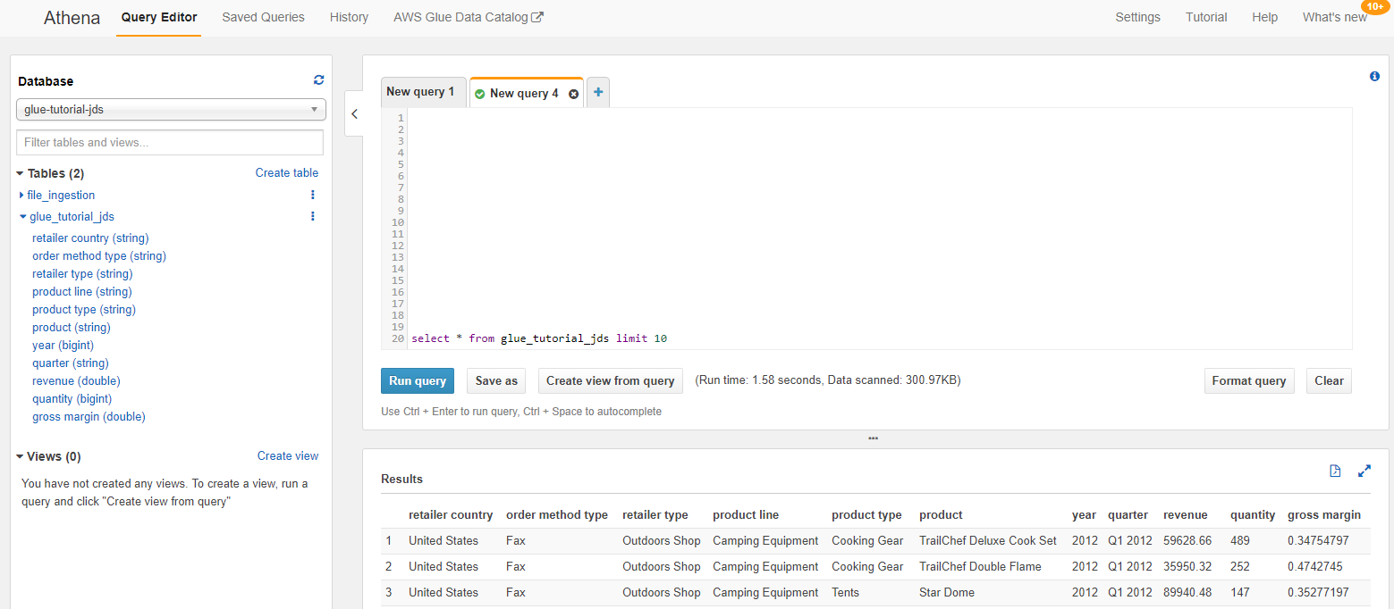
Athena
Run an SQL select query to verify data populating correctly

Slide 33
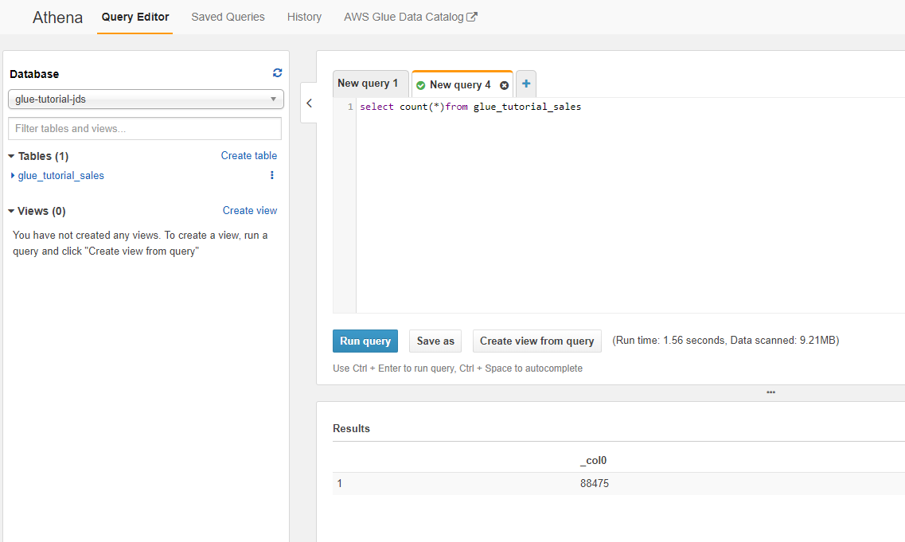
Athena
Run an SQL count query to verify all data is there

Slide 34
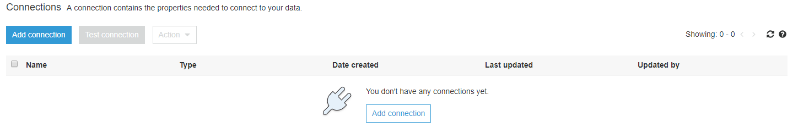
Create a connection to the database in the glue console
Click on add connection to create a connection the redshift cluster
Go to the Glue in services and click on connections

Slide 35
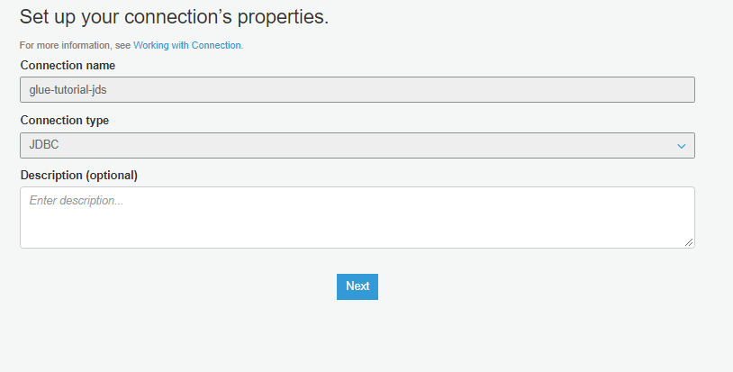
Create a connection
Name of the connection should be glue-tutorial-<initials>
The connection type should be JDBC

Slide 36
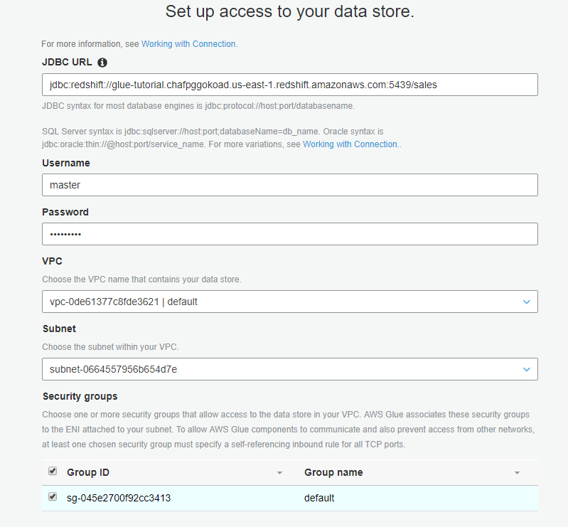
Create a connection
This is the Redshift cluster url
This is the username/password for the redshift cluster
This vpc is where the redshift cluster runs and needs to have the same vpc/subnet/security group in order to connect

Slide 37
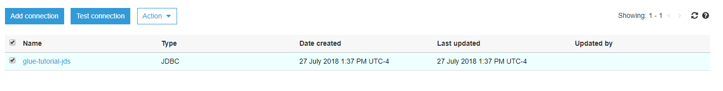
Test the connection

Slide 38
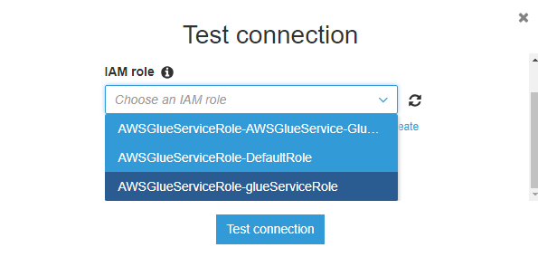
Test the connection
Select this IAM role

Slide 39
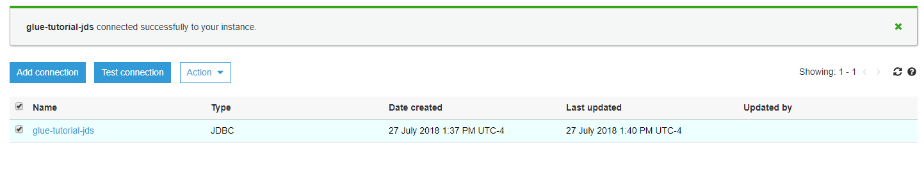
Test the connection

Slide 40
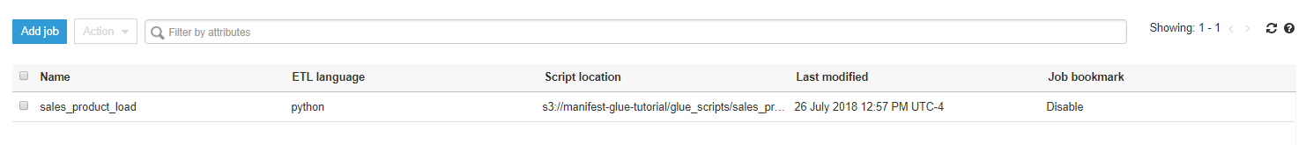
Create a Glue Job
Click on jobs in the glue Console

Slide 41
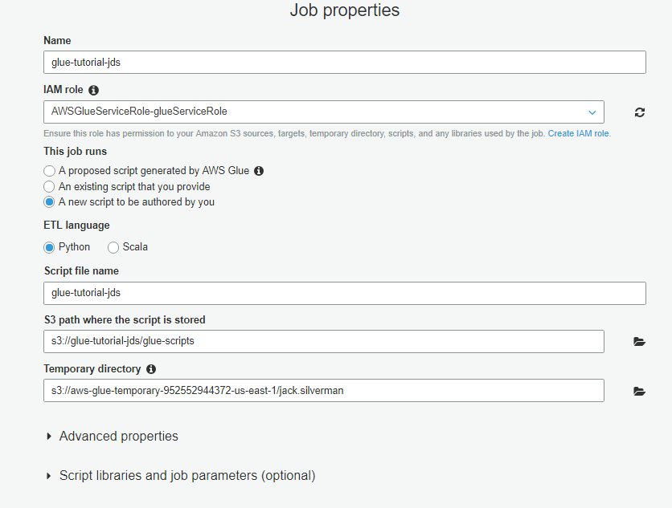
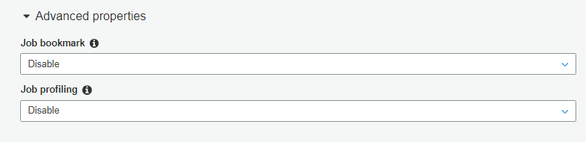
The language used to write the script
Give your job a name glue-tutorial-<initials>
Give you job a role to perform the actions necessary to run
Remember where the job left off
Create a new blank script
Give your script a name glue-tutorial-initials.py
Creates cloudwatch metrics when the job runs
This is where a temporary script is generated when the script is being edited
The location in which you script will be placed in s3

Slide 42
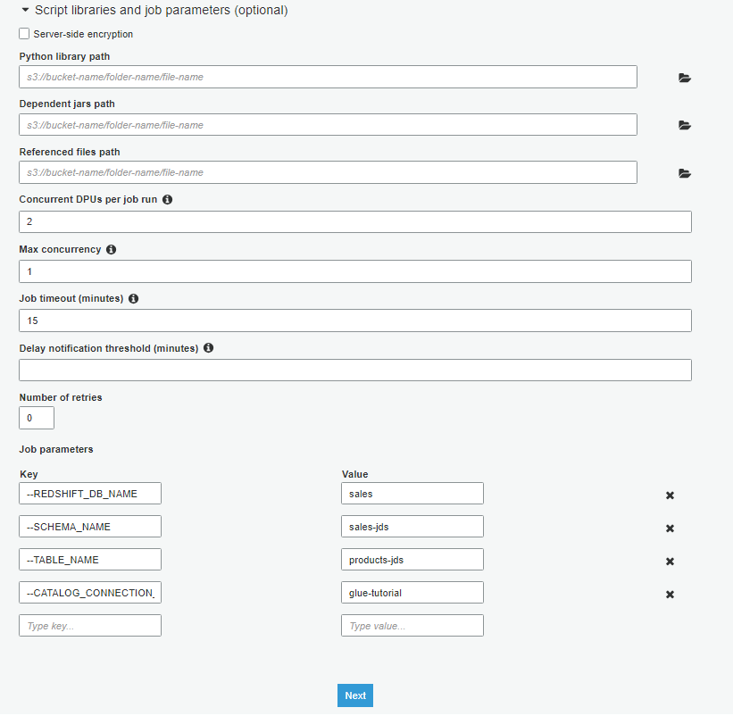
Create a Glue Job
This is the s3 path to where extra python resources will go
This is the s3 path to where extra scala resources will go
This is the s3 path to where extra configuration files will be referenced
The message to send after a certain amount of time has passed
DPU=Data Processing Unit
Number of times job will retry
Number of times the glue job can run concurrently
Max amount if time job is allowed to run
Parameters to be passed to the script for less hardcoded values

Slide 43
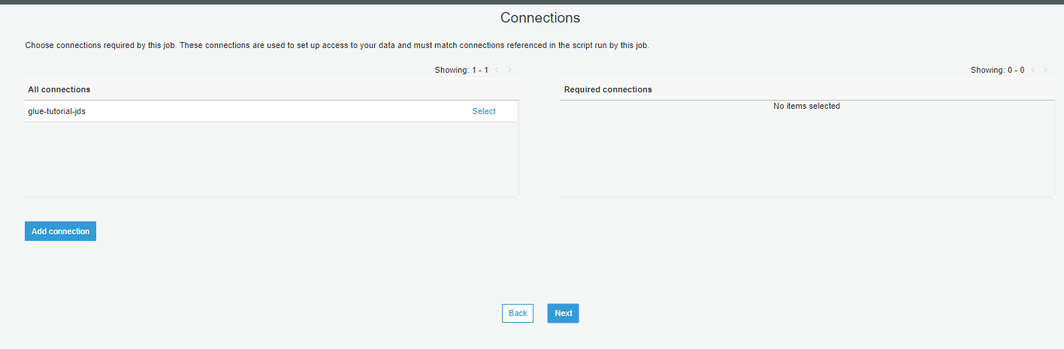
Create a Glue Job
Select the redshift connection that you want to use, should be glue-tutorial-<initials>

Slide 44
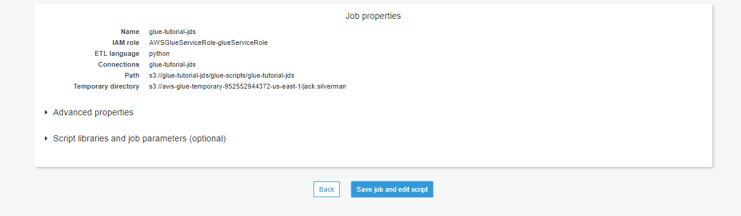
Create a Glue Job

Slide 45
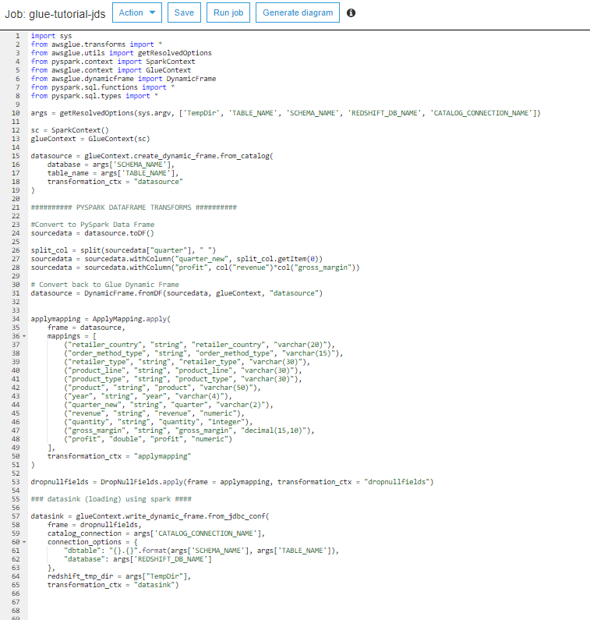
Writing the script
This code is setting up the environment to run the script. Under the covers of glue it is pyspark that is doing all of the work.
These are the parameters that were passed into the glue job
Pyspark is a service that allows the developer to perform data analysis on the data that is being used.
This is setting up the spark and glue environment to be able to interact with the data

Slide 46
Writing the script
The data will be written to the datasource as a DynamicFrame
These are the database and the table that we created in glue
Pyspark uses frames and will know in what order to do things according to the transformation_ctx
Notes:
Dynamic Frame is a service provided by glue. A Dynamic Frame allows glue to write the data to a frame without requiring a schema name.

Slide 47
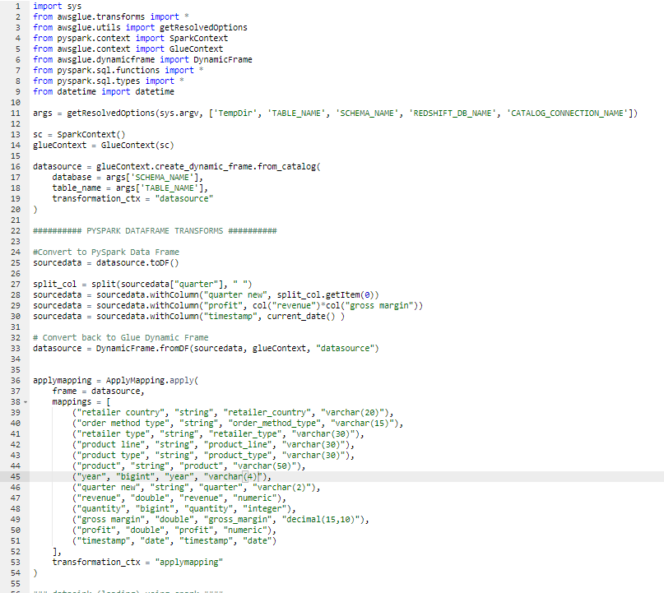
Writing the script
sourcedata needs to be changed to a DataFrame
This is where the transformations happen.
Notes:
The DynamicFrame needs to be changed in to a dataframe in order for Pyspark to be able to do transformations on it.
The transformations happening here. Split_col is splitting the column “quarter” because quarter has the quarter of the year as well as the year which is unnecessary since there is already a year column.
this transformation splits the column on the space and saves that as an array to split col which is then called in the next line to save that to a new column called quarter_new with just the quarter and not the year
The next transformation is taking columns “revenue” and “gross_margin” and is calculating the profit and creating that column
The last transformation is creating a timestamp of when the data was loaded into redshift.

Slide 48
Writing the script
This is converting the pyspark DataFrame back into a glue DynamicFrame
This is how the data in the DynamicFrame will be mapped to the columns in Redshift

Slide 49
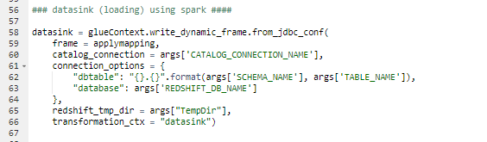
Writing the script
The datasink will connect to Redshift using the parameters given and load the data to Redshift

Slide 50
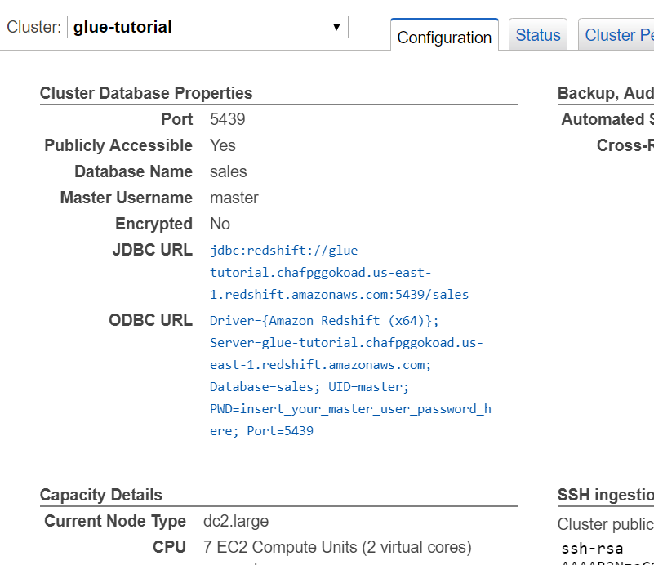
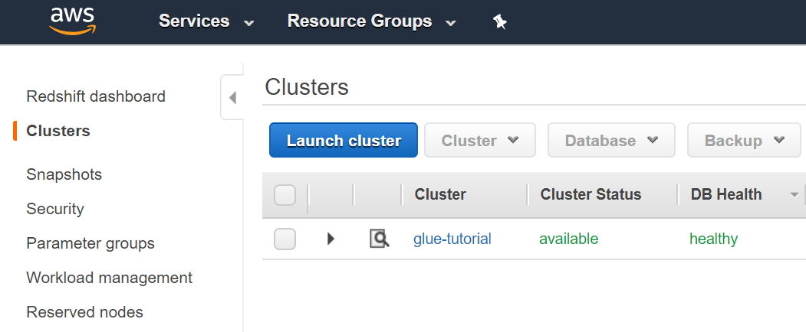
Connect to Redshift
Go to Redshift and select ‘Clusters’
Select glue-tutorial
Scroll down to Cluster Database Properties and copy the JDBC URL

Slide 51
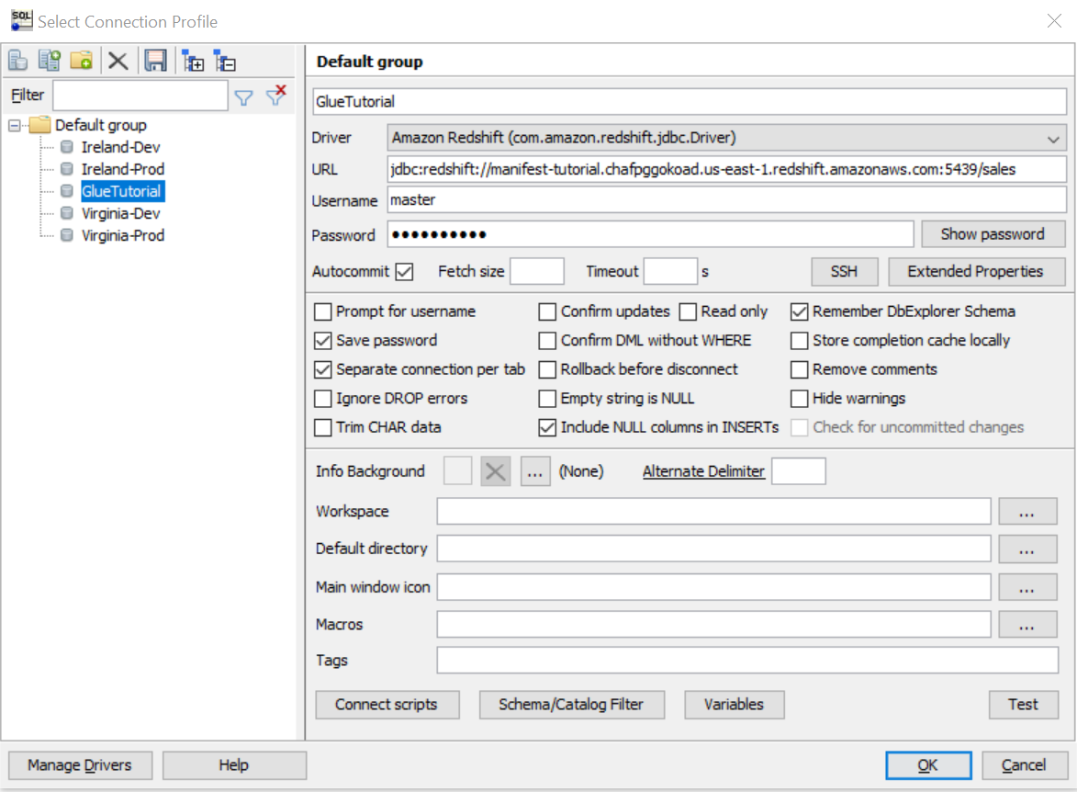
Connect to Redshift
Open SQL Workbench and select Create a new connection
Set the Driver to Amazon Redshift and paste the JDBC URL
The username is master and the password is WelcomeIn1
Select Autocommit

Slide 52
Connect to Redshift
Test your connection

Slide 53
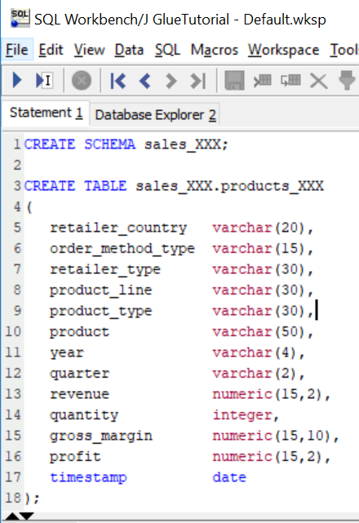
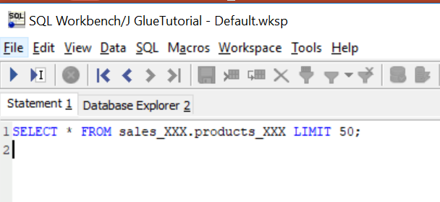
Create tables in Redshift
Run the script to create your schema and table
Add your own initials to the schema and table names
Run a SELECT to make sure your table was made and nothing is in it
Copy the SQL script from the github repository into SQL Workbench

Slide 54


Run your Glue Job
Go back to Glue and run your glue job
When the job succeeds, check your Redshift table

Slide 55

View your Table

Slide 56
Additional AWS Tools
Lambda
DynamoDB
IAM Roles
CloudFormation
QuickSight

Slide 57


Lambda
Serverless Function
Use Case:
Trigger a glue job when a file arrives
You can set a lambda to run when a file lands in an S3 bucket
Then make the lambda run the glue job
Notes:
Notice that the name of the glue job is hardcoded in the lambda. It would be better if it could run different glue jobs based on the file. We could store that information in…

Slide 58

DynamoDB
Non-relationional database
Use Case:
Store parameters for the Glue Trigger Lambda

Slide 59

Lambda
The Lambda can look up the filename in the DynamoDB table to find which Glue job to run
Notes:
The lambda function is a bit more complicated now. What’s happening is it’s getting an event from the S3 bucket. This event includes the key, which is the file path including the filename. We get the filename out of that then search the DynamoDB table with it. This returns the glue job associated with that file.

Slide 60

IAM Roles
Permission properties associated with a role that determine what a service with that particular role is able to do in AWS
IAM user groups define what permissions different users have to view, create, or modify items in various services
Use Case:
Add permission to the Lambda role to access DynamoDB and Glue
If you made the lambda from the previous slides, you would get an AccessDeniedException

Slide 61


IAM Roles
Notes:
To add policies, we can select “Attach policies” and search through the AWS managed polices for the one we want. In this case, we want the DynamoDB Read Only Access. For the glue permission, there isn’t a managed policy that fits what we need, so we can add an inline policy instead. We only need to allow one action, called StartJobRun. Now, our lambda will be able to access the DynamoDB table and start the Glue job.

Slide 62
CloudFormation
Template used build the infrastructure for AWS resources
Use Case:
Build Glue job through Cloud Formation vs Glue console
Advantages
Easy to modify
Easy to create multiple glue jobs with similar patterns
Easy to delete multiple related resources at once
Easy to deploy to a different account

Slide 63
QuickSight
Cloud based Business Intelligence reporting tool
Build Reports from
Files in s3
Redshift
Athena

Slide 64
QuickSight Tutorial
Create Analysis
Select data set
Select fields
Set field format
Add drill down layer
Select/change visual type
Publish to the dashboard

Slide 65

QuickSight Tutorial
Select new Analysis

Slide 66

QuickSight Tutorial
Select product_jds ( table in Redshift)

Slide 67

QuickSight Tutorial
Select Create Analysis

Slide 68

QuickSight Tutorial
Select Add > Add Title

Slide 69

QuickSight Tutorial
Choose product_line and revenue

Slide 70

QuickSight Tutorial
Change the format of Revenue to Currency

Slide 71

QuickSight Tutorial
Add product_type and product as drill down layer

Slide 72

QuickSight Tutorial
Change Visual Type

Slide 73

QuickSight Tutorial
Publish to Dashboard

Slide 74

QuickSight Tutorial
Name the Dashboard and select Publish dashboard

Slide 75

QuickSight Tutorial
Share the dashboard

