Slide 1
Constructing Dataset Based on Concept Hierarchy for Evaluating Word Vectors Learned from Multisense Words
2019/08/27
Aoyama Gakuin University, JPN
Notes:
Thank you, chairman! Hello, everyone!
I’m a student of Aoyama Gakuin University in Japan.
From now, I will introduce our work on the dataset for evaluating word vectors Learned from multisense words.

Slide 2





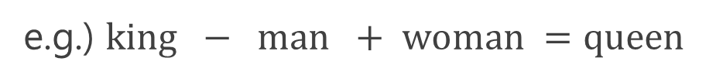


Background
Word Embedding
A technique that represents a word as a vector
Optimizes vectors to distinguish words’ meanings from each other
Learns vectors from parts of sentences in which individual words appear
contexts
Interesting features such as enabling analogy
$$−$$
$$+$$
$$=$$
e.g.) $king − man + woman =queen$
Notes:
Our background is here.
Word Embedding is a technique that represents a word as a vector.
This technique optimizes vectors to distinguish meaning from each other
and learns vectors from parts of sentences in which individual words appear.
Resulting vectors trained by word embedding techniques can possess such as analogy derived from a calculation of them.
We can obtain the “queen” vector by subtracting the “man” vector from the “king” vector and then adding the “woman” vector( to it).

Slide 3
Existing Techiniques
Learning models
Assign a single (word) vector to each word e.g.) word2vec [1]
Assign multiple (sense) vectors to each word To prevent individual meanings from being mixed in a single vector e.g.) sense2vec [2], MSSG [3], and DeConf [4]
Notes:
Word embedding methods are roughly divided into 2 types:
one that assigns a single vector to each word and the other one that assigns multiple vectors to each word to prevent individual meanings from being mixed in a single vector.
To distinguish learned vectors from each other, we classified learned vectors into 2 types of vectors: word vectors and sense vectors.
word2vec, typical word embedding method, belongs into the first category.
sense2vec, MSSG, and DeConf are the methods belonging into the latter category.

Slide 4
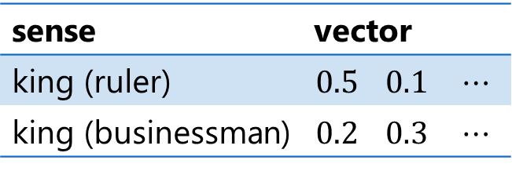
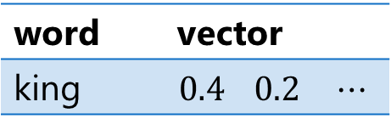
Leaning Sense Vectors
Assigning multiple vectors to each word
word (single) vector
sense (multiple) vector
word | vector
king | $$0.4$$ | $$0.2$$ | $$⋯$$
sense | vector
king (ruler) | $$0.5$$ | $$0.1$$ | $$⋯$$
king (businessman) | $$0.2$$ | $$0.3$$ | $$⋯$$
Learning multiple vectors from various information
Part-of-Speech (PoS) base: sense2vec [2]
Clustering base: MSSG [3]
WordNet’s synset base: DeConf [4]
Notes:
For example, word “king” has 2 or more meanings, say, in the sense of “ruler” or in the sense of “businessman” like this.
Even in such a case, word embedding methods such as word2vec assign a single vector to “king” like this.
On the other hand, methods that learn sense vectors can assign multiple vectors to “king” according to its meanings like this.
To this end, a variety of strategies to learn Multiple vectors have been proposed so far.
For examples, sense2vec uses Part-of-Speech information, MSSG adopts a clustering method, and DeConf utilizes WordNet’s synsets.

Slide 5
Recent Activities
Learning models
Assign a single (word) vector to each word e.g.) word2vec [1]
Assign multiple (sense) vectors to each word To prevent individual meanings from being mixed in a single vector e.g.) sense2vec [2], MSSG [3], and DeConf [4]
Datasets for evaluation
Evaluate how well word vectors are learned
Assign similarity scores to pairs of words
Notes:
In addition to these learning methods, to evaluate how well word vectors are learned, word similarity datasets have been proposed so far.
These word similarity datasets assign similarity scores to pairs of words.

Slide 6
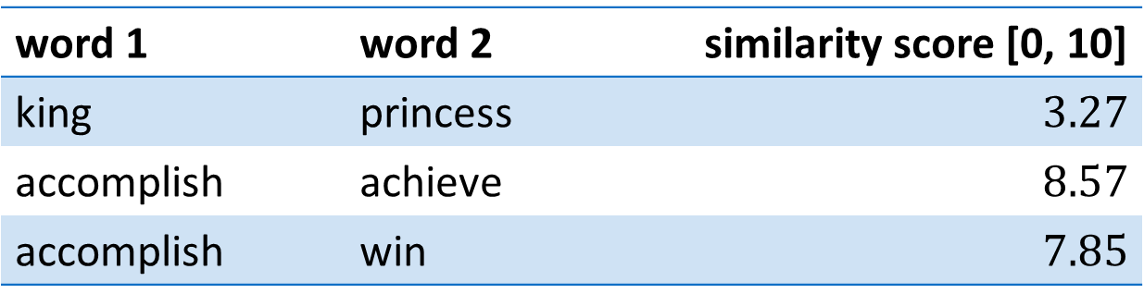
Word Similarity Dataset
SimLex-999 [5]
Contains 999 pairs of words with similarity scores
Evaluates the rank correlation between 2 ordered lists of word pairs: similarity scores v.s. similarities between learned vectors
averaged scores given by annotators
word 1 | word 2 | similarity score [0, 10]
king | princess | $3.27$
accomplish | achieve | $8.57$
accomplish | win | $7.85$
Notes:
For example, SimLex-999, which is one of widely used datasets, assigns a similarity score ranging from 0 to 10 to each word pair like this.
This similarity score is an average of scores given by human annotators.
This dataset evaluates the rank correlation between two ordered lists of word pairs. One is the fixed list based on similarity scores in SimLex-999.
The other one is a list of word pairs in order of similarities between learned vectors.

Slide 7
Motivation
Can existing datasets properly evaluate multiple vectors?
Existing datasets Evaluate similarity between words
word-based evaluation
Notes:
For such existing datasets, there is one question, namely,
can they properly evaluate multiple vectors?
In fact, they evaluate word vectors based merely on similarity between words, and assigns a single similarity score to a pair of words even if they have multiple meanings.
We call this approach the word-based evaluation.

Slide 8


Word-based Evaluation
Assigns a single similarity score to a pair of words
Using some summarized value such as average or max
king | queen | e.g. $7.00$
summarizing multiple values
king (ruler)
queen (ruler)
to a single value
king (businessman)
queen (musician)
Notes:
To assign a single similarity score to a pair of words, the word-based evaluation uses some summarized value such as average or maximum.
For example, let consider the case in which words “king” and “queen” respectively have 2 meanings like this.
In this case, the word-based evaluation calculates similarity scores for all combinations of sense vectors corresponding to each of their meanings, and then summarize resulting values to make a single similarity

Slide 9
Motivation
Can existing datasets properly evaluate multiple vectors?
Existing datasets Evaluate similarity between words
word-based evaluation
Problem
Used in same contexts
king (ruler)
queen (ruler)
king (businessman)
queen (musician)
Notes:
But, here note that in this computation, sense vectors used in different meanings are considered to compute similarity scores, which intuitively does not make sense.

Slide 10
Purpose
We propose the sense-based evaluation
Compares only pairs of vectors used in the same context
Collecting related words used in the same context
sense
: related words
: unrelated words
evaluate
queen (ruler)
crowned_head
Same contexts
king (ruler)
not evaluate
Different contexts
musician, businessman
Notes:
So, to exclude such inappropriate combinations, in this work, we propose a novel approach named the sense-based evaluation for multisense words that compares only vectors used in the same context, or in the same sense.
To this end, the proposed evaluation collects related words of a target word according to its individual meanings.
In the previous “king” and “queen” example, we can find a common related word “crowned_head” for sense vectors corresponding to the meaning of “ruler”. On the other hand, since the sense vector of “queen” corresponding to “musician” doesn’t have the related word “crowned_head”, it cannot be compared to the sense vector of “king” used in the sense of “ruler” like this. They are used in different contexts.

Slide 11
Our Approach
Constructing dataset and proposing an evaluation metric
: related words
: unrelated words
evaluate
queen (ruler)
hypernyms in WordNet & BabelNet
crowned_head
king (ruler)
not evaluate
musician, businessman
Collect related words from concept hierarchies
node: synset (a set of synonyms)
link: hyernym-hyponym (parent-child) relationship
Notes:
For this purpose, in this work, we propose a method of constructing the dataset including related words and a novel evaluation metric.
More specifically, we collect related words corresponding to each meaning of target words from concept hierarchies in WordNet and BabelNet.
In these conce pt hierarchies, a node stands for a synset of a word which is a set of its synonyms and a link between nodes represents hypernym-hyponym between them. Thus, we utilize the synset and its hypernyms to collect related words.

Slide 12
Overview of Dataset
word | PoS | synonyms | hypernyms-1 | …
hectare | Noun | ha, hm2, … | metric, area_unit, … | …
liter | Noun | microlitre, … | metric_capacity_unit, … | …
 | Noun | litér, … | village, hamlet, … | …
accomplish | Verb | fulfil, action, … | effect, complete, … | …
 | Verb | achieve,attain, … | win, succeed, … | …
single
multiple
meanings
sub-records
Records are pairs of a word and sub-records
Each word has sub-records corresponds to the sense
Sub-records are composed of PoS tag (Noun or Verb), synonyms (synset), and 3 hypernyms
Notes:
Overview of the dataset is here.
Each record of the proposed dataset consists of a taget word and its sub-records corresponding to its meanings.
The number of sub-records are equal to the number of meanings of the word.
Each sub-record has five columns, PoS tag, synonyms, and 3 hypernyms up to 3 upper levels from the synset.
In this work, we limit PoS tags to use only to Noun and Verb.

Slide 13

How to Get Related Words
Collect related words from concept hierarchies
hierarchy of liter (unit) in WordNet
is-a
hypernyms-1
$$\{{\text{metric}\text{_}\text{capacity}\text{_}\text{unit}}_{Noun}^{1},…\}$$
is-a
synonyms (synset)
$$\{{liter}_{Noun}^{1},{\text{cubic}\text{_}\text{decimiter}}_{Noun}^{1},{litre}_{Noun}^{1},…\}$$
word | synonyms | hypernyms-1 | …
liter | cubic_decimiter, litre, … | metric_capacity_unit, … | …
related words of liter (unit)
Notes:
Actually, synonyms and hypernyms in each sub-record are brought from the concept hierarchies of WordNet and BabelNet like this.
And they are merged to compose related words corresponding to the meaning of the target word that sub-record expresses.

Slide 14
WordNet v.s. BabelNet
WordNet (comprehension:△) [6] Famous concept hierarchy maintained manually BabelNet (comprehension:〇) [7] Semi-automatically created by using WordNet and Wikipedia
e.g. ) BabelNet has more variety of synsets of words
a metric unit of capacity
a village in Hungary
WordNet
liter
BabelNet
Combine WordNet and BabelNet to collect meanings
Notes:
As mentioned previously, we use both WordNet and BabelNet to construct the proposed dataset.
WordNet is a famous concept hierarchy that is well organized based on linguistic knowledges and maintained by hand.
BabelNet is a concept hierarchy that is semi-automatically constructed by using WordNet and Wikipedia to make it more comprehensive than WordNet and to include up-to-date meanings of words.
In fact, we combine WordNet and BabelNet to collect meanings of words like this.

Slide 15


Combining WordNet & BabelNet
WordNet
BabelNet (Wikipedia)
hypernyms
hypernyms
is-a
metric_ capacity_unit
metric_ capacity_unit
is-a
is-a
is-a
$$1L$$
is-a
is-a
unit_of_measure
liter
synonyms
synonyms
cubic_decimiter, litre, l, …
megalitre,
microlitre, …
Merge words to compose related words
word | synonyms | hypernyms-1 | …
liter | cubic_decimiter, litre, l, megalitre, microlitre, … | metric_capacity_unit, unit_of_measure, … | …
WordNet
BabelNet
Notes:
Essentially, we use synsets and their hypernyms that appear in WordNet and in addition to them we append synsets and hypernyms that appear in BabelNet but not in WordNet.

Slide 16





Removing Inappropriate Words
For properly evaluation, remove words having inappropriate hypernym-hyponym relationships
different sense appear in different hierarchies
different synsets of words have the same synset
same relation
$${evaluate}_{Verb}^{2}$$
$${diversion}_{Noun}^{1}$$
is-a
is-a
is-a
$${evaluate}_{Verb}^{1}$$
same word
$${play}_{Noun}^{8}$$
$${play}_{Noun}^{14}$$
Leave words that can be properly evaluated
Notes:
However, concept hierarchies sometimes have too specific meanings that cause ambiguity during the evaluation process.
More precisely, such ambiguity is caused if a target word has either of these 2 relationships in the concept hierarchy.
The first case is the hypernym-hyponym relationship in which the target word appear both in the parent and child nodes like this.
The other case is the one that the target word appear in sibling nodes like this.
Actually, different nodes in the concept hierarchy have different meanings even if they have an identical word,
but, in these cases, we cannot properly distinguish the differences between them during our evaluation process.
Thus, we remove target words from the dataset if they have either of these relationships in concept hierarchies.

Slide 17
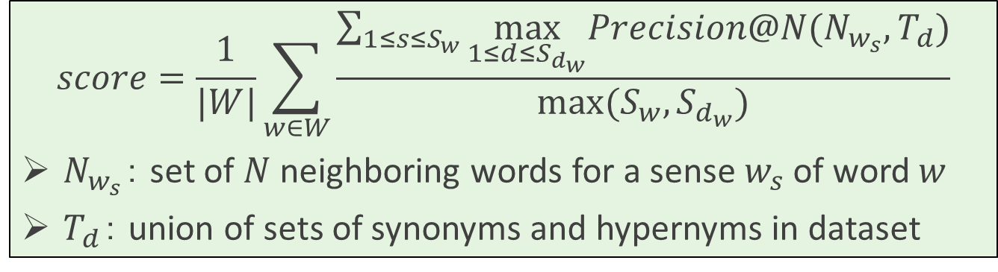
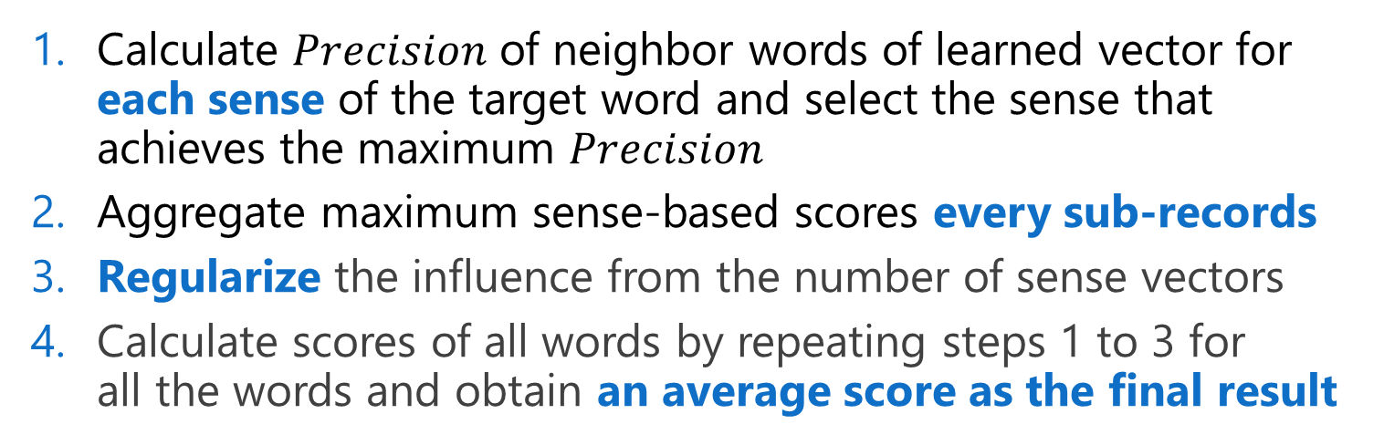
Evaluation Metric
4
2
1
$$score=\frac{1}{|W|}\sum_{w∈W}{\frac{\sum_{1≤s≤S_{w}}{\max_{1≤d≤S_{d_{w}}}Precision@N(N_{w_{s}},T_{d})}}{max⁡(S_{w},S_{d_{w}})}}$$
$N_{w_{s}}$： set of $N$ neighboring words for a sense $w_{s}$ of word $w$
$T_{d}$： union of sets of synonyms and hypernyms in dataset
3
Calculate $Precision$ of neighbor words of learned vector for each sense of the target word and select the sense that achieves the maximum $Precision$
Aggregate maximum sense-based scores every sub-records
Regularize the influence from the number of sense vectors
Calculate scores of all words by repeating steps 1 to 3 for all the words and obtain an average score as the final result
Notes:
This is the equation of the proposed evaluation method which has 4 steps to obtain the evaluation result.
In the first step, we Calculate $Precision$ of neighbor words of learned vector for each sense of the target word and select the sense that achieves the maximum $Precision$
In the second step, we aggregate maximum sense-based scores every sub-records.
In the third step, we regularize the influence from the number of sense vectors.
Finally, we calculate scores of all words by repeating 1 to 3 steps against all words and obtain an average score as an evaluation result

Slide 18
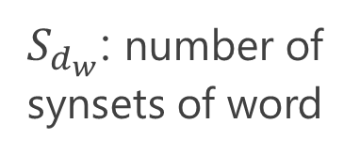
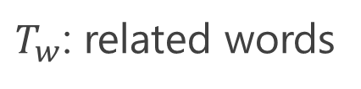
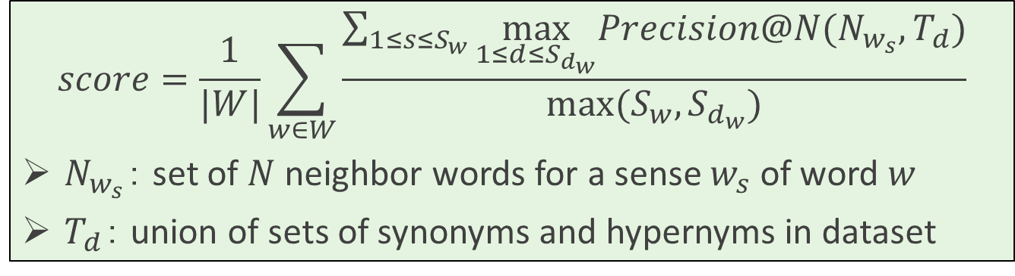
Evaluation Method
Evaluate multiple by $Precision$ and each related words
4
2
1
$$score=\frac{1}{|W|}\sum_{w∈W}{\frac{\sum_{1≤s≤S_{w}}{\max_{1≤d≤S_{d_{w}}}Precision@N(N_{w_{s}},T_{d})}}{max⁡(S_{w},S_{d_{w}})}}$$
$N_{w_{s}}$： set of $N$ neighbor words for a sense $w_{s}$ of word $w$
$T_{d}$： union of sets of synonyms and hypernyms in dataset
3
$T_{w}$: related words
word | PoS | synonyms | hypernyms-1 | …
accomplish | Verb | carry_out, fulfil, … | effect, … | …
 | Verb | achieve, attain, … | win, … | …
$S_{d_{w}}$: number of synsets of word
Notes:
In the first steps, we calculate Precision by 2 factors:
one is a set of N numer of neighboring words for a sense of word and the other one is an union of sets of synonyms and hypernyms in the proposed dataset.
Sdw denotes the number of synsets of the target word and Tw is the related words of the target words.

Slide 19





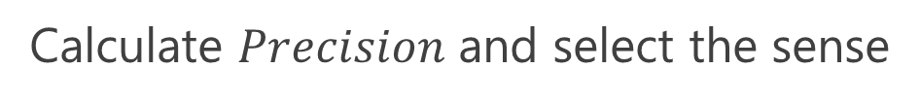


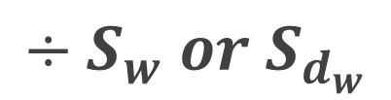




Case of “accomplish” vectors
1
Calculate $Precision$ and select the sense
2
Aggregate
learned vectors
dataset
accomplish-1
sense-1
carry_out, fulfil, execute, …
$$Precision@5$$
carry_out, fulfil
$$0.4$$
sense-2
achieve, attain, reach, …
accomplish-2
$$0.2$$
achieve, by_luck
$$÷S_{w} or S_{d_{w}}$$
3
: neighbor words
: related words
for regularization
4
Average
scores of “accomplish” and others
final result
$$0.4$$
$$0.2$$
・・・
$$0.3$$
$$0.3$$
$$0.1$$
$$÷S_{w} or S_{d_{w}}$$
・・・
$$S_{w} or S_{d_{w}}$$
$$S_{w} or S_{d_{w}}$$
Notes:
First, we calculate Precision and select the sense by using the neighbor words of learned vectors and the related words of the dataset.
In the second step, we aggregate them, and, in the third step, we divide their values by the number of sense vectors or the number of the sense in the dataset for regularizing the number of sense vectors.
Finally, we calculate an average of scores that words have and obtain the final result.

Slide 20
Experiments
Investigate the validity of the proposed dataset and metric
How they evaluate word vectors
We examined evaluation results from the following viewpoints:
Influence of the number of neighbor words
Influence of the existence of compound words
Influence of the number of sense vectors
How well they can handle multisense words
Comparing the proposed dataset with SimLex-999
Notes:
We experimentally investigated the validity of the proposed dataset and metric.
More specifically, how they evaluate word vectors and how well they can handle multisense words:
For the first point, we examined evaluation results in the following viewpoints:
influence of the number of neighboring words, influence of the existence of compound words, and influence of the number of sense vectors.
As for the second point, we compared the result by the proposed dataset with the one by SimLex-999..

Slide 21
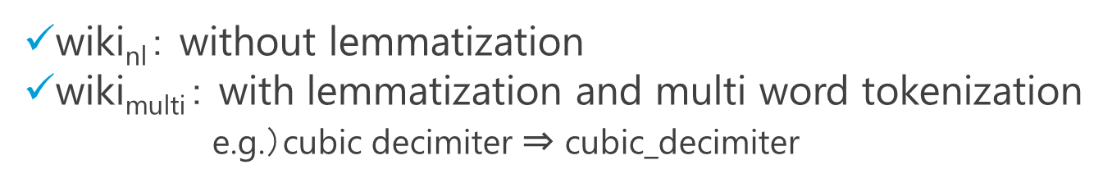
Word Vectors to Evaluate
Word Vectors We used 7 set of word vectors learned or pre-trained
Learned vectors
Pre-trained vectors
model | corpus
word2vec | wiki_{nl}
 | wiki_{multi}
sense2vec | wiki_{nl}
 | wiki_{multi}
model | corpus
word2vec | Google News [8]
DeConf | Google News
MSSG | Wikipedia [9]
[8] https://news.google.com
wiki_{nl}： without lemmatization
$\text{wiki}\text{multi}$： with lemmatization and multi word tokenization e.g.）cubic decimiter ⇒ cubic_decimiter
Notes:
In our experiments, we used 7 set of word vectors that are learned or pre-trained.
Out of them, 4 sets of word vectors are learned from Wikipedia by using python codes.
To this end, we used 2 kinds of Wikipedia corpora:
one without lemmatization and one with lemmatization and multi word tokenization.
As for the rest 3 sets of word vectors, we used pre-trained ones learned from Google News corpus or Wikipedia corpus.
This is because the implementation of DeConf and MSSG are not available.

Slide 22
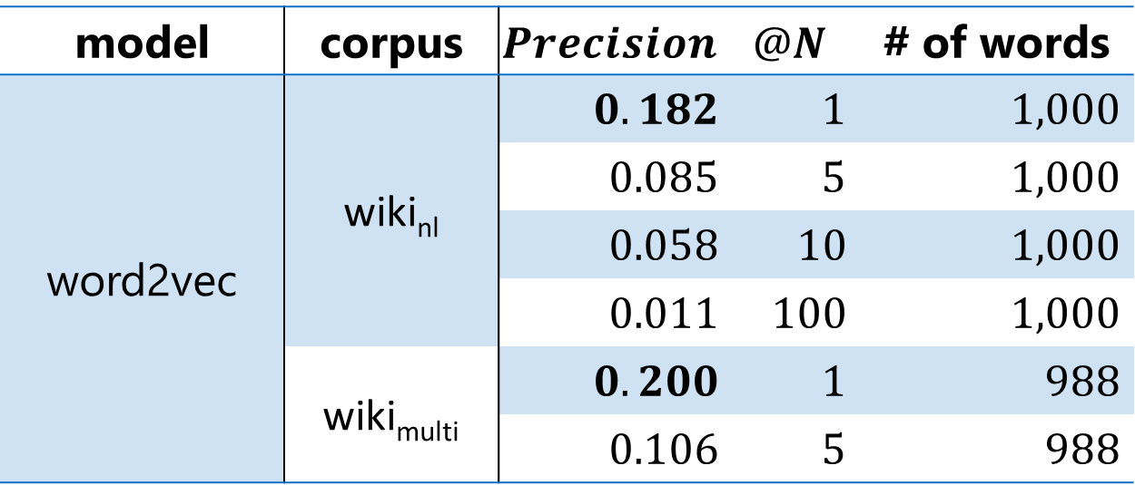
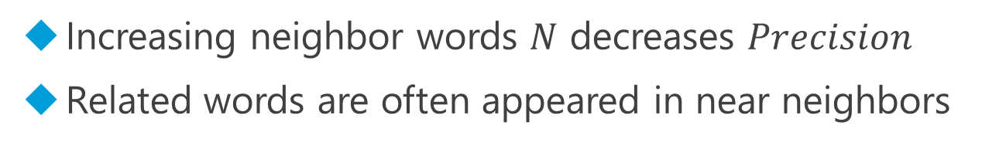
Influence of the Number of Neighbor Words
model | corpus | $$Precision$$ | $$@N$$ | # of words
word2vec | wiki_{nl} | $0.182$ | $1$ | $1,000$
 |  | $0.085$ | $5$ | $1,000$
 |  | $0.058$ | $10$ | $1,000$
 |  | $0.011$ | $100$ | $1,000$
 | wiki_{multi} | $0.200$ | $1$ | $988$
 |  | $0.106$ | $5$ | $988$
Increasing neighbor words $N$ decreases $Precision$
Related words are often appeared in near neighbors
Number of neigbor words is desirable to $5$ or $10$
Notes:
First of all, I will show you the result of investigating the influence of the number of neighboring words.
Here, we examined how the precision changes by varying the number of neighboring words in its computation.
These results are the ones obtained from 2 kinds of Wikipedia corpora by word2vec.
From these results, we can find the precision decreases as the number of neighboring words increases,
which implies related words are likely to be the nearest neighbor words of learned vectors.
But, actually, this is not always true. So, it seems reasonable to use 5 or 10 as a value of N, the number of neighboring words.

Slide 23

Influence of the Existence of Compound Words
model | corpus | $$Precision$$ | $$@N$$ | # of words
word2vec | wiki_{nl} | $0.182$ | $1$ | $1,000$
 |  | $0.085$ | $5$ | $1,000$
 |  | $0.058$ | $10$ | $1,000$
 |  | $0.011$ | $100$ | $1,000$
 | wiki_{multi} | $0.200$ | $1$ | $988$
 |  | $0.106$ | $5$ | $988$
Models learned from wiki_{multi} improves $Precision$
Considering compound words is very important
Notes:
Next, we investigate the same results from the different viewpoint, that is how the existence of compound words influences on evaluation results.
Comparing these results, we can say the resulting precision gets better by applying lemmatization and multi-word tokenization to the corpus.
In other words, considering compound words is very important to properly learn word vectors from a given corpus.

Slide 24
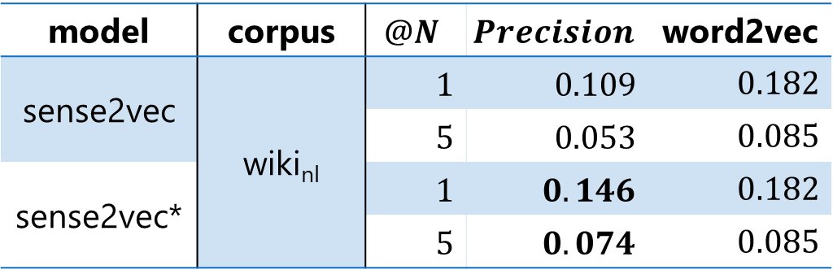
Influence of the Number of Sense Vectors
sense2vec
word2vec model learned in consideration of PoS tagging
If PoS tagging is perfect, sense2vec would outperform word2vec
model | corpus | $$@N$$ | $$Precision$$ | word2vec
sense2vec | wiki_{nl} | $1$ | $0.109$ | $0.182$
 |  | $5$ | $0.053$ | $0.085$
sense2vec* |  | $1$ | $0.146$ | $0.182$
 |  | $5$ | $0.074$ | $0.085$
use all PoS
use only related PoS
sense2vec is worse than word2vec and sense2vec* ⇒ Errors of PoS tagging make another problems to learn multisense words
When using sense2vec, accurate PoS tagging is important
Notes:
Next, we examined the influence of the number of sense vectors on the resulting evaluation score.
Here, we first compare the results by sense2vec with those by word2vec.
It is expected that If PoS tagging is perfect, sense2vec would outperform word2vec,
but, actually, as shown here, the results of sense2vec are worse than those of word2vec.
To investigate the influence of PoS tagging errors, we conducted additional experiments in which we used only PoS tags that appear in the learning corpus.
The results are indicated by sense2vec-star in this table, and we can observe the resulting scores improved
From these results, we can say PoS tagging errors may generate irrelevant sense vectors that degrade the final evaluation score.
Thus, when using sense2vec, accurate PoS tagging is very important, but, at present, the perfect PoS tagging is still challenging.

Slide 25
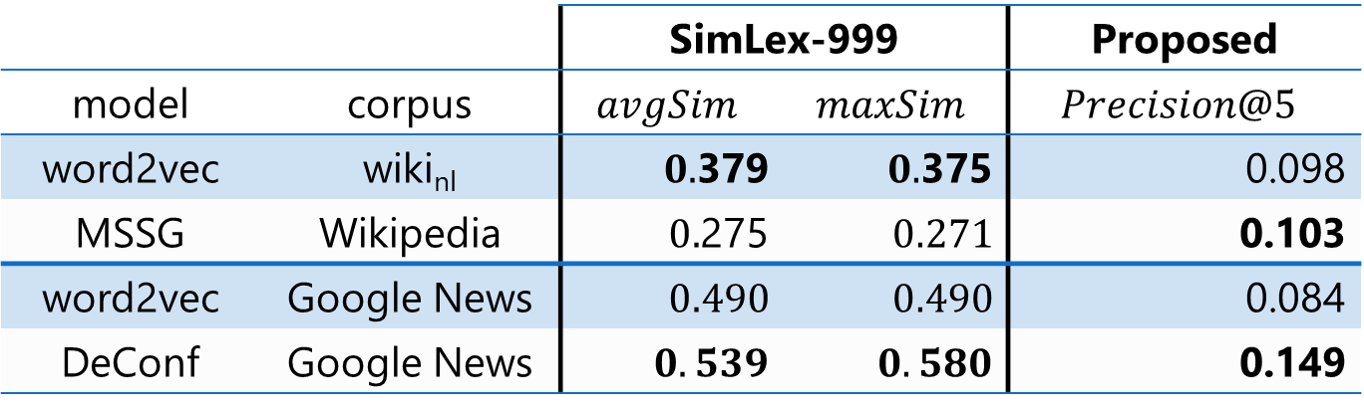


Comparison with SimLex-999
 |  | SimLex-999 |  | Proposed
model | corpus | $$avgSim$$ | $$maxSim$$ | $$Precision@5$$
word2vec | wiki_{nl} | $0.$379 | $0.$375 | 0.098
MSSG | Wikipedia | $0.$275 | $0.271$ | 0.103
word2vec | Google News | $0.490$ | $0.490$ | 0.084
DeConf | Google News | $0.539$ | $0.580$ | 0.149
In SimLex-999
MSSG $<$ word2vec $<$ DeConf
In the proposed dataset
word2vec $<$ MSSG, DeConf
SimLex-999 sometimes evaluate vectors inappropriately
Proposed dataset tends to evaluate vectors appropriately
Notes:
Finally we compare the results by the proposed dataset with those by SimLex-999 to investigate how well the proposed dataset can handle multisense words.
In this experiment, we evaluated vectors learned by word2vec, MSSG, and DeConf, respectively.
Again, it is expected that if MSSG and DeConf properly learn sense vectors for multisense words, their evaluation scores get better than the score of word2vec.
But, when evaluated them with SimLex-999, the score of MSSG was worse than that of word2vec.
On the other hand, when used the proposed dataset, MSSG and DeConf outperformed word2vec as expected.
From these results, the proposed dataset and metric tends to evaluate learned vectors appropriately unlike SimLex-999 does.

Slide 26
Conclusion
We proposed a method of constructing Dataset and an evaluation metric to realize sense-based evaluation of sense vectors for multisense words
Proposed Dataset
Utilizes synonyms in WordNet and BabelNet to compose related words that enable us to identify meanings of learned sense vectors
Evaluation metric
Can evaluate sense vectors more appropriately than existing word similarity datasets such as SimLex-999
Future work
Evaluating the proposed dataset and evaluation metric under a wide variety of settings
Constructing dataset for evaluation of leaning models from sentence level
Notes:
I will conclude my talk.
In this work, we propose the dataset

Slide 27
References 1
[1] Mikolov, T., Chen, K., Corrado, G., Dean, J.: Efficient estimation of word representations in vector space. arXiv preprint arXiv:1301.3781 (2013)
[2] Trask, A., Michalak, P., Liu, J.: sense2vec-a fast and accurate method for word sense disambiguation in neural word embeddings. arXiv e-prints arXiv:1511.06388 (2015)
[3] Neelakantan, A., Shankar, J., Passos, A., McCallum, A.: Efficient non-parametric estimation of multiple embeddings per word in vector space. In: Proceedings of the 2014 Conference on Empirical Methods in Natural Language Processing (EMNLP), pp. 1059-–1069. Association for Computational Linguistics (2014). https://doi.org/10.3115/v1/D14-1113. http://aclweb.org/anthology/D14-1113
[4] Pilehvar, M.T., Collier, N.: De-conflated semantic representations. In: Proceedings of the 2016 Conference on Empirical Methods in Natural Language Processing, pp. 1680–-1690. Association for Computational Linguistics (2016). https://doi.org/10.18653/v1/D16-1174. http://aclweb.org/anthology/D16-1174
Notes:
These are references. Thank you for listening.

Slide 28
References 2
[5] Hill, F., Reichart, R., Korhonen, A.: Simlex-999: evaluating semantic models with (genuine) similarity estimation. Comput. Linguist. 41(4), pp. 665–-695 (2015)
[6] Fellbaum, C.: Wordnet and wordnets. In: Barber, A. (ed.) Encyclopedia of Language and Linguistics, pp. 2–-665. Elsevier, Amsterdam (2005)
[7] Navigli, R., Ponzetto, S.P.: Babelnet: the automatic construction, evaluation and application of a wide-coverage multilingual semantic network. Artif. Intell. 193, pp. 217--250 (2012)
[9] Shaoul, C.: The westbury lab wikipedia corpus. Edmonton, AB: University of Alberta, p. 131. (2010)

Slide 29
Non-existent Meaning
Obtaining only necessary meaning leads to better result
“accomplish” vectors
model | PoS | matched words
word2vec | - | achieve, fulfill
sense2vec | Verb | achieve
 | Noun | -
 | Adjective | achieve, fulfill
 | Adposition | -
non-existent PoS
⇒ Same results both in the case of using only Verb and all PoS
PoS tagging errors cause non-existent meanings

Slide 30


Learning Different Meaning
Word vector learns multisense obtain better result
“accomplish” vectors
MSSG fails to learn different meanings
model | matched words
word2vec | achieve, fulfill
MSSG | achieve, fulfill
MSSG $=$ word2vec
“announce” vectors
MSSG succeeds in learning different meanings
model | matched words
word2vec | proclaim
MSSG | declare
 | Inform, declare
 | -
MSSG $>$ word2vec

Slide 31
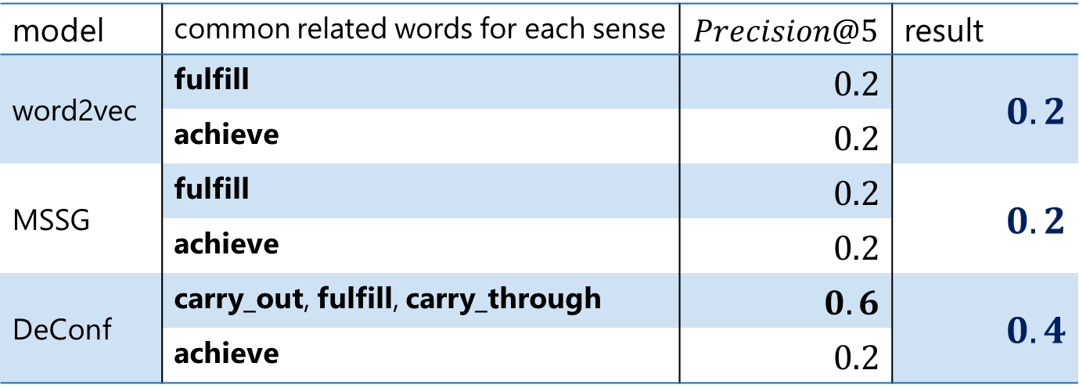
To Improve Evaluation Results
DeConf obtains multiple neighbor words for one sense
“accomplish” vectors
model | common related words for each sense | $$Precision@5$$ | result
word2vec | fulfill | $0.2$ | $0.2$
 | achieve | $0.2$
MSSG | fulfill | $0.2$ | $0.2$
 | achieve | $0.2$
DeConf | carry_out, fulfill, carry_through | $0.6$ | $0.4$
 | achieve | $0.2$
For a better result, multiple matched words are needed

