Slide 1
The EnKF as shipped: what the analysis found
two separate problems — the Kalman update barely acts on the forecast, and sigma carries no information

Slide 2
Overview: the EnKF's numbers
EnKF, 7 test days | blind walkable cells | all walkable cells | ideal
RMSE | 0.263 | 0.275 | -
spread / skill (mean sigma / RMSE) | 0.010 | 0.009 | 1.0
coverage of the nominal 90% interval | 1.6% | 1.3% | 90%
For reference, the three learned methods score RMSE 0.222-0.230 on blind walkable cells.
Two separate problems behind these numbers:
  A. point estimate - the Kalman update barely acts on the forecast
  B. uncertainty - sigma carries no information
Everything that follows describes the configuration as shipped.

Slide 3
A1. The Kalman gain ignores vx, vy and var: a localisation bug
update() is called without the observed cell positions - by the original project's own
evaluation code as well as by ours - so it rebuilds them from the observation matrix:
    observed_cells = [(i // W, i % W) for i in C.nonzero()[1]]
The state stacks the four channels one block after another. For a vx, vy or var observation
the column index i is offset by 1, 2 or 3 x H*W, so i // W is a row 36, 72 or 108 rows below
the grid. Its distance to its own cell is at least 36 > localisation radius 7: weight 0.
channel | density | vx | vy | var
mean self-gain | 9.5e-5 | 0 | 0 | 0
vx, vy and var observations never reach the state through the Kalman gain;
they still enter through the bias correction (A3).
gain census: day atc-20130811, 400 frames, ensemble 100, radius 7, as shipped. Code: enkf_lab/pedpred/ENKF.py, LocalizedEnsembleKalmanFilter.update(); the original's own calls are enkf.step(C_joint, obs_vector, model=model)

Slide 4
A2. Even for density the gain is ~1e-4
K = P_xy @ pinv(P_yy), P_yy = ensemble term + R (observation noise) + 1e-3 (hard-coded)
The ensemble term is a tiny share of that denominator:
channel | ensemble term | R | regularisation | ensemble share
density | 4.3e-7 | 3.2e-3 | 1e-3 | 1.0e-4
vx | 1.3e-5 | 9.9e-2 | 1e-3 | 1.3e-4
vy | 2.8e-6 | 7.4e-3 | 1e-3 | 3.3e-4
var | 1.8e-5 | 4.2e-5 | 1e-3 | 1.7e-2
The ensemble has collapsed (part B), so the filter trusts its forecast and all but
ignores the observations. For var the hard-coded 1e-3 is larger than the observation
noise itself. (vx, vy, var are listed for the denominator; their gain is already 0, A1.)
gain census: day atc-20130811, 400 frames, ensemble 100, radius 7, as shipped; each term averaged over analysis steps

Slide 5
A3. What does reduce the error: an undocumented bias correction
Besides the Kalman gain, forecast() subtracts a moving average of (ensemble mean - observation),
at full strength. Not in the paper; the code comment reads "estimatin NN model bias".
Switching the two correction paths on and off separately:
arm | Kalman gain | bias correction | RMSE
A | off | off | 0.255
B | off | on | 0.175
C | on | off | 0.255
D (as shipped) | on | on | 0.175
C = A and D = B: the Kalman gain adds nothing; the ~32% error reduction is the bias correction.
Per channel, B vs A: density -62%, vx -6%, vy -21%, var -48% - it corrects all four channels.
Its size is ~1100x the Kalman increment.
arms: day atc-20130811, frames 500-2000, blind cells of the full grid, ensemble 100, radius 7, paired (one random stream); per-channel line: all cells. Bias / increment ratio: gain census, 400 frames

Slide 6
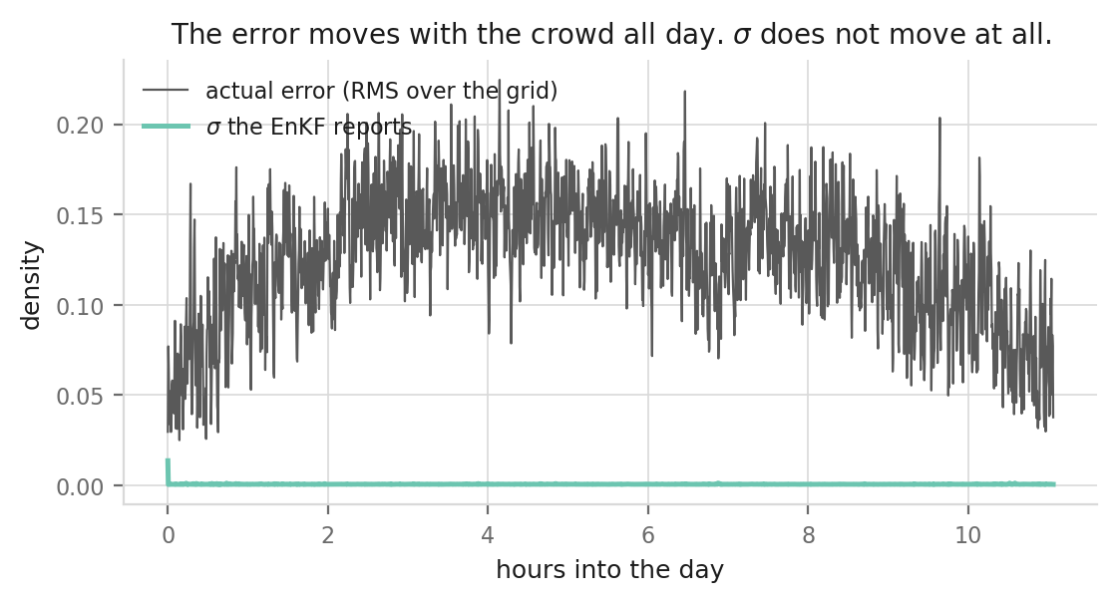
B1. Symptom: sigma never moves
grey = actual density error, 0.03-0.22 all day
green = the sigma the EnKF reports: flat on the axis
It does not respond to anything, and it is
about 100x too small.
All four channels, spread / skill over 7 days:
  density 0.004 vx 0.010 vy 0.010 var 0.022
sigma = spread of the 100 members at a cell. It
should be small where a robot just looked, large
where nobody has looked for a while.
figure: density, day atc-20130811. Per-channel spread / skill: 7 test days, all grid cells

Slide 7
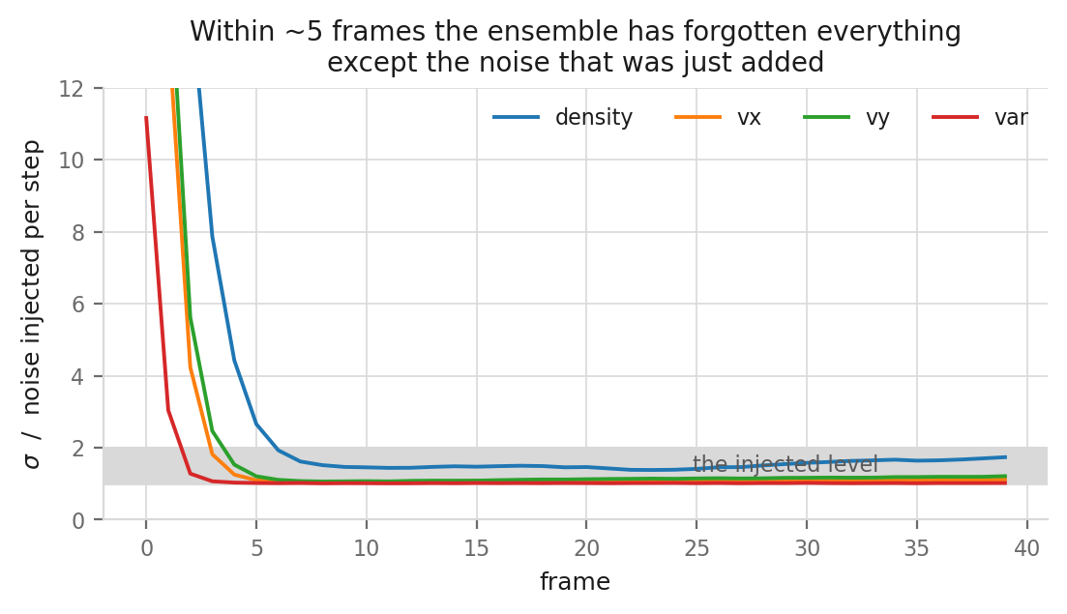
B2. Cause: the ensemble collapses within ~5 frames
y-axis = sigma / noise injected per step
Each step does two things:
  the forecast model damps member differences by 65%
  a little noise is added, np.full(H*W, s)
    - one number for the entire grid
After a few frames the ensemble holds only the
noise just added; everything else is gone.
The injection is a hard-coded 0.01 x Q.
Mean sigma / injected noise, 7 days:
  density 2.0 vx 1.2 vy 1.3 var 1.0
damping: methods/varnet/check_outputs/eval/enkf_spread_growth.json (verdict 'contractive')

Slide 8
Summary: two separate problems
A. The Kalman update barely acts on the forecast
    A1 vx, vy and var observations get zero Kalman weight - a localisation bug
    A2 the density gain is ~1e-4: the collapsed ensemble trusts its forecast
    A3 the error reduction the filter does achieve is an undocumented bias correction
B. sigma carries no information
    B1 flat all day and ~100x too small, in all four channels
    B2 the ensemble collapses within ~5 frames onto the injected noise
Link: the collapse in B is also why the gain in A2 is so small.
Open: whether any of this was intended by the original authors cannot be told from the code.

