Slide 1
Four methods, two benchmarks — and a ranking that moves
Crowd-field reconstruction from partial robot observations · ATC, 7 held-out days
2026-09-07
Notes:
One sentence to open with: every headline number in this deck is stable, and every RANKING built from those numbers is not. That is the finding, not a caveat.

Slide 2
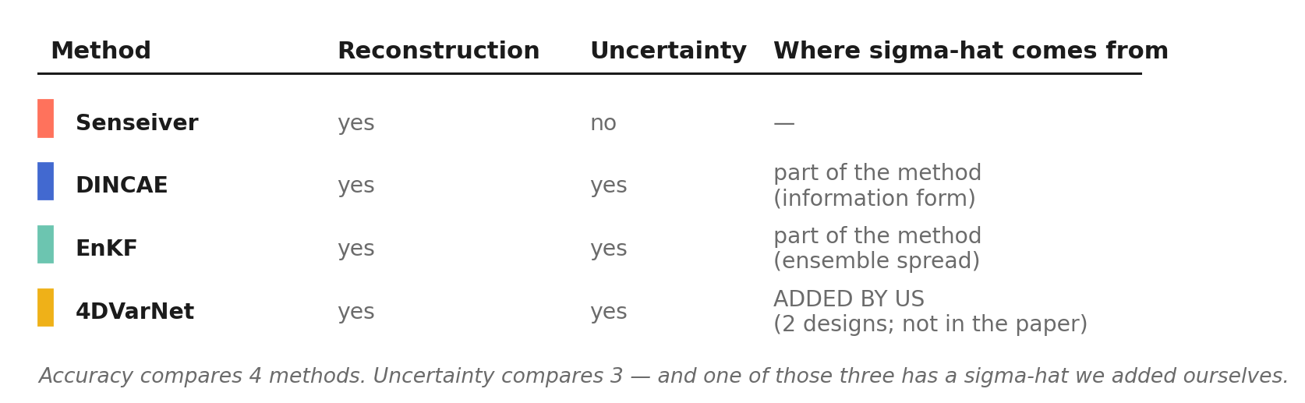
What the four methods actually offer
Accuracy compares four methods. Uncertainty compares three — Senseiver has no sigma-hat at all.
For DINCAE and the EnKF the uncertainty IS the method: remove the information form or the ensemble and you no longer have that method.
For 4DVarNet we added it. Two designs, neither in the original paper.
So: four reconstruction methods, plus two 4DVarNet uncertainty designs that are ours, not the paper's.
Notes:
The bottom line settles what “three-way” means for this project: the comparison is over four independent RECONSTRUCTION methods, and the two 4DVarNet sigma-hat designs are ours rather than the paper's.
If asked why Senseiver has no uncertainty: it is a deterministic sensor-to-field decoder; adding a variance head would be the same kind of bolt-on we are about to show does not work for 4DVarNet.

Slide 3
Hypothesis
The ranking of these four methods is decided by a scoring convention that most papers do not state.
Two independent tests, both on the same 7 held-out days:
accuracy — which cells count
uncertainty — which cells count
If the hypothesis is wrong, the ordering survives both. It survives neither.
Notes:
Say the last line slowly. The deck is falsifiable: two chances for the ordering to hold, and it holds in neither.

Slide 4
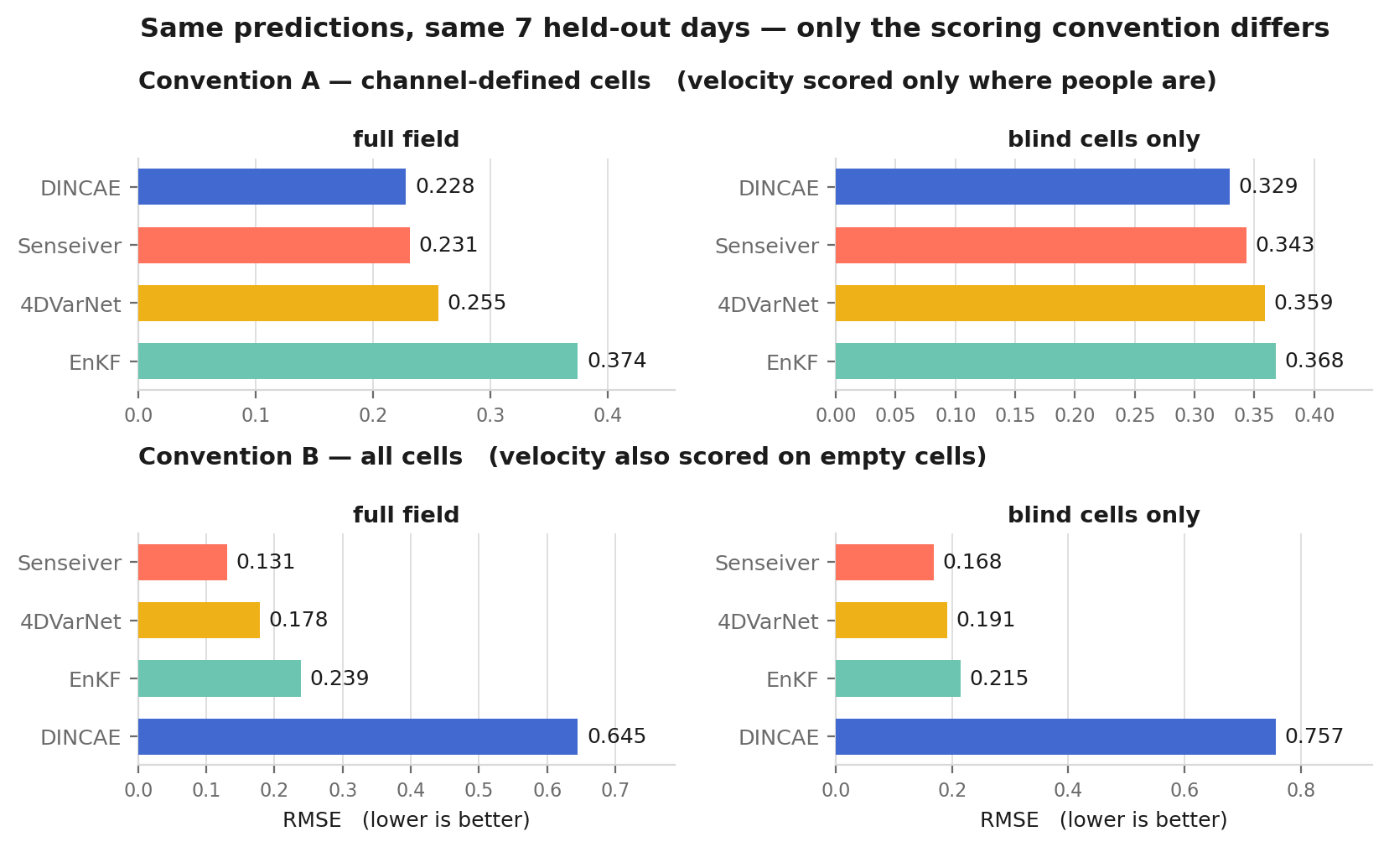
Test 1 — accuracy: the same predictions, scored two ways
DINCAE is first under one convention and last under the other — 4.5x worse than Senseiver. Nothing about the model changed.
Cause: DINCAE only defines velocity where density > 0. 88.4% of blind velocity cells are empty, and on those the truth is exactly 0 (measured: 0.000% non-zero).
Convention A is the defensible one — “velocity” on an empty cell is not a physical quantity.
Left column scores the full field, right column the blind cells alone. Observed cells are handed to the model, so the right column is the reconstruction task.
Notes:
Numbers if pushed: convention A blind RMSE — DINCAE 0.329, Senseiver 0.343, 4DVarNet 0.359, EnKF 0.368. Convention B — Senseiver 0.168, 4DVarNet 0.191, EnKF 0.215, DINCAE 0.757.
All five rows are single models, default configuration, seed 0, and each one's checkpoint picked on ITS OWN validation set. No ensembling, no checkpoint averaging. Held ready: 16-checkpoint averaging is worth only 1.7% to DINCAE, less than picking the right single checkpoint.
Four panels, not four bars in two: convention down the rows, cell scope across the columns. Each panel is one plain bar chart in the method colours, so nothing has to be decoded from a legend.
One detail visible in the figure and worth having ready: the EnKF is the only method whose FULL-FIELD error (0.374) is worse than its blind error (0.368). Every other method is clearly better where it was given observations. That is the same ensemble collapse the uncertainty slide is about — the gain is so small the filter barely assimilates what it sees.

Slide 5
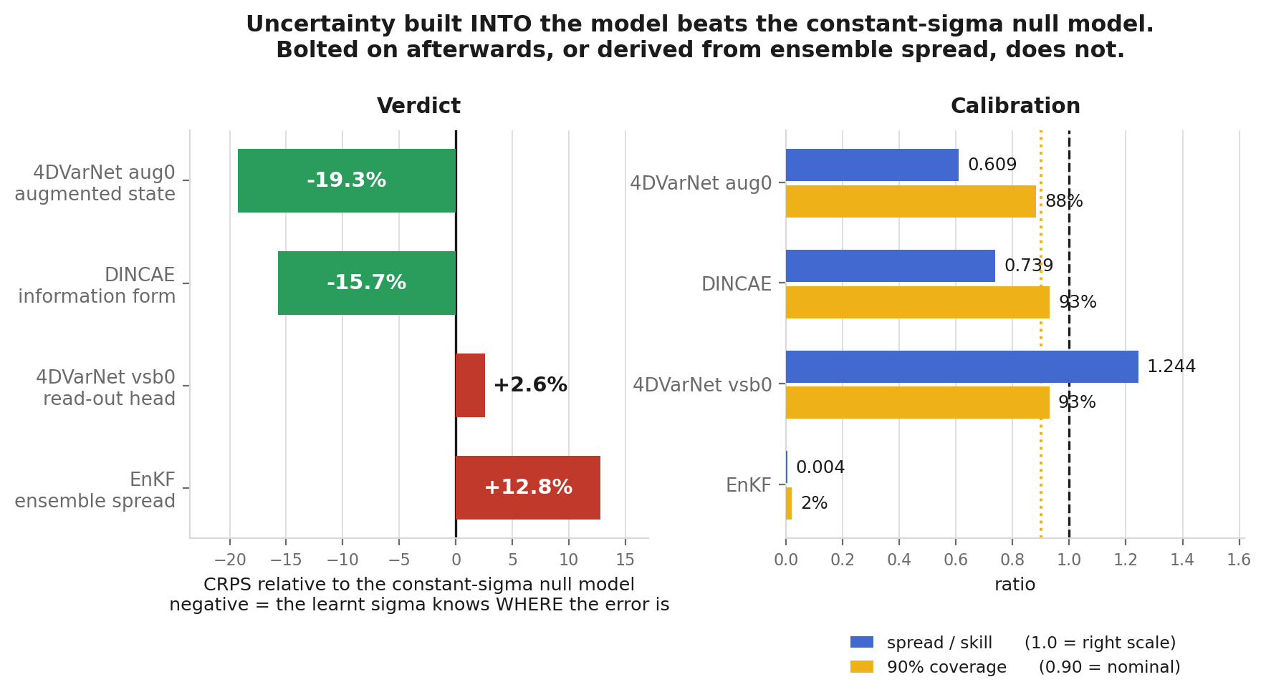
Test 2 — uncertainty: what makes a sigma-hat useful
Judged against a null model: replace every cell's sigma-hat with one constant, that split's own RMSE. It knows how big the error is on average and nothing about WHERE — and it scores a perfect 1.00 spread/skill for free.
Uncertainty built into the model beats it. Bolted on afterwards, or read off ensemble spread, does not.
This ordering is the one thing in the deck that does NOT move with the convention.
Notes:
Why CRPS is the verdict column and not NLL: NLL has a (x-mu)^2/2sigma^2 term that is unbounded as sigma -> 0. The EnKF's ensemble collapses to sigma = 0.0025 while actually being wrong by 0.215, so its NLL is 1.7e18 (all-cells convention, matching the 0.215) — that cannot rank anything. CRPS is bounded, in data units, and reduces to MAE as sigma -> 0.
Robustness, the important part: under the all-cells convention the same four come out, in table order, -24.3% / -76.1% / +50.1% / +26.8%. The magnitudes move a lot — vsb0 looks far from the null model there and level with it here — but the SIGN does not: the two structural designs sit below the null model under both conventions, the two added afterwards sit above it under both.
Cost, if asked: the sigma-hat is not free. aug0 is 13.9% worse than plain MSE on accuracy, vsb0 10.2% worse; the three arms' 5-seed intervals do not overlap. So vsb0 pays and buys nothing, aug0 pays 3.7 points more and buys a usable sigma.

Slide 6
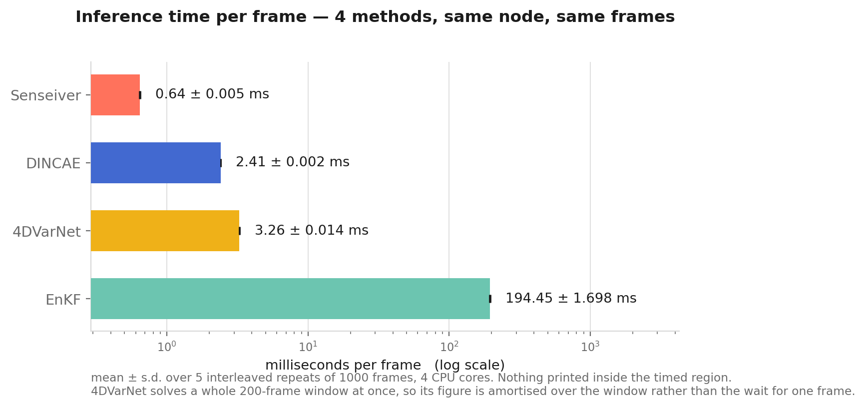
Action item — inference time, per frame
You were right that last week's figure was total run time, not inference time. This is per frame: mean ± s.d. over 5 interleaved repeats, all four methods on the same node over the same frames, with nothing printed inside the timed region.
Senseiver is the fastest by a wide margin — and it is also the most accurate under Convention B.
Caveat on the 4DVarNet bar: it solves a whole 200-frame window at once, so its 2.74 ms is amortised over the window, not the wait for one frame.
Notes:
Own the correction plainly, then move on — it is one slide, not a defence.
Interleaved, not blocked: round 1 runs every method, then round 2, and so on. Blocking would let a change in the shared node's background load land entirely on one method and be read as a difference between methods. Largest run-to-run spread here is 1.7% of the mean.
The caveat matters and I would rather state it than be asked: for the three per-frame methods this number IS the delay before that frame's estimate exists. For 4DVarNet it is not — one window (200 frames) solves in about 0.65 s. I have the latency figures measured and can show them if you want, but the amortised cost is what is on this slide.
k=4 is not shown: in our setting the robots observe every frame. The a2 widened-prior 4DVarNet is not shown either — the bar here is the same model as the accuracy slides.

Slide 7
The ablation that settles it
Same DINCAE architecture. Same 7 days. Same validation-picked checkpoint rule. The only change: supervise every cell instead of only the defined ones.
all-cells blind RMSE: 0.757 -> 0.173 (-77%)
defined blind RMSE: 0.329 -> 0.349 (+5.9%)
Last place, 4.5x behind, becomes second — by changing the loss mask, not the model. The gap under convention B was never a capability gap.
And the 5.9% it loses under convention A says the information form is genuinely part of why DINCAE wins there — not just its architecture.
Notes:
Everything before this argues the hypothesis across methods; this proves it INSIDE one method, where architecture, data, and checkpoint rule are all held fixed.
Cost: 150 epochs, ~21 GPU-hours, plus a separate 13 GB target cache. The change itself is two lines in encode_target.
One trap worth mentioning if the question comes: the naive version — flip the loss mask to 1 and keep the existing targets — trains the network to predict the per-cell CLIMATOLOGY on empty cells, because a stored 0 in normalised space decodes to mean[c] (-0.067 for vy), not to physical zero.

