Slide 1
The dynamical prior Φ
9,420 parameters · 0.5% of the model
Xinle Zhang

Slide 2
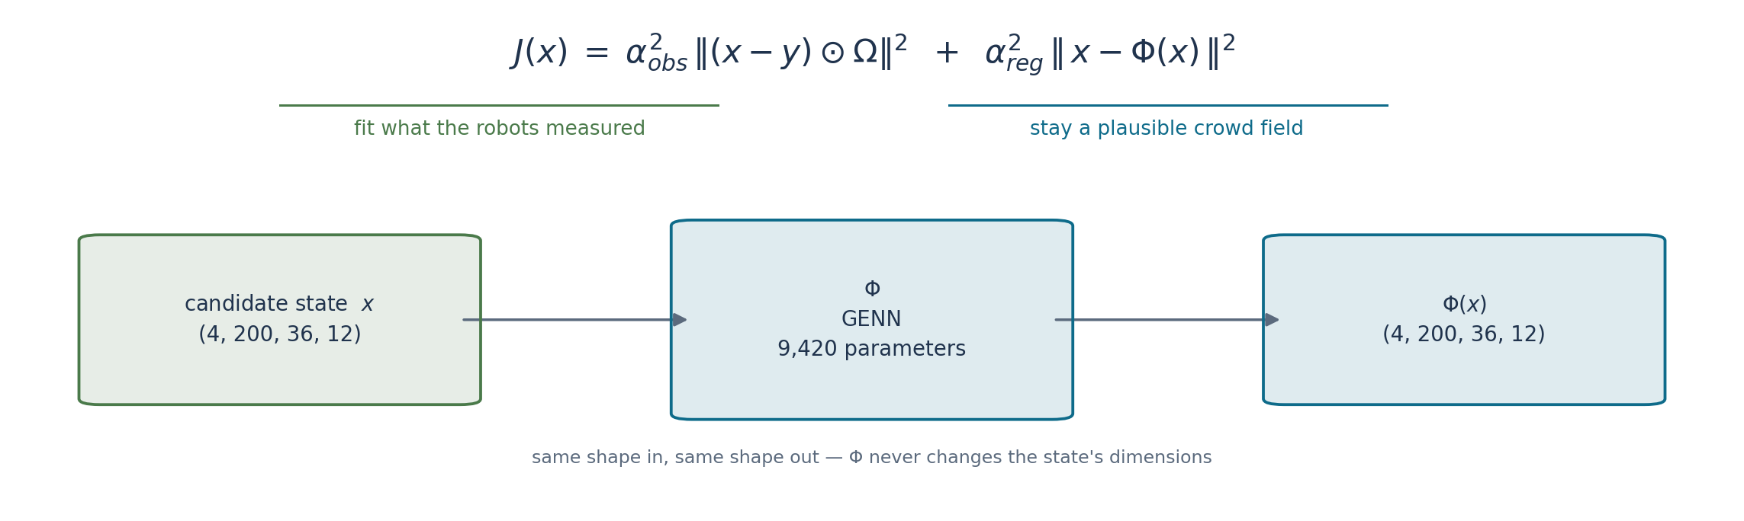
What the prior is for
Not a forecaster: given x, it says what each frame SHOULD look like, judged from the frames around it.
Plausible x → x ≈ Φ(x), term small. Impossible x → term large, solver pushed away.
The only route to cells no robot saw — the observation term is zero there.
Notes:
Say the last bullet out loud even if nobody asks: it is the reason the prior matters at all for our problem. Roughly 38% of walkable cells carry no observation in a given frame, and their reconstruction comes only from Φ.
α_obs and α_reg are learned alongside everything else, so the balance between the two terms is not hand-tuned either.

Slide 3
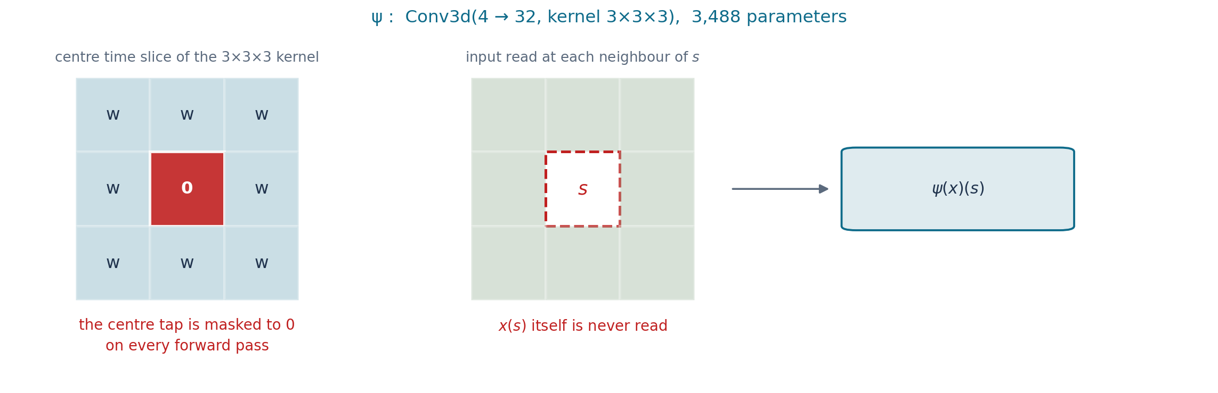
Inside Φ, part 1 — ψ, the one convolution that sees neighbours
The output at a point never reads the input at that point.
Without it, Φ = identity drives ‖x − Φ(x)‖² to zero for EVERY x — the prior would constrain nothing.
The mask is re-applied every forward pass, so the optimiser cannot undo it.
Notes:
This is the single most important slide in the deck — everything else in the prior's design exists to protect this property.
If asked how far it reaches: kernel 3x3x3 means +-1 frames in time and +-1 cells in space. Because phi is pointwise, that is the ENTIRE receptive field of one branch.

Slide 4
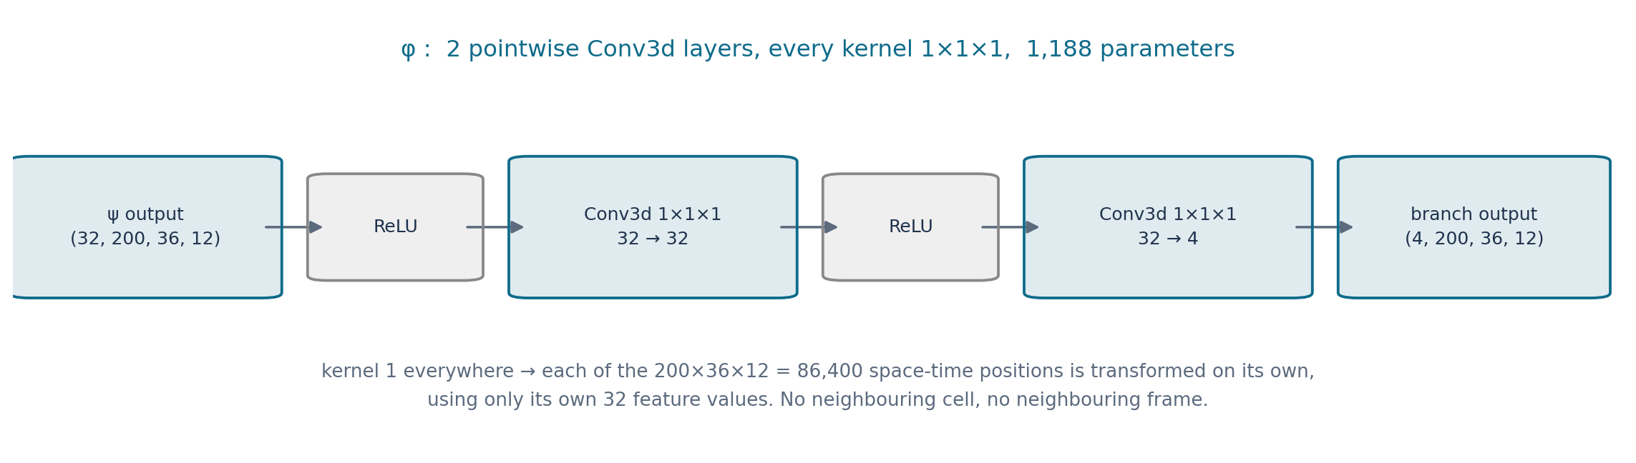
Inside Φ, part 2 — φ, pointwise on purpose
Paper Sec. 3.2 requires it: every kernel size is 1.
A wider kernel would pull in a neighbour — which does depend on x(s) — and make the identity reachable again.
So all spatial and temporal context comes from ψ alone. Widening φ adds capacity, not reach.
Notes:
The order in the code is psi -> ReLU -> Conv(1x1x1) -> ReLU -> Conv(1x1x1); the 1,188 parameters are the two convolutions..

Slide 5
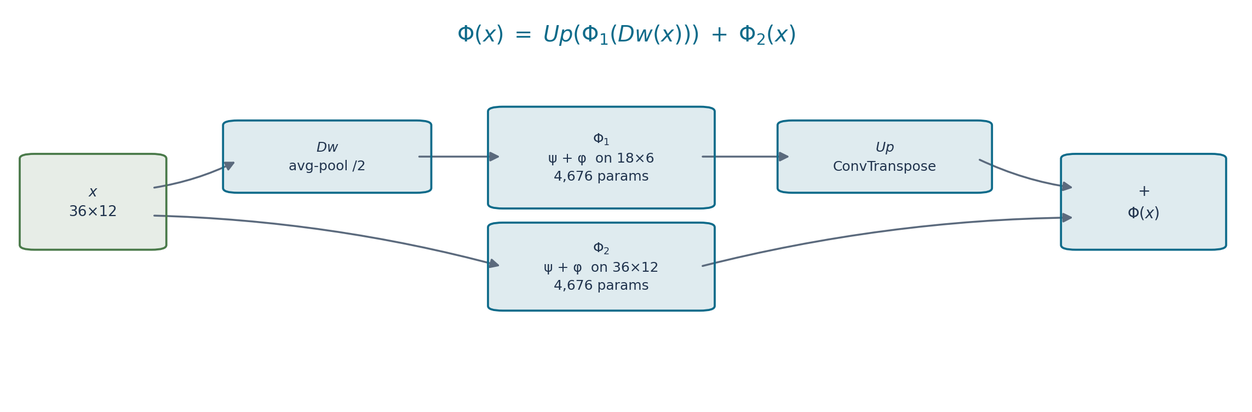
Inside Φ, part 3 — two scales (Eq. 10)
Each branch is a full ψ + φ (4,676 params), both zero-centre. Prior total 9,420.
Φ₁ runs AT 18×6, so its 3×3 kernel covers 6×6 fine cells — genuinely different scales.
Φ₂ takes x itself, not a high-pass residual; Up is learned, not interpolation.
Notes:
The mistake we made first and then fixed: blurring x, feeding blur and high-pass to two FULL-resolution branches. Both branches then had the same receptive field in real terms, which defeats the purpose. Now the coarse branch genuinely runs on the smaller grid.
Caveat if pressed: with two scales the zero-centre property is no longer exact. Pooling folds x(s) into a coarse cell and Up spreads it back, so d|Phi(x)(s)|/dx(s) is 2e-2 on this model — 2% of what the identity would give, against exactly 0 for a single branch. Still far from reachable, but say 'effectively excluded', not 'excluded'. It is a property of Eq.10 itself; the paper does not quantify it. Measured by checks/check_paper_conformance.py.

Slide 6
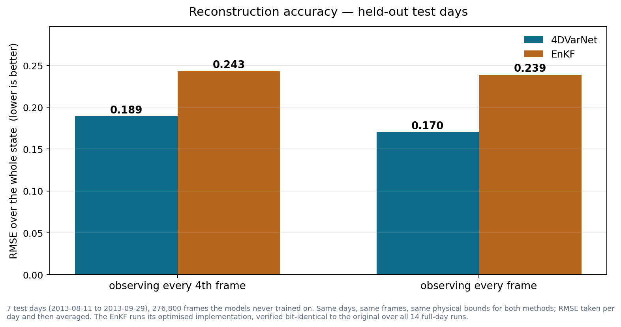
Where it stands — accuracy
7 held-out test days, 276,800 frames. Same frames and bounds for both methods; RMSE over the whole state.
Notes:
More observations help us far more than they help the filter (0.188 -> 0.167 against 0.243 -> 0.239).
If asked why the filter barely improves: its ensemble spread is about 90x smaller than its actual error, so the Kalman gain is near zero and observations are largely ignored — measured, not inferred. Mention only if asked, and add that it is their configuration and we did not change it.

Slide 7
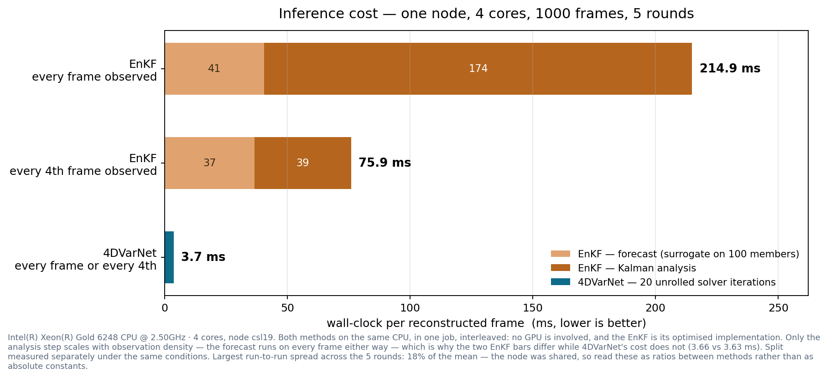
Where it stands — inference cost
One node, 4 cores, no GPU either side. EnKF is its optimised implementation, bit-identical to the original.
Notes:
If asked how solid the absolute numbers are, say it plainly: the EnKF's per-frame cost has measured anywhere from 130 to 290 ms across sessions on identical code, because every batch-csl node is shared and its k=1 pass runs for minutes, so it absorbs whatever else is on the node. 4DVarNet's is stable (3.3-3.8 ms) because each pass is seconds. The ratio between the methods is what survives that, and it is 40-80x in every session. No exclusive node was available to do better.
The structural point the figure makes: the filter's cost tracks observation density because it pays a Kalman analysis per observed frame, while its forecast runs every frame either way (33 vs 32 ms). The solver's cost does not move at all (3.66 vs 3.63 ms) — it runs a fixed 20 iterations over the whole dense window.
So denser observations widen the gap in speed as well as in accuracy.

