Slide 1
Training results
Four configurations of the reconstruction, 5 ensemble members, all on the same 7 held-out test days
Xinle Zhang

Slide 2
What has been trained
b0 prior 9,420 params (hidden 32, kt 3) — MODEL OF RECORD
full-state RMSE 0.1702 (k=1) / 0.1891 (k=4); best epoch 145 of 150, still improving when it stopped
a2 prior 32,076 params (hidden 64, kt 5)
RMSE 0.1666 / 0.1883 — 2.1% better than b0 at k=1, for 3.4x the prior and 2.15x the inference time (3.66 -> 7.86 ms/frame, same 4-core CPU)
a4 prior 54,220 params (hidden 96, kt 5)
RMSE 0.1648 / 0.1870 — the best accuracy of the three, but its training destabilised at epoch 52 and never recovered
ml5 b0's architecture, trained on the Gaussian NLL, 5 members
RMSE 0.1732 ± 0.0005 — +1.8% against b0, in exchange for a calibrated per-cell uncertainty
Notes:
a4 was left unfinished earlier and has now been completed to epoch 100 and evaluated, so there are no partial runs left.
The inference figures quoted for b0 and a2 are the 4-core CPU benchmark, which is the convention used throughout. a4 was never benchmarked on CPU; on a matched A100 it is 3.1x b0's architecture, but that is a different measurement and should not be mixed with the CPU numbers.

Slide 3
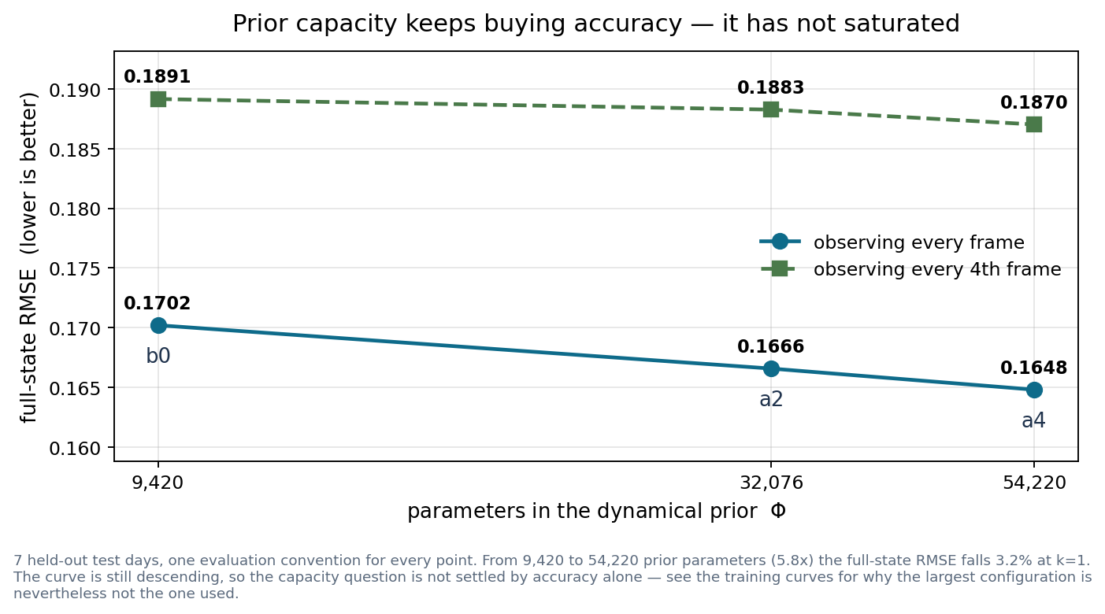
Prior capacity has not saturated
From 9,420 to 54,220 prior parameters — 5.8x — the full-state RMSE falls 3.2%, and it is still descending. Accuracy alone would argue for the largest prior.
Notes:
This corrects an expectation I had going in: I assumed capacity would saturate somewhere near 30k parameters and that a4 would confirm it. It did not — a4 is the most accurate of the three.
The prior is a small fraction of the model either way: even a4's 54,220 is 2.6% of the 2.1M total, almost all of which is the ConvLSTM solver. So this is not a story about model size, it is about the prior specifically.

Slide 4
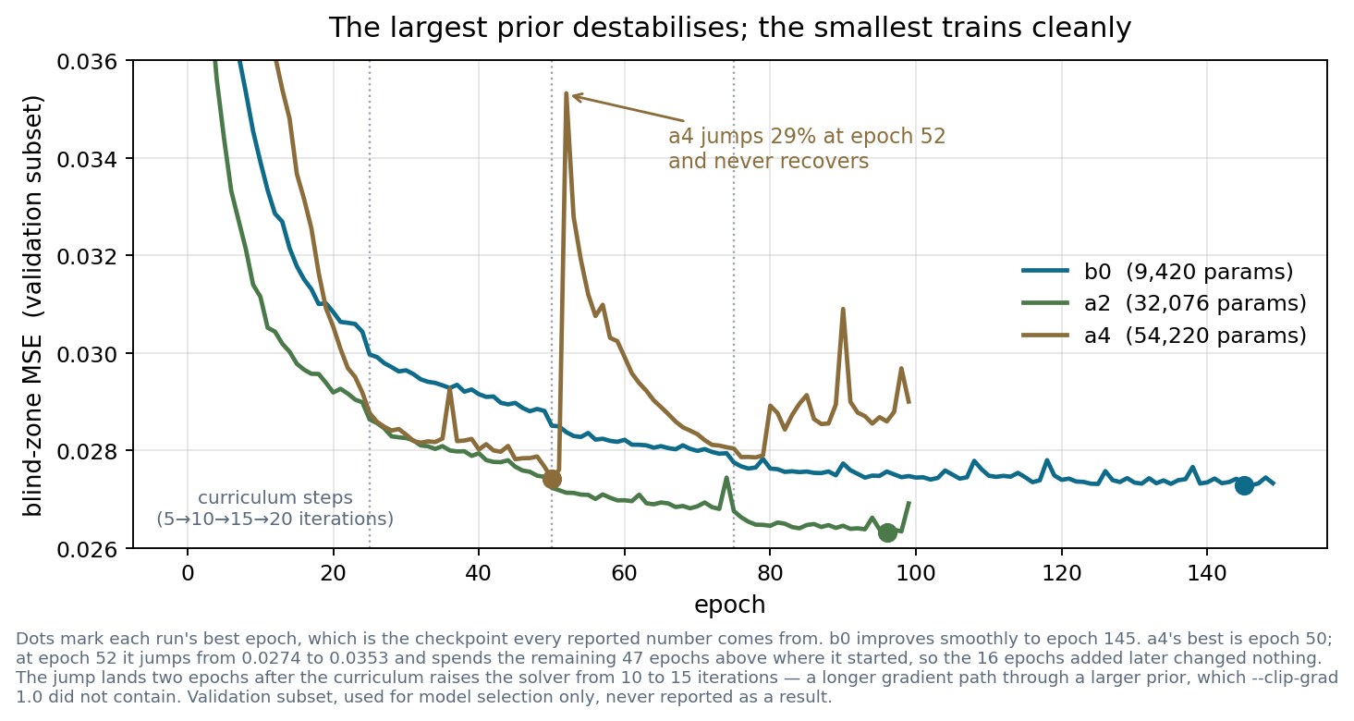
But the largest prior does not train reliably
a4's best epoch is 50. At epoch 52 its blind-zone error jumps 29% and stays above its own starting point for the remaining 47 epochs — the 16 epochs added to finish the run changed nothing. b0 trains smoothly throughout.
Notes:
The jump lands two epochs after the curriculum raises the solver from 10 to 15 iterations. A longer unrolled gradient path through a larger prior is the obvious suspect and --clip-grad 1.0 did not contain it, but this is one run at one capacity — a mechanism worth stating as a hypothesis, not a conclusion.
The practical consequence is what matters: the accuracy advantage on the previous slide comes from a checkpoint taken before the instability, so it is real but it was not obtained by a training procedure I would rely on. b0 delivers within 3% of it, trains monotonically, and runs 2-3x faster.

Slide 5
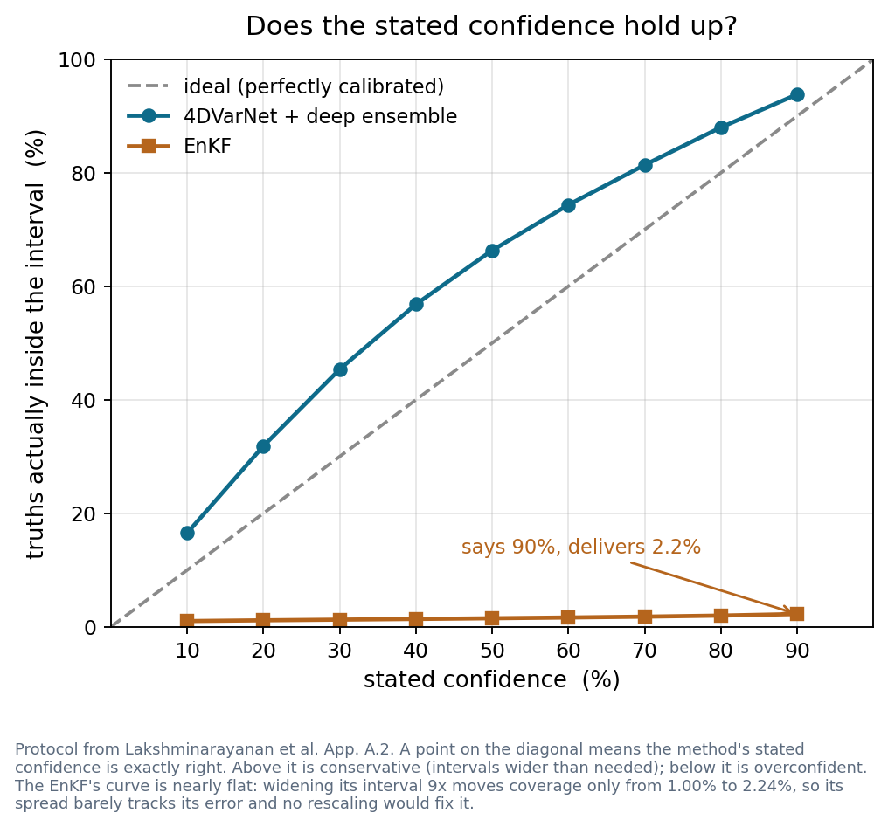
What the NLL objective bought: a usable uncertainty
spread / skill — ideal is 1.0
ours 0.87 overall, 0.99 in the blind cells · EnKF 0.011
90% interval actually contains — ideal is 90%
ours 93.8% · EnKF 2.2%
does sigma know WHERE it is unsure?
ours: 0.1960 in blind cells against 0.1177 in observed ones (1.67x)
EnKF: 0.0025 against 0.0025 — identical, it cannot tell them apart
The blind cells — the ones this exists for — are close to ideal at 0.99. The observed cells are over-confident at 0.71, so we are not uniformly on the safe side; the EnKF is over-confident everywhere by roughly 90x.
Structurally the matched comparison is against the members' disagreement alone: 0.0890 against the EnKF's 0.0025.
Notes:
This is the answer to 'why pay 1.8% accuracy'.
These numbers are from after the head's sigma^2 floor was removed — same five checkpoints, no retraining, sigma^2 = softplus(head). A floorless retrain (runs/varnet_nf5_s*) is running now; if it moves these numbers it will move them in the observed cells, which is where the mismatch is. Anyone who saw an earlier version of this slide saw different figures.
The member spread is not optional: the learnt sigma alone is calibrated at 0.65 with 76.9% coverage and its NLL diverges, because nothing floors a member that claims certainty. That question used to be open and is now settled.
The EnKF's spread is its own project's configuration, unmodified.

Slide 6
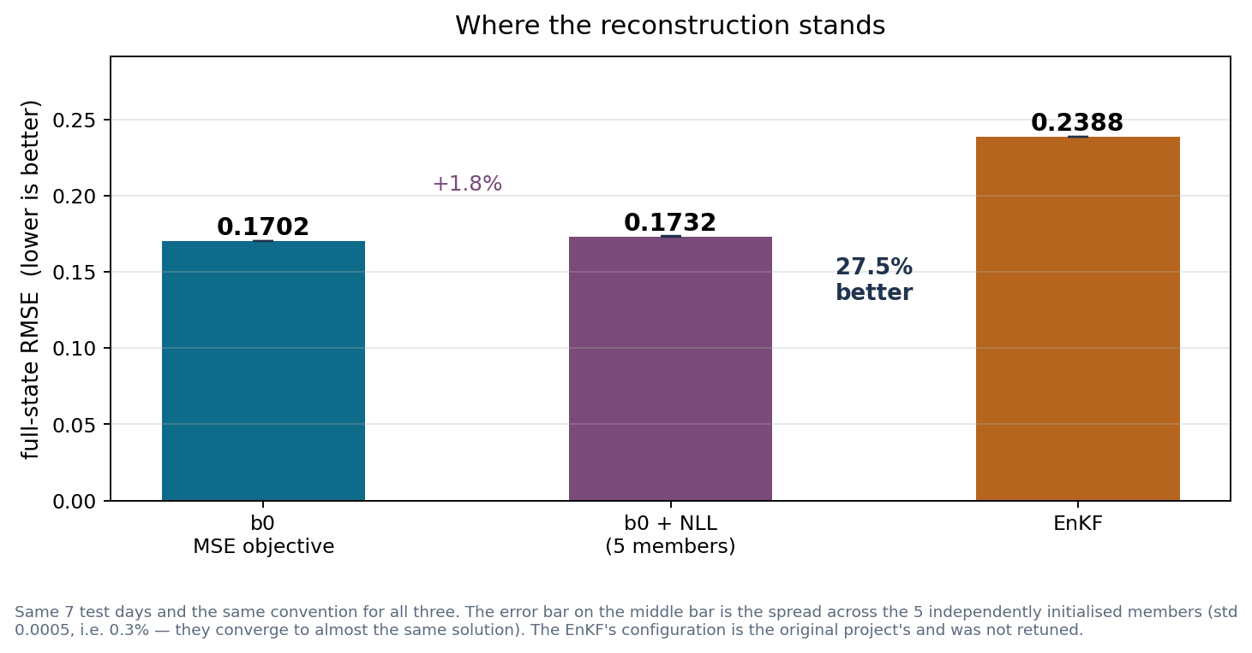
Where the reconstruction stands
Against the EnKF baseline at k=1: b0 is 28.7% better, and the NLL variant 27.5% better while also reporting a per-cell uncertainty. The 5 members agree to within 0.3%.
Notes:
The EnKF number is its own project's configuration, unmodified — worth saying before it is asked.
Open items, none of them blocking: no CPU benchmark for a4; no uncertainty measured at k=4 for our side; and whether the 5-member ensemble is needed at all, given how closely the members agree.

