Slide 1
Uncertainty: completing the EnKF evaluation, and a third method
Both tasks done — 7-day EnKF evaluation at k=1 and k=4, and deep ensembles implemented and compared
Xinle Zhang

Slide 2
Task 1 — the optimised EnKF, 7 days, both observation densities
Accuracy and uncertainty both complete, on all 7 held-out test days (479,594,304 points per setting).
k=1 (every frame observed) RMSE 0.2388 CRPS 0.1472 spread/skill 0.011 90% coverage 2.24%
k=4 (every 4th frame) RMSE 0.2428 CRPS 0.1475 spread/skill 0.010 90% coverage 1.99%
Four times the observations changes almost nothing: RMSE moves 1.7%, CRPS 0.2%. Together with the Kalman correction accounting for 0.22% of the forecast error, this says the observations are barely entering the state.
Notes:
Say the last point deliberately: it is the first hint of what slide 5 explains.
One gap to own if asked: test_metrics_enkf_k*.json does not record which of the three copies (orig / lab / opt) produced it, so 'the optimised implementation' currently rests on the process record rather than on the file. The numbers are unaffected -- verify_enkf_opt.py proves the three are bit-identical -- and I am adding the field.

Slide 3
Task 2 — the third method: deep ensembles
Lakshminarayanan, Pritzel & Blundell, NeurIPS 2017 (arXiv:1612.01474). Chosen because it is the standard against which uncertainty methods are measured, and because it needs no change to the reconstruction itself.
The recipe, and what we implemented
each network predicts a mean AND a variance, and is trained on the Gaussian NLL instead of MSE (their Eq.1) — a proper scoring rule, so it rewards a calibrated sigma rather than merely a small error
5 members, differing only in initialisation (5 trained, 150 epochs each, ~79 GPU-hours); combined by their Sec. 2.4 moment matching
adversarial training (their Sec. 2.3) skipped: optional, and their Table 2 states it does not help on regression
The variational cost J(x) is untouched — only the training loss changed, which is a substitution 4DVarNet explicitly allows. The solver still descends the gradient of the cost, computed from observations alone.
Notes:
The question to put to the meeting: deep ensembles is an uncertainty RECIPE, not a separate reconstruction method — we applied it to our own 4DVarNet. If the three-way benchmark is meant to have three independent RECONSTRUCTION methods, that is a different search and I should know now.
Cost detail if asked: the variance head is 548 parameters, 0.03% of the model.

Slide 4
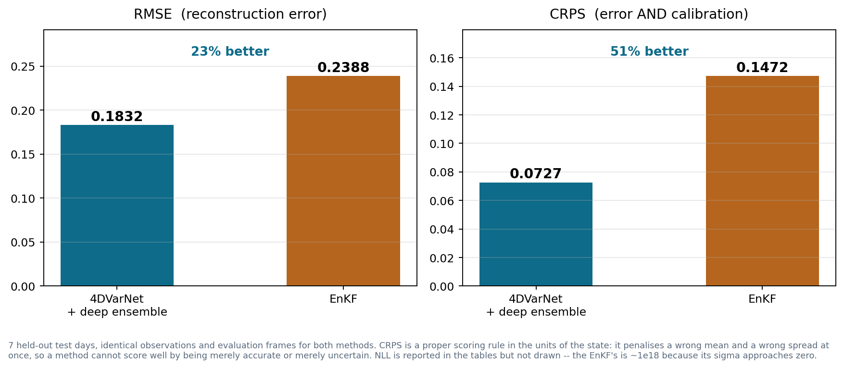
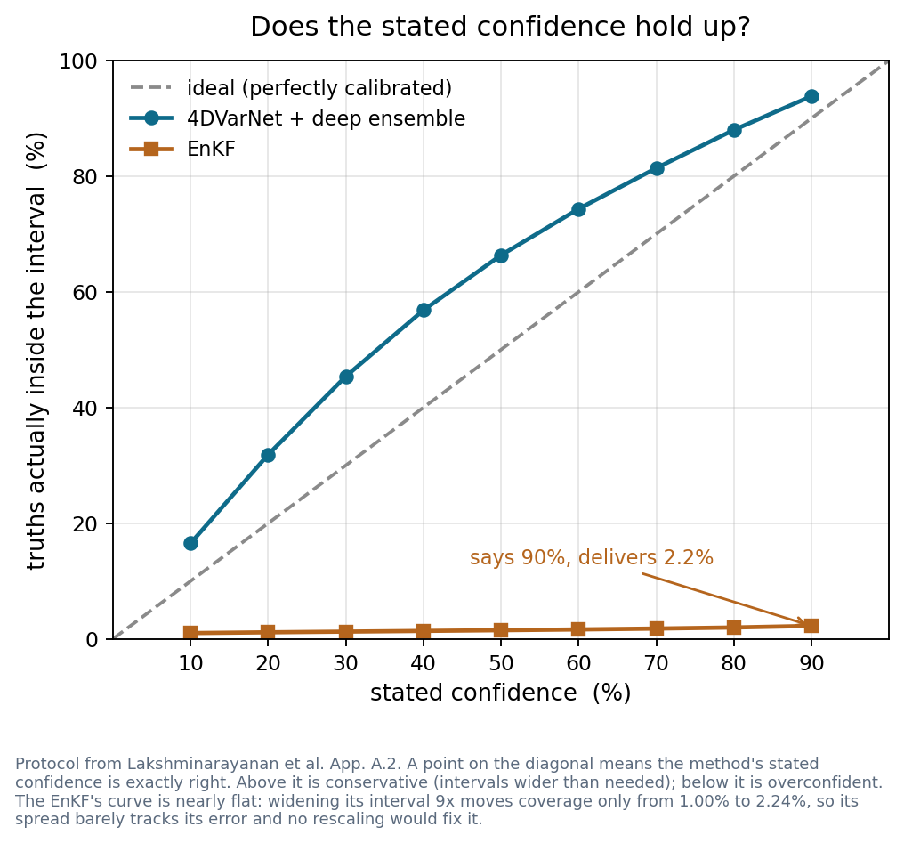
Result — better on accuracy and on uncertainty
RMSE 0.1832 against 0.2388 (23% better); CRPS 0.0727 against 0.1472 (51% better).
Calibration: spread/skill 0.87 against 0.011 (1.0 is perfect), and 0.99 in the blind cells, which is where it has to work. The observed cells are over-confident at 0.71 — we are not uniformly on the safe side.
Cost of the change: full-state RMSE 0.1599 -> 0.1616, +1.1% at matched epochs. The paper reports a median penalty of 5.6% for the same trade.
Notes:
These numbers are from after the head's sigma^2 floor was removed, so they differ from any earlier version of this deck. No retraining — the same five checkpoints with sigma^2 = softplus(head). A floorless retrain (runs/varnet_nf5_s*) is running now; if it moves these numbers it will move them in the observed cells, which is where the mismatch is.
The member spread is not optional. The learnt sigma alone scores 0.65 spread/skill against the five-member 0.87, and its NLL diverges, because with nothing flooring it a single member can claim a sigma near zero. While the floor existed the aleatoric-only variant was the better calibrated of the two, so this used to look like a way to cut inference 5x. It is not any more.
The learned sigma also knows where it is unsure: 0.1960 in blind cells against 0.1177 in observed ones. The EnKF's is 0.0025 against 0.0025 — identical.

Slide 5
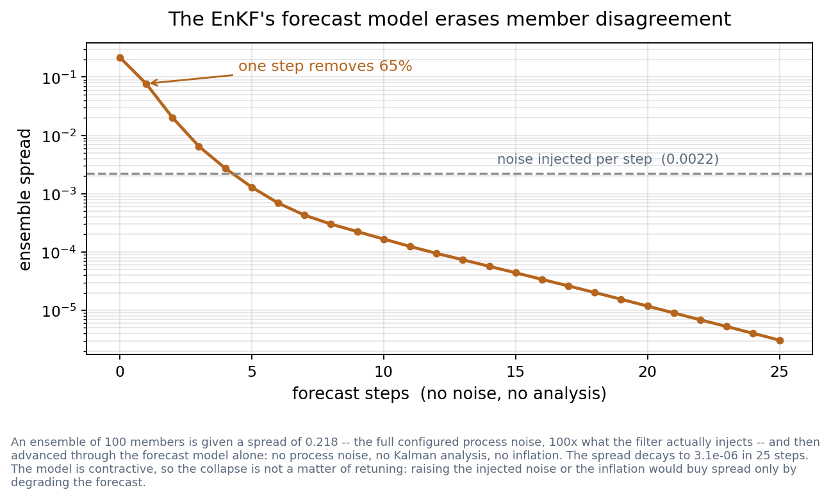
Why the EnKF's uncertainty fails — and why tuning would not fix it
Its uncertainty IS the ensemble spread, and the forecast model removes member disagreement faster than any noise term can restore it.
So the collapse is structural, not a bad setting: a deterministic surrogate trained to minimise prediction error is trained to be contractive, which is exactly what an ensemble needs it not to be.
This is why we did not retune the baseline. Raising the inflation or the process noise buys spread only by corrupting the forecast.
Notes:
This is the strongest technical content in the deck. The chain, all measured: the surrogate removes ~65% of member disagreement per step; the filter injects 0.0022 per step; the equilibrium spread is 0.0025, which is what we observe. With spread that small the Kalman gain is near zero, so observations are barely assimilated -- which is why slide 2's k=1 and k=4 look the same, and why the accuracy suffers too.
If pushed to fix it: matching the true error would need ~100x the injected noise, i.e. adding noise of the same magnitude as the state itself every step. Inflation would need ~2.9 against a normal range of 1.02-1.2.
The honest limit of the claim: this is about a deterministic neural surrogate as the forecast model, not about ensemble filters in general.

Slide 6
Where this leaves us
Settled
the EnKF evaluation is complete at both observation densities, and the comparison is favourable on every metric we measured
the uncertainty is calibrated and it is informative — it is larger in cells no robot saw (0.196) than in observed ones (0.118), and it beats a constant-sigma null model on CRPS (0.0727 against 0.0861)
Open
the observed cells are over-confident at 0.71 spread/skill while the blind cells sit at 0.99. The heads were fitted WITH a sigma^2 floor and are being read without one; a floorless retrain (runs/varnet_nf5_s*) is running now and should say whether that split is the cause
we have no 4DVarNet uncertainty at k=4; given that the EnKF barely moves between k=1 and k=4, the value of adding it looks low against 79 more GPU-hours
is the three-way benchmark meant to compare three reconstruction methods, or three uncertainty treatments? That decides the next search
Notes:
Lead with the open question about what 'three-way' means -- it is the one thing only the supervisor can answer, and it determines the next two weeks.
One item that used to be on this list is now settled: whether the five members are needed. With the sigma^2 floor removed the learnt sigma alone is badly calibrated and its NLL diverges, so the member spread is load-bearing. They stay.

