Slide 1
Learned-covariance sequential Kalman filter
two networks, one differentiable Kalman layer

Slide 2
The idea
A filter needs two things: a forecast, and a sense of how far to trust it.
We learn both. One network predicts where the crowd will be. A second predicts
how uncertain that prediction is, cell by cell.
A differentiable Kalman layer fuses the two with whatever the robots happened
to see, and returns a full-field estimate together with a per-cell uncertainty.
Because the layer is differentiable, the whole thing trains end to end - which
matters, because nobody can label a covariance directly.

Slide 3
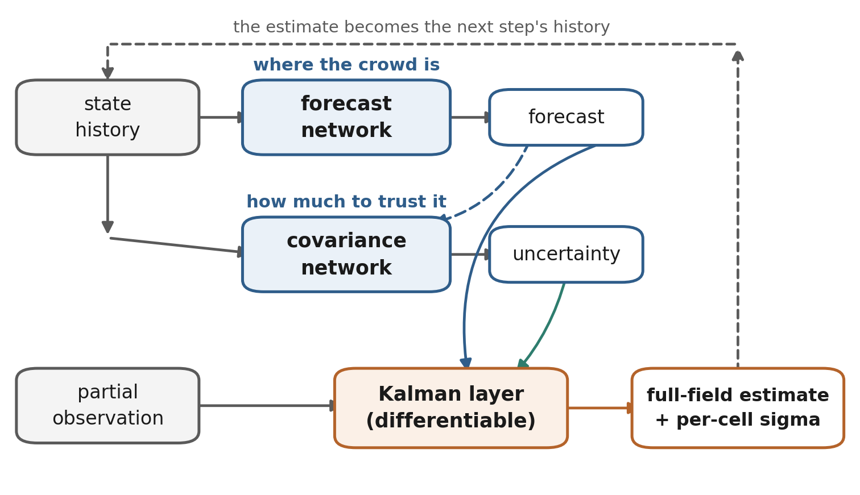
The framework
The robots see only part of the corridor.
The forecast covers all of it; the learned
uncertainty decides, cell by cell, whether to
move towards what was measured or to stay
with what was predicted.
It runs sequentially: each estimate becomes
part of the next step's history.

