Slide 1


Invest in Civil Cases
Jack Fazzone
Gonzalo Garcia
Jexibeth Amaris
Olan Ogunbufunmi

Slide 2
Contingency Fee System vs LawToken
Contingency | LawToken
Work, expenses, etc. put up by firm High risk premium Up to 30% of judgment forfeited | Firm only risks time worked on case Pooled risk lowers premium Larger portion of judgment retained

Slide 3
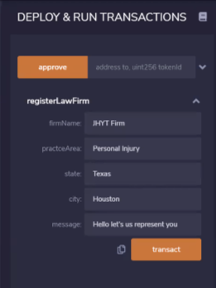
Law Firm Users
Firms can view open cases and connect with potential clients
Submit bid to represent plaintiffs:
Firm name
Firm practice area
Lump sum payment bid
Equity bid
Introductory message

Slide 4
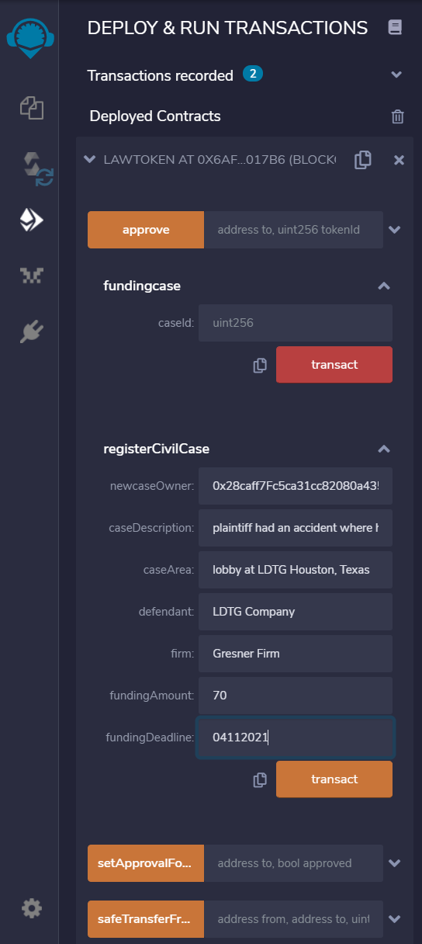
Register Civil Case
Case information
Decision of potential investors
caseId

Slide 5


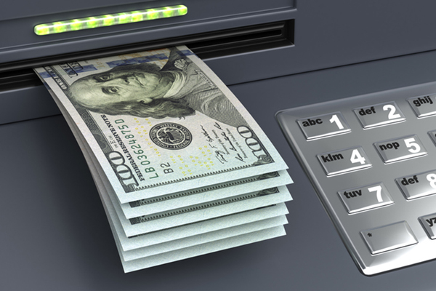
Funding, Cancel and, Withdrawing the Civil Case
Funding
Maximum amount to invest is asking funding .
Accounts balance must be equal to asking funding amount to proceed.
Cancel
In case the asking funding amount did not reach the goal.
Return LAWT to investors.
Withdrawing
Allows to used the funding to cover the civil case expenses during its process.

Slide 6




Mint tokens that represent equity in judgment to attorney and investors
Equity in judgment is issued from Crowdsale of Tokens
CASE
Exchangeable Fungible Tokens on Ethereum
LAWYER - CASE
INVEST
LAWT COIN
BTC, ETH
MINT
LAWT
TOKENS
ERC 20 standard
OpenZeppelin Secure Contracts
INVESTOR
WRAPPED - TOKEN
CONTRACT

Slide 7





The case has been settled, now what?
Automatic distribution
Limit funding account (safeguarding)
Attorney equity is a flexible rate (weighted distribution per settlement range)
Utilizing arrays to facilitate weighted distribution

Slide 8
Conclusion and Future Improvements
Conclusion
Squire offers to host the funding of civil cases through a smart contract.
Trust smart contract system
Potential Improvements
Web platform to allow users to better view and interact with cases
Bundled equities in numerous cases.
Use previous cases to predict total legal expenses and/or likely payment if case is won.
Transferrable tokens for each case or bundle.
Allowing structured settlement distributions.

