Slide 1

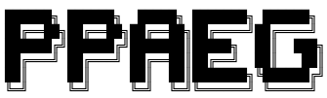
PPAEG: Automatic Exploit Generation for Server-side Prototype Pollution Vulnerabilities
Zhengyu Liu, Kecheng An, Yiyang Li, Tianjian Li
Presented by
October 18th, 2022
Notes:
Hi everyone, this is Zhengyu. We are also having Kecheng, Yiyang and Tianjian in our group.
Our project name is PPAEG, Automatic Exploit Generation for Server-side Prototype Pollution Vulnerabilities

Slide 2
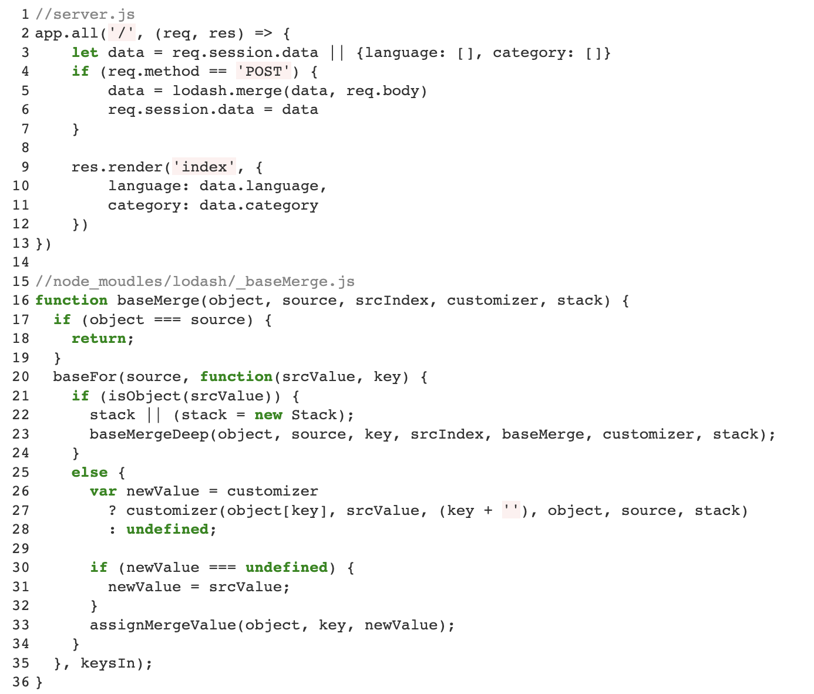
1 Introduction: Beyond Detection: From DOS to RCE
An Example of PP Detection
https://github.com/phith0n/code-breaking/tree/master/2018/thejs
from CodeBreaking 2018 TheJS Challenge
Notes:
Prototype pollution vulnerability is something familiar to us.
However, I am going to briefly introduce a motivating example to explain our threat model.
Let’s take a look at the example here.
The merge operation is called in the server code whichout sanitation to splice user input with existing information to complete the user profile, indicating that we can achieve prototype pollution.

Slide 3
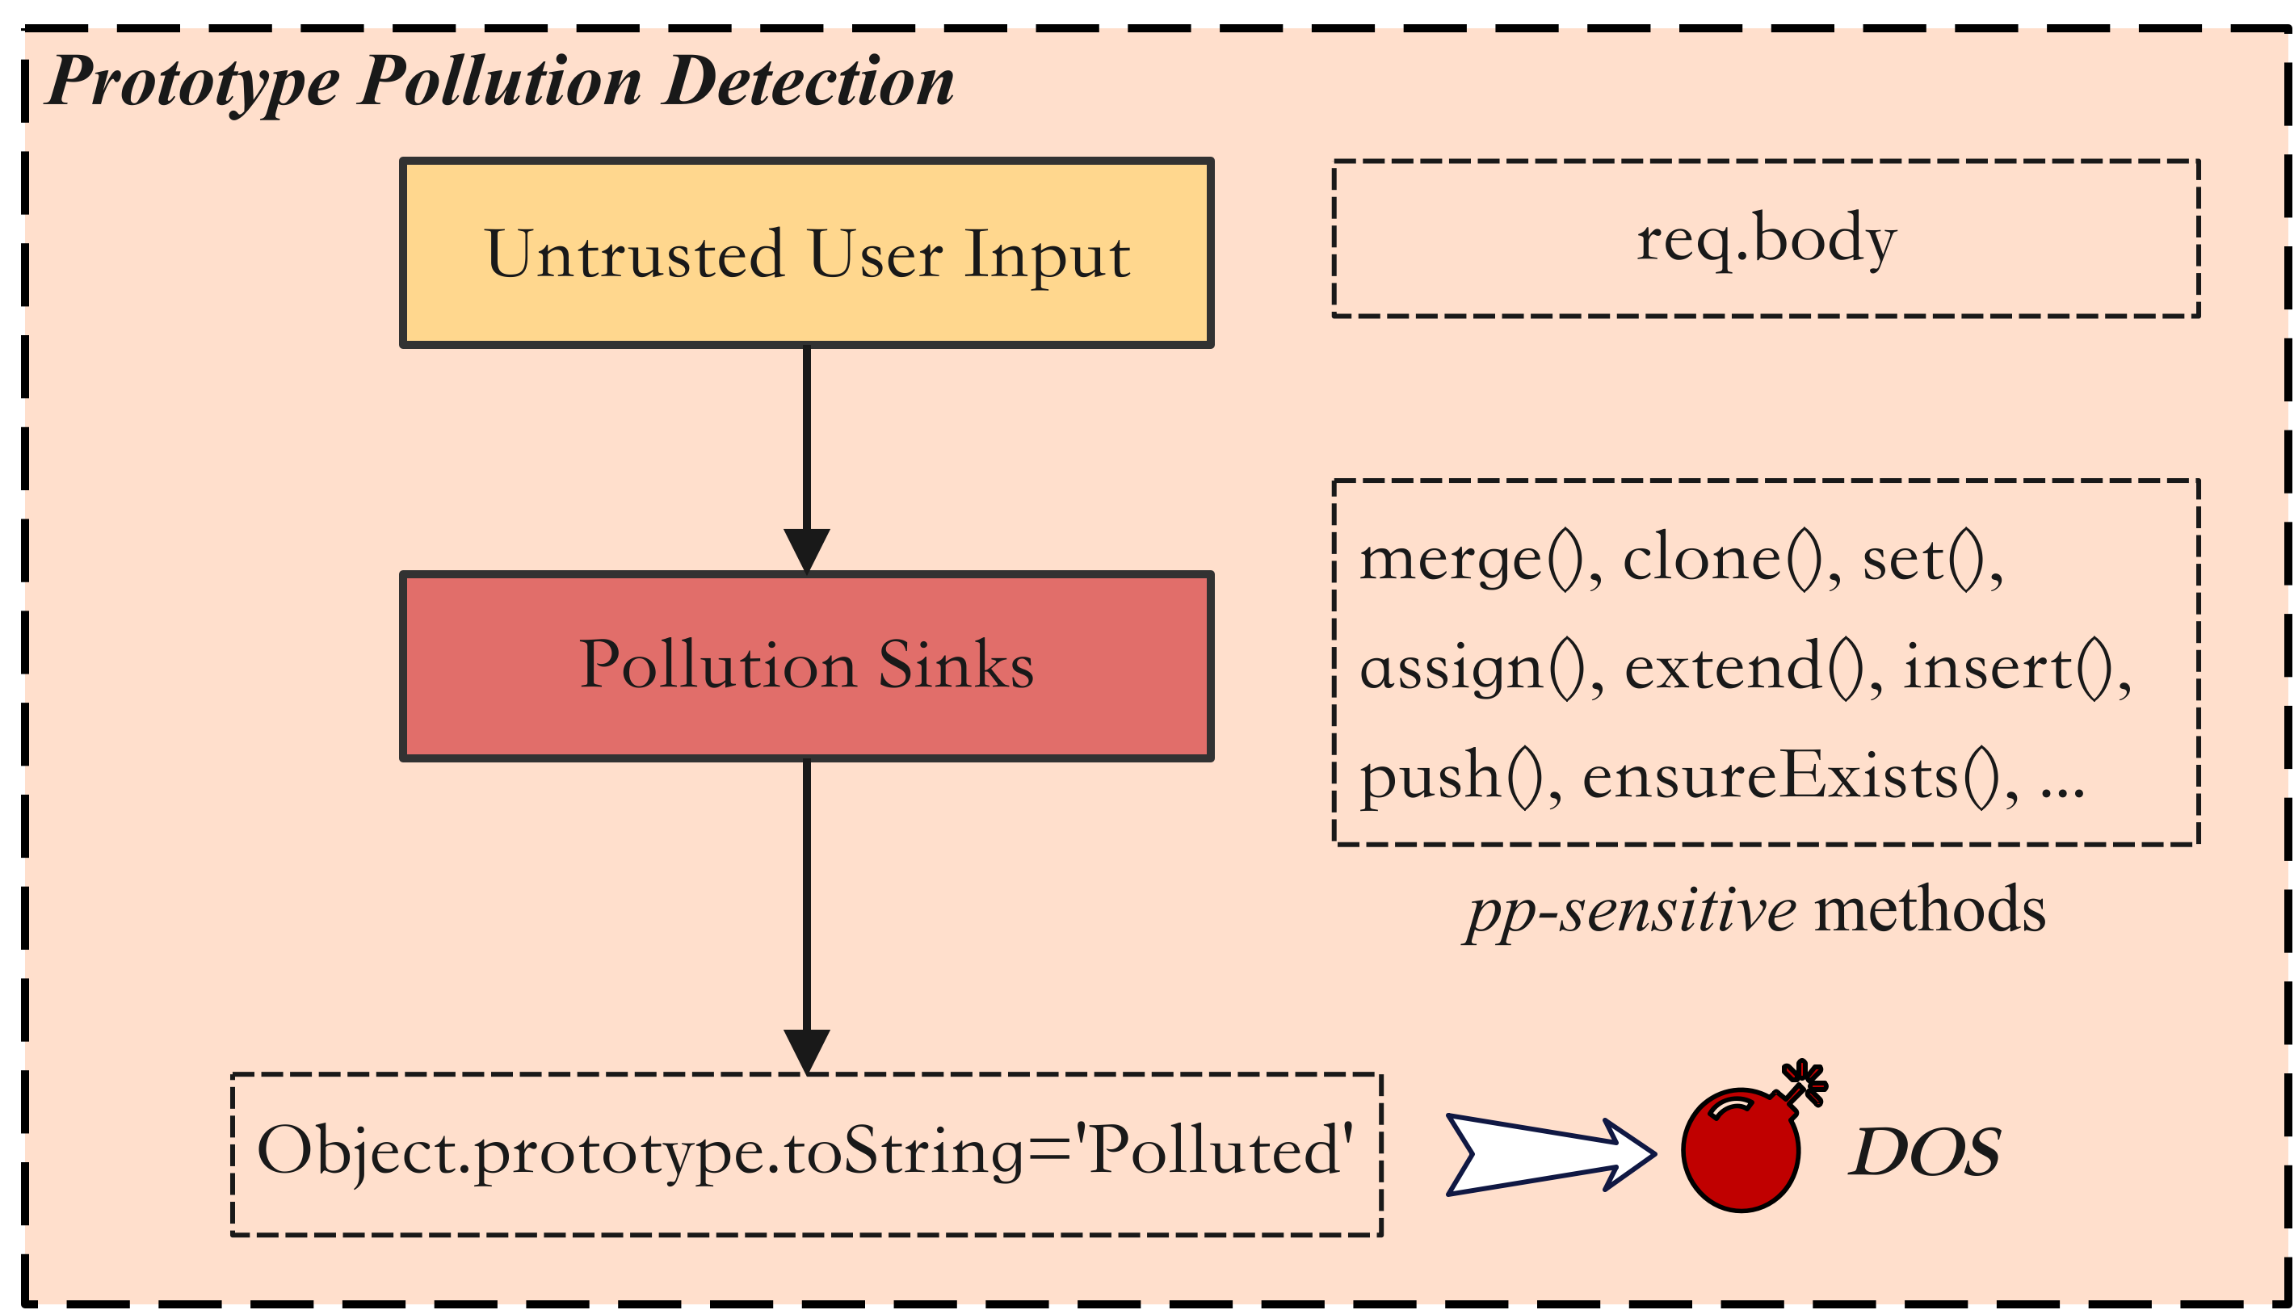
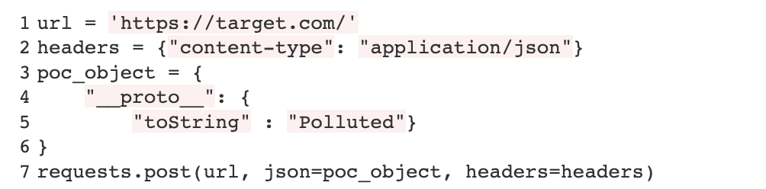
1 Introduction: Beyond Detection: From DOS to RCE
An Example of PP Detection
poc.py
Notes:
For the detection task, we can leverage static analysis to find the path from user input to the pollution sinks in the code and complete a simple POC to verify that the prototype can be successfully polluted.
But the story is far from over!
For now, we cause a Denial of Service attack but nothing else.
We really expect that prototype pollution would drive us to somewhere more dangerous like remote code execution.

Slide 4
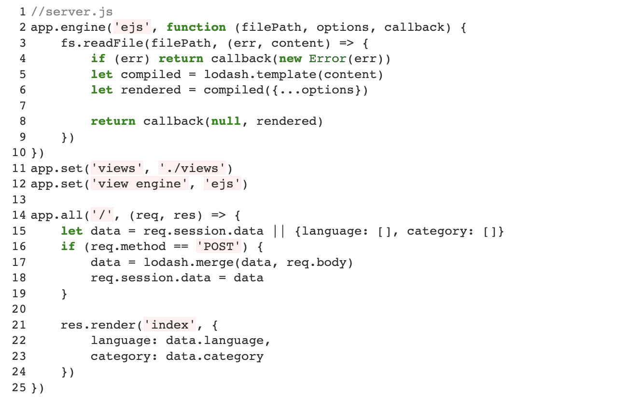
1 Introduction: Beyond Detection: From DOS to RCE
From Detection To AEG
using template engine which usually compile the engine-specific source code into a JavaScript function that takes a data object as an argument.
Notes:
How could we do that? Let's keep digging.
We found that the author used a template engine when returning the page. And template engine is usually powerful in js which usually compile the engine-specific string into a JavaScript function that can generate an html.
What if we can add malicious code during the process of the template parsing, and compilation and expect it will display to the final returned js function? It would be a perfect environment for our code execution!

Slide 5
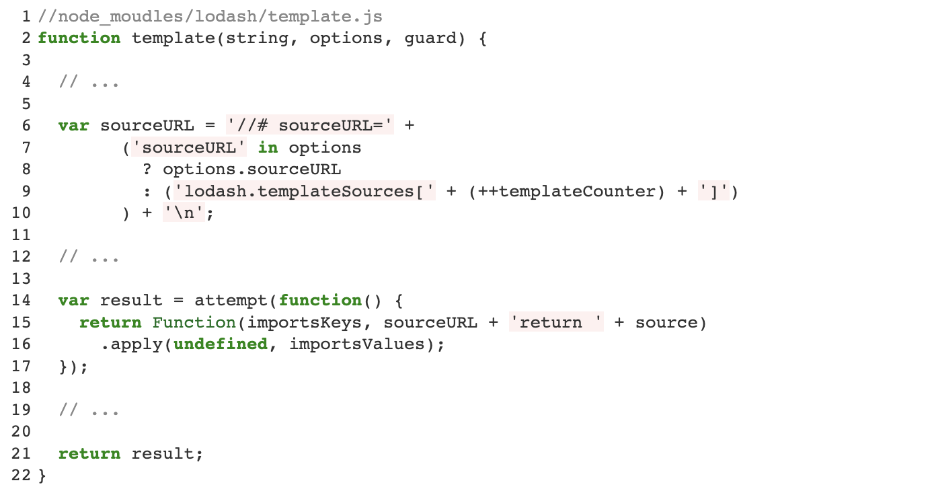
1 Introduction: Beyond Detection: From DOS to RCE
From Detection To AEG
find a potentially undefined property that is passed for generating the compiled function.
Notes:
Let’s follow the template function inside the lodash and we would find something interesting that there is an undefined property of options object and would lead to a prototype lookup.
This means that our polluted value could carry to the sourceURL, and finally the sourceURL would become a part of the dynamic generated function that return to the server code.

Slide 6
1 Introduction: Beyond Detection: From DOS to RCE
From Detection To AEG
The payload should be trailered to the given execution context.
Notes:
So, our next step is to pollute the sourceURL property as something like malicious code and hope it will be executed when returned.
And it should be noted that the payload might need to be trailered to the given execution context.

Slide 7
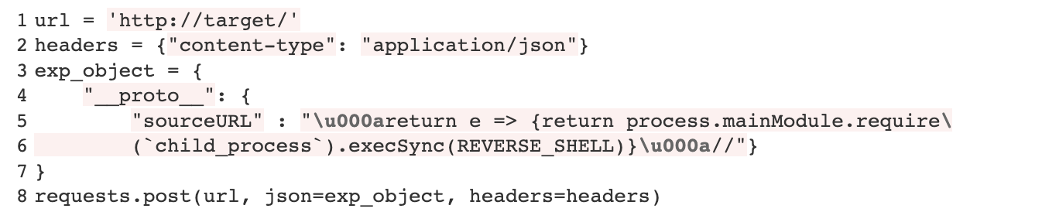
1 Introduction: Beyond Detection: From DOS to RCE
From Detection To AEG
exp.py
Notes:
Finally, we could construct an exploit like shown on the right side.

Slide 8
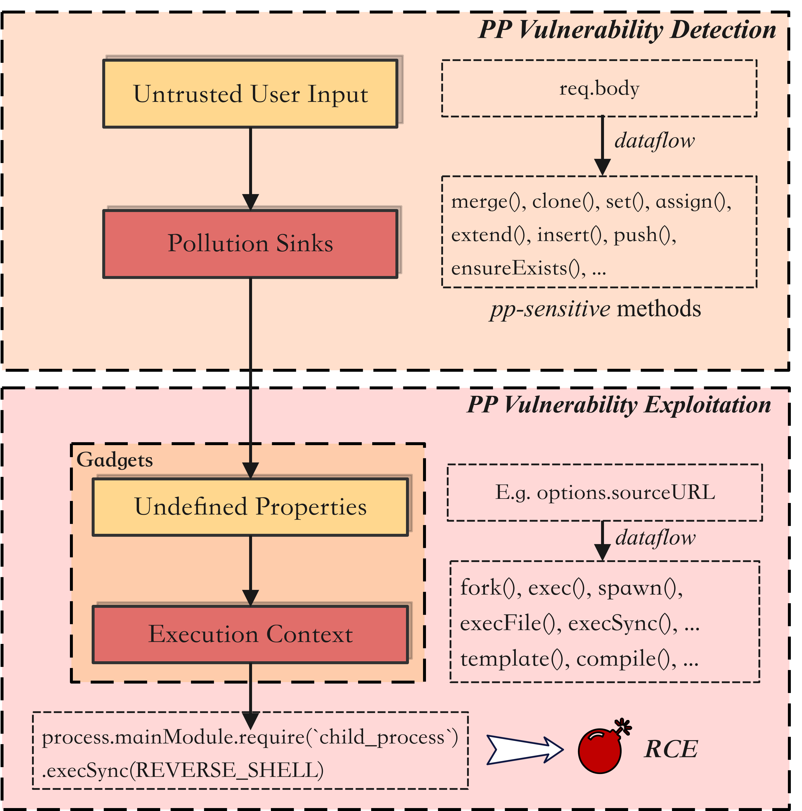
1 Introduction: Objectives of PPAEG
With great ambition, we expect PPAEG would become end-to-end prototype pollution exploit generation tool.
However, currently, we will build on the existing PP Detector and mainly focus on the vulnerability exploitation part:
identifying available gadgets from applications and their dependencies.
generating exploit objects that could successfully pollute the prototype and leverage the gadgets to get the attack vector executed.
Notes:
To sum up, we could define a threat model look like this on the left.
As the objectives of PPAEG, With great ambition, we expect PPAEG would become end-to-end prototype pollution exploit generation tool.
However, currently, we will build on the existing PP Detector and mainly focus on the vulnerability exploitation part:
identifying available gadgets from applications and their dependencies.
generating exploit objects that could successfully pollute the prototype and leverage the gadgets to get the attack vector executed.

Slide 9
2 Challenges
Identifying Gadgets
(C1-1) How to find the undefined properties that cause lookups to the Object.prototype in runtime?
(C1-2) It is difficult to identify and locate the execution contexts, especially those involved with template compilation and rendering.
(C1-3) The data flow from undefined properties to the execution contexts should be modeled correctly, which helps with identifying available gadgets.
Generating exploits (Fuzzing)
(C2-1) Other than the target properties, properties that help 1. the control flow reaching the execution contexts and 2. repairing the program after polluting the prototype should be added to the exploit object as well.
(C2-2) Attack Payloads might need to be tailored to given execution contexts.
Notes:
For the mentioned two steps, we can currently envision the challenges that should be addressed.
For the Gadgets identifying, we first need to find the undefined properties, and potential execution contexts. Then we need to find promising gadgets by statically analyzing the dataflow between them.
Then, to generate the exploits,
Other than the target properties, properties that help 1. the control flow reaching the execution contexts and 2. repairing the program after polluting the prototype should be added to the exploit object as well.
Secondly, attack payloads might need to be tailored to given execution contexts as shown in the previous case.

Slide 10
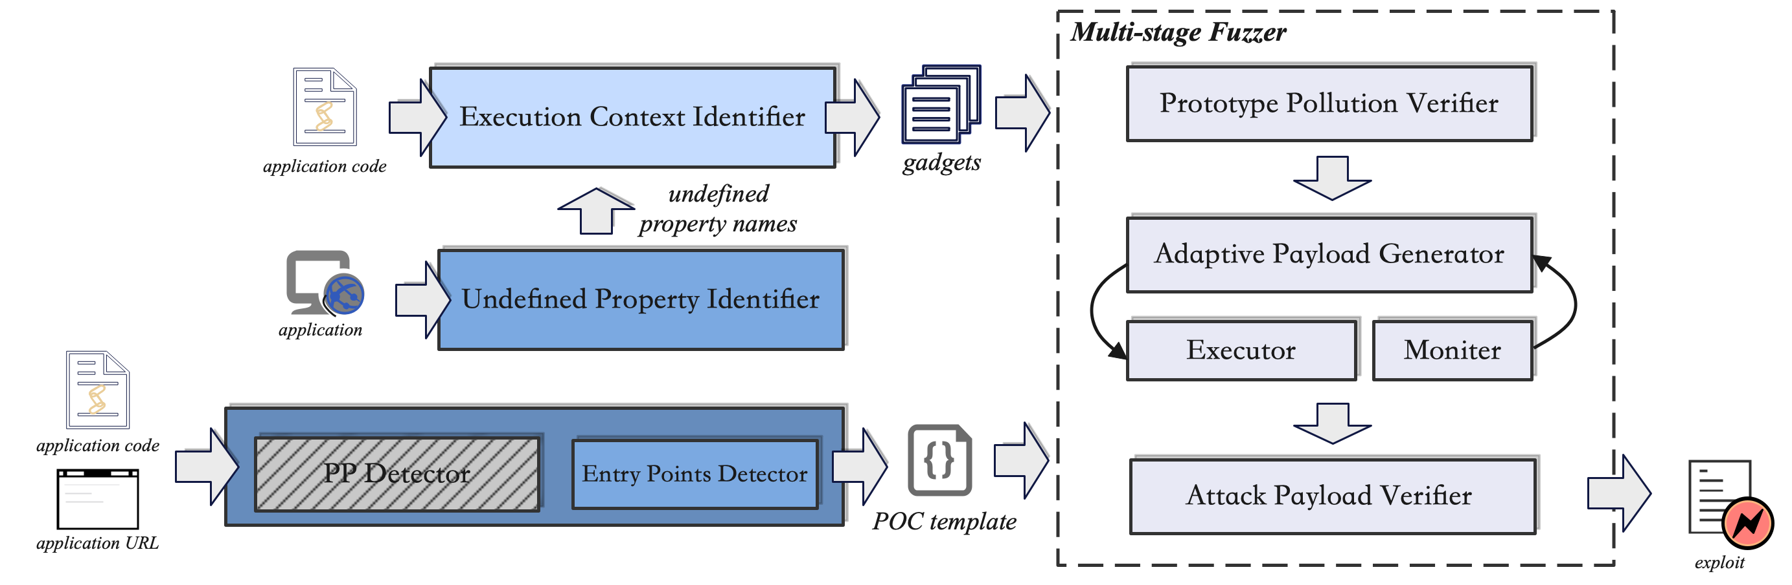
3 Methodology: The Overview of PPAEG
From the perspective of the objectives of AEG
Notes:
This is the prototype of our PPAEG.

Slide 11
3 Methodology: PP Detector
Objective:
Given the source code, find the prototype pollution sink candidates;
Generate the proof-of-concept template of the pollution sink candidates;
Notes:
I have said that our PPAEG are going to build on the existing PP Detector.
We hope it will find the prototype pollution sink candidates and generate the proof-of-concept template for us.
Or we may need to write a wrapper to generate a POC template by ourselves based on the information it provides.

Slide 12
3 Methodology: Undefined Property Identifier
Objective:
Given the source code and application, identify the undefined properties in runtime.
Solution:
Parse the application’s source code and extract all directly read properties.
Set Handler in Object.prototype to log all extracted properties lookup.
Run the application and check the log to find undefined properties.
Notes:
Our undefined property identifier will conduct dynamic analysis to identify the undefined properties in the runtime based on the given source code and application.

Slide 13
3 Methodology: Execution Context Identifier
Objective:
Identify the execution context in the program
Analyze the dataflow from undefined properties to the execution sinks and generate available gadgets
Solution:
Manually read the document and previously disclosed vulnerabilities and define code patterns in node.js that potentially run/evaluate code in the runtime.
Conduct taint tracking to identify paths from the undefined property and the execution sink.
Notes:
Then,move to the execution context identifier, its first task is to identify the execution context in the program. So, we are going to manually read the document and previously disclosed vulnerabilities and define code patterns in node.js that potentially run/evaluate code in the runtime.
Then, given the property candidates, it would conduct taint tracking to identify paths from the undefined property and the execution sink and generate gadgets.

Slide 14
3 Methodology: PP Fuzzer
Objective:
Given a target property and execution sink, construct the correct payload (from the generated POC templates) that successfully results in malicious remote code executions.
Solution:
In the first stage, verify that the target property can be polluted successfully;
In the second stage, properties inside the exploit object will be mutated and sent to the application, and check whether it can reach from undefined properties to the execution context.
Once the execution sink can be reached, in the final stage, the attack payloads will be tailored and delivered to the execution context until we monitor its execution or raise a time up.
Notes:
Finally, base on the identified gadgets and poc templates, we would conduct a multi-stage fuzzing tests on the application.
In the first stage, verify that the target property can be polluted successfully;
In the second stage, we are going to manipulate the properties to make sure that the gadgets can be reached and the polluted values can arrive at the execution sinks.
Once the execution sinks are reached, in the final stage, the attack payloads will be repeatly tailored and delivered to the execution context until we monitor its execution.

Slide 15

4 Related Works & Future Works
Silent Spring: Prototype Pollution Leads to Remote Code Execution in Node.js
Mainly focused on universal gadgets in the Node library.
Human-in-the-loop exploits generation.
Future Plan
First collect 20-30 PP vulnerable applications and exploit by ourselves
Review the system design and details the technique used in different part.
Split the tasks and work on our own module.
Kecheng
Zhengyu
Tianjian
Yiyang
Notes:
We luckily found a really new paper called Silent Spring, which has the same objective as ours.
However, there are two points that need to be noted firstly they mainly focus on universal gadgets which means gadgets inside the template engine is beyond their scope. And they didn’t try to generate exploits automatically.
And here are our future plan:

Slide 16
Thank you for your attention!
Zhengyu Liu
thisiszhengyu@gmail.com
Notes:
Thanks for your attention, that’s all.

