Slide 1

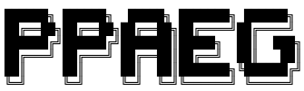
PPAEG: Automatic Exploit Generation for Server-side Prototype Pollution Vulnerabilities
Zhengyu Liu, Kecheng An, Yiyang Li, Tianjian Li
December 6th, 2022
Notes:
Hi everyone, this is Kecheng. Our group members are Zhenyu, Yiyang and Tianjian.
Our project name is PPAEG, Automatic Exploit Generation for Server-side Prototype Pollution Vulnerabilities

Slide 2
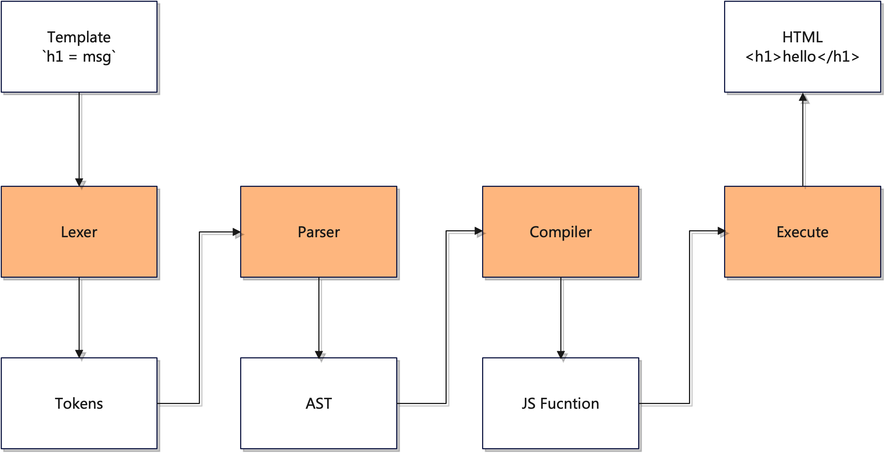
1 Introduction: Motivating Example
Template Engine
Pug
Template Engine
Notes:
You may have used template in Node.JS backend development. Template engine helps to create an HTML file with minimal code. Also, data can be injected into the HTML file conveniently.
Here we use a template engine Pug has an example, when you code up `h1 = msg`, and the msg is bind with data “hello”, it will be rendered into HTML code at the server side.

Slide 3
1 Introduction: Motivating Example
PP2RCE gadgets inside template render engine
Notes:
What happened under the hook is four commons steps:
the template code will be tokenized,
Then an Abstract syntax tree or AST is generated in a token Parser,
Then the AST will be compiled into JS function.
Once executed, the JS function will generate an HTML file.

Slide 4
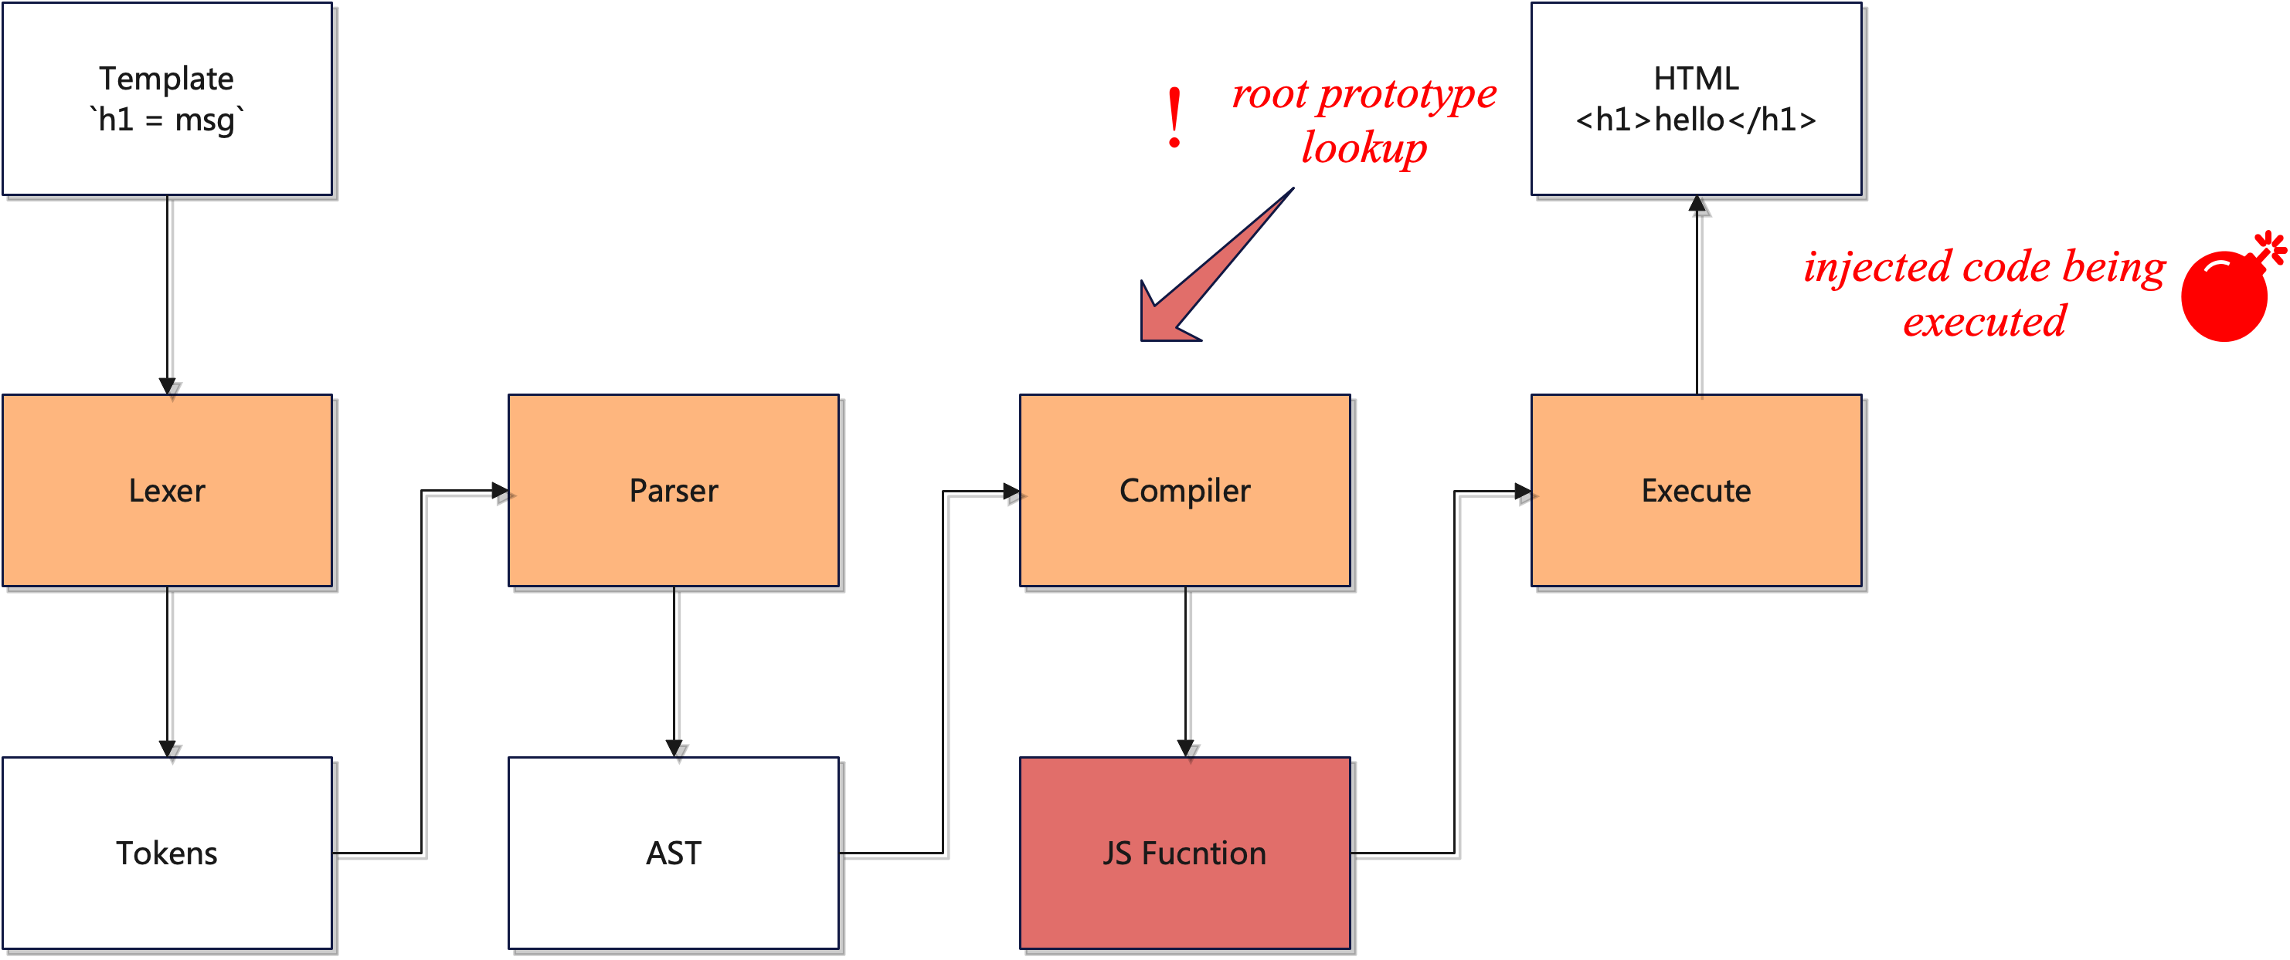
1 Introduction: Motivating Example
PP2RCE gadgets inside template render engine
Direct pollution gadgets
Chained pollution gadgets
Notes:
During this process, there are two types of Prototype pollution gadgets.
First is Direct pollution gadgets: during the compiler step (3rd step) if there is a prototype lookup, the polluted value will be loaded into JS function, and get executed in the forth step.

Slide 5
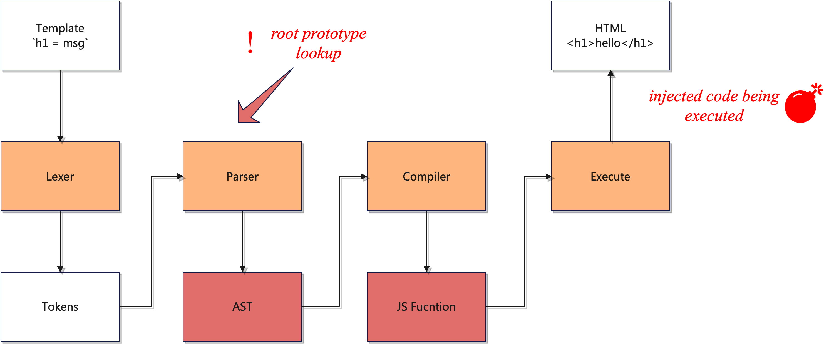
1 Introduction: Motivating Example
PP2RCE gadgets inside template render engine
Direct pollution gadgets
Chained pollution gadgets
Notes:
For the second type, Chained pollution gadgets, things can be a little complicated.
The root prototype lookup may occur earlier, at the Parser and AST generation stage, or the second step.
So if we inject some property in the prototype, it will be first loaded in the parser.
As an Object, its property could be loaded multiple times in the following code execution.
At the end, the final payload will reach the function constructor sink and get executed.

Slide 6
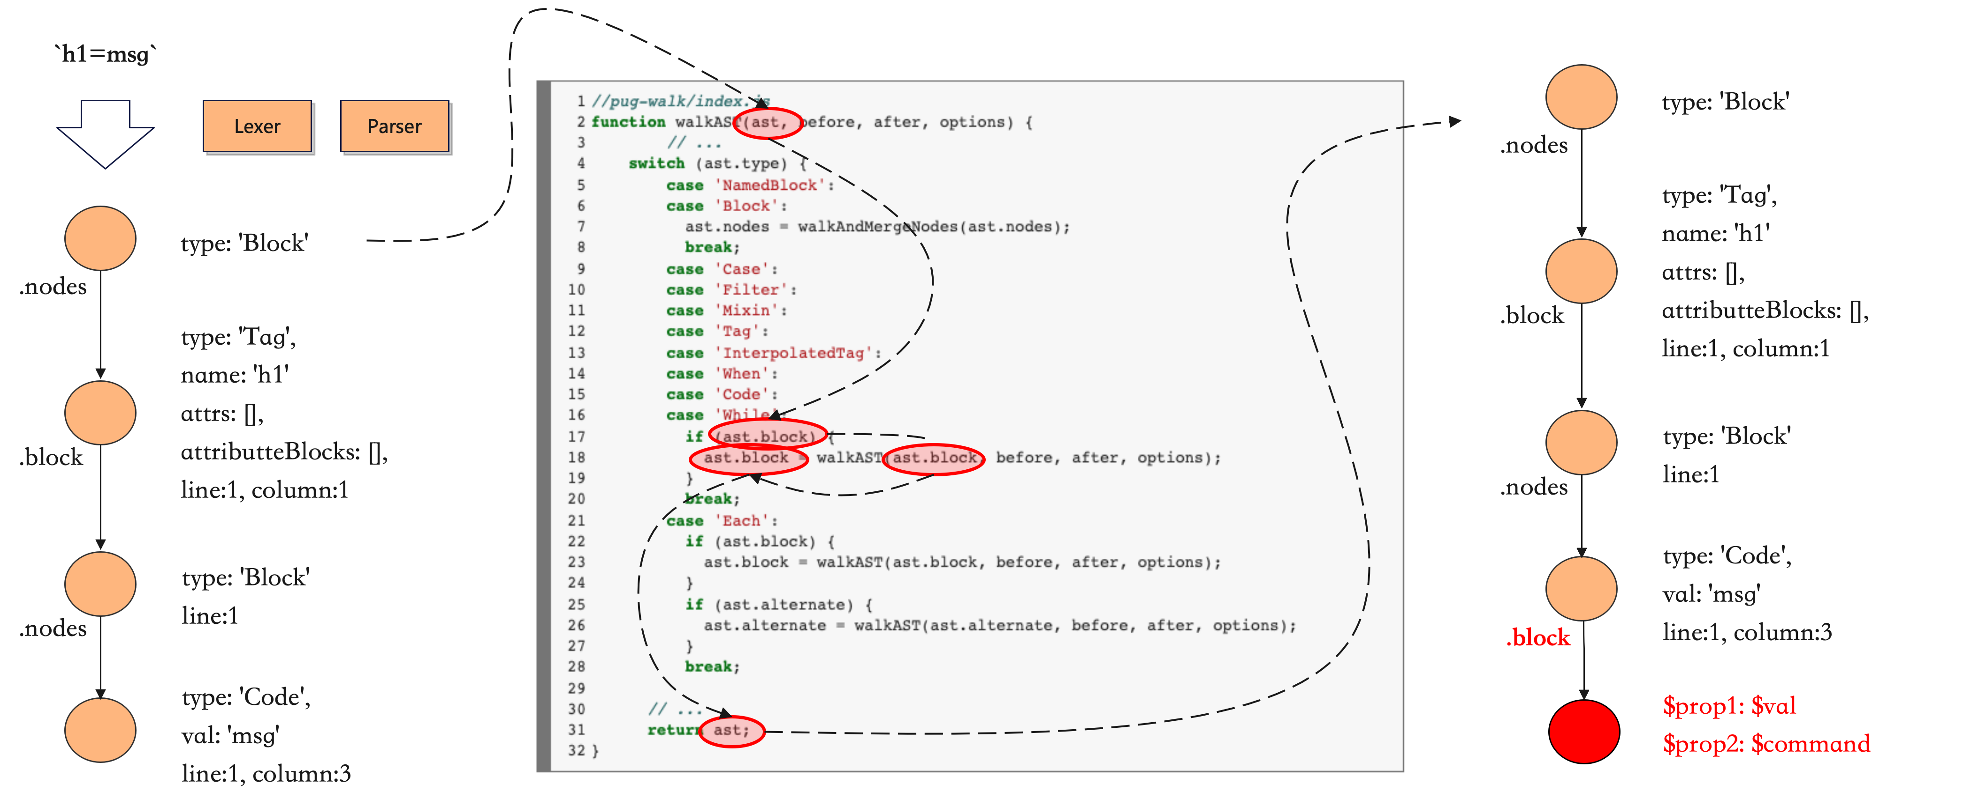
1 Introduction: Motivating Example - Pug
An Example of PP2RCE Chained Gadgets in Pug
previous AST
AST after walked will be passed to compiler
Notes:
Here is an example for our 2nd type: Chained Pollution Gadgets. This is an example from Pug Template Engine.
You see on the left, Lexer Parser in the template engine will turn statement `h1 equals to a msg` into an Abstract syntax tree.
However, you see the code in the middle, the AST will be walked.
when reaching the last node in the tree, it does not contain the block property. So, the the block property in the root prototype will be looked up.
If the attacker inject a property called “block” into root prototype, after walking the AST, a new fake node will be added. This is payload first landing.

Slide 7
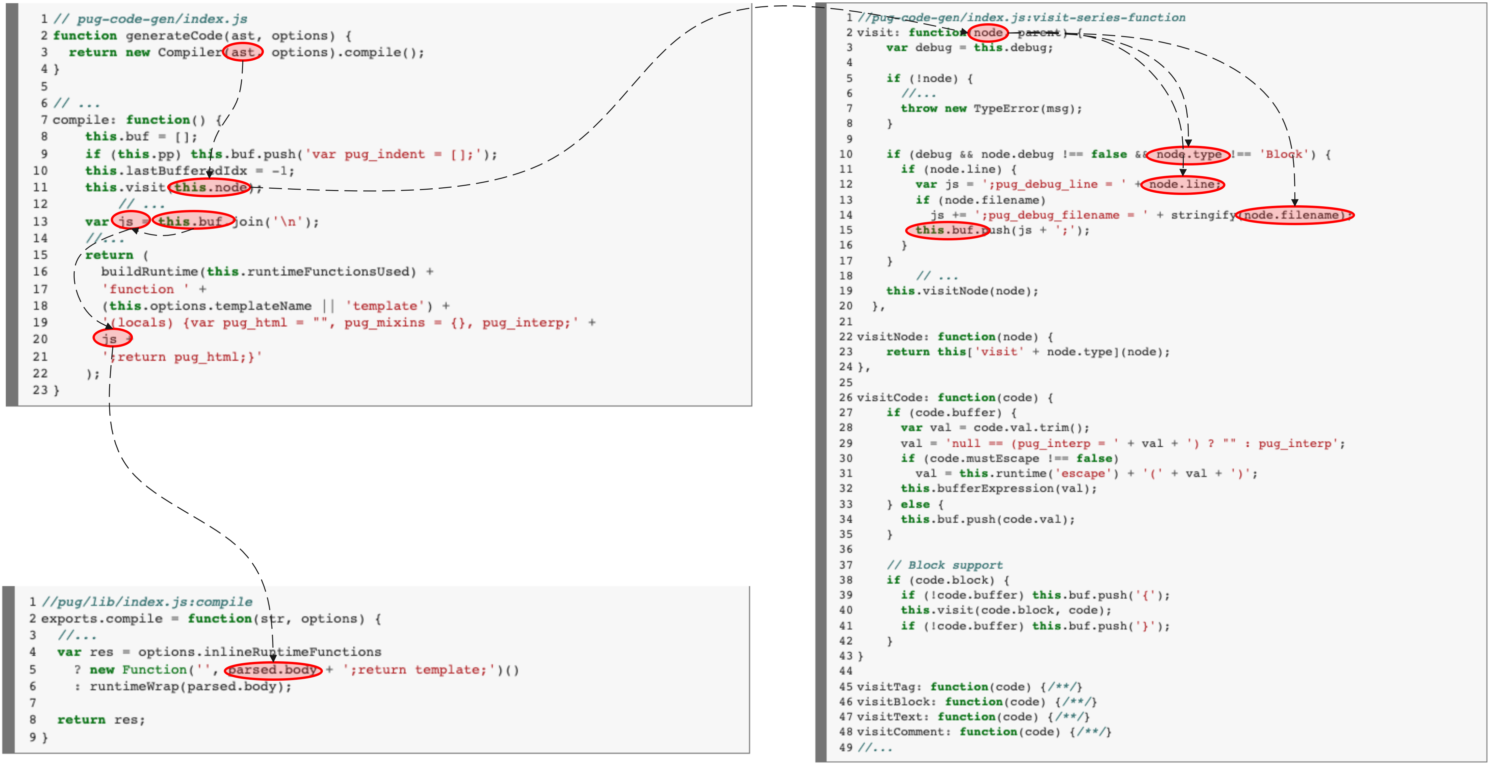
1 Introduction: Motivating Example - Pug
An Example of PP2RCE Chained Gadgets in Pug
Notes:
This is what happens next. At the compiler stage you see on the left, this polluted AST will be visited again to generate JS code.
We show the Visit function on the right.
Essentially, every node will be recursively visited. Within the Visit function, the debuggingg information will be added to buffer first.
Then, the VisitNode function works like a switch statement. It will call different functions depends on the node type to generate corresponding JS code.

Slide 8
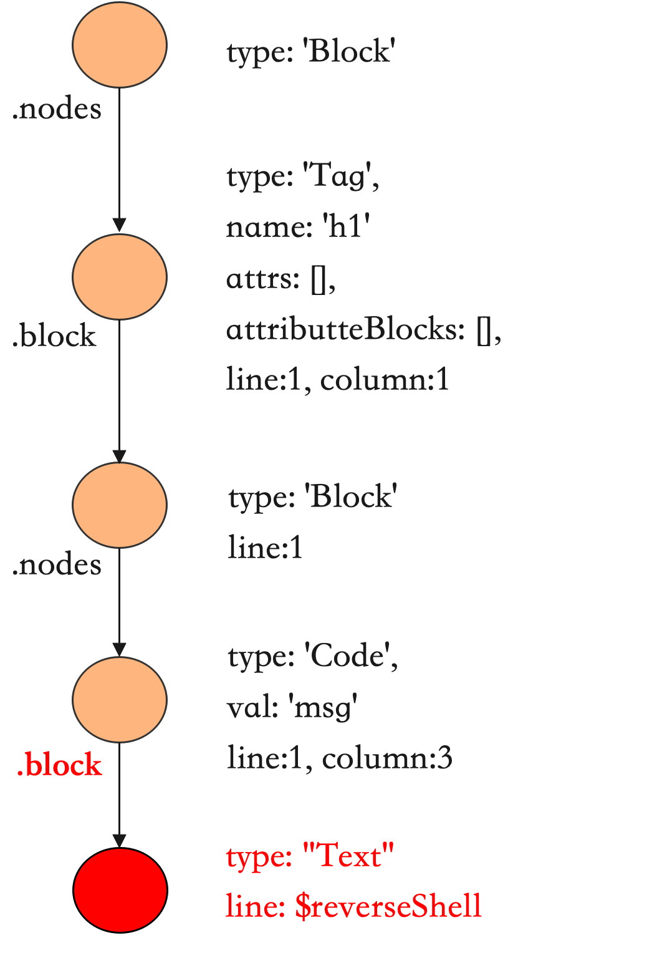
1 Introduction: Motivating Example - Pug
An Example of PP2RCE Chained Gadgets in Pug
Object.prototype.block = {
type: “Text”,
line: “$reverseShell”
}
Notes:
When the node we injected is visited, we would like its property be landed again.
In the VISIT function, properties like line and filename will be added into JS function.
So we can place our ReverseShell code in the “line” property like you see on the bottom right.

Slide 9
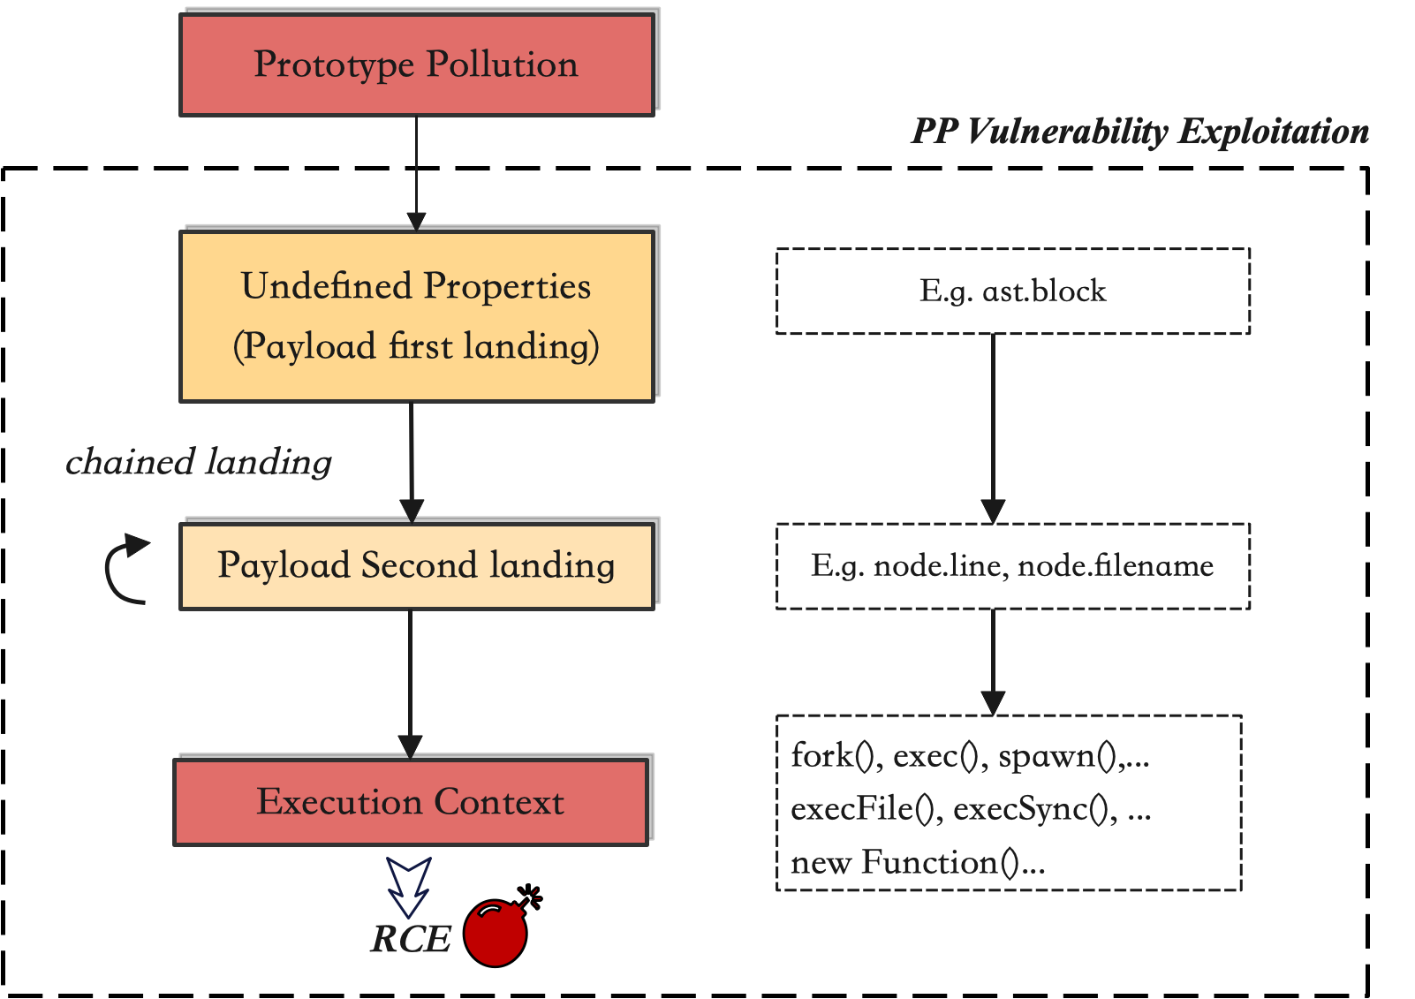
1 Introduction: Modeling of PP2RCE Gadgets
Our Goal
building the exploit objects that could leverage the gadgets in the program and drive the payload to the execution context to get the attack vector executed.
Main Work
find the undefined properties in the program
find the potential landing gadgets
find the dataflow from a payload landing to the execution sink
add additional properties to patch the error & manipulate the control flow.
Notes:
Our goal is
To build a payload that leverages the program gadgets and drive the execution context.
to summarize, there are 3 steps:
We assume we can inject something to prototype by finding one undefined property. We call it the First Payload Landing Point. It corresponds to ast.block in our example.
We will need to adjust our payload so that different layers of payload is accessed. It’s the second Payload Landing Point. it’s node.line or node.file In our previous example
To achieve RCE, we need find a dataflow from our final loaded property to execution context. This context can be folk(), exec() etc.

Slide 10
2 Compared to Related Work
Limitation of Silent Spring (USENIX Security’23)
Suffer from data-flow tracking loss
could handle direct landing (one-time landing) gadgets
especially information loss through (runtime-determined) function calls and external object properties
Prone to taint flooding, making it impossible to find the exact gadgets, resulting in high false positives and a heavy manual review workload
proved in paper that 3 Node.JS API > 342 gadgets > 11 TP
difficult to handle programs with recursive or loop calls (linear code execution is static analysis’s favorite)
Ignore the conditions for control flow execution, resulting in missing ancillary properties
In the case of hogan, it will miss the property asString.
In the case of pug, it will miss the property block.Type='Text'
Notes:
The most relevant work is Silent Spring, which focuses on static analysis combined with manual checking to find gadgets.
Their approach has 3 limitations.
It can handle simple direct landing gadgets. But struggled in complex cases. for example. In runtime determined function calls, data flow tracking may be disconnected.
high false positive. Or Taint flooding we called it. In their paper, they experimented on 3 Nodejs API and find 342 potential gadgets. Only 11 of them are True Positive. manually finding useable one from these gadgets is a daunting if working on a complex application.
Static analysis will not consider the actual control flow execution. We listed some example properties that they may miss here.

Slide 11
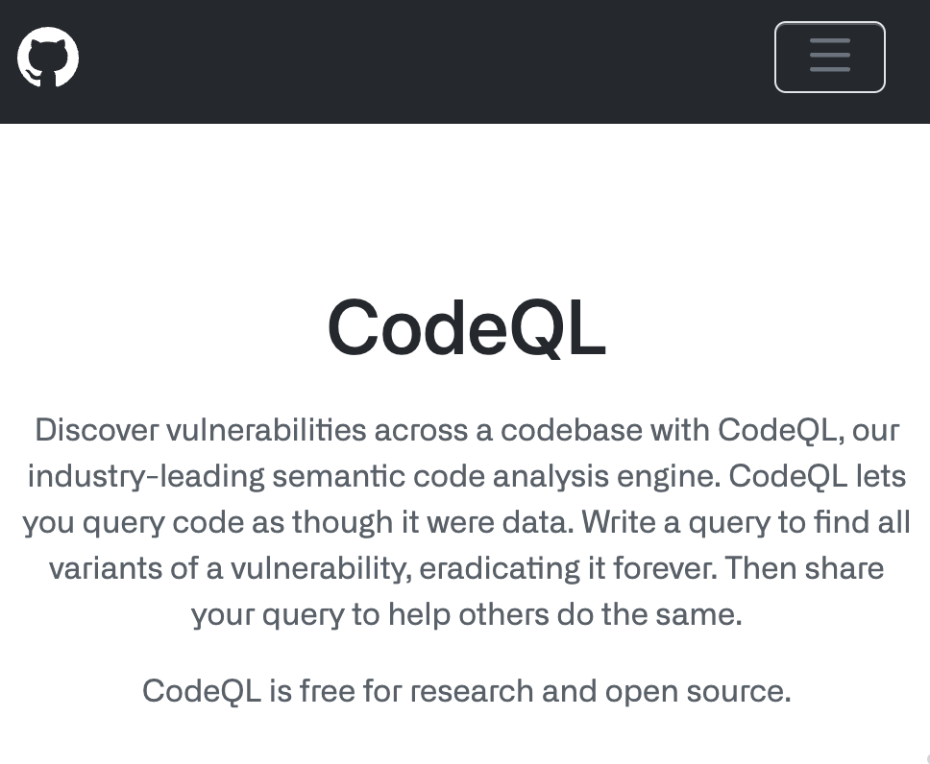
2 Compared to Related Work
Limitation of Silent Spring (USENIX Security’23)
asked for the gadgets finding query script, replied to disclose in Jan or Feb next year.
According to their statement, our own written CodeQL query only finds the easiest gadgets.
Notes:
they are using CodeQL by GitHub for static analysis.
We have asked the author and they say they will open source in Jan or Feb next year. So, we can have detailed comparison then by running their code.
Currently, we wrote our own CodeQL query based on the Silent Spring paper.

Slide 12
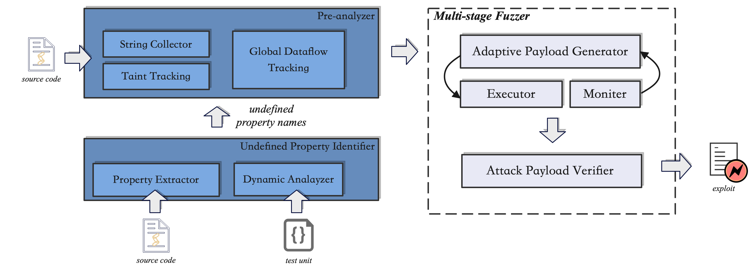
3 Methodology: The Overview of PPAEG
Notes:
Here are our methodology: we want to combine dynamic analysis with static analysis.
It consists of 3 major steps:
Identify undefined property dynamically,
a static Pre-analyzer to propose candidate property for payload generation,
and a multi-stage fuzzing to generate payload.
I will introduce each steps in details:

Slide 13
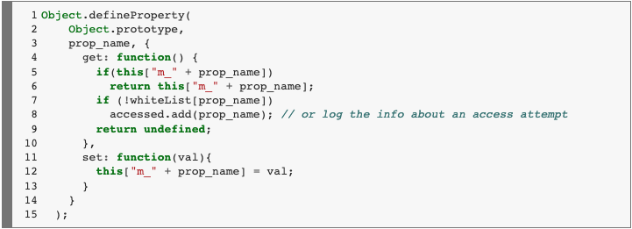
3 Methodology: a. Undefined Property Identifier
Objective:
Given the source code and application, identify the undefined properties in runtime.
Adopted Solution (Silent Spring):
Parse the application’s source code and extract all directly accessed properties.
Set Handler in Object.prototype to log all extracted properties lookup.
Run the application and check the log to find undefined properties.
Known limitation:
Cannot find indirect property lookup
destructuring object pattern
destructuring array pattern
element access in for..of loop
Notes:
First, finding undefined property.
We first collect all directly accessed properties’ name.
Then, we set a handler in Object.prototype for each property and run the application
So every time a property look up get the the root prototype level, we will add this property name to our pool.
The limitation of this approach is that we cannot find indirectly property look up, such as elements in a while loop or array, object de-structuring.

Slide 14
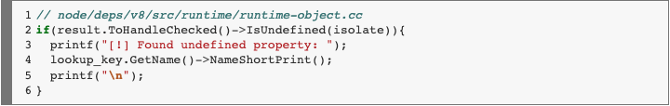
3 Methodology: a. Undefined Property Identifier
Objective:
Given the source code and application, identify the undefined properties in runtime.
Alternative Solution:
find the property lookup part in the nodejs(v8)
add a few lines to print the lookup key if the result is undefined
re-compile the nodejs
Known limitation:
1. print so many non-source code related property keys
Notes:
(OMITTED)
Another approach we are pursuing is to modify the Javascript compiler V8 in Node.js.
But we still have an issue: the newly compiled V8 will print out keys unrelated to our target application.

Slide 15
3 Methodology: b. Pre-analysis for object generation
Objective:
Generate property corpus to help fuzzer generate reasonable objects (property structure)
Collect string corpus to help fuzzer generate reasonable value
Notes:
The second part of the system is to generate property corpus.
With property corpus, our fuzzer will be able to generate more related payload. So, our fuzzing can complete in a limited timeframe.

Slide 16
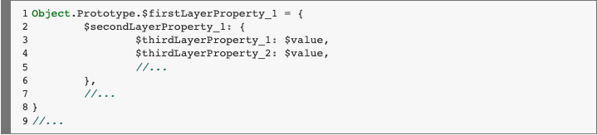
3 Methodology: b. Pre-analysis for object generation
To define a reasonable inject object:
The first-layer property should be an undefined property
The nested property name should be a "real" property of its parent property.
Say there is `var a={b:{c:1}}; var c={d:2}; var e=a.b`, if property `b` is an undefined property, our inject object should never be `b.d` since the injected property `d` would never be accessed in the runtime.
This strong constraint will make our fuzz testing feasible in a limited amount of time.
Every object should contain a property (final payload landing) that has a dataflow to the sink.
The $value fields are in types of String, Boolean, Number, Object, and flag(which can be identified in the return body)
Notes:
So, what do we mean by reasonable? Here are 3 requirements
The first layer OR outmost layer of the object should be an undefined property
The nested property should be a real property, meaning our injection property structure should align with what is used in the application, so that the injected property will be potentially visited.
Every object should contain a property that has a dataflow to the sink.

Slide 17
3 Methodology: b. Pre-analysis for object generation
To define a reasonable inject object:
The first-layer property should be an undefined property
undefined property found by Undefined Property Identifier
The nested property name should be a "real" property of its parent property.
Say there is `var a={b:{c:1}}; var c={d:2};`, if property `b` is an undefined property, our inject object should never be `b.d` since the injected property `d` would never be accessed in the runtime.
This strong constraint will make our fuzz testing feasible in a limited amount of time.
could handle easy cases through global dataflow tracking script based on CodeQL.
Every object should contain a property (final payload landing) that has a dataflow to the sink.
could handle most cases through taint tracking from property read to eval-like sink based on CodeQL.
The $value fields are in types of String, Boolean, Number, Object, and flag(which can be identified in the return body)
Notes:
Generating such reasonable inject object is difficult.
our current approach is to write CodeQL queries for the second and third requirements. For now, we can only handle simple cases.

Slide 18
3 Methodology: c. Fuzzer
Objective:
Generate injected objects based on the properties given by pre-analysis and monitor whether the payload can reach the return function body and results in malicious remote code execution.
Solution:
In the first stage, based on the pool of potential undefined properties from static analysis, attach payloads are generated iteratively through all possible combinations of these properties initialized with desired values.
In the second stage, once the execution sink can be reached, the attack payloads will be tailored and delivered to the execution context until we monitor its execution or raise a time up.
Known limitation:
1. Computational power limits the ability to iteratively generate nested injected objects, as time complexity exponentially increases with each adding layer.
2. Further optimization of the code could be achieved through testing objects sequentially based on their coverage and other metrics.
Notes:
The last step is Fuzzing, Our fuzzer is modified from JSFuzzer. Basically, is a trial-and-error process.
So payload are generated through combing different candidate property from step two
Then we will run the application to see if the execution sink is reached.

Slide 19
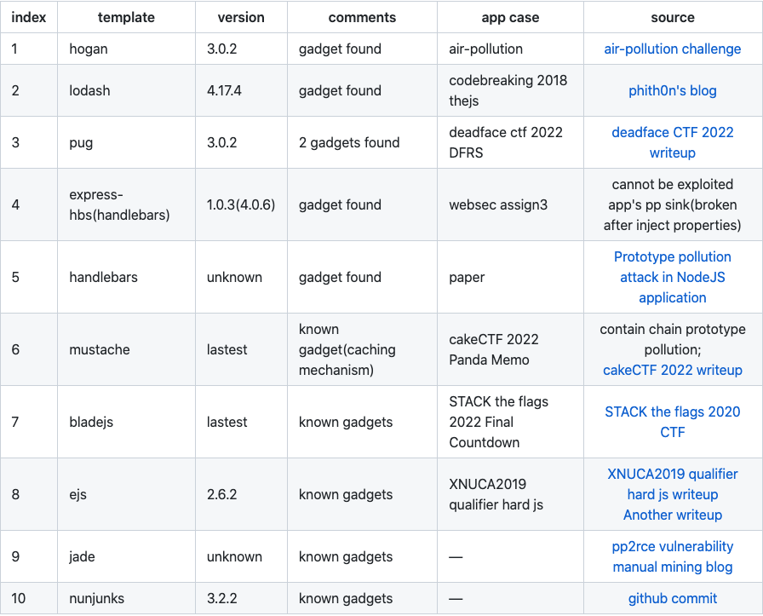
4 Results
Notes:
For the dataset, we have collected 10 template engine with known gadgets.
We have experimented on the first 3, hogan, lodash and pug.
However, when experimenting with these application we found, we found that we still need to optimize fuzzer. We expect to deliver the fuzzing result in our report.

Slide 20
5 Future Work
Fuzzing parts:
working on the task of generating “real” property of injected objects
making the fuzz testing algorithm to be adaptive by getting code coverage and error messages involved(could collect for now, but still to figure out how to make use of them).
Experiment parts:
finding unknown gadgets in other template render engines(20+ left)
finding gadgets in other kinds of npm third party packages
Compared with Silent Spring’s CodeQL-based method, once they released their code.
Notes:
For future work, we believe it’s mainly on the fuzzing part.
It’s still difficult to find the REAL property. We have not come up with a good solution yet
A potential solution can be making the fuzzing algorithm adaptable leveraging the code coverage and error information.
For the experiment section, there are 20+ template engines that we don’t know if any gadgets exist.
Also, these gadgets can be outside of the template as well. It can be in other NPM third party packages.
Last, we can compare against Silent Spring’s work once they publish their code early next year.

Slide 21
Thank you for listening! Q & A
Zhengyu Liu
thisiszhengyu@gmail.com
Notes:
Thanks for your attention, that’s all.

