Slide 1

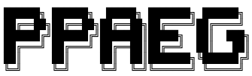
PPAEG: Automatic Exploit Generation for Server-side Prototype Pollution Vulnerabilities
Zhengyu Liu, Kecheng An, Yiyang Li, Tianjian Li
Presented by
December 6th, 2022
Notes:
Hi everyone, this is Zhengyu. We are also having Kecheng, Yiyang and Tianjian in our group.
Our project name is PPAEG, Automatic Exploit Generation for Server-side Prototype Pollution Vulnerabilities

Slide 2
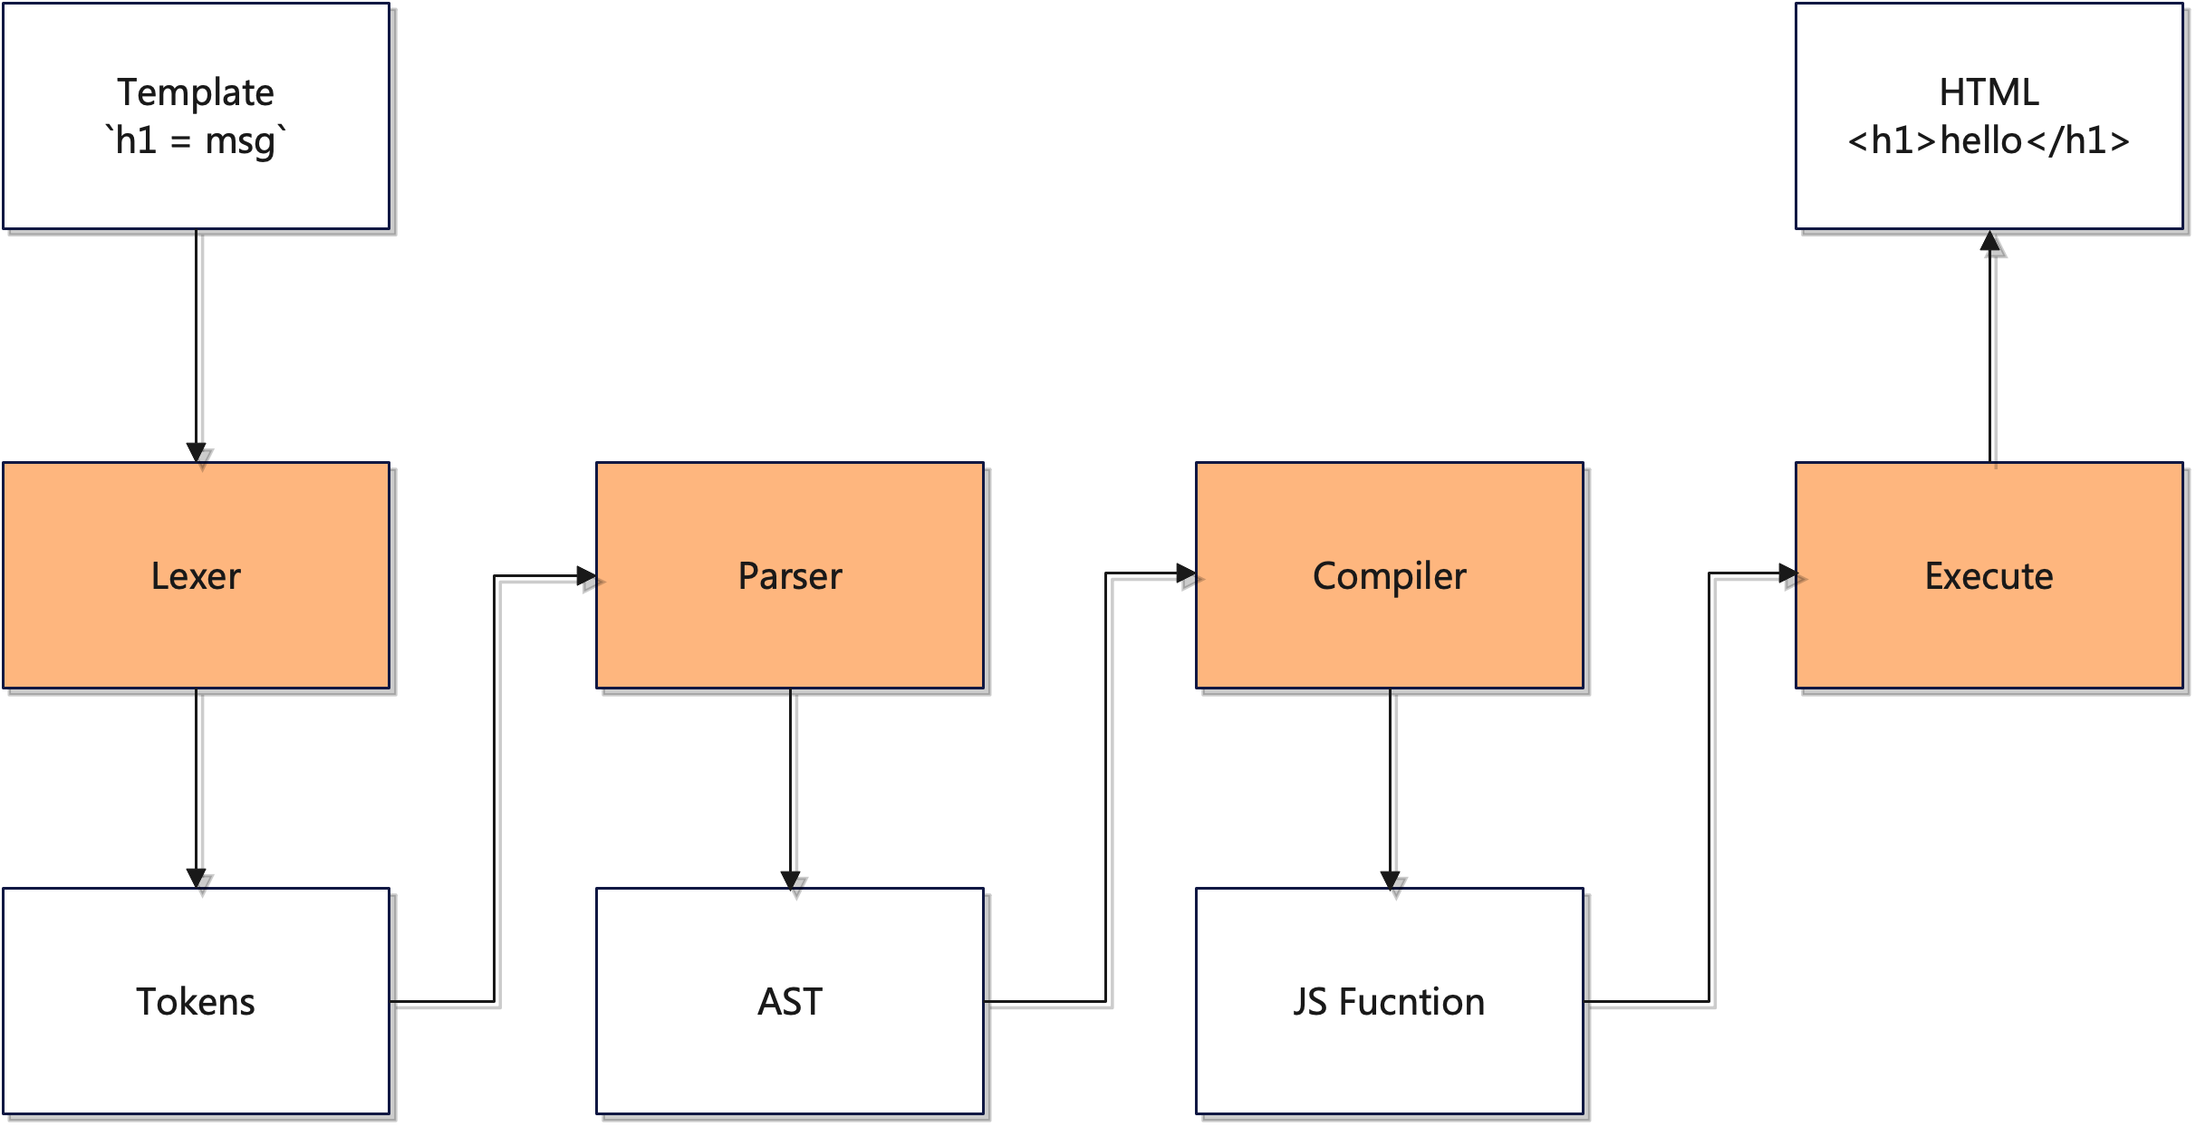
1 Introduction: Motivating Example
PP2RCE gadgets inside template render engine

Slide 3
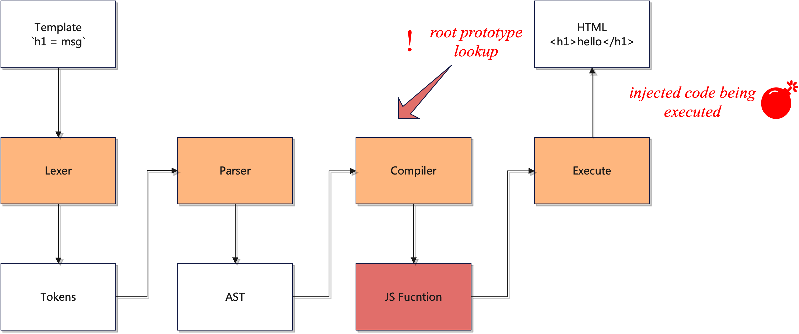
1 Introduction: Motivating Example
PP2RCE gadgets inside template render engine
Direct pollution gadgets
Chained pollution gadgets

Slide 4
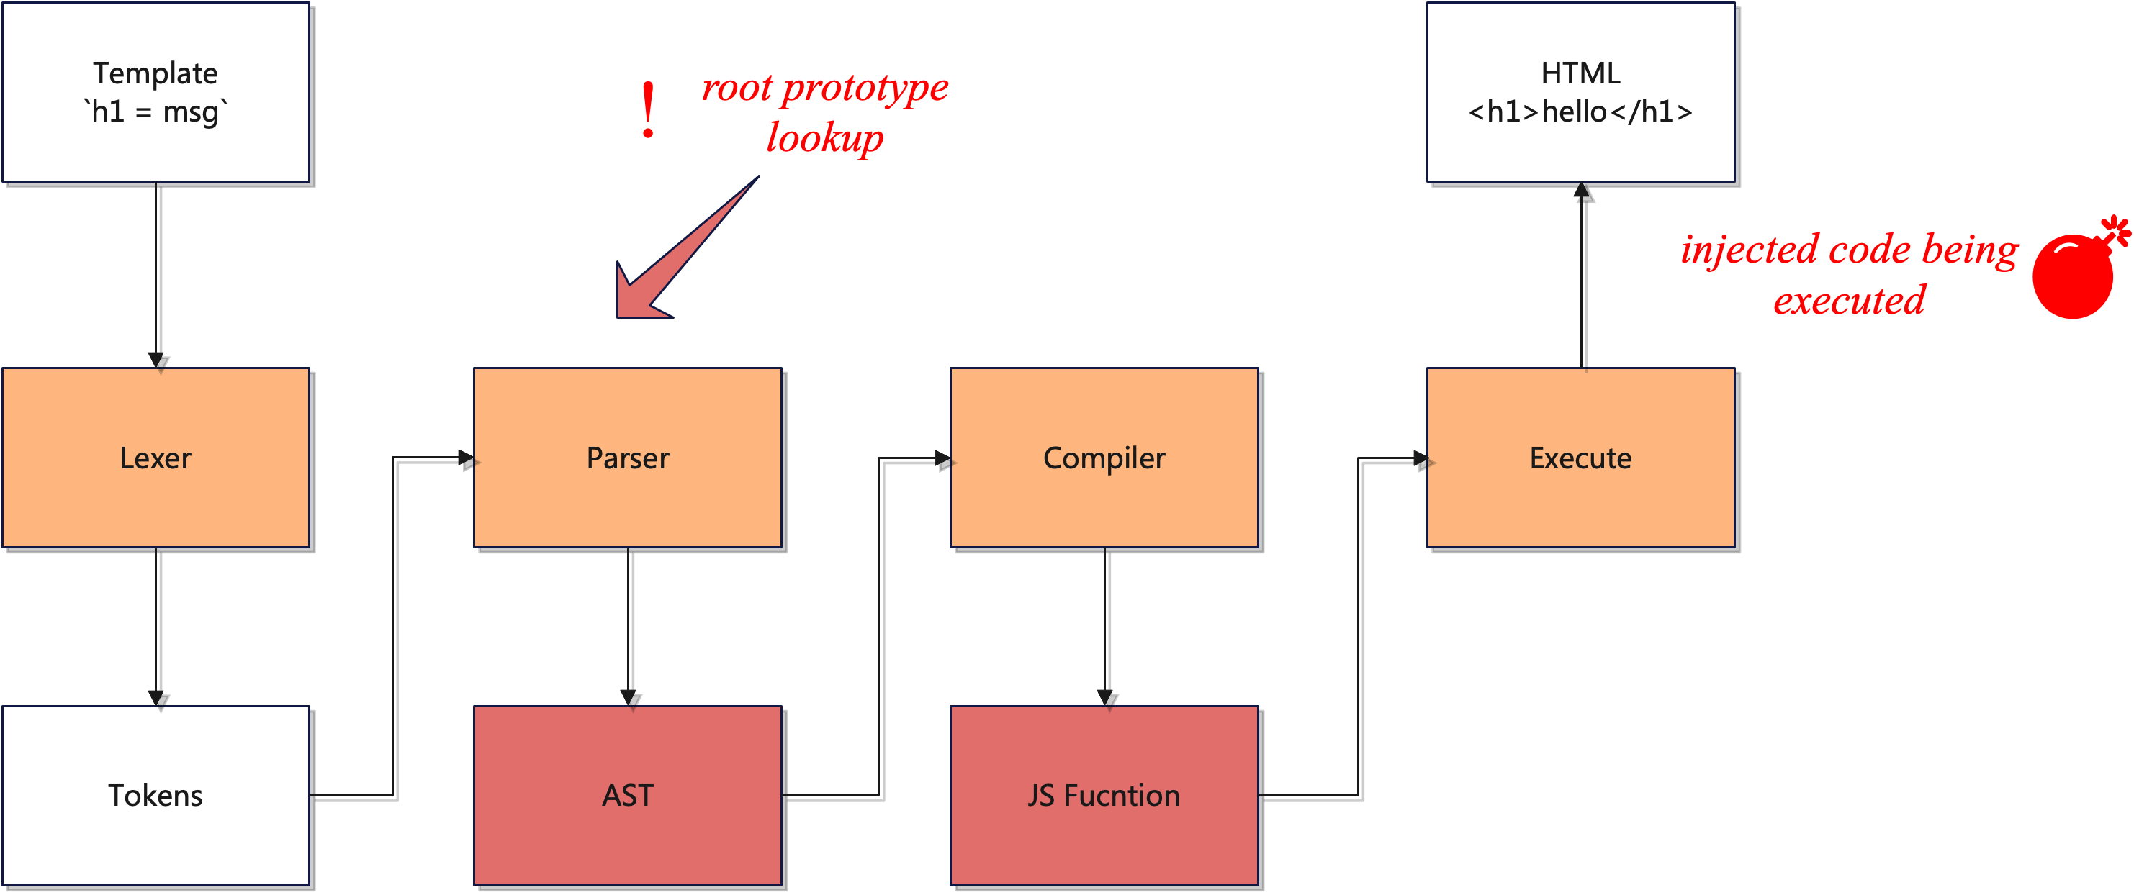
1 Introduction: Motivating Example
PP2RCE gadgets inside template render engine
Direct pollution gadgets
Chained pollution gadgets

Slide 5
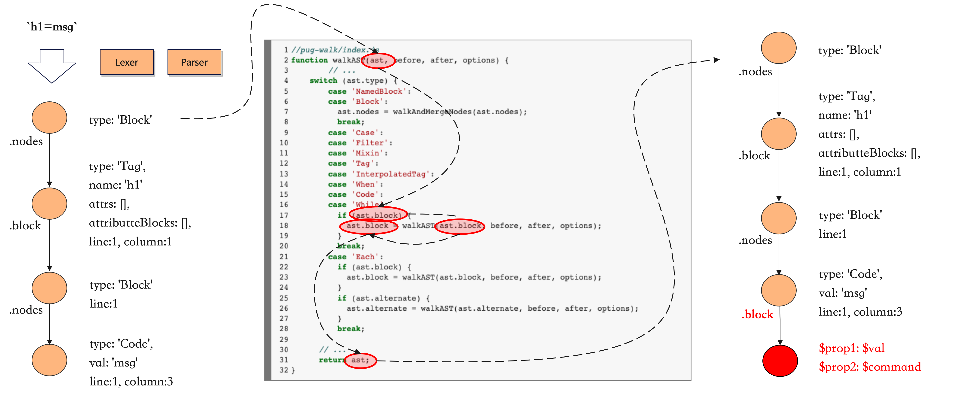
1 Introduction: Motivating Example - Pug
An Example of PP2RCE Chained Gadgets in Pug
previous AST
AST after walked will be passed to compiler

Slide 6
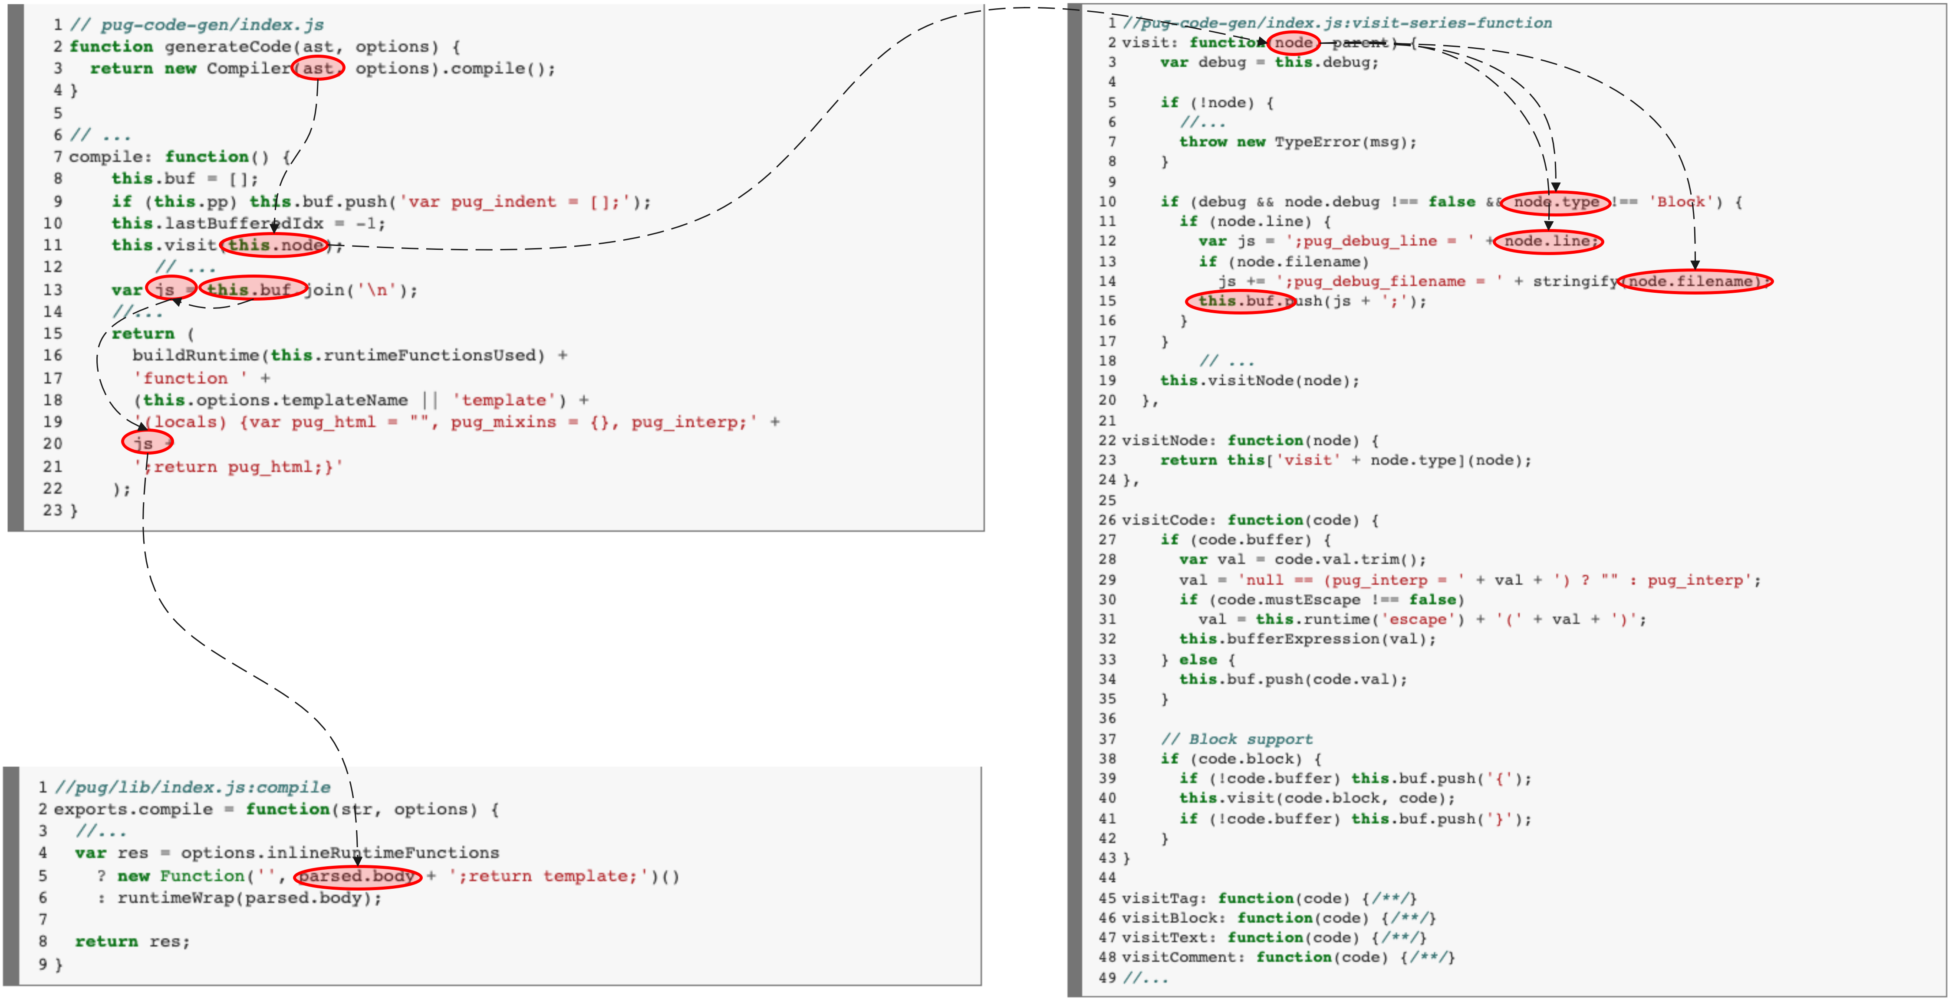
1 Introduction: Motivating Example - Pug
An Example of PP2RCE Chained Gadgets in Pug

Slide 7
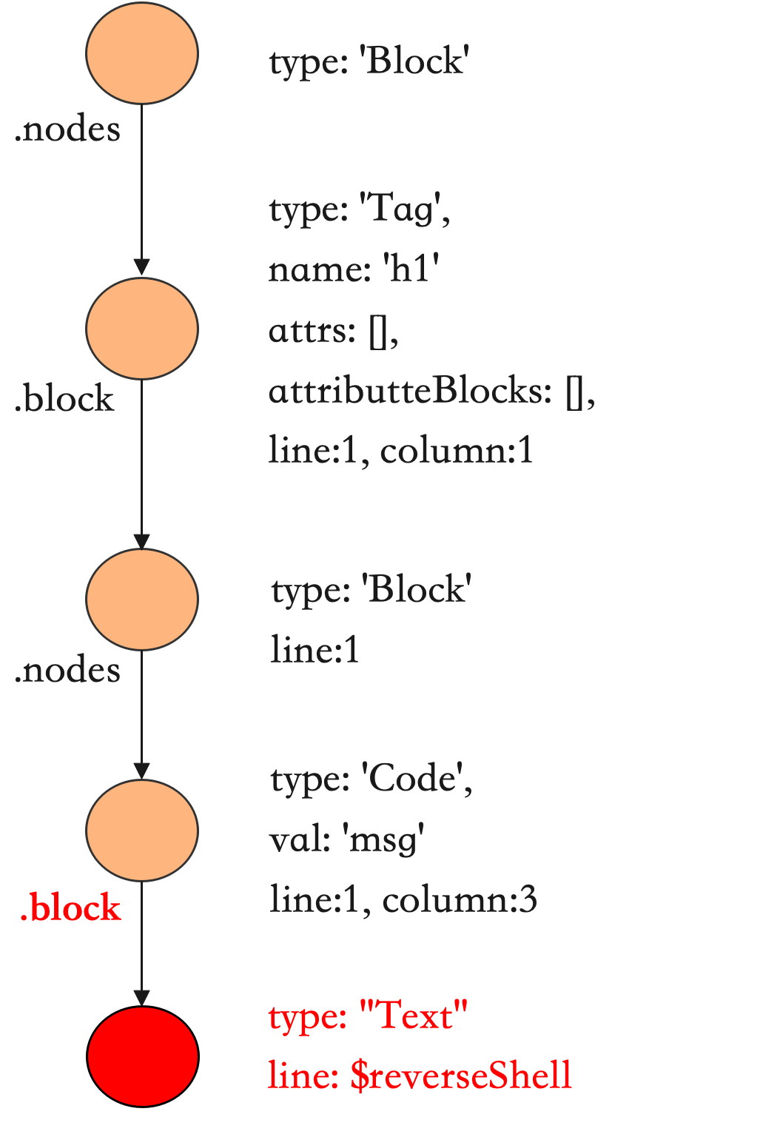
1 Introduction: Motivating Example - Pug
An Example of PP2RCE Chained Gadgets in Pug
Object.prototype.block = {
type: “Text”,
line: “$reverseShell”
}

Slide 8
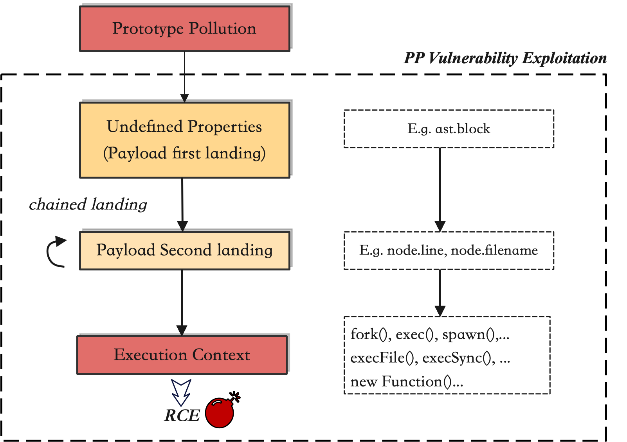
1 Introduction: Modeling of PP2RCE Gadgets
Our Goal
building the exploit objects that could leverage the gadgets in the program and drive the payload to the execution context to get the attack vector executed.
Main Work
find the undefined properties in the program
find the potential landing gadgets
find the dataflow from a payload landing to the execution sink
add additional properties to patch the error & manipulate the control flow.

Slide 9
2 Compared to Related Work
Limitation of Silent Spring
Suffer from data-flow tracking loss
could handle direct landing (one-time landing) gadgets
especially information loss through (runtime-determined) function calls and external object properties
Prone to taint flooding, making it impossible to find the exact gadgets, resulting in high false positives and a heavy manual review workload
proved in paper that 3 nodejs api > 342 gadgets > 11 TP
difficult to handle programs with recursive or loop calls (linear code execution is static analysis’s favorite)
Ignore the conditions for control flow execution, resulting in missing ancillary properties
In the case of hogan, it will miss the property asString.
In the case of pug, it will miss the property block.Type='Text'
asked for the gadgets finding query script, replied to disclose in Jan or Feb next year.
According to their statement, our own written codeql query only finds the easiest gadgets.

Slide 10
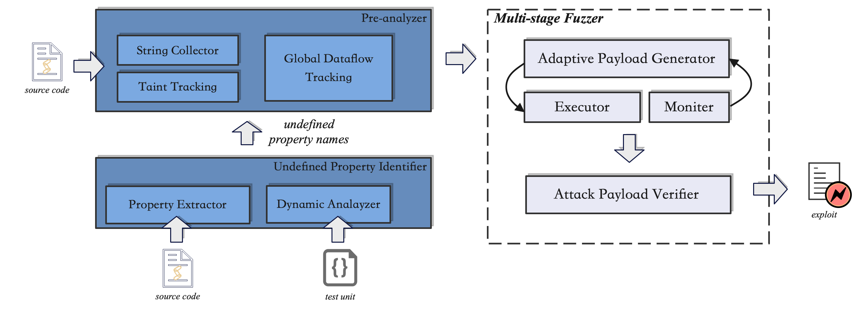
3 Methodology: The Overview of PPAEG
Notes:
This is the prototype of our PPAEG.

Slide 11
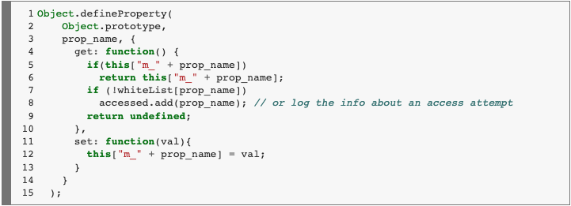
3 Methodology: Undefined Property Identifier
Objective:
Given the source code and application, identify the undefined properties in runtime.
Adopted Solution (Silent Spring):
Parse the application’s source code and extract all directly accessed properties.
Set Handler in Object.prototype to log all extracted properties lookup.
Run the application and check the log to find undefined properties.
Known limitation:
Cannot find indirect property lookup
destructuring object pattern
destructuring array pattern
element access in for..of loop

Slide 12
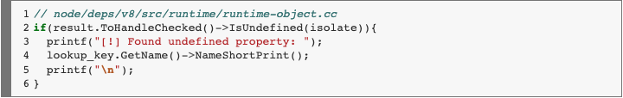
3 Methodology: Undefined Property Identifier
Objective:
Given the source code and application, identify the undefined properties in runtime.
Alternative Solution:
find the property lookup part in the nodejs(v8)
add a few lines to print the lookup key if the result is undefined
re-compile the nodejs
Known limitation:
1. print so many non-source code related property keys

Slide 13
3 Methodology: Pre-analysis for object generation
Objective:
Generate property corpus to help fuzzer generate reasonable objects (property structure)
Collect string corpus to help fuzzer generate reasonable value

Slide 14
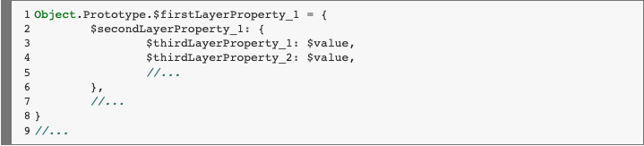
3 Methodology: Pre-analysis for object generation
To define a reasonable inject object:
The first-layer property should be an undefined property
The nested property name should be a "real" property of its parent property.
Say there is `var a={b:{c:1}}; var c={d:2};`, if property `b` is an undefined property, our inject object should never be `b.d` since the injected property `d` would never be accessed in the runtime.
This strong constraint will make our fuzz testing feasible in a limited amount of time.
Every object should contain a property (final payload landing) that has a dataflow to the sink.
The $value fields are in types of String, Boolean, Number, Object, and flag(which can be identified in the return body)

Slide 15
3 Methodology: Pre-analysis for object generation
To define a reasonable inject object:
The first-layer property should be an undefined property
undefined property found by Undefined Property Identifier
The nested property name should be a "real" property of its parent property.
Say there is `var a={b:{c:1}}; var c={d:2};`, if property `b` is an undefined property, our inject object should never be `b.d` since the injected property `d` would never be accessed in the runtime.
This strong constraint will make our fuzz testing feasible in a limited amount of time.
could handle easy cases through global dataflow tracking script based on codeql.
Every object should contain a property (final payload landing) that has a dataflow to the sink.
could handle most cases through taint tracking from property read to eval-like sink based on codeql.
The $value fields are in types of String, Boolean, Number, Object, and flag(which can be identified in the return body)

Slide 16
3 Methodology: Fuzzer
Objective:
Generate injected objects based on the properties given by pre-analysis and monitor whether the payload can reach the return function body and results in malicious remote code execution.
Solution:
In the first stage,
In the second stage, once the execution sink can be reached, the attack payloads will be tailored and delivered to the execution context until we monitor its execution or raise a time up.

Slide 17
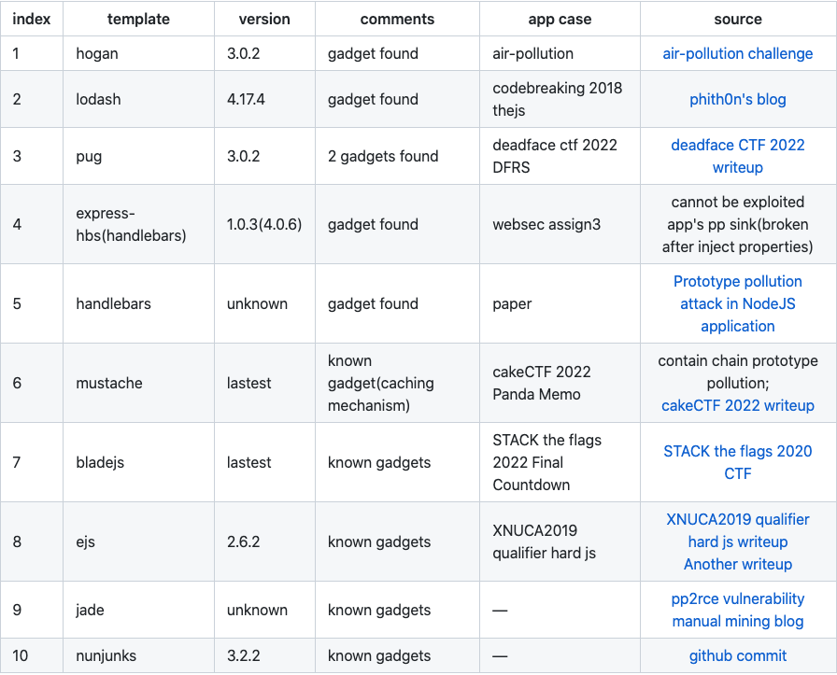
4 Results

Slide 18
5 Future Work
Fuzzing parts:
working on the task of generating “real” property of injected objects
making the fuzz testing algorithm to be adaptive by getting code coverage and error messages involved(could collect for now, but still to figure out how to make use of them).
Experiment parts:
finding unknown gadgets in other template render engines(20+ left)
finding gadgets in other kinds of npm third party packages
Compared with Silent Spring’s codeql-based method, once they released their code.

Slide 19
Thank you for your attention!
Zhengyu Liu
thisiszhengyu@gmail.com
Notes:
Thanks for your attention, that’s all.

