Slide 1
Vector Processing

Slide 2
Properties of Vector Processors
Each result independent of previous result => long pipeline, compiler ensures no dependencies => high clock rate
Vector instructions access memory with known pattern => highly interleaved memory => no (data) caches required! (Do use instruction cache)
Reduces branches and branch problems in pipelines
Single vector instruction implies lots of work (» loop) => fewer instruction fetches

Slide 3
Alternative Model:Vector Processing
Vector processors have high-level operations that work on linear arrays of numbers: "vectors"
SCALAR
(1 operation)
VECTOR
(N operations)
r1
r2
v1
v2
+
+
r3
v3
vector
length
add r3, r1, r2
add.vv v3, v1, v2
Notes:
25

Slide 4
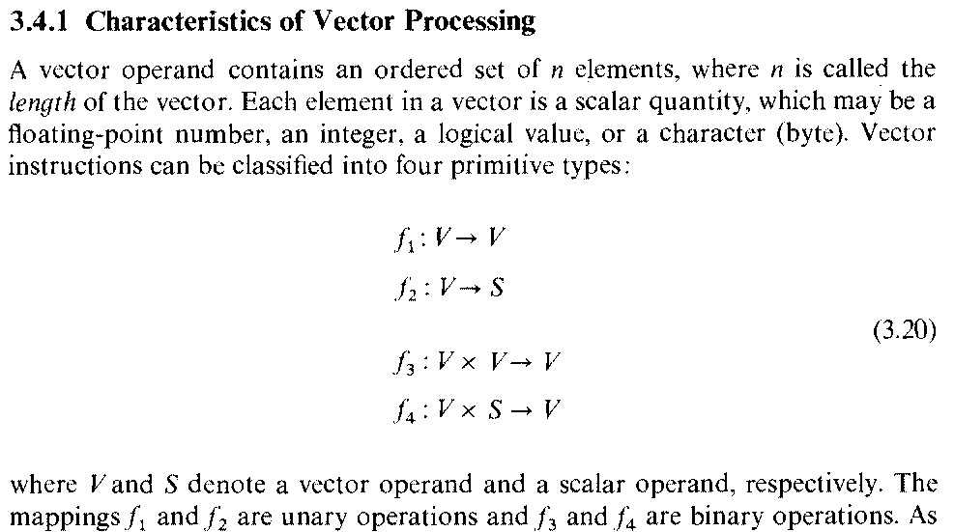

Slide 5
Vector Instruction
Given V- a Vector(operand)
  An ordered set of n elements(n : the length of vector)
    Elements are scalar : floating point number, integer, logical value, character(byte)
Given S- a scalar (operand)
Unary Operation- f1 and f2:
  f1: V V example

Slide 6
Vector Instruction contd….
Unary Operation- f1 and f2:
  f2: V S example:
Binary Operation- f3 and f4:
  f3: V x V V example:
- f4: V x S V example:

Slide 7
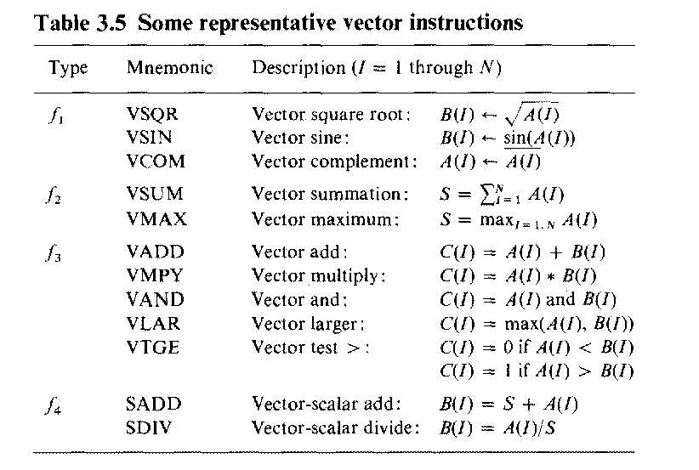

Slide 9
VECTOR LENGTH
vector length of 64.
  1. In real world applications vector lengths are not exactly 64.
      adding just first n elements of a vector ,Vector Length register(VLR) used for this
      VLR controls the length of any vector operation by defining
      their length.
      value cannot be greater than the length of the vector registers. (64 in this case)
  2. In real world applications, data in vectors in memory can be greater
    than the MVL of the processor.
    we use a technique called Strip Mining

Slide 10
STRIP MINING
Splitting data : each vector operation is done for a size less than or equal to MVL.
  Done by a simple loop with MOD operator as control point.

Slide 11
STRIP MINING continued…
low = 0;
VL = (n % MVL); /*find odd-size piece using modulo op % */
for (j = 0; j <= (n/MVL); j=j+1)
{ /*outer loop*/
for (i = low; i < (low+VL); i=i+1) /*runs for length VL*/ Y[i] = a * X[i] + Y[i] ; /*main operation* /
low = low + VL; /*start of next vector*/
VL = MVL; /*reset the length to MVL*/ }

