Slide 1

ALGORITHM
THE ART OF THOUGHT

Slide 2

AMORTIZED ANALYSIS
  Time required to perform a sequence of operations is averaged over all the operations(op.)
  Amortized Analysis(AA) can be used to show that the average cost of an operation is low though a single operation may be expensive
  AA is different from Average-Case analysis as no probability is involved.
        It guarantees the average performance of each operation in the Worst- Case
<number> of 20

Slide 3
AMORTIZED ANALYSIS cont.
Three Major Techniques are used -
Aggregate Method : T(n)/x
Accounting Method :
  Each type of operation may have different Amortized Cost.
Potential Method :
  Define potential associated with the data structure
  Both 2 and 3 has a concept of prepaid credit.
<number> of 20
Notes:
Social networks display small world phenomenon. Like in co-authorship network Erdos number is determined by taking Erdos as the source node and taking single source shortest paths to all the other nodes. In a famous paper published in Nature Watts and Strogatz explained that the structure of social network is somewhere between random and regular/uniform networks.
Also social networks are scale free, which means the distribution of certain features follow power law. P(k) being the fraction of nodes having k degree, it is almost equal to c.k^-alpha, where alpha is between 2 to 3. c is a normalization constant.

Slide 4
AGGREGATE METHOD
Let a sequence of n operations take T(n) time in Worst –Case.
So Amortized Cost=T(n)/n.
This Amortized Cost will apply for each operation whatever may be the type of operations.
<number> of 20
Notes:
Can be k-partite graphs. Can be dynamic. For simplification we’ll use undirected graphs mostly. Direction also defines work-specific roles and makes it even more complicated. Analysis of topological structure enables us to understand the structure and features of communities.

Slide 5
AGGREGATE METHOD cont.…
Example :
Enhance PUSH(S,X) and POP(S) by Multi pop(S,K)
Multipop(S,K)
While not Stack-Empty(S) & K!=0
Do POP(S)
K←K-1
What is the running time of Multi pop(S,K) in a stack of S objects?
        min(S,K) is the cost
<number> o 20
Notes:
Detecting communities from a large graph is seen as an interesting problem in social networks.

Slide 6

AGGREGATE METHOD cont.…
Let us analyse a sequence of n PUSH,POP,Multipop operations.
Worst Case cost of Multipop is O(n),since the stack size is n.
So, the Worst Case for n operations is O(n²) but this is not tight.
Any sequence of n PUSH,POP,MultiPop operation can cost at most O(n).
    The no. of times pop can be called on a non-empty stack(including those inside Multipop) is at most the no. of PUSH operations which is O(n).
    A.Cost → O(n)/n=O(1).
<number> of 20
Notes:
In communities we can see strong ties among the nodes (according to sociologist Mark Granovettor). These ties can be used for spreading an information and hence useful for viral marketing. Widgets for social website or media can be planned where people will leave their first hand experience of a product and share it with friends.

Slide 7
AGGREGATE METHOD cont.…
Incrementing a Binary Counter
Array A[0….k-1] of length k bits.
X = ^{k-1}
[ A[i].2^{i} ; LSB=0, MSB=k-1
_{i=0}
To add 1 (modulo 2^{k}) to the counter, we use the procedure:
INCREMENT (A)
i←0
While i<length[A] & A[i]=1
Do A[i]←0 /*RESET*/
<number> of 20

Slide 8
AGGREGATE METHOD cont.…
i←i+1
If [i]<length[A] THEN
A[i]←1 /*SET*/
Same Algorithm as hardware ripple carry adder
Cost of each increment operation is linear to the no. of bits flipped.
<number> of 20

Slide 9
AGGREGATE METHOD cont.…
Value A(2)A(1)A(0) Total Cost
0 00000 0
1 00001 1
2 00010 3
3 00011 4
4 00100 7
5 00101 8
6 00110 10
7 00111 11
8 01000 15
<number> of 20

Slide 10
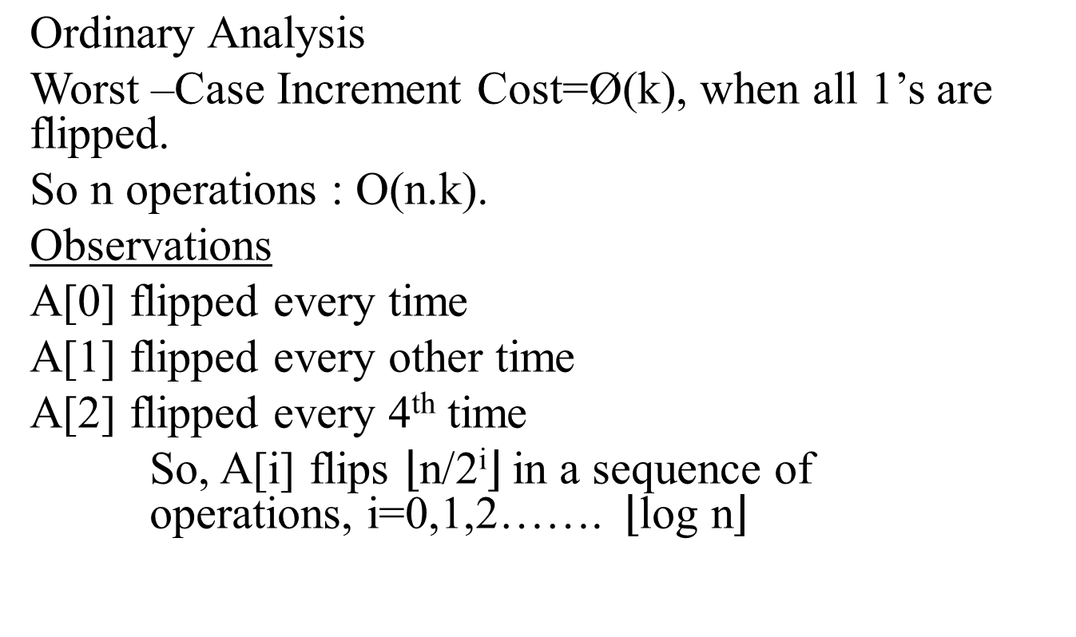
AGGREGATE METHOD cont.…
<number> of 20
Notes:
Microsoft Engineering Excellence
Microsoft Confidential

Slide 11
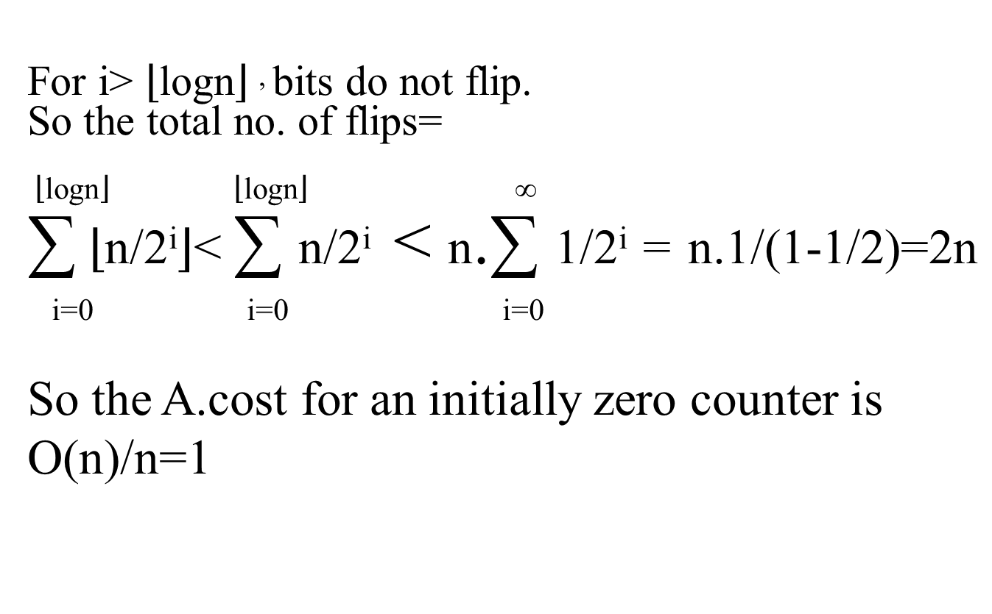
AGGREGATE METHOD cont.…
<number> of 20
Notes:
Microsoft Engineering Excellence
Microsoft Confidential

Slide 12
AGGREGATE METHOD cont.…
Some Problems
If Multipush is included, will it remain O(1)?
  Answer: No. why?
Show if DECREMENT is there in K bit counter, Ø(n.k) time is required for n operation
  Hint: Consecutive Increment-Decrement for all 1’s.
C(i)=1 if i=2^{k} , k ϵ Z⁺
= 1 , Otherwise
^{A.cost = ?}
<number> of 20
Notes:
Microsoft Engineering Excellence
Microsoft Confidential

Slide 13
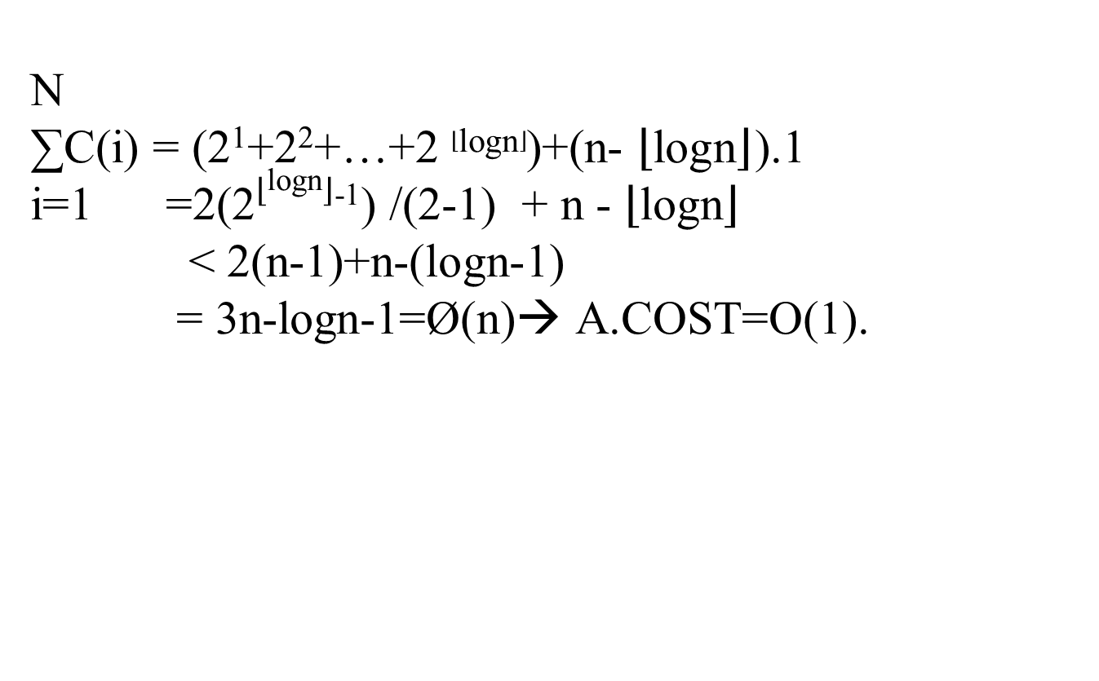
AGGREGATE METHOD cont.…
<number> of 20
Notes:
Microsoft Engineering Excellence
Microsoft Confidential

Slide 14
Accounting Method
Assign different charges to different operations.
Some operations charges more or less than the actual cost
When an operation is amortized exceed the actual cost the difference is assigned to credit
Amortized cost can be split operation into actual cost and credit.
Credit can either be deposited or used up but total credit can never be negative.
<number> of 20
Notes:
Microsoft Engineering Excellence
Microsoft Confidential

Slide 15
Accounting Method cont.…
Stack Operation
Actual Cost – PUSH 1
- POP (1,0)
- Multipop min(S,K)
S is the stack size.
Amortized Cost
-PUSH 2
-POP 0
-Multipop 0
since stack has non empty elements , credit is non negative

Slide 16
Accounting Method cont.…
So the total Amortized cost is upper bound to total actual cost.
So total Amortized. Cost is O(n), therefore the total actual cost is O(n).

Slide 17
Accounting Method cont.…
Incrementing Bin Counter
Actual cost is proportional to no. of bits flipped
  charge 2 to set bit to 1.
  charge 0 to reset bit.
So each 1 in the number at any time will be credited by 1 in it.
Now at most 1bit is set in each increment operation, so Amortized cost of an increment operation is at most 2.

Slide 18
Accounting Method cont.…
No. of 1’s in the counter is never negative.
So credit is always non negative.
  For N increment operation ,
Total Amortized Cost=O(n)

Slide 19
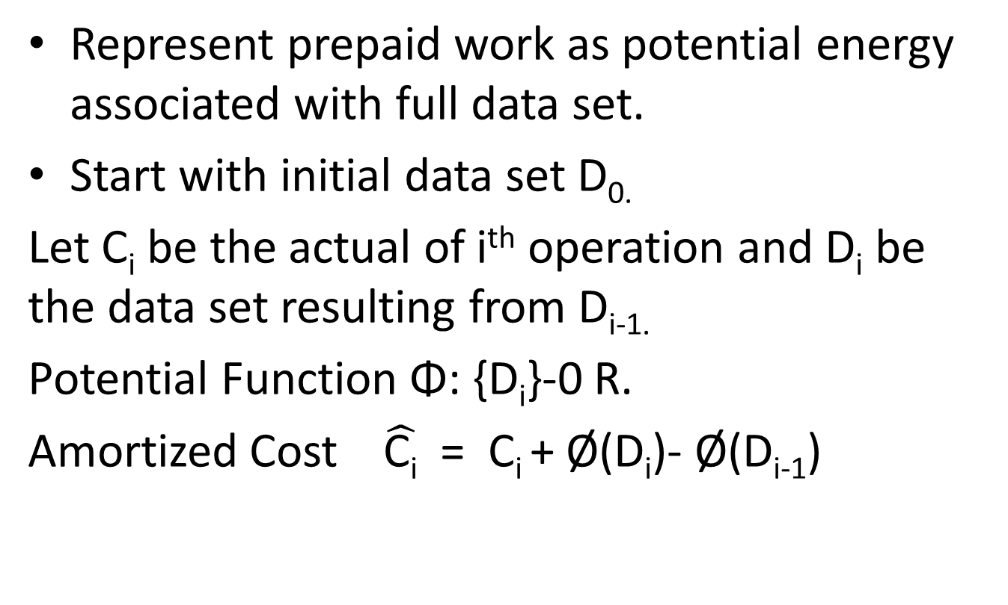
Potential Method

Slide 20
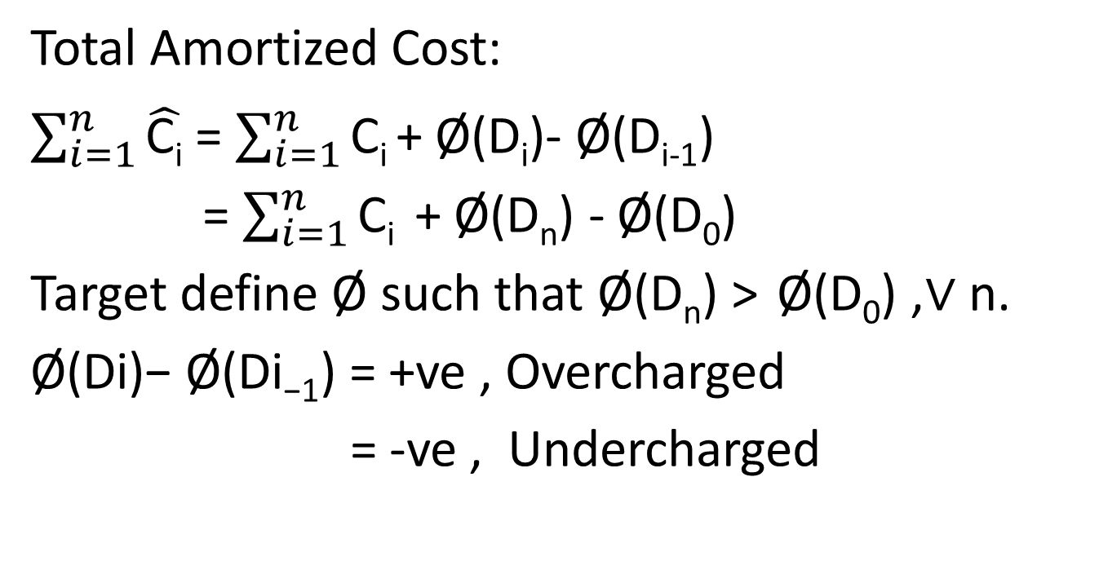
Potential Method cont.…

Slide 21
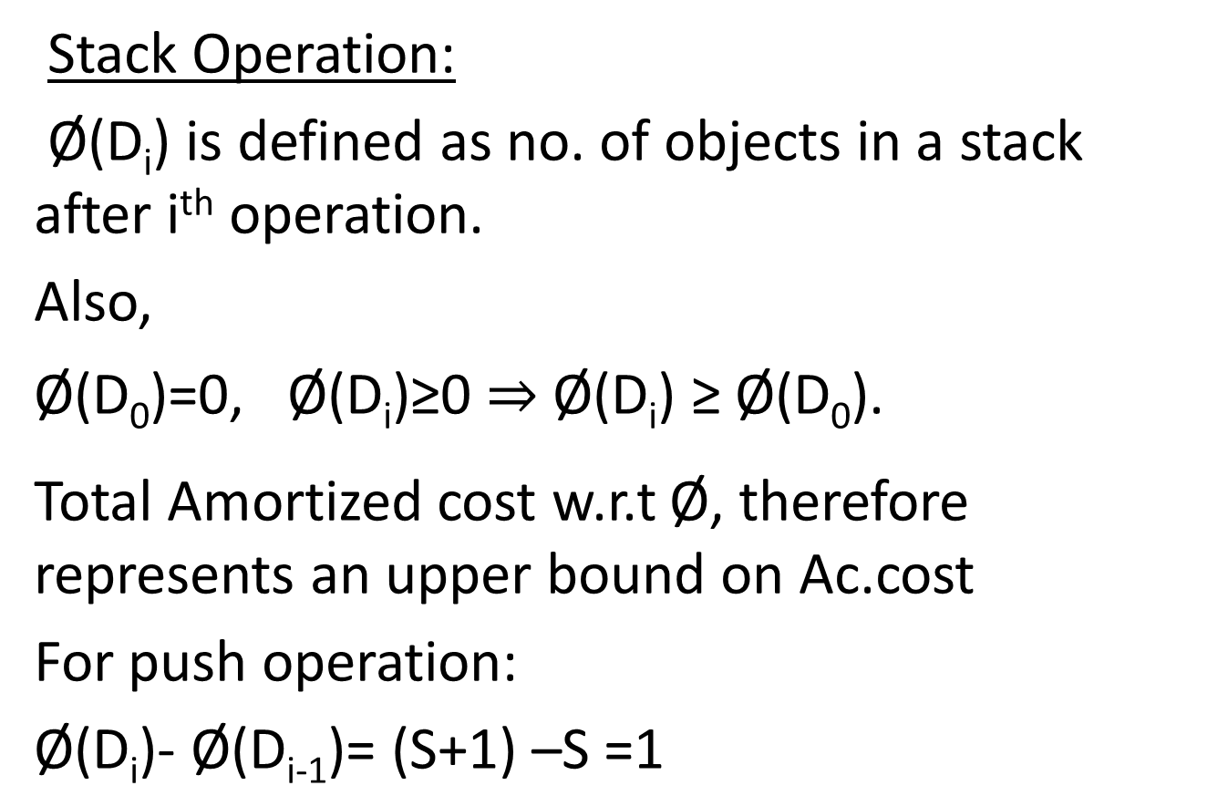
Potential Method cont.…

Slide 22
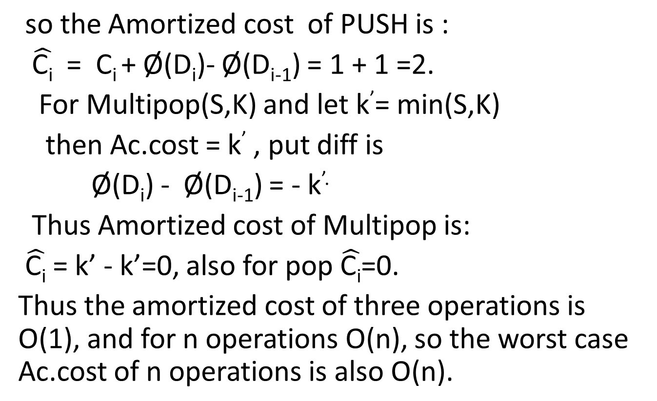
Potential Method cont.…

Slide 23
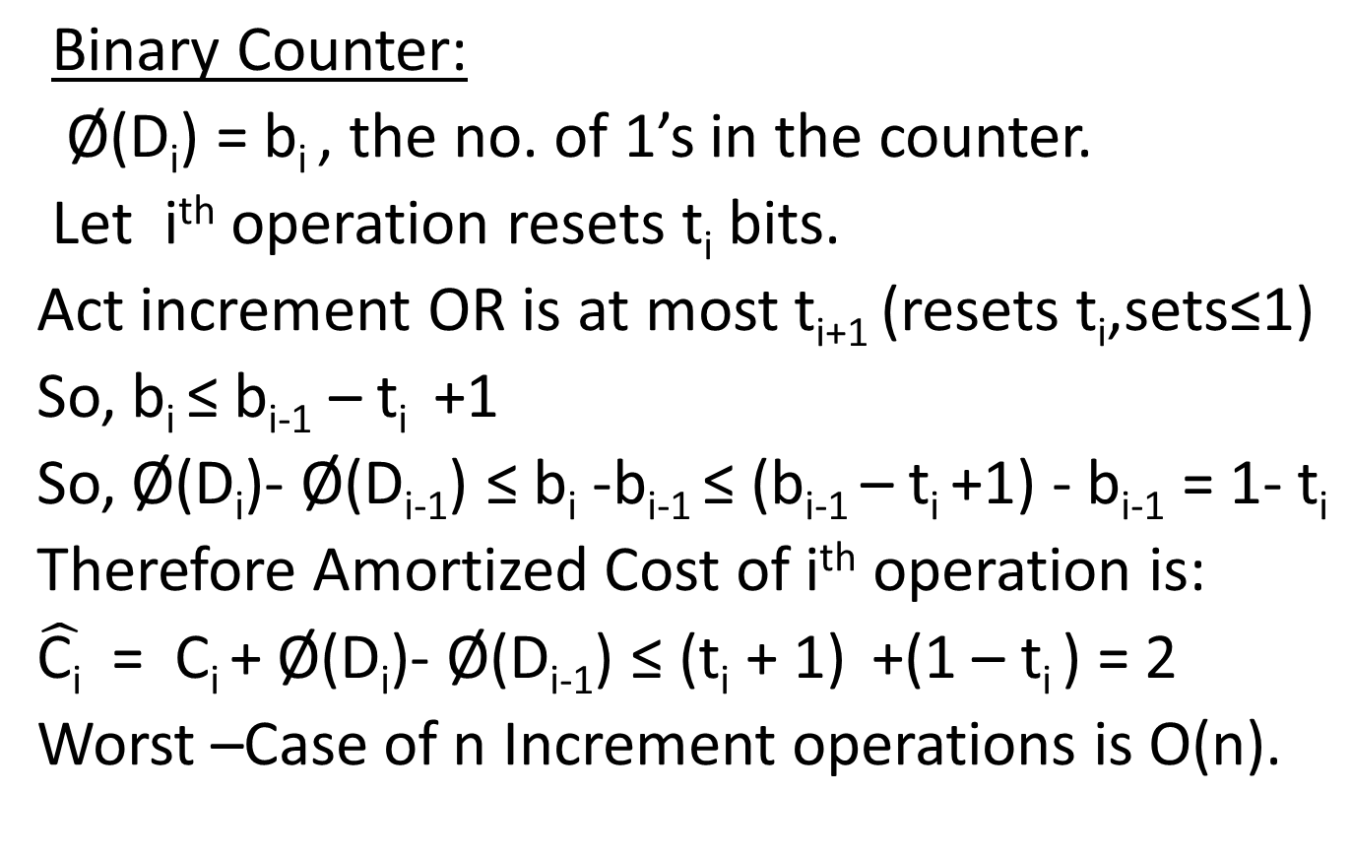
Potential Method cont.…

Slide 24
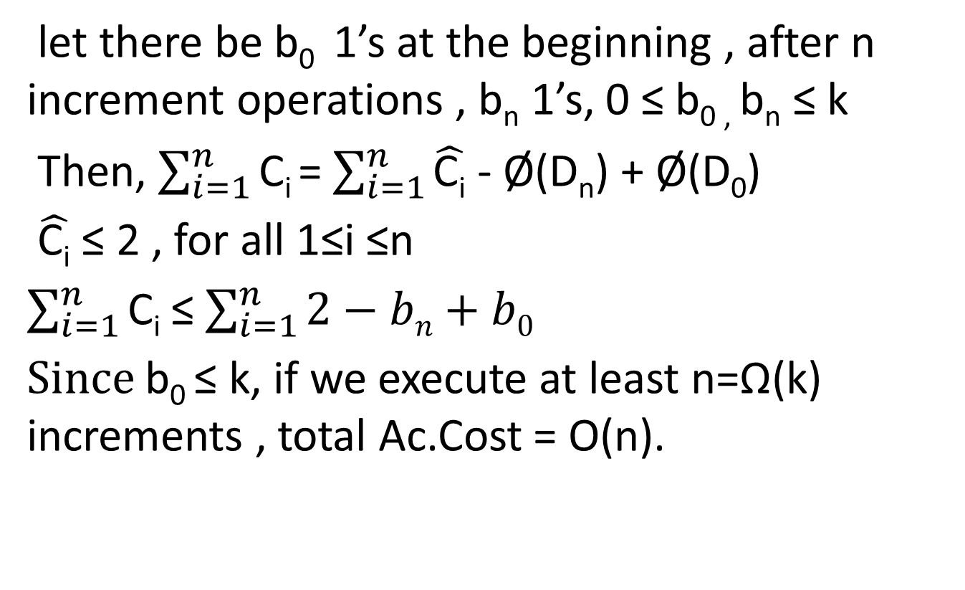
Potential Method cont.…

Slide 25
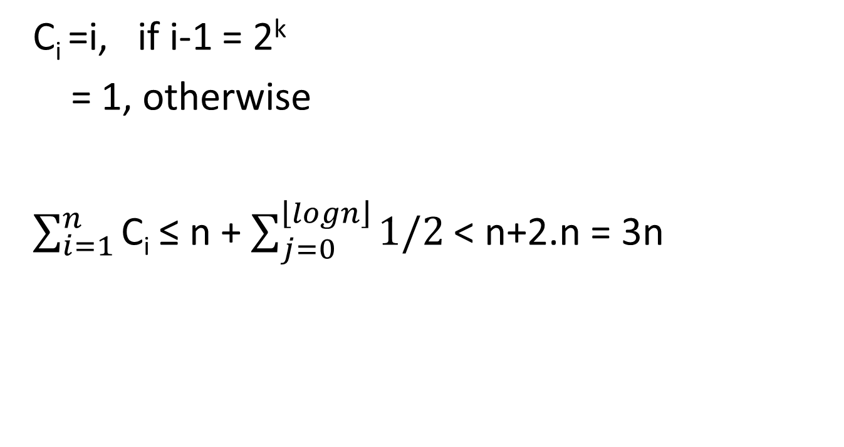
Potential Method cont.…

Slide 26
Potential Method cont.…
TABLE_INSERT(T,x)
if size(T)=0
Then allocate tab[T] with 1s to t
Size[T] ← 1
If num[T] = Size[T]
Then allocate new table with 2. Size[T] slots
Insert all odd items to new.T
Free tab[T]
tab[T] ← new-Table
Size[T] ← z. Size[T]
Insert x into tab[T]
num[T] ← num[T] +1 Ø(T)=2. num[T] - Size[T]

Slide 27
THANK YOU

