Slide 1
Computer organization
Computer organization refers to the operational units and their interconnections that realize the architectural specifications.
Examples of organizational attributes include those hardware details transparent to the programmer, such as
  control signals,
  interfaces between the computer and peripherals, and the memory technology used.

Slide 2
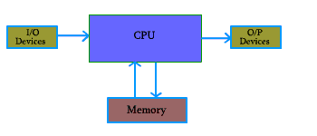
Figure 1.1: Basic Unit of a Computer
Central Processor Unit
Input Unit
Output Unit
Memory Unit

Slide 3
Central Processor Unit (CPU) :
Central processor unit consists of two basic blocks :
  The program control unit has a set of registers and control circuit to generate control signals.
  The execution unit or data processing unit contains a set of registers for storing data and an Arithmetic and Logic Unit (ALU) for execution of arithmetic and logical operations.
CPU may have some additional registers for temporary storage of data.

Slide 4
Input Unit
With input unit data from outside can be supplied to the computer.
Program or data is read into main storage from input device or secondary storage under the control of input instruction.
Example of input devices:
Keyboard, Mouse, Hard disk, Floppy disk, CD-ROM drive etc.

Slide 5
Output Unit
With output unit computer results are provided to the user or it can be stored in storage device permanently for future use. Output data from main storage go to output device under the control of output instructions.
Example of output devices:
Printer, Monitor, Plotter, Hard Disk, Floppy Disk etc.

Slide 6
Memory Unit
Memory unit is used to store the data and program. CPU can work with the information stored in memory unit. This memory unit is termed as primary memory or main memory module. These are semi conductor memories.
two types of semiconductor memories -
Volatile Memory : RAM (Random Access Memory).
Non-Volatile Memory :
  ROM (Read only Memory), PROM (Programmable ROM)
  EPROM (Erasable PROM), EEPROM (Electrically Erasable PROM).

Slide 7
Secondary Memory
Secondary memories are non volatile memory and it is used for permanent storage of data and program.
Example of secondary memories
Hard Disk, Floppy Disk, Magnetic Tape :magnetic devices
CD-ROM: optical device
Thumb drive (or pen drive):semiconductor memory

Slide 8
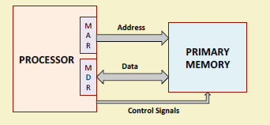
Interfacing with the Primary Memory
To read data from memory
  Load the memory address into MAR.
  Issue the control signal READ.
  The data read from the memory is stored into MDR.
To write data into memory
  Load the memory address into MAR.
  Load the data to be written into MDR.
  Issue the control signal WRITE.

Slide 9
Exercise: Size of Registers
Given : Memory size = 4096 words
        Word size = 16 bit
        One word Instruction is used
  1. Draw a schematic diagram of memory with above stated value
  2.Give word size in bytes
  3. How many bits required to select a word in memory?
  4. What is the size of MAR in bits?
  5. What is the size of MDR in bits and in bytes?
  6. What is the size of the Program Counter(PC)?
  7. What is the size of Instruction Register(IR)?

Slide 10
Registers
The memory has 4096 words in it
4096 = 2¹², so it takes 12 bits to select a word in memory
Each word is 16 bits long
Size of MAR=12 bits
Size of MDR=16bits
Two special-purpose registers are used:
Program Counter (PC): Holds the memory address of the next instruction to be executed.
Automatically incremented to point to the next instruction when an instruction is being executed.
Instruction Register (IR): Temporarily holds an instruction that has been fetched from memory.
Need to be decoded to find out the instruction type.
Also contains information about the location of the data.

Slide 11
Byte-Addressable Memory- 32 bits word
Word
Address
0
4
8
12
0 | 1 | 2 | 3
4 | 5 | 6 | 7
8 |  |  | 11
12

Slide 12
A SPECIFIC SYSTEM EXAMPLE: IAS

Slide 13
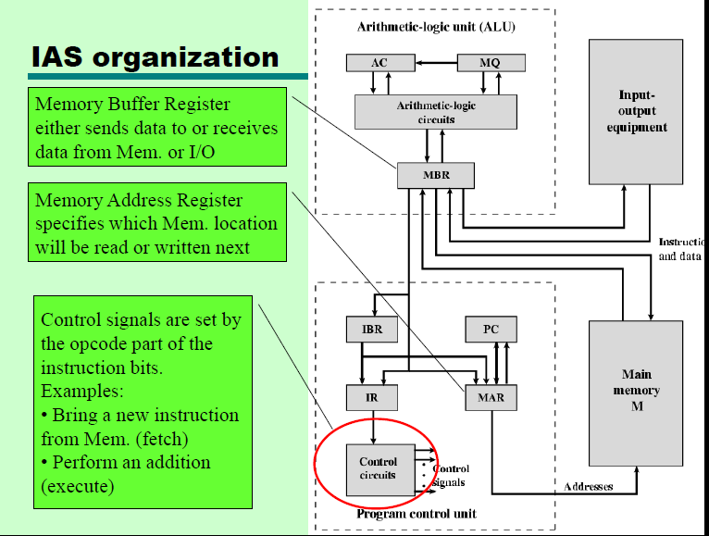

Slide 14
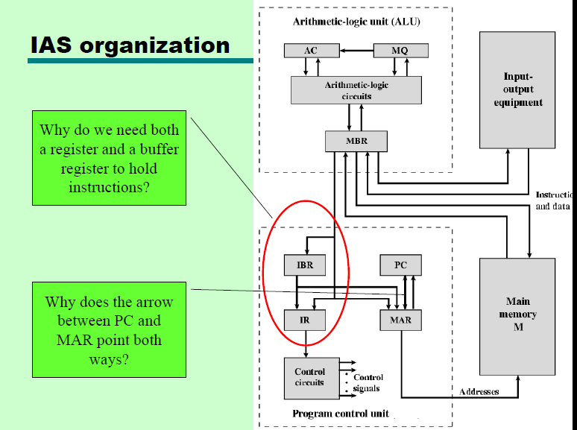

Slide 15
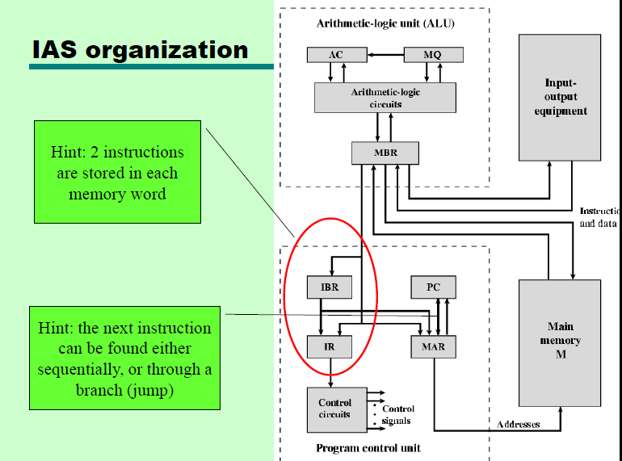

Slide 16

Instruction Cycle
Two steps:
  Fetch
  Execute
Fetch Cycle
  Program Counter (PC) holds address of next instruction to fetch
  Processor fetches instruction from memory location pointed to by PC
  Increment PC
    Unless told otherwise
  Instruction loaded into Instruction Register (IR)
  Processor interprets instruction and performs required actions

Slide 17
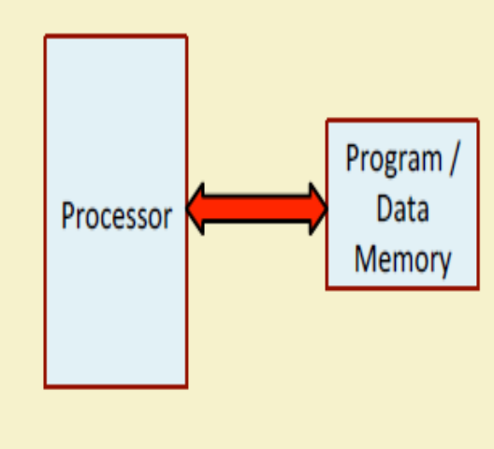
von-Neumann Architecture
Stored Program concept
Main memory storing programs and data
ALU operating on binary data
Control unit interpreting instructions from memory and executing
Input and output equipment operated by control unit
More flexible and easier to implement.
Suitable for most of the general purpose processors.
Disadvantage:
The processor-memory bus acts as the bottleneck.
All instructions and data are moved back and forth through the pipe

Slide 18
von-Neumann Architecture
How can this be reduced?
This performance problem is reduced by using cache memory.(details in memory part)
Using RISC architecture as it uses less number of memory reference instruction and uses large number of registers.

Slide 19
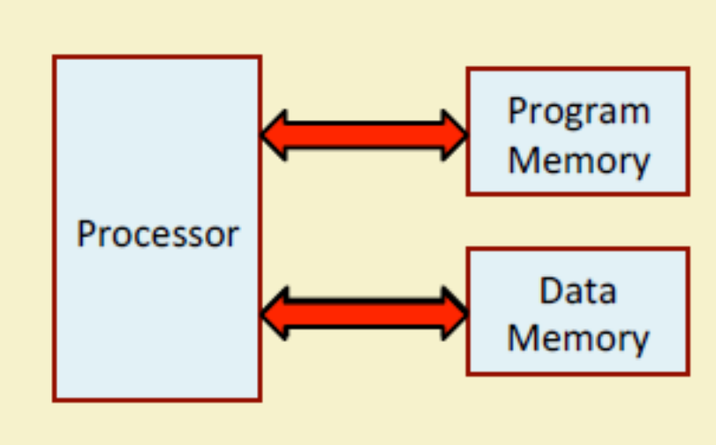
Harvard Architecture
Separate memory for program and data.
Instructions are stored in program memory
Data are stored in data memory.
Instruction and data accesses can be done in parallel.
Some microcontrollers and pipelines with separate instruction and data caches follow this concept.
The processor-memory bottleneck remains.

Slide 20
Instruction Set & Addressing
Various addressing modes
Machine Instruction
Instruction Format

Slide 21
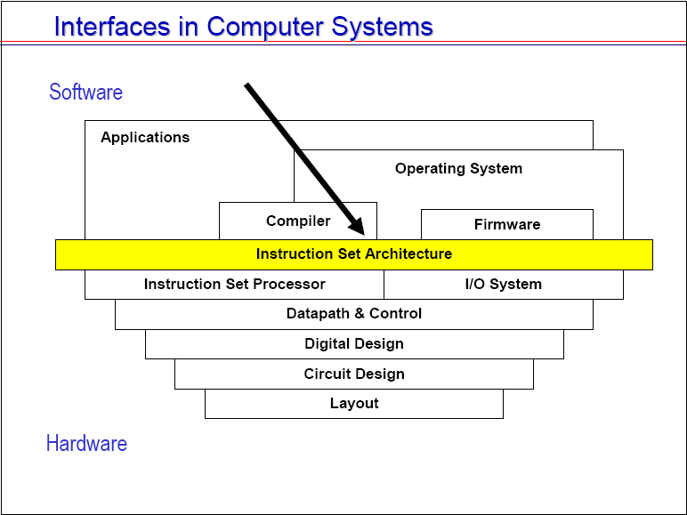

Slide 22
Instructions: Language of the Computer

Slide 23
To command a computer’s hardware
You must speak its language
Instruction Set
  All Instructions that a computer hardware understands
Example:
Instruction Set from MIPS Technologies similar to ARMv7 instruction set(address size 32 bits) and ARMv8 instruction set (Address size 64 bit)
  ARM processor instruction set widely used in personal mobile devices
  Large share of embedded core market uses MIPS processor instruction set
    Applications in consumer electronics, network/storage equipment, cameras, printers
Instruction set of Intel x86 dominated PC era and so far dominates cloud computing
Ref: Computer Organization and Design , Patterson and Hessessy -5th Ed

Slide 24
Instruction Set
Different computers have different instruction sets
  many aspects are common
(Note: Computer Designers’ goal:
Choose instruction set
  That makes it easy to build supporting hardware
  For which it is easy to write compiler while maximizing performance and minimizing cost and energy
)

Slide 25
Computer
Must have instructions capable of performing 4 types of instructions
  Arithmetic and logical operation on data
  Data transfer between the memory and processor registers
  Program sequencing and control
  I/O transfers

Slide 26
Operations of Computer Hardware
& corresponding Instruction
Every computer must perform arithmetic
  Every computer Instruction set has arithmetic instructions
In High Level Language (say C)
add 2 variables int A,B and assign the sum to
variable int C : - C = A + B;

Slide 27
Notation of Content of Variable
High Level Language variable A,B,
  After compilation a table keeps the address of the memory location where the value of the variable is found
  Symbol Table:
Variable | Address
A | 00100……..10
In Register transfer language content of variable A given by [A]

Slide 28
Arithmetic Instruction Example contd…..
Add three operands
  Two sources variables A and B , one destination variable C
add C, A, B # C <- [A] + [B]
All arithmetic operations (add,sub,mult,div) have this form
(Design Principle 1: Simplicity favours regularity
  Regularity makes implementation simpler
  Simplicity enables higher performance at lower cost)
§2.2 Operations of the Computer Hardware
Chapter 2 — Instructions: Language of the Computer — <number>
Notes:
The University of Adelaide, School of Computer Science
Chapter 2 — Instructions: Language of the Computer

Slide 29
Register Operands(General Example)
General purpose 32 registers within processor with symbolic names
  R0, R1, R2…..R31

Slide 30
Arithmetic Example
C code:
f = (g + h) - (i + j);
Compiled general code :
add R1, g, h # R1 = [g] + [h]
add R2, i, j # R2 = [i] + [j]
sub f, R1, R2 # f = [R1] – [R2]
Instruction Type: 3 address Instruction
Chapter 2 — Instructions: Language of the Computer — <number>
Notes:
The University of Adelaide, School of Computer Science
Chapter 2 — Instructions: Language of the Computer

Slide 31
Register Operands using MIPS assembly code
Arithmetic instructions use register operands
MIPS has a 32 × 32-bit register file
  Use for frequently accessed data
  Numbered 0 to 31
  32-bit data called a “word”
Assembler names
  $t0, $t1, …, $t9 for temporary values
  $s0, $s1, …, $s7 for saved variables
Design Principle 2: Smaller is faster
  c.f. main memory: millions of locations
§2.3 Operands of the Computer Hardware
Chapter 2 — Instructions: Language of the Computer — <number>
Notes:
The University of Adelaide, School of Computer Science
Chapter 2 — Instructions: Language of the Computer

Slide 32
Register Operand Example
C code:
f = (g + h) - (i + j);
  f, …, j in $s0, …, $s4
Compiled MIPS code:
add $t0, $s1, $s2
add $t1, $s3, $s4
sub $s0, $t0, $t1
Chapter 2 — Instructions: Language of the Computer — <number>
Notes:
The University of Adelaide, School of Computer Science
Chapter 2 — Instructions: Language of the Computer

Slide 33
Two Address Instruction
Register Transfer Language
Operation Source, Destination
Add A, B # B <- [A] + [B]
Disadvantage:
Value of B changed after execution. Previous value of B destroyed. To ensure B does not change; transfer value of B to another variable C
Move B, C # C <- [B]….copy value in B to C variable
Add A,C # C <- [C]+ [A]

Slide 34
Computer
Must have instructions capable of performing 4 types of instructions
  Arithmetic and logical operation on data
  Data transfer between the memory and processor registers
  Program sequencing and control
  I/O transfers

Slide 35
Data transfer between the memory and processor registers
Symbolic names stand for hardware binary address
  LOC,A,B,
  Processor register names R1, R2,R5…
  I/O register names DATAIN, OUTSTATUS,DATAOUT
Mov R1, A # A <- [R1] same as :- Store R1,A
Move B, R5 # R5 <- [B] same as:- Load B,R5

Slide 36
Processors where arithmetic operations allowed only on operands that are in processor registers
HLL :- C=A+B
Move A, Ri
Move B, Rj
Add Ri, Rj
Mov Rj , C
These processors much faster ( since register access is fast) than Processors that allow arithmetic operation with memory access

Slide 37
One Address Instruction
Computer with special register ACCUMULATOR (AC) use One Address Instruction
Load A # AC <- [A]
Add B # AC <- [AC] + [B]
Store C # C <- [AC]

Slide 38
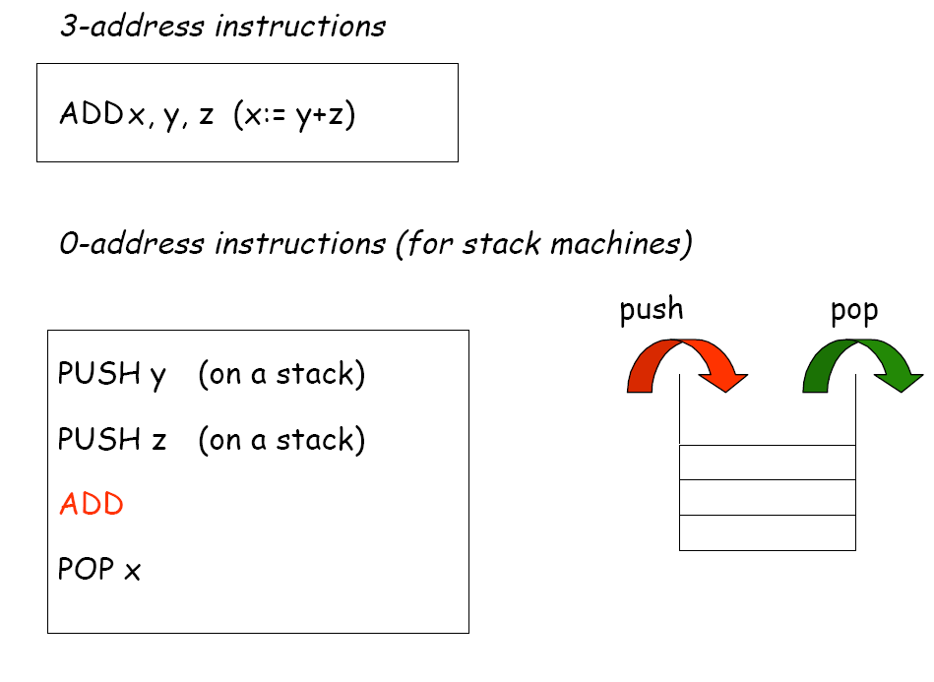

Slide 39
Exercise on Various number of Address Instruction
Evaluate the arithmetic statement
X=(A+B)/(C-D) using 3 address, two address, one address and zero address instructions
1.Three Address Instruction:
Sub Ri, C,D # Ri <- M[C] –M [D]
Add Rj, A ,B # Rj <- M[A] + M[B]
Div X, Rj,Ri # X <- [Rj] / [Ri]

Slide 40
Exercise on Various number of Address Instruction contd..
2.Two Address Instruction:
Load R1, C # R1 <- M[C]
Sub R1, D # R1 <- [R1] - M[D]
Load R2, A # R2 <- M[A]
Add R2, B # R2 <- [R2] + M[B]
Div R2,R1 # R2 <- [R2] / [R1]
Store X,R2 # M[X] <- [R2]

Slide 41
Exercise on Various number of Address Instruction contd…
3. One Address Instruction(with accumulator AC):
Load C # AC <- M[C]
Sub D # AC <- [AC] - M[D]
Store T # M[T] <- [AC]
Load A # AC <- M[A]
Add B # AC <- [AC] + M[B]
Div T # AC <- [AC] / M[T]
Store X # M[X] <- [AC]

Slide 42
Exercise on Various number of Address Instruction contd…
4. Zero Address Instruction(stack based processor, stack pointer register (SP)):
push C # [SP] <- M[C]
push D # [SP] <- M[D]
Sub
push A # [SP] <- M[A]
push B # [SP] <- M[B]
Add
Div
Pop X # M[X] <- [SP]

Slide 43
Computer
Must have instructions capable of performing 4 types of instructions
  Arithmetic and logical operation on data
  Data transfer between the memory and processor registers
  Some idea given
  Program sequencing and control
  I/O transfers
  To do

Slide 44
Instruction Set Architecture (ISA)
Serves as an interface between software and hardware.
Consists of information regarding the programmer’s view of the architecture (i.e. the registers, address and data buses, etc.).
Also consists of the instruction set.
Many ISA’s are not specific to a particular computer architecture.
They survive across generations.
Classic examples: IBM 360 series, Intel x86 series, etc.

Slide 45
Different Hardware can support same Instruction set
  Just need a hardware to execute each instruction of the instruction set

Slide 46
Instruction Formats
Layout of bits in an instruction
Includes opcode
Includes (implicit or explicit) operand(s)
May be more than one instruction format ( different address modes, different number of ) in an instruction set ( complex instruction set computer CISC)

Slide 47
Instruction Length
Affected by and affects:
  Memory size
  Memory organization
  Bus structure
  CPU complexity
  CPU speed
Instruction may be 2 or 3 words long in Complex Instruction Set Computer

Slide 48
Operand Addressing
operands and operations
  machine instructions
address of an operand specified, and bits of an instruction organized
  to fit into the word size
  Word size limit set by word size that the processor can handle.

Slide 49
Addressing Modes:
how does the control unit determine which addressing mode is being used in a particular instruction ?
  different opcodes used for different addressing modes
  or one or more bits in the instruction format used as a mode field (keeps code for addressing mode).

Slide 50
Effective Address
What is the interpretation of effective address
  In a system without virtual memory
    effective address
      either a main memory address or a register.
  In a virtual memory system
    effective address
    is a virtual address or a register
    The actual mapping to a physical address is a function of the paging mechanism and is invisible to the programmer.

Slide 51
Addressing Modes:
To explain the addressing modes, we use the following notation:
A=contents of an address field in the instruction that refers to a memory
R=contents of an address field in the instruction that refers to a register
EA=actual (effective) address of the location containing the referenced operand
(X)=contents of location X

Slide 52
Addressing Modes:
Common addressing modes are:
  Immediate
  Direct
  Indirect
  Register
  Register Indirect
  Displacement
  Stack

Slide 53
1. Immediate Addressing
Operand is part of instruction
Value of operand given explicitly
e.g. ADD #5, R1 or ADDI 5,R1
  Add 5 to contents of register R1
  5 is operand
No memory reference to fetch data
Fast
Limited range
Notes:
3

Slide 54
Immediate Addressing
HLL constant value and address contant value translated to this assembly code
A=B+6
Move B, R1
Add #6,R1 (for decimal 6) or
Add #%00000110,R1 (binary constant) or
Add #$06,R1 (Hexadecimal constant)
Move R1 , A
Notes:
3

Slide 55
Immediate Addressing
used to define and use constants
  to increment counters
  to test for some patterns
  or set initial values of variables

Slide 56
Immediate Addressing:
The advantage of immediate addressing is that no memory reference other than the instruction fetch is required to obtain the operand.
The disadvantage is that the size of the number is restricted to the size of the address field, which, in most instruction sets, is small compared with the world length.

Slide 57
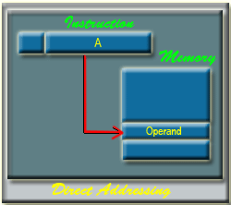
2. Direct Addressing:
the address field of operand contains the tive address of the operand:
EA = A
It requires only
one memory reference
and no special calculation.
Here, 'A' indicates the memory
address for the operand.

Slide 58
Addressing Modes
(Used in Assembly Language)
2.Absolute Mode or Direct Mode:
  Name of operand used explicitly
  Move B , R2
  HLL int A,B;
  Compiler assigns memory location A and B to the variables

Slide 59
Absolute or Direct Addressing Diagram
Instruction
Opcode
A(memory address of
the operand)
Memory
Operand
(HLL variable A value)
Notes:
6

Slide 60
Absolute or Direct Addressing
Disadvantage:
  Number of bits available for memory address of operand is less than number of bits available in total word

Slide 61
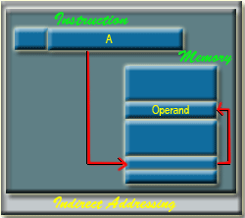
3.Indirect Addressing:
With direct addressing
  length of the address field is less than the word length, thus limiting the address range
Indirect (Pointer) addressing
  address field refer to the address of a word in memory, which in turn contains a full-length address of the operand
EA = (A)
Here 'A' indicates the memory address which contains the address(one word size) of the required operands.

Slide 62
Indirect Addressing
Memory cell pointed to by address field contains the address of (pointer to) the operand
EA = (A)
  Look in A, find address and contents of the address in A is the operand
e.g. ADD (A)
  Add contents of cell pointed to by contents of A to accumulator
Notes:
7

Slide 63
Indirect Addressing Diagram
Instruction
Opcode
Address A
Memory
Pointer to operand
Operand
Notes:
9

Slide 64
Indirect Addressing Mode
HLL A=*B;
May compile into :
Move B,R1
Move (R1),A

Slide 65
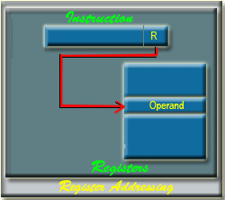
4. Register Addressing:
The disadvantage of register addressing is that the address space is very limited.
'R' indicates the address of the register where the operand is present.
address field refers to a register rather than a main memory address:
EA = R
The advantages of register addressing are that only a small address field is needed in the instruction and no memory reference is required.

Slide 66
Register Mode
Operand is the content of processor register
  In this example R2,gives the address of the register, (if 32 registers then address needs 5 bits only)
  Name of the processor register keeps the address of the register where the value of the operand found
  Move B , R2

Slide 67
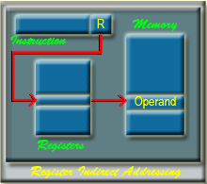
5. Register Indirect Addressing:
address field refers to a register instead of a memory location, therefore 5-7 bits required(for 32 or 64or 128 registers)
EA = (R)
Register indirect addressing uses one less memory reference than indirect addressing. Because, the address of the memory location is available in a register (Memory not accessed to get address of the operand in memory)
register access is much more faster than the memory access.

Slide 68
Displacement Addressing: Relative addressing(PC) , Index Addressing/ Base-register addressing(Arrays)
A( R )
  Displace by offset A the address kept in register R
EA = A + (R)

Slide 69
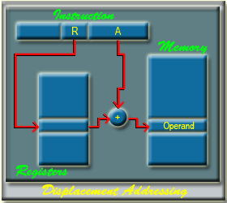
Displacement Addressing:
Three of the most common use of displacement addressing are:
Relative addressing
Index Addressing Mode
Base-register addressing
EA= A +(R)

Slide 70
5. Relative Addressing: (Displacement Addressing)
X(PC)
  X ( bytes offset) added to current instruction address (PC register value) to produce Effective address
EA= X + (PC)..address of the next instruction
X(PC)…X bytes offset can be
–tive (going back in instruction sequence)
or +tive (going forward in instruction sequence)

Slide 71
Relative Addressing
A version of displacement addressing
R = Program counter, PC
EA = A + (PC)
i.e. get operand from A cells away from current location pointed to by PC
c.f locality of reference & cache usage
Notes:
17

Slide 72
Relative Addressing
1000 Loop
1004
1008
1012
PC 1016 | Branch > 0 -16(PC)

Slide 73
6. Index Addressing Mode used for HLL Lists and Arrays
Effective Address X(R1)
  EA = offset(or displacement)+ index register R1 contents value
  = X + [R1] = 20 + 1000 = 1020
Add 20(R1),R2
. . .
86
1000
R1
IndexRegister
1000
310
R2
20 offset
or displacement
1020
operand
396
R2

Slide 74
EA = X + [R1] = 1000 + 20 = 1020
Add 1000(R1),R2
. . .
86
20
20
R1
IndexRegister
10000 offset
or displacement
1020

Slide 75
7. Base-Register Addressing (Displacement)
Base Register Rj with Index Register Ri
  (Ri,Rj)
EA = (Ri) + (Rj)
Address field hold two values
  Rj = base address value
  Ri = register that holds index(displacement)
  or vice versa
Notes:
15

Slide 76
Base-Register Addressing contd….:
  Or vice versa
  base register (Ri)contains array base memory address
  address field contains Rj contains index/displacement from base address
EA= (Ri) + (Rj)

Slide 77
Index Addressing Mode Variations
More complex index modes
Base register with index register and offset:
X(Ri,Rj)
EA = X + Ri + Rj

Slide 78
Index Mode
 | Test1 | Test2
Student1 | val11 | val12
Student2 | val21 | val22
.. .. | … .. | . ...
GrandTot
 | Move N,R4
 | Move #LIST,R0
LOOP | Add 4(R0),R1
 | Add 8(R0),R2
 | Add #12,R0
 | Decr R4
 | Branch >0 LOOP
 | Move R1, SUM1
 | Move R2,SUM2
N | n
LIST | STUDENT ID
LIST+4 | Test1
LIST+8 | Test2
LIST+12 | STUDENT ID
 | Test1

Slide 79
8. Autoincrement Mode (Ri)+
Autodecrement Mode -(Ri)
Ri contains address of operand
1.(Ri)+ After accessing operand(Ri), contents of Ri automatically incremented to point to next item in list
2. –(Ri) Contents of Ri decremented by 1 and then used.
Used for stack data structure stack pointer
 | Move N,R4
 | Move #LIST,R0
LOOP | Add 4(R0)+,R1
 | Add (R0),R2
 | Add #4,R0
 | Decr R4
 | Branch >0 LOOP
 | Move R1, SUM1
 | Move R2,SUM2

Slide 80
Stack Addressing:
stack is a linear array or list of locations
  pushdown list or last-in-first-out queue
  stack is a reserved block of locations
  Items appended to the top of the stack so that, at any given time, the block partially filled
  Associated with the stack is a pointer whose value is the address of the top of the stack
  Stack pointer maintained in a register
    references to stack locations in memory are in fact register indirect addresses.
The stack mode of addressing is a form of implied addressing. The machine instructions need not include a memory reference but implicitly operate on the top of the stack.

Slide 81
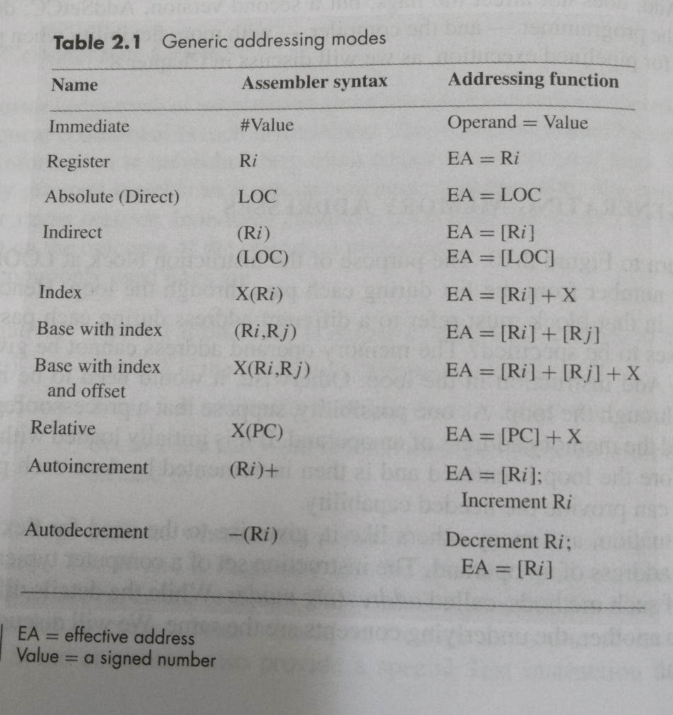

Slide 82
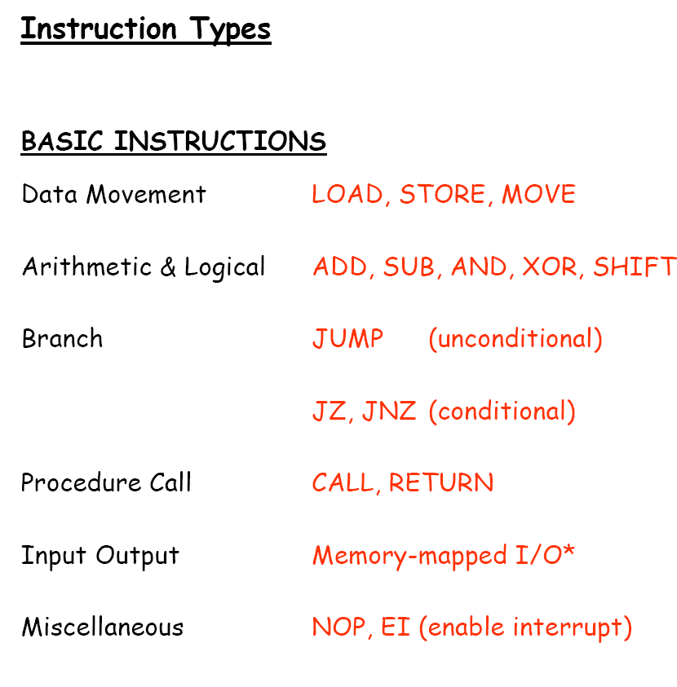

Slide 83
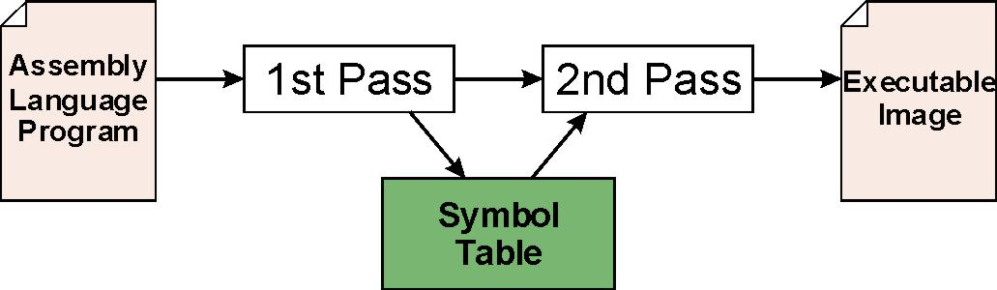
Assembly Process
First Pass:
  scan program file
  find all labels and calculate the corresponding addresses;
  this is called the symbol table
Second Pass:
  convert instructions to machine language,
  using information from symbol table
7-<number>

Slide 84
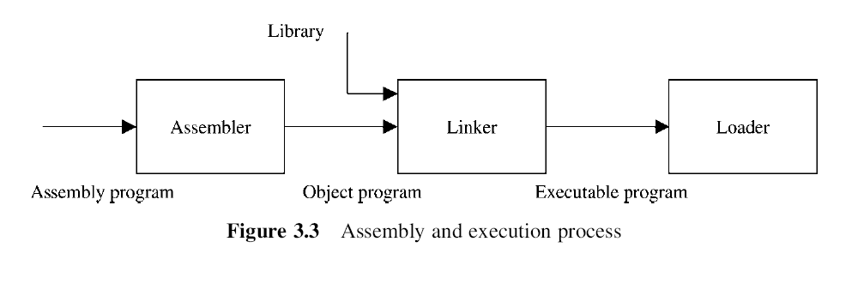

Slide 85
Linking and Loading
Loading is the process of copying an executable image into memory.
  more sophisticated loaders are able to relocate images to fit into available memory
  must readjust branch targets, load/store addresses
Linking is the process of resolving symbols between independent object files.
  suppose we define a symbol in one module,
  and want to use it in another
  some notation, such as .EXTERNAL, is used to tell assembler that a symbol is defined in another module
  linker will search symbol tables of other modules to resolve symbols and complete code generation before loading
7-<number>

Slide 86
Example Addressing Mode
Ref: Mano:- Computer System Architecture

Slide 87
Numerical Example :-Word addressable Accumulator based Computer with Two-word instruction at address 200 and 201
First word of instruction contains op code :"load to AC”instruction, and mode
Second word of instruction contains operand field equal to 500
PC has the value 200 for fetching this instruction
Content of processor register R 1 is 400,
Content of an index register XR is 100
AC receives the operand after the instruction is executed
Following slide figure lists other addresses of memory and their content

Slide 88
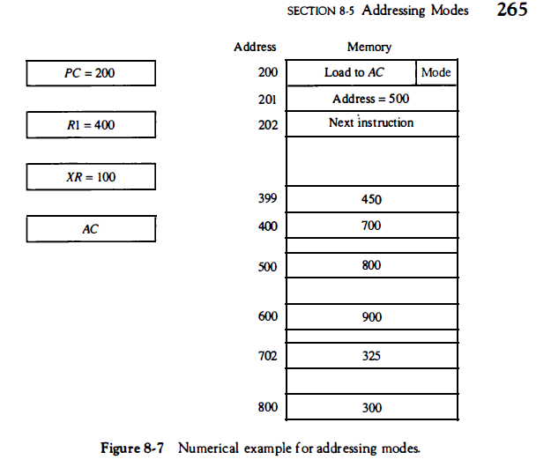

Slide 89
Numerical Example
Mode field of the instruction can specify any one of a number of modes.
For each mode we calculate the effective address and the operand that must be loaded into AC .
1. In direct address mode
  the effective address = address part of the instruction =500
  operand to be loaded into AC is 800
2. In immediate mode the second word of the instruction is taken as the operand rather than an address
  so 500 is loaded into AC (effective address in this case is 201 )
3.In indirect mode
  the effective address is stored in memory at address 500. Therefore, the effective address is 800
  the operand is 300.

Slide 90
Numerical Example(Ref: Mano –Computer System Architecture)
4. In the relative mode
  effective address is 500 + 202 = 702
  operand is 325. (Note that the value in PC after the fetch phase and during the execute phase is 202.)
5.In the index mode
  effective address is XR + 500 = 100 + 500 = 600
  operand is 900.
6.In the register mode the
  operand is in R 1 and 400 is loaded into AC . (There is no effective address in this case. )

Slide 91
Numerical Example(Ref: Mano –Computer System Architecture)
7. In the register indirect mode
  effective address is 400, equal to the content of R 1
  operand loaded into AC is 700.
8. The autoincrement mode is the same as the register indirect mode
  except that R 1 is incremented to 401 after the execution of the instruction.
The autodecrement mode
  decrements R1 to 399 prior to the execution of the instruction.
  operand loaded into AC is now 450
Following Table 8-4 lists the values of the effective address and the operand loaded into AC for the nine addressing modes.

Slide 92
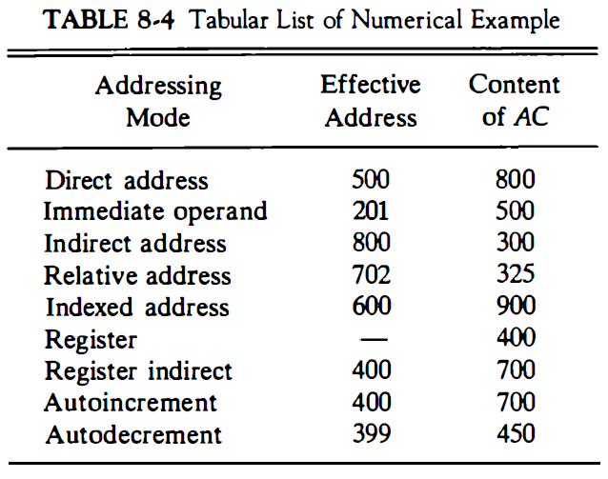

Slide 93
Example Addressing Mode
Ref: Hamacher:- Computer Organization

Slide 94
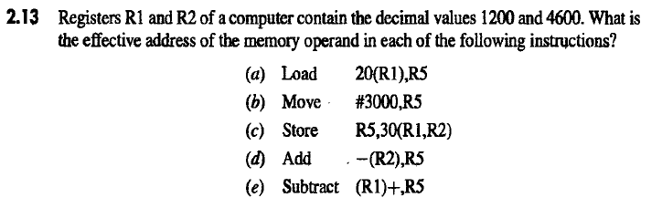

Slide 95
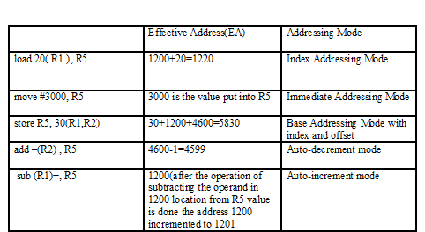
Assuming Word Addressable Processor
R1=1200, R2=4600
R5
1199
33
3000
3060
1860
Memory
1220 …. | 33
4599 | 60
. .
5830 | 3000

