Slide 1
ALGORITHM

Slide 2
SORTING
INTERNAL
EXTERNAL
COMPARISION - BASED
DISTRIBUTION - BASED
Exchange
Bubble
COUNTING
Quick
RADIX
INSERTION
BUCKET
SELECTION
Heap
ENUMERATION
MERGE
STABLE SORTING – Records with equal keys should maintain their relative order.

Slide 3
BUBBLE SORT –
(Also known as EXCHANE SELECTION or PROPAGATION)
Input – Array [ 1….n] of records R_{i}
Output – Records in the array such that the keys k_{i} are in ascending order.
For simplicity assume keys are the only contents of records.
PROC – BubbleSort
Alternatively -
for i = 1 to n-1 do n-1 downto 1
for j=1 to (n-i) do j=1 to i
if k_{j} > k_{j+1}
do exchange
end for
end for

Slide 4
 | Pass 1 | Pass 2 | Pass 3
71 | 99 | 99 | 99
97 | 71 | 97 | 97
99 | 97 | 71 | 71
43 | 56 | 56 | 56
56 | 43 | 49 | 49
49 | 49 | 43 | 43
n-1
i = 1
Possible Improvements –
If on a certain pass no exchange happens, then we should be able to terminate.
2. After the kth pass it is ensured that the top k elements are in their proper position. If suppose k+3 elements are in proper position, then the (k+1)th pass can be made smarter .

Slide 5
Improved Bubble Sort
Bound ← n // Bound is the highest index for which record
is not known to be in its final position
do
{
t ← 0
for j = 1 to BOUND -1
if k_{j} > k_{j+1}
interchange R_{j} ↔ R_{j+1}
t ← j
end if
end for
BOUND t
}while ( t > 0)
←

Slide 6
So variable t takes care of Improvement 1 and variable BOUND takes care of Imp. 2
Suggestion before.

Slide 7
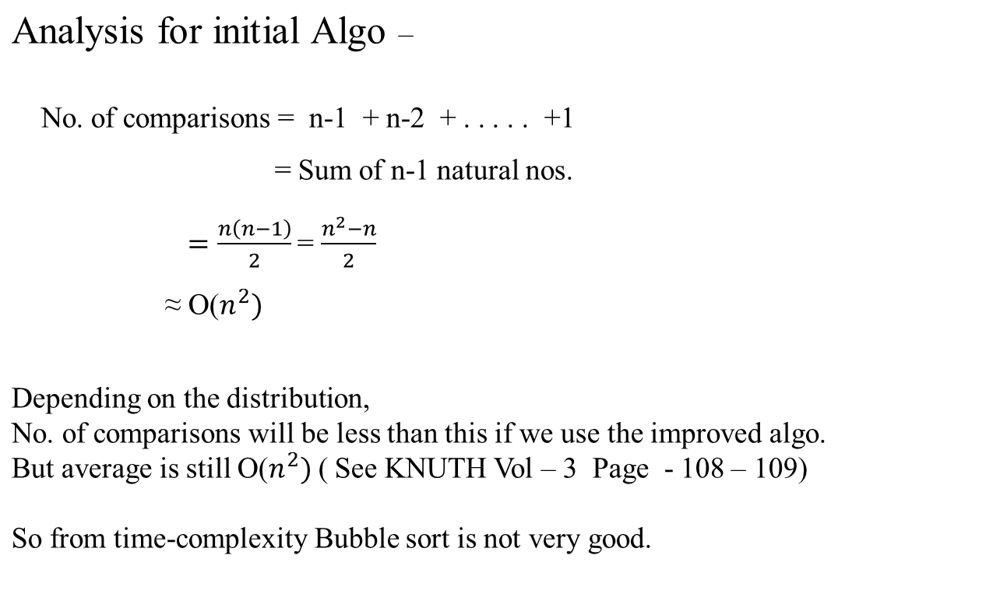

Slide 8
Further Refinements –
If in our example we used a slight variation.
 | Pass 1 | Pass 2 | Pass 3 | Pass 4 | Pass 5
53 | 99 | 99 | 99 | 99 | 99
97 | 53 | 97 | 97 | 97 | 97
99 | 97 | 53 | 58 | 58 | 58
55 | 58 | 58 | 53 | 55 | 55
43 | 55 | 55 | 55 | 53 | 53
58 | 43 | 49 | 49 | 49 | 49
49 | 49 | 43 | 43 | 43 | 43
BOUND=7 BOUND=6 BOUND=5 BOUND=4 BOUND=3
Observations -
1st comparison in Pass 3 is redundant and Likewise 1st 2 comparisons in Pass 5.
Elements can move down/left only one step per pass.
- If minimum is in the right/top, we need n-1 passes.

Slide 9
Improvement over point no.2 –
Cocktail – Shaker Sort
- Alternate passes go in opposite direction.
- Average no. of comparisons get slightly reduced.
Interesting Observation by IVERSON
If j is an index such that R_{j} and R_{j+1} are not exchanged in 2 consecutive passes in opposite direction then R_{j} and R_{j+1} need not enter into any further comparisons.
eg. 4 3 2 1 8 6 9 7 5
3 2 1 4 6 8 7 5 9
1 3 2 4 5 6 8 7 9
no exchange between R4 and R5

Slide 10
QUICK SORT
The result of each comparison determines what keys to be compared next
inappropriate for parallel computers
Basic Idea
  Take one record R₁ and move it to the final position that it should occupy in the file, say S.
  We will also rearrange the other keys so that there is no key greater than that of R₁ to the left of S, and none with smaller keys to the right.
  So problem set got partitioned and 2 similar problems of smaller size emerged.
  We keep on applying the same technique until they are sorted.

Slide 11
A typical scheme to quick sort ( R.Sedgewick)
Use 2 pointers i & j with i = 2 & j = N initially
If R_{i} ispart of the left-hand sub-file, then keep increasing i by 1 till otherwise.
If R_{j} is part of the right-hand subfile, then keep decreasing j by 1 until finding an R_{j} which will belong to left subfile with respect to R₁.
If i < j, exchange R_{i} & R_{j}, and then keep processing the records the same way until i ≥ j.
- Finally exchange R_{j} with R₁.
Whenever a file gets partitioned, we keep the longer subfile in the stack, and proceed with the shorter one
guarantees that the stack will never have more than lg₂N entries.

Slide 12
i
j
69 | 25 | 37 | 92 | 46 | 78 | 5 | 91 | 83 | 80
i
j
i < j
69 | 25 | 37 | 5 | 46 | 78 | 92 | 91 | 83 | 80
j
i
i ≥ j
i
j
46 | 25 | 37 | 5 | 69 | 78 | 92 | 91 | 83 | 80
i = j
Stack
5 | 25 | 37 | 46

Slide 13
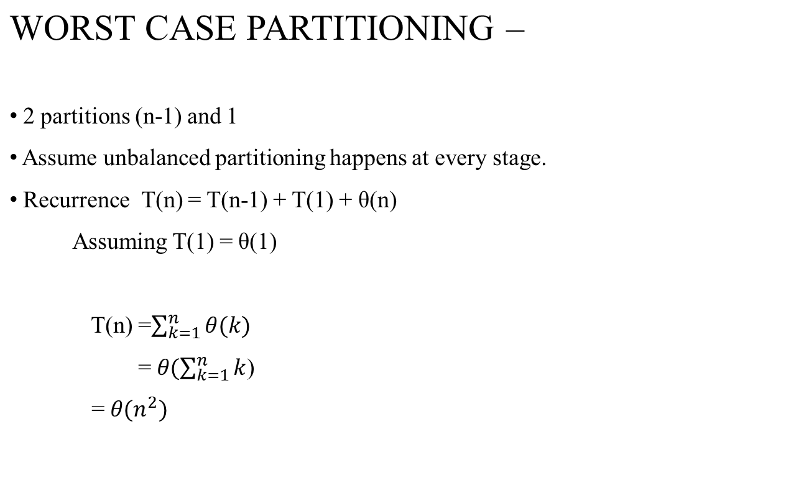

Slide 14
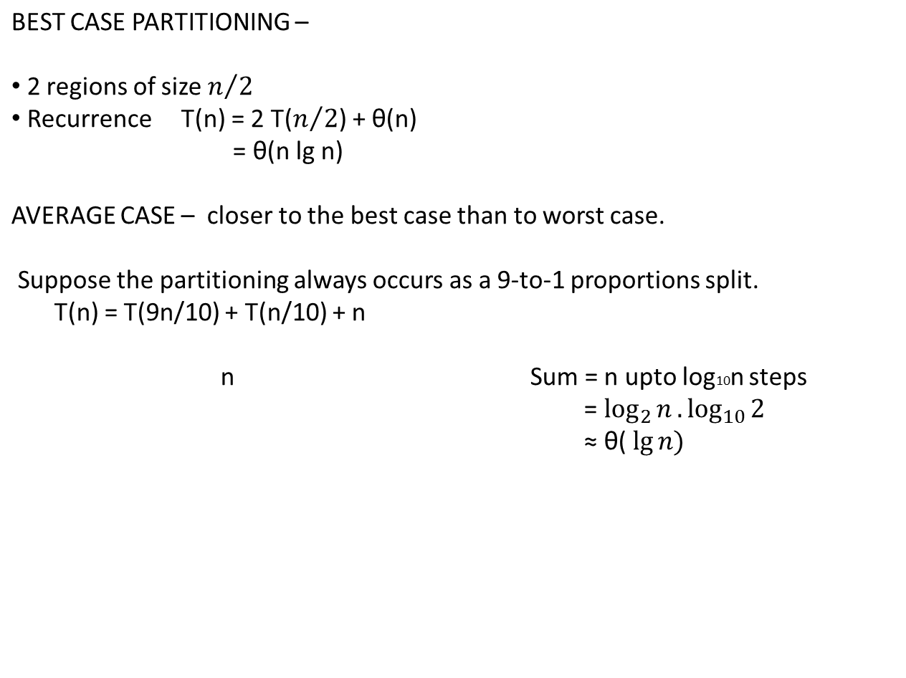
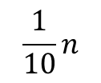

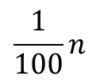
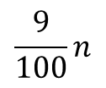
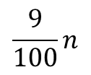
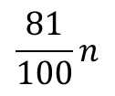
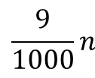
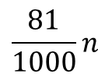
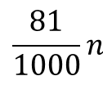
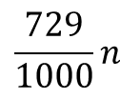
Sum=n
Sum=n

Slide 15
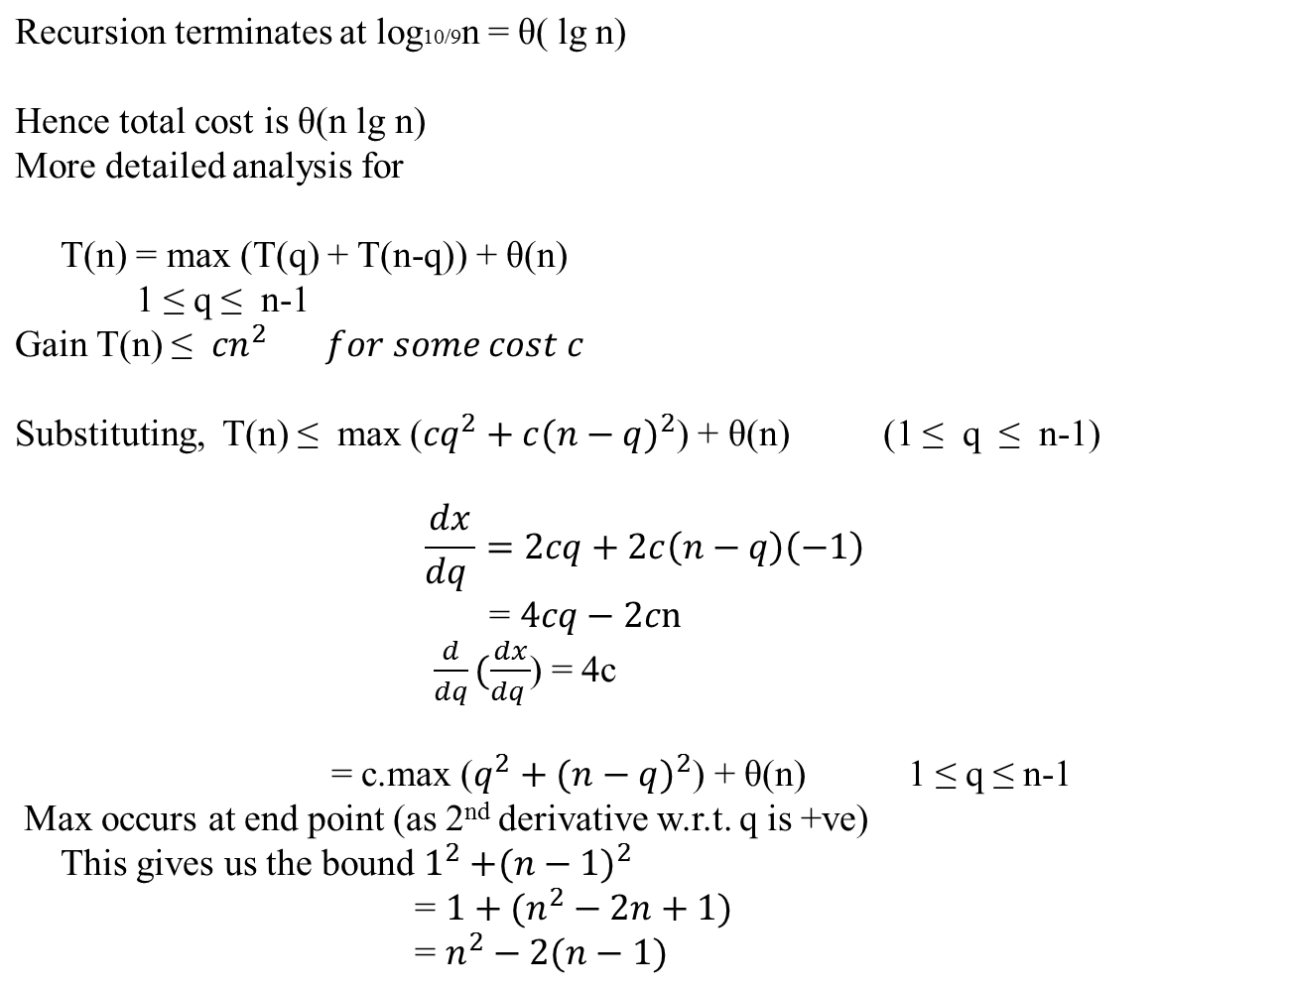

Slide 16
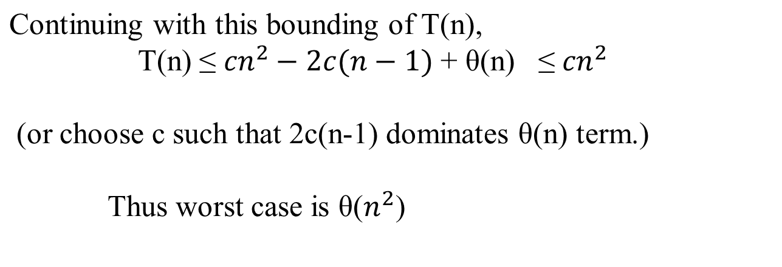

Slide 17
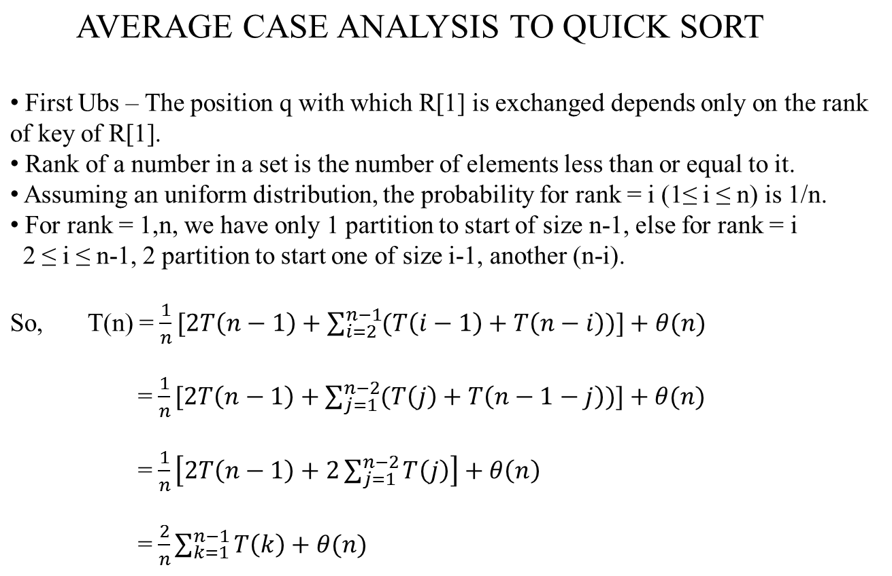

Slide 18
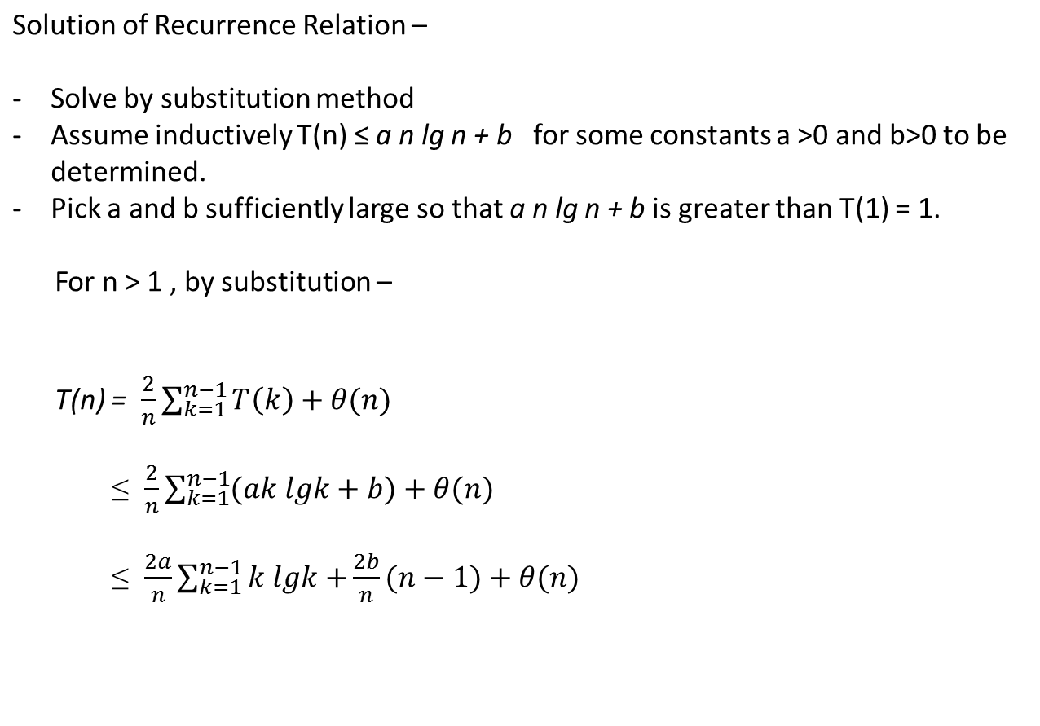

Slide 19
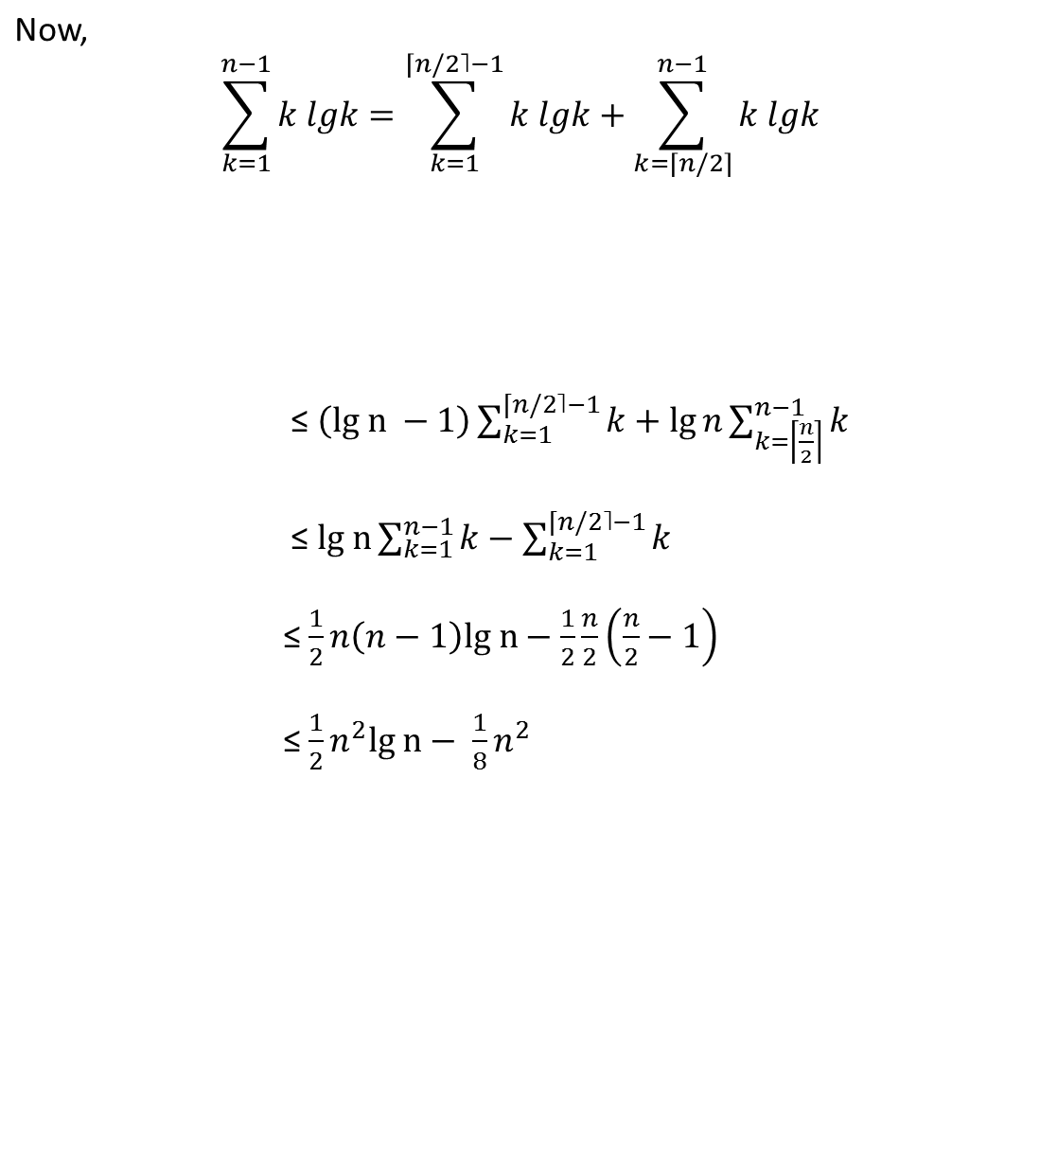
lg k is bounded by lg(n/2) = lgn-1
lg k is bounded by lg n

Slide 20
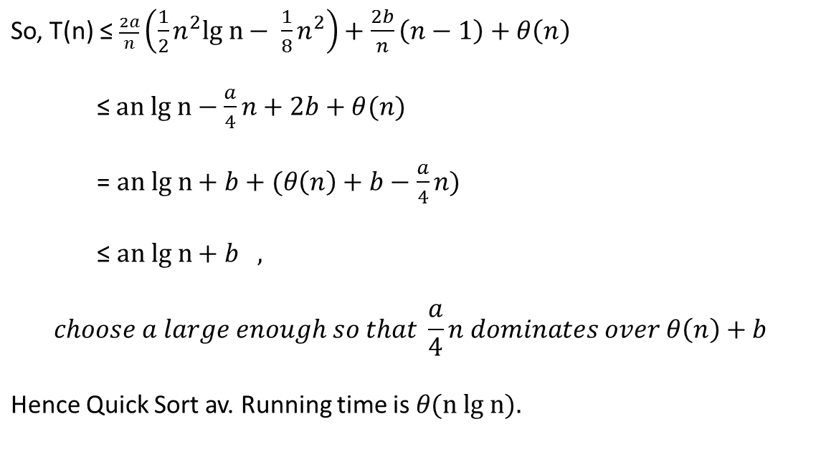

Slide 21
RANDOMIZED QUICK SORT –
QSORT(A,p,r) RAND-PART(A,p,r)
if p < r i ← RANDOM(p,r)
then q PARTITION(A,p,r) exchange A[p] ↔ A[i]
QSORT(A,p,q-1) return
QSORT(A,q+1,r) PARTITION(A,p,r)
Initially Call QSORT(A,1,length[A]) Randomized Qsort will just
call RAND_PART instead of
PARTITION(A,p,r) PARTITION
{
Implement as discussed
class
}
←

Slide 22
Sample pseudo code for quick-sort
QuickSort(A,p,r)
if p < r
then q ← Partition(A,p,r)
QuickSort(A,p,q-1)
QuickSort(A,q+1,r)
Partition(A,p,r)
X ← A[r]
i ← p-1
for j ← p to r-1
do if A[j] ≤ X
then i ← i+1
exchange A[i] ↔ A[j]
exchange A[i+1] ↔ A[r]
return i+1

Slide 23
35 | 11 | 92 | 58 | 7 | 46 | 71 | 33
11 | 35
11 | 7 | 92 | 58 | 35
11 | 7 | 33 | 58 | 35 | 46 | 71 | 92
7 | 11
 |  |  | 35 | 58 | 46
 |  |  | 35 | 46 | 58
1st call P(A,1,8)
X=33, i=0
2nd call P(A,1,2)
X=7, i=0
3rd call P(A,4,8)
X=92, i=3
5th call P(A,4,6)
X=46, i=3
No more as in the 6th and 7th call p=r

Slide 24
INSERTION SORT
Think about playing cards
All the cards are on the table at first
Remove one card at a time and insert into the proper position in left-hand
The simple algorithm given above is
Insertion Sort
Numbers are sorted in place
At most a constant no. of them stored outside the array at any time

Slide 25
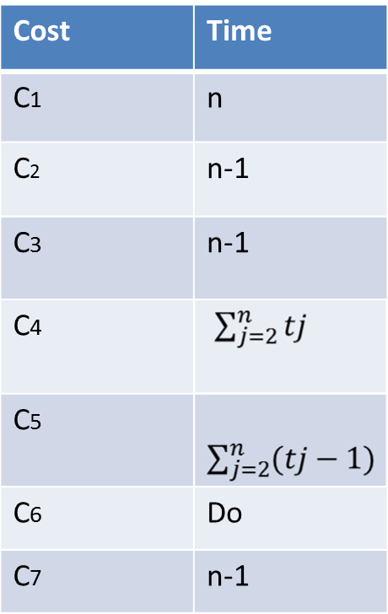
ALGO- INSERTION-SORT(A)
INPUT- Array A[1..n]
for j ← 2 to length[A]
do key ← A[j] //Insert into sorted A[a….j-1]
i ← j – 1
while (i > 0) and (A[i] > key)
do A[i+1] ← A[i]
i ← i – 1
A[i+1] ← key

Slide 26
INSERTION SORT CONT…….
We assume a generic one processor random access machine(RAM)
Instruction are executed one after another with no concurrent operations
Analysis of insertion Sort:- Time required
Depends on the size of the input
Depends on sequences even if size is same- like how nearly sorted they are.
Input Size may be-
Number of items in the input – as in sorting the array-size n
May be to the number of bits needed to represent the input in ordinary binary form- for multiplying two integers
Sometimes 2 numbers rather than one- like an a graph algorithm involving G(V,E), |V| & |E|

Slide 27
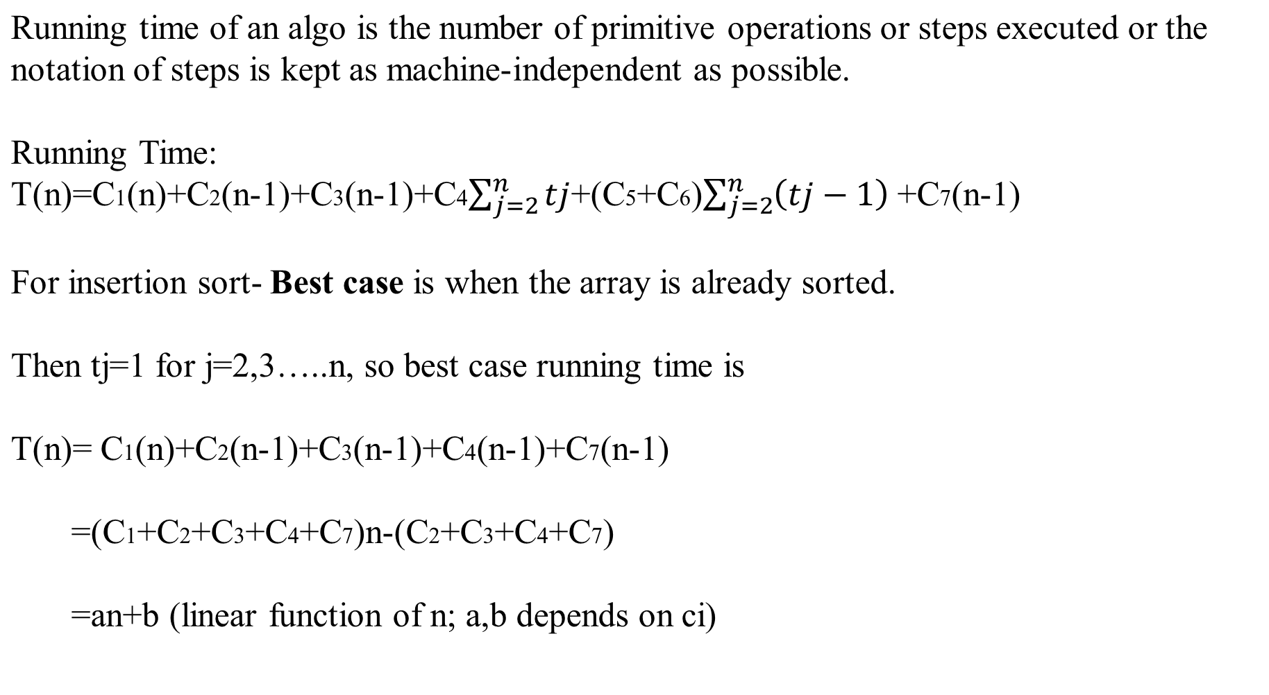
INSERTION SORT CONT….

Slide 28
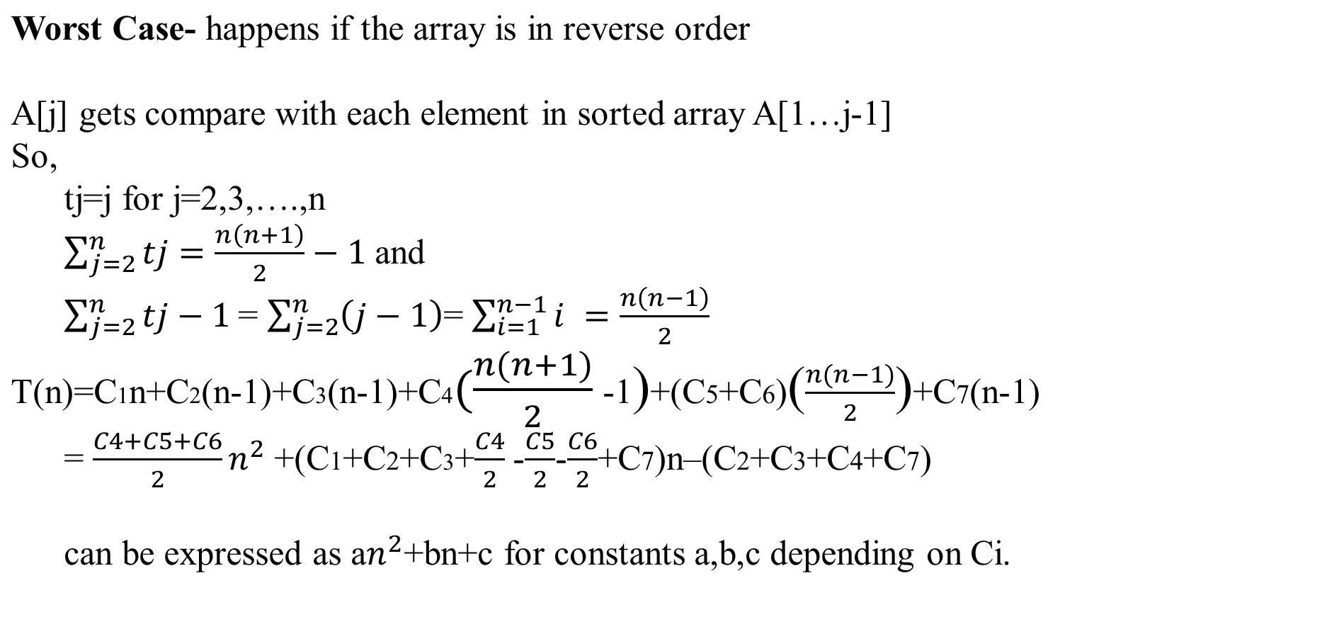
INSERTION SORT CONT……..

Slide 29
INSERTION SORT CONT……..
Usually we will be interested in worst-case because-
Worst-case gives an upper bound over the running time of an algorithm.
For some algorithm worst-case occurs fairly often– for database worst-case happens if element is not present
Average case is often as bad as worst-case asymptotically.
Like for insertion-sort, if we randomly choose n numbers, have long does it take to find the position of A[j] in A[1…j-1]. On average for uniform distribution tj=j/2
This will also be quadratic as worst-case.

Slide 30
HEAP SORT
Max_Heapify(A, i)
l ← LEFT(i)
r ← RIGHT(i)
if (l < heap_size[A] && A[l] > A[i])
then largest ← l
else largest ← i
if (r < heap_size(A) && A[r] > A[largest])
then largest ← r
if (largest ≠ i)
then exchange(A[i]↔A[largest]
Max_Heapify(A, largest)
LEFT(i) is 2i+1
RIGHT(i) is 2i+2

Slide 31
HEAP SORT CONT……
Build_Max_Heap(A)
1. heap_size(A) ← length(A)
2. for (i ← ⎣length[A]-2/2⎦ down to 0)
3. Max_Heapify(A, i)
HEAPSORT(A)
1. Build_Max_Heap(A);
2. for (i ← length[A]-1 downto 1)
3. do exchange(A[0] ↔ A[i])
4. heap_size[A]← heap_size[A]-1
5. Max_Heapify(A,0)

Slide 32
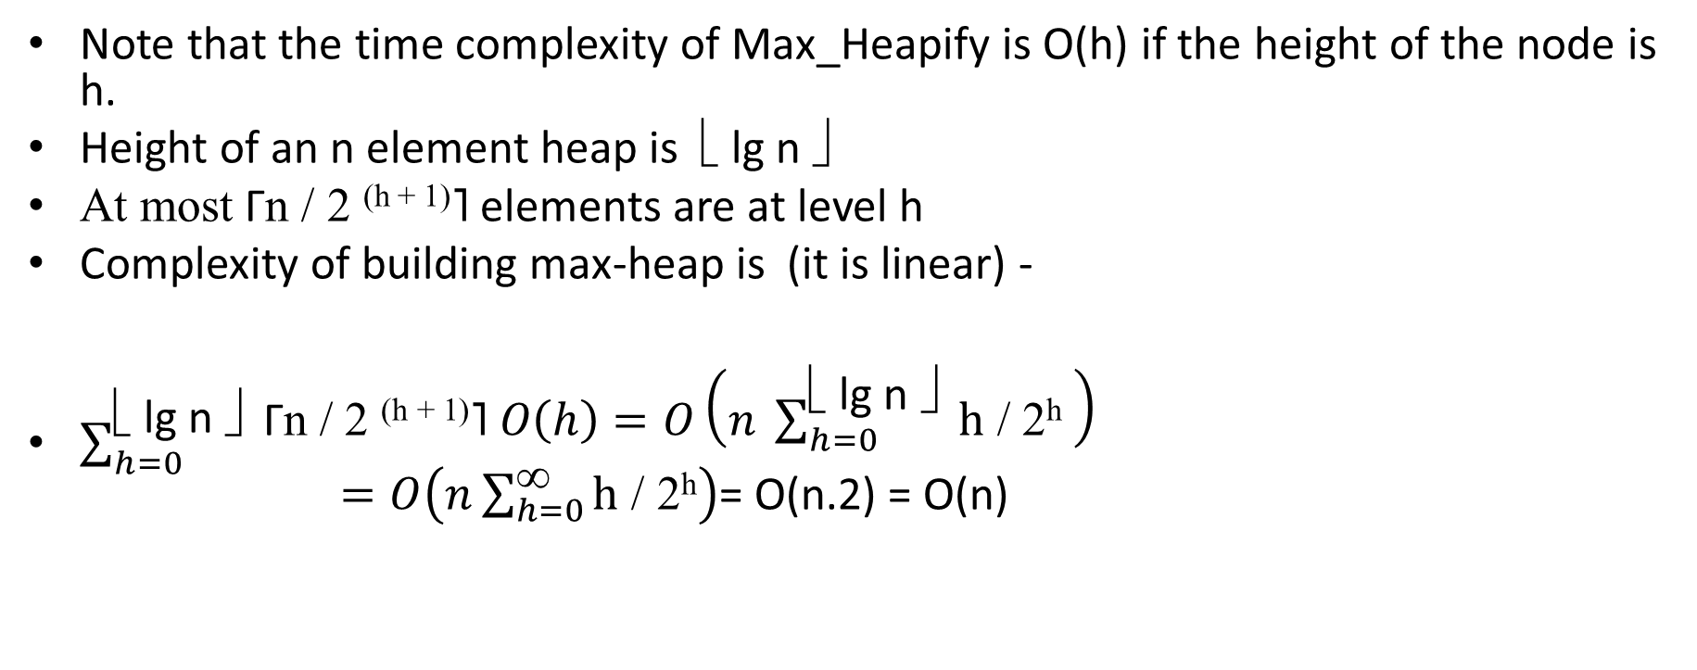
Time Complexity of Heapsort (best-avg-worst)

Slide 33
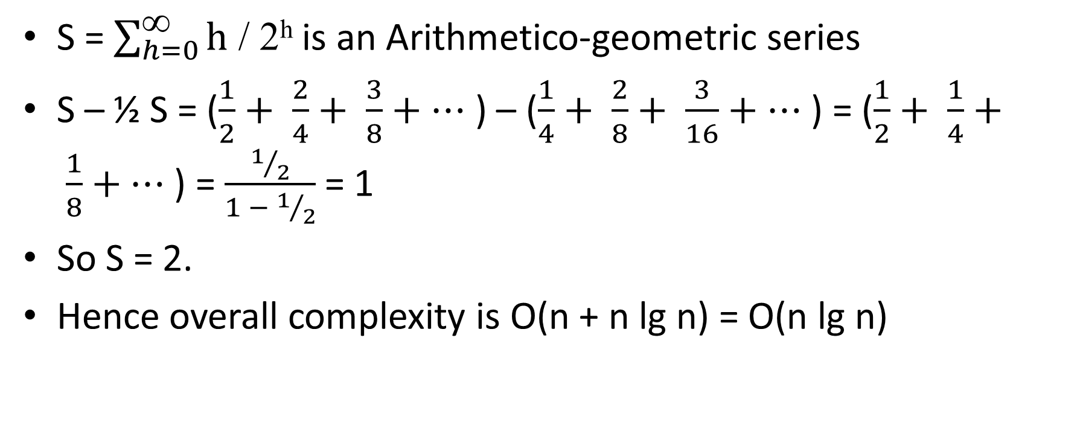

Slide 34
Divide & conquer Approach
Divide the problem into a number of sub-problems
2. Conquer the sub-problems by solving them recursively.
Sub-problem small enough -> solve in a straight forward manner
Combine the solutions of sub-problems into a solution of original problem
Eg.
(i) Binary Search
(ii) Quick Sort
(iii) Merge Sort

Slide 35
MERGE SORT
MERGE_SORT(A, p, r)
If p<r
then q← ⎣(p + r)/2 ⎦
MERGE_SORT(A, p, q)
MERGE_SORT(A,q+1,r)
MERGE(A, p, q, r)

Slide 36
MERGE SORT CONT…
MERGE(A, p ,q, r)
1. n1 ←q-p+1
n2 ←r-q
Create array’s L[1…n1+1] and R[1…n2+1]
for i ←1 to n1
do L[i] ←A[p+i-1]
For j ←1 to n2
do R[j] ←A[q+j]
L[n1+1] ←∞
R[n2+1] ←∞
i←1
j←1
for k← p to r
do if L[i]<=R[j]
then A[k] ← L[i]
i←i+1
else A[k] ← R[j]
j←j+1

Slide 37
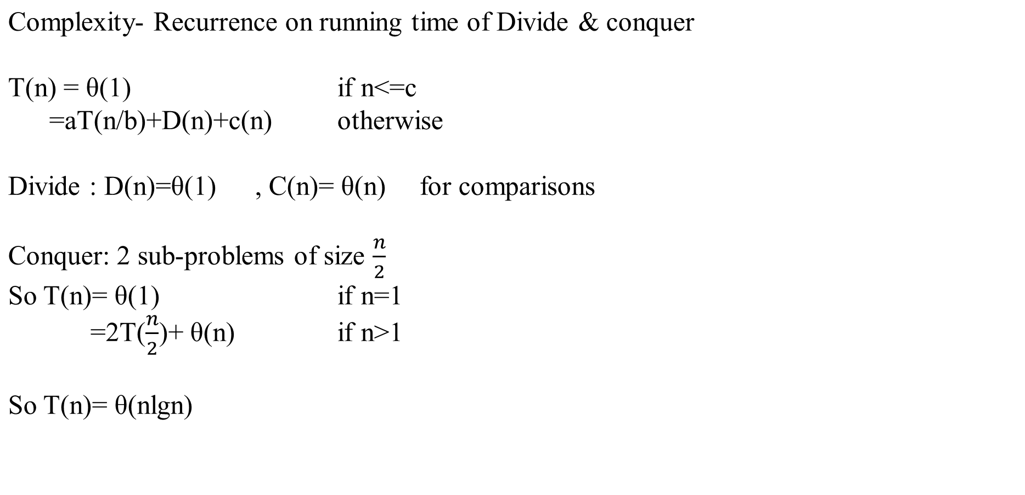
MERGE SORT CONT…

Slide 38
Selection Sort Algorithm
For i = 1 to n do
exam a[i] to a[x] add suffix to the smallest element is at a[j]
Interchange a[i] and a[j]
Selection Sort Pseudo code
Selection_Sort(a,n)
//Sort the array a[1:n] into non-decreasing order
For i = 1 to n do
j ← i
for k = i+1 to n do
if( a[k] < a[j]) then
j ← k
a[j]↔ a[i]

Slide 39
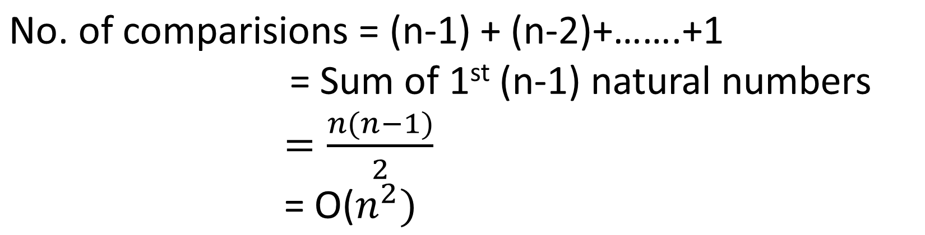

Slide 40
COUNTING SORT - (i)
Assumption – Each of input elements is an integer in the range 0 to k.
So when k=O(n), it runs in O(n) time.
Basic Idea – For each element x, determine the no. of elements less than x, if 7 elements are less than x, x’s output position is 8. However if all elements are not distinct, then the scheme has to be modified slightly.
Actually the idea can be even simpler, just count the no. of occurences of each element x (0≤x≤k), and then construct the output sequence. The name also comes from that only.
However while implementing, it is not done as told in the Basic idea, so that it is stable , i.e. number with the same value appear in the output array in the same order as they do in input array. Stability is important if only satellite data is present. A handy example is when it is used as a subroutine in radix sort ( we will do next). In fact, counting sort’s stability is crucial to radix sort’s correctness.

Slide 41
Counting sort -(ii)
Input array A[1:n], length[A] = n
Output array B[1:n], Temporary working storage C[0..k]
Counting_Sort(A,B,k)
for i ← 0 to k
do C[i] ← 0
For j ← 1 to length[A]
do C[A[j]] ← C[A[j]] + 1
// C[i] now contains the number of elements equal to I
for i ← 1 to k
do C[i] ← C[i] + C[i-1]
//C[i] now contains the # of elements ≤ I
For j ← length[A] downto 1
do B[C[A[j]]] ← A[j]
C[A[j]] ← C[A[j]] - 1
Complexity 𝜃(k+n)
If k = 𝜃(n)
Then overall complexity is
𝜃(n)

Slide 42
Example ( Worked Out) n = 8, k = 5
1 2 3 4 5 6 7 8
0 1 2 3 4 5
0 1 2 3 4 5
A
2 | 5 | 3 | 0 | 2 | 3 | 0 | 3
C
2 | 0 | 2 | 3 | 0 | 1
C
2 | 2 | 4 | 7 | 7 | 8
(after line 4)
(after line 7)
C
0 1 2 3 4 5
B
1 2 3 4 5 6 7 8
2 | 2 | 4 | 6 | 7 | 8
1 | 2 | 4 | 6 | 7 | 8
1 | 2 | 4 | 5 | 7 | 8
1 | 2 | 3 | 5 | 7 | 8
0 | 2 | 3 | 5 | 7 | 8
0 | 2 | 3 | 4 | 7 | 8
0 | 2 | 3 | 4 | 7 | 7
0 | 2 | 2 | 4 | 7 | 7
 |  |  |  |  |  | 3
 | 0 |  |  |  |  | 3
 | 0 |  |  |  | 3 | 3
 | 0 |  | 2 |  | 3 | 3
0 | 0 |  | 2 |  | 3 | 3
0 | 0 |  | 2 | 3 | 3 | 3
0 | 0 |  | 2 | 3 | 3 | 3 | 5
0 | 0 | 2 | 2 | 3 | 3 | 3 | 5

Slide 43
RADIX SORT
Used by card sorting machines which are now found only in museums.
It used to have 80 columns and in each column a hole can be punched in 12 places – 10 for the decimal digits and 2 for encoding the non numeric characters.
Now, a d-digit number will occupy a field of d columns, then look at one column at a time and sort.
Intuitively, we would want to sort numbers starting from most significant digit ,sort each of the resulting bins recursively, then combine the decks in order. Since 9 of the 10 piles have been set aside, it generates many intermediate piles.

Slide 44
Contd…
So ,sorting in Radix sort is done starting from the least significant digit. These cards are then combined into a single deck with cards in 0 bin preceding the cards in 1 bin and so on. The entire deck is then sorted on the 2nd least significant digit and recombined in a like manner. Only d passes are required to sort d-digit numbers.

Slide 45
Example of Radix Sort:-
329
457
657
839
436
720
355
729
720
355
436
457
657
329
839
729
729
720
329
436
839
355
457
657
329
355
436
457
657
729
720
839

Slide 46
Radix_sort(A,d)
For i = 1 to d
  2. Do
  use a stable sort to sort Array A of digit i.
Lemma – Given n digit numbers in which each digit can take upto k possible values, Radix_sort sorts these numbers in Ɵ(d(n+k)) time.
Proof - Trivial

Slide 47
Lemma – Given n b-bit numbers and any +ve integer r ≤ b, Radix_sort correctly sorts these numbers in Ɵ((b/r)(n+2^{r})) time.
Proof:-
For r ≤ b, we view each key as having d =┌b/r┐
digits of r bits each. So each digit is between 0 to
2^{r} – 1, so use counting sort with k = 2^{r} – 1.
Rest follows by inserting d and k in previous eg.

Slide 48
In a 32- bit word, assume Lemma it has 4 8-bit
digits, so :-
b=32, r =8, k = 2^{r} – 1= 255, d=32/8 = 4.
So, Ɵ(d(n + k)) = Ɵ((b/r)(n+ 2^{r} ))
NOTE: Try to choose r in such a way that the whole expression minimizes.
If b ≤ log n , then for any value of r ≤ b, we have n + 2^{r} = Ɵ(n).
Choosing r = b, we get :-
(b/b)(n + 2^{b} ) = Ɵ(n)
└
┘

Slide 49
└
┘
If b ≥ log n , choosing
r = log n yields a running time Ɵ(b n / log n ) which is the best.
As we increase r observe log n ,the numerator 2^{r} grows faster than denominator which is required yields Ω(bn / log n).
└
┘
└
┘

Slide 50
N=8
┌ ┐
┌ ┐
Exact = 2 ^{log(n+1)}
2^{n+1}
┌ ┐
N=15
Atmost = n /2^{n+1}
O(n)
(n-1) times
O(1+1+ log n ) = O (log n)
O (nlogn)
O(n + nlogn) = O(nlogn)
└ ┘

