Slide 1
 |  |  |  | m3 | m2 | m1 | m0
 |  |  |  | q3 | q2 | q1 | q0
 |  |  |  | m3q0 | m2q0 | m1q0 | m0q0
 |  |  | m3q1 | m2q1 | m1q1 | m0q1
 |  | m3q2 | m2q2 | m1q2 | m0q2
 | m3q3 | m2q3 | m1q3 | m0q3
p7= | p6= | p5= | p4= | p3= | p2= | p1= | P0= m0q0

Slide 2
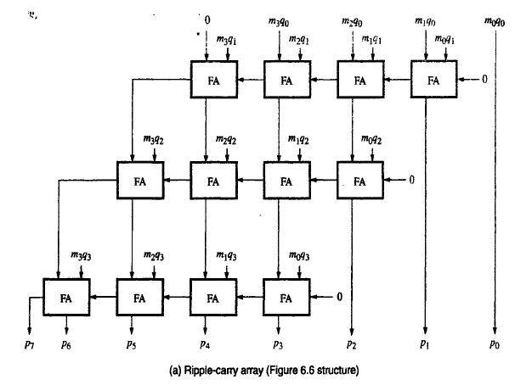

Slide 3
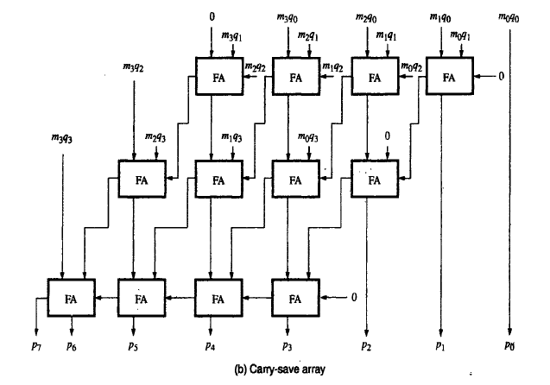

Slide 4
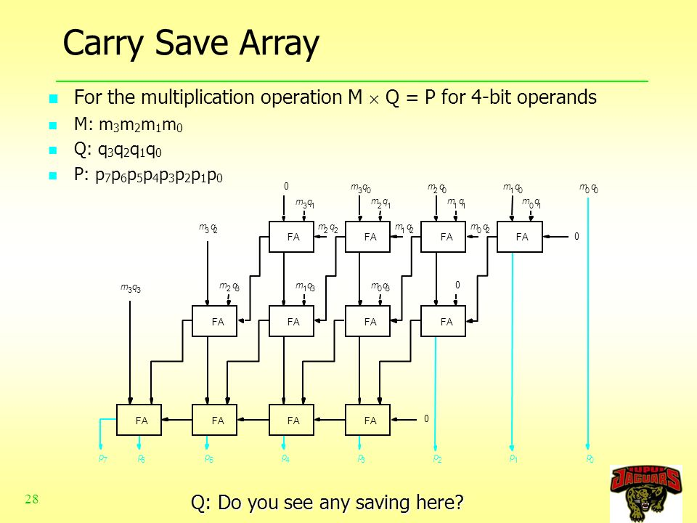
Gate delay CSA:- 2(perFA)
*2 (levels)
+ 1(and)+ 4 (CLA)=9

Slide 5
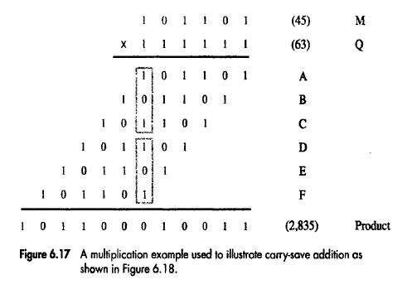

Slide 6
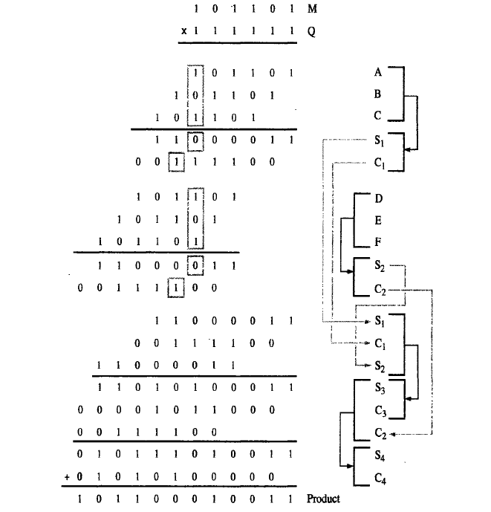

Slide 7
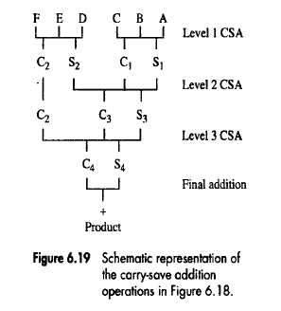
Carry Save Adder Tree for 6 Operands

Slide 8
Exercise
How many levels are needed to reduce
  8 summands to 2 ?
  5 summands to 2?

Slide 9
Carry Save Adder (CSA)
Operand1 Operand2 Operand3
4bits 4bits 4bits
4 bit carry save adder
4bits 4bits
Carry Sum

Slide 10
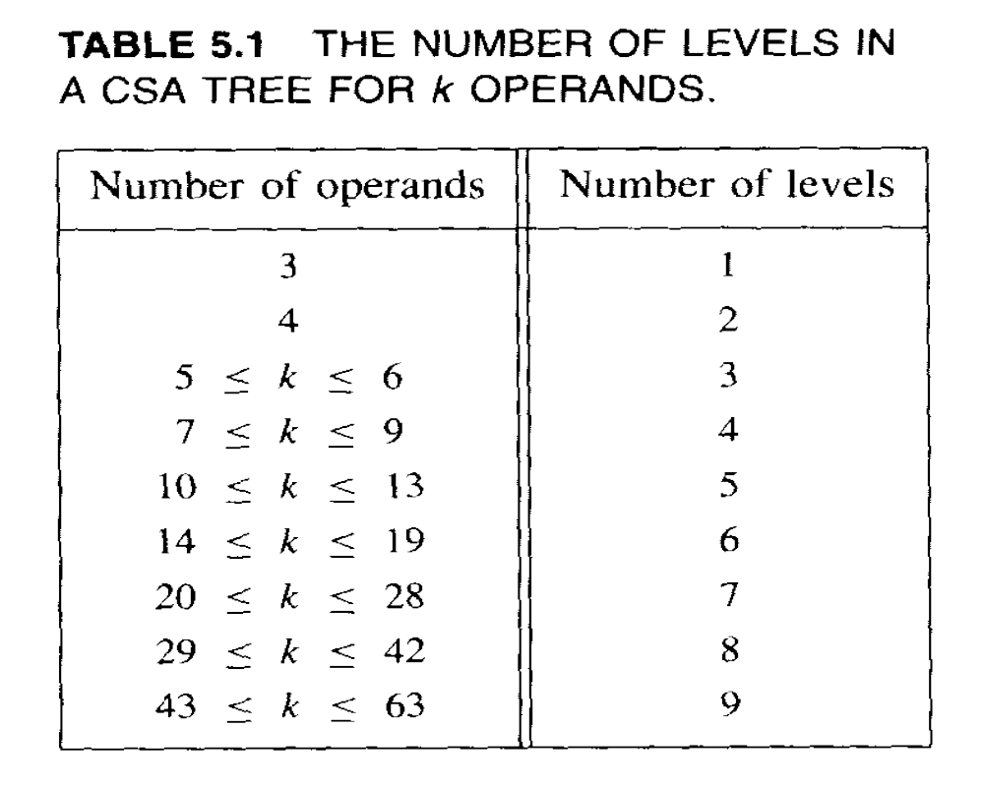
Levels in the CSA Tree
Approx 1.7log2k-1.7 to 1.7log2k-3.4 levels of CSA steps needed to reduce k summands to 2 vectors

