Slide 1
Control Unit
Hamacher:
Chapter 7.1,7.2,7.4,7.5

Slide 2
Basic Components of Processor
ALU
Control Unit
Registers
Internal bus
External bus
  The registers, ALU, and interconnecting bus are collectively referred to as datapath

Slide 3
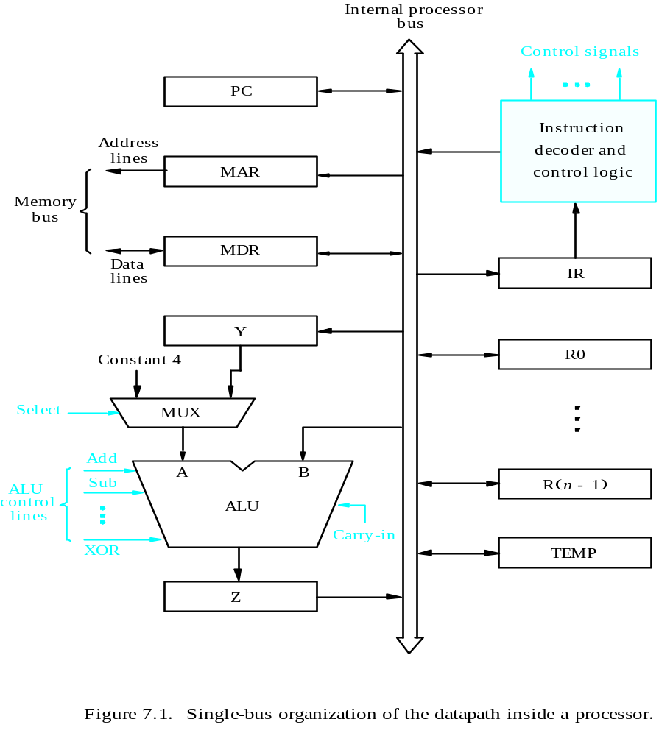
A Simple Processor Organization
MDR HAS TWO INPUTS AND TWO OUTPUTS
Datapath
Hamacher Page 413

Slide 4
Register Transfers
Internal processor
b
us
R
i
in
R
i
R
i
out
Y
in
Y
Constant 4
Select
MUX
A
B
ALU
Z
in
Z
Z
out
Figure 7.2. Input and output gating for the registers in Figure 7.1.

Slide 5
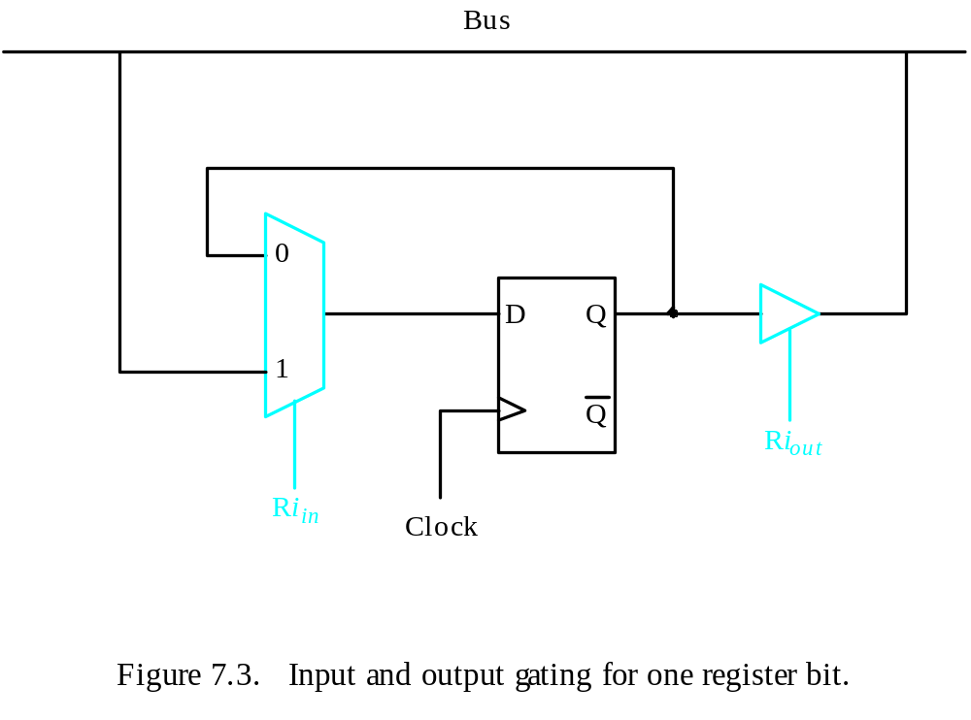
Register Transfers
All operations and data transfers are controlled by the processor clock.
Output
Tri-state Gate
Q | Riout | Output
0 | 0 | High Impedence
1 | 0
0 | 1 | 0
1 | 1 | 1
Figure 7.3. Input and output gating for one register bit.

Slide 6
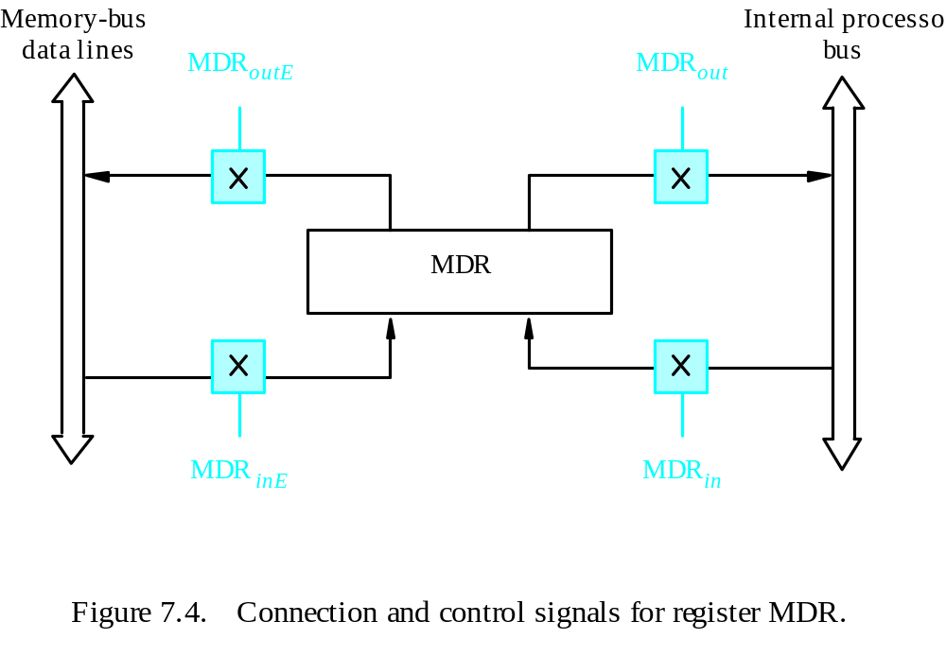
Fetching a Word from Memory
Address into MAR; issue Read operation; WMFC
data into MDR.
Figure 7.4. Connection and control signals for register MDR.

Slide 7
Functions of Components of Processor
ALU
  performs arithmetic and logic operations on data values stored in registers or memory
CU (Control Unit)
  generates all control signals to ensure the sequence of all micro-operations (register/memory transfers/arithmetic or logic operations) related to a machine code instruction
  Activates the specific hardware units that are required for the set of operations that execution of a machine instruction requires
  i.e. opcode decoding

Slide 8
Register Transfers
Internal processor
b
us
R
i
in
R
i
R
i
out
Y
in
Y
Constant 4
Select
MUX
A
B
ALU
Z
in
Z
Z
out
Figure 7.2. Input and output gating for the registers in Figure 7.1.

Slide 9
Micro-operation sequence and Control Signals for Fetching a Word from Memory
The response time of each memory access varies (cache miss- memory-mapped I/O).
To accommodate this, the processor waits(WMFC) until it receives from memory-a Memory-Function-Completed, MFC signal.
For Assembly code Instruction: MOV (R3),R1 (assuming R1 is destination
Time | (ActionsNeeded) Micro-operations | Control Unit needs to generate following Control Signals
T1: | MAR<- [R3] | R3out, MARin, Read (starts a read signal on memory bus)
T2: | Load MDR from memory bus when MFC received | MDRinE, WMFC
T2+n: | R1 <- [MDR] | MDRout, R1in

Slide 10
Register Transfers
Internal processor
b
us
R
i
in
R
i
R
i
out
Y
in
Y
Constant 4
Select
MUX
A
B
ALU
Z
in
Z
Z
out
Figure 7.2. Input and output gating for the registers in Figure 7.1.

Slide 11
Performing an Arithmetic or Logic Operation
The ALU is a combinational circuit that has no internal storage.
ALU gets the two operands from MUX and bus. The result is temporarily stored in register Z.
For Assembly code ADD R1,R2,R3 //R3 destination
Internal
Processor bus
R
i
in
R
i
R
i
out
Y
in
Y
Constant 4
Time | (ActionsNeeded) Micro-operations | Control Signals Needed
T1: | Y<- R1 | R1out, Yin
T2: | Z<- R2+ Y | R2out, SelectY, Add, Zin
T3: | R3 <- Z | Zout, R3in
Select
MUX
A
B
ALU
Z
in
Z
Z
out
Input and output gating for
the registers in Figure 7.1.

Slide 12
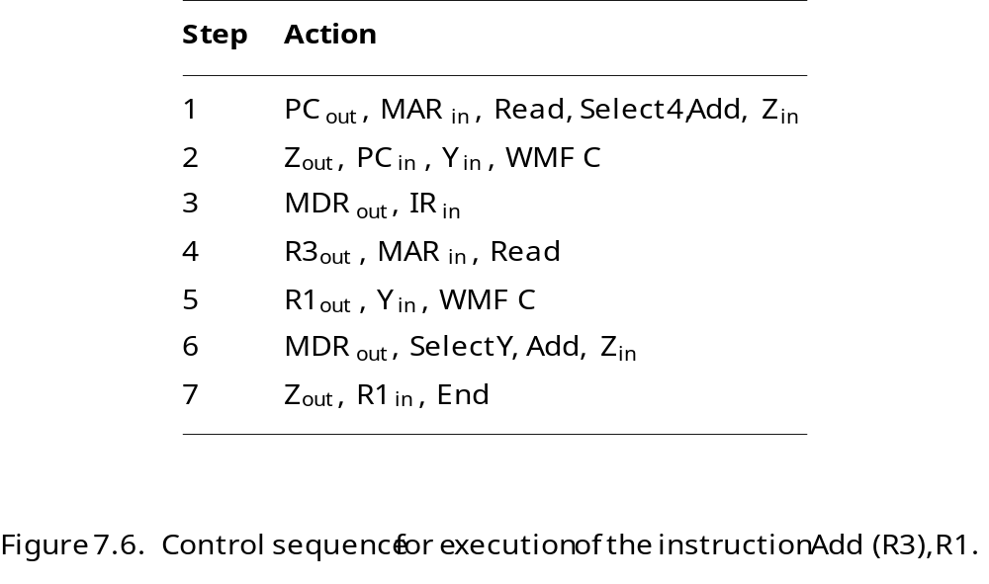
Execution of another Assembly/M/C Instruction
Add (R3), R1

Slide 13
Execution of Branch Instructions
A branch instruction replaces the contents of PC with the branch target address, which is usually obtained by adding an offset X given in the branch instruction.
The offset X is usually the difference between the branch target address and the address immediately following the branch instruction.
Conditional branch

Slide 14
Execution of Branch Instructions
Step
Action
1
PC
out
,
MAR
in
,
Read,
Select4,
Add,
Z
in
2
Z
out
,
PC
in
,
Y
in
,
WMF
C
3
MDR
out
,
IR
in
4
Offset-field-of-IR
out
,
Add,
Z
in
5
Z
out
,
PC
in
,
End
Figure 7.7. Control sequence for an unconditional branch instruction.

Slide 15
Quiz
What is the control sequence for execution of the instruction
Add R1, R2
including the instruction fetch phase? (Assume single bus architecture)

Slide 16
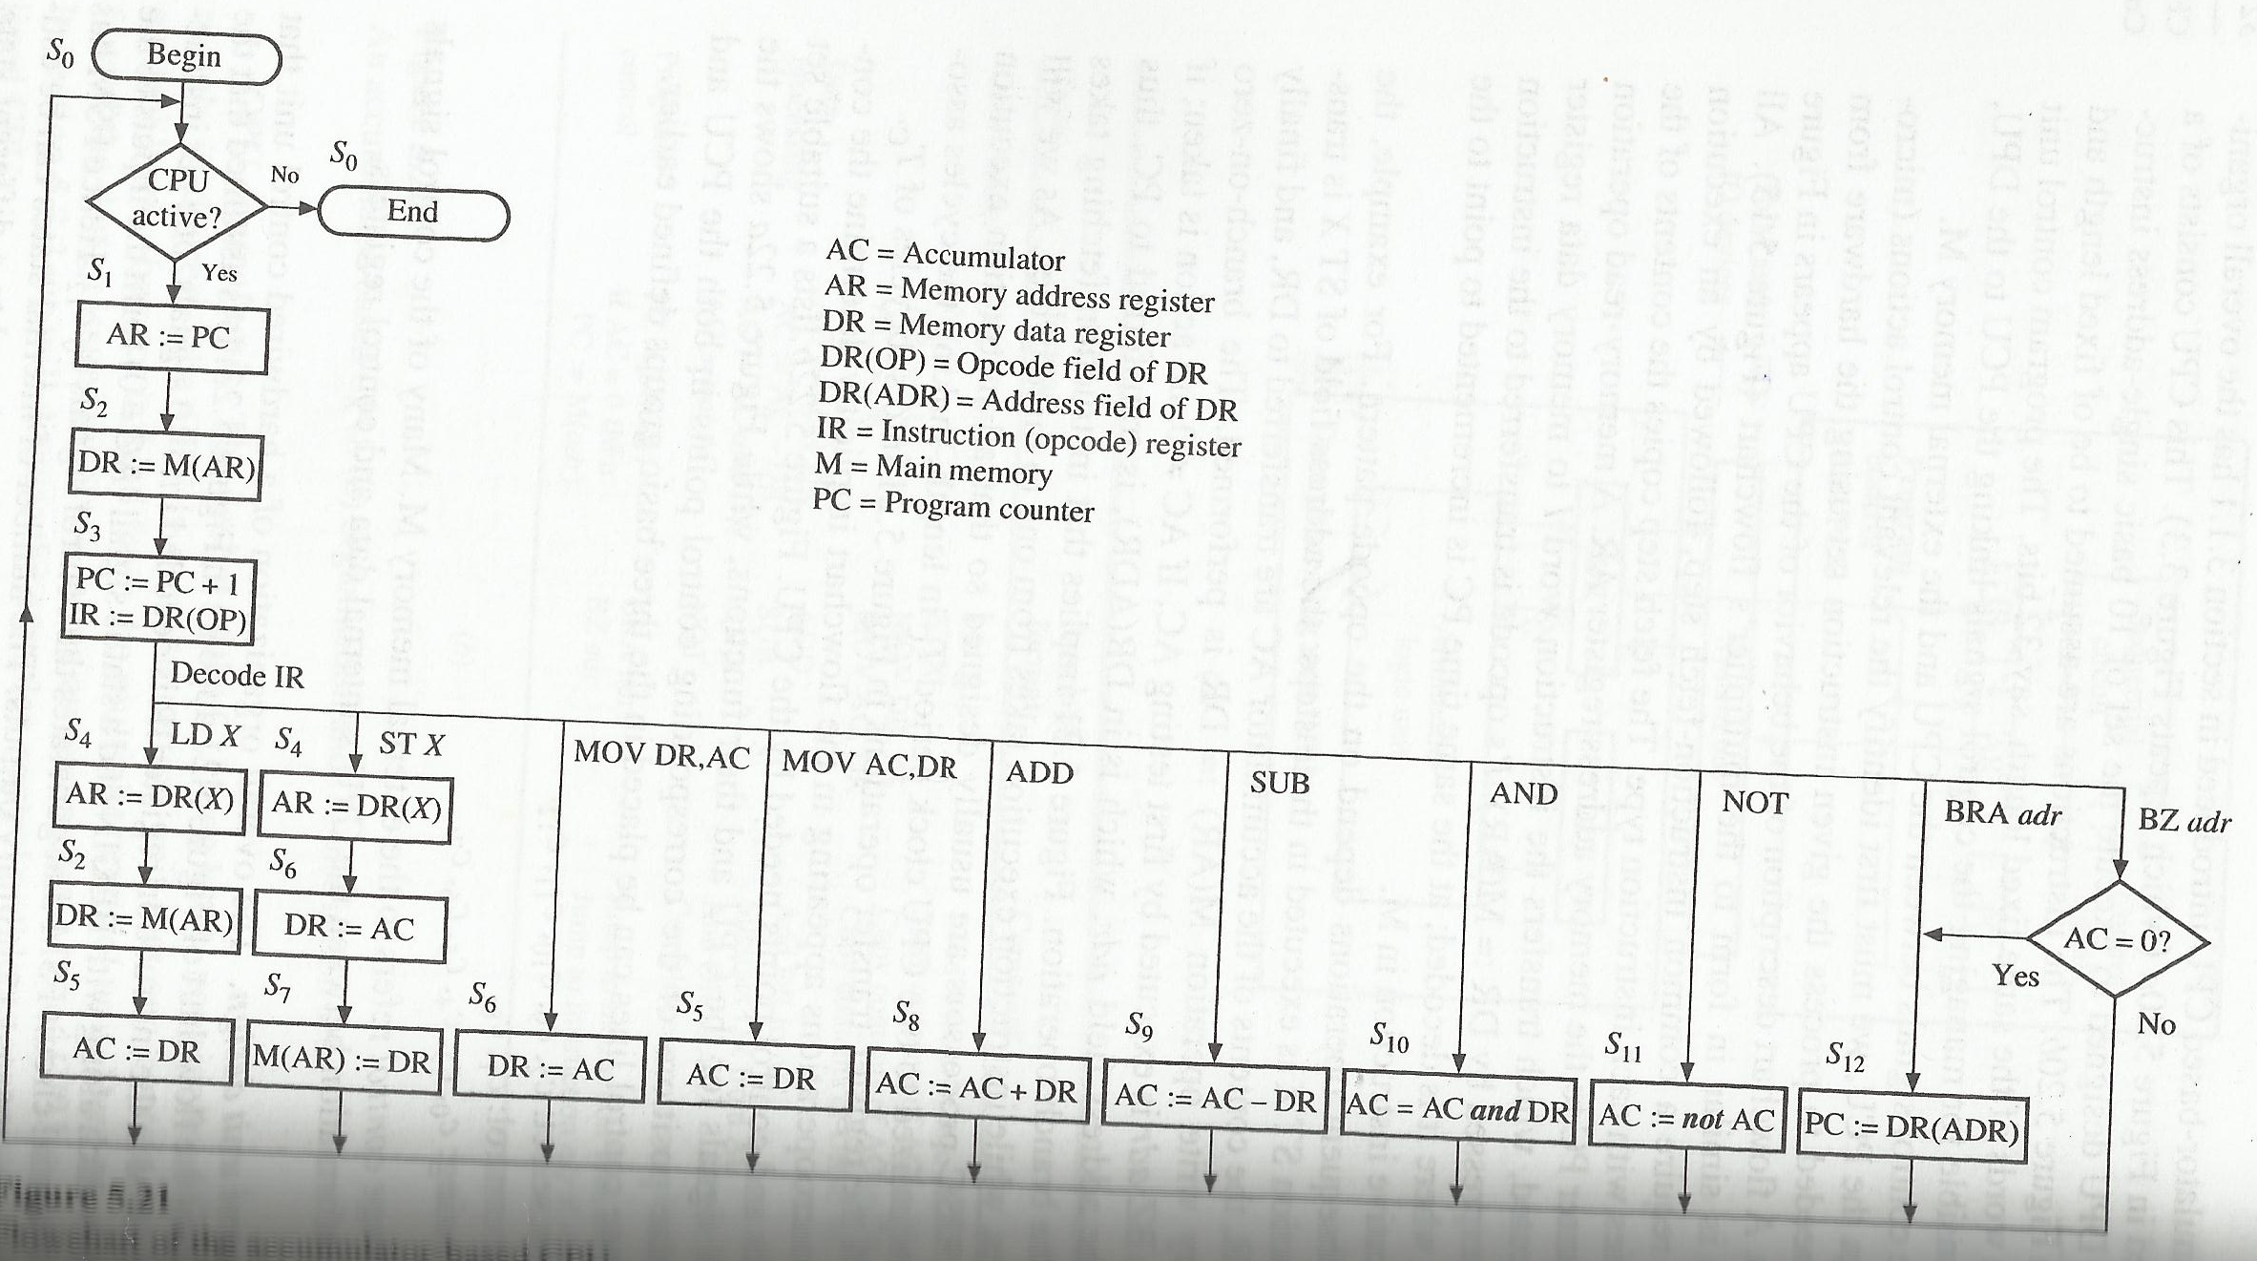
States of a Simple Accumulator based Processor from Hayes Page 328
Notice the states are finite in number

Slide 17
Hardwired Control

Slide 18
Processor (Control Unit)Overview
To execute instructions, the processor must have some means of generating the control signals needed in the proper sequence.
Two categories: hardwired control and microprogrammed control
Hardwired system can operate at high speed; but with little flexibility.

Slide 19
Control Unit Organization
Clock
CLK
Control step
counter
External
inputs
Decoder/
IR
encoder
Condition
codes
Control signals
Figure 7.10. Control unit organization.

Slide 20
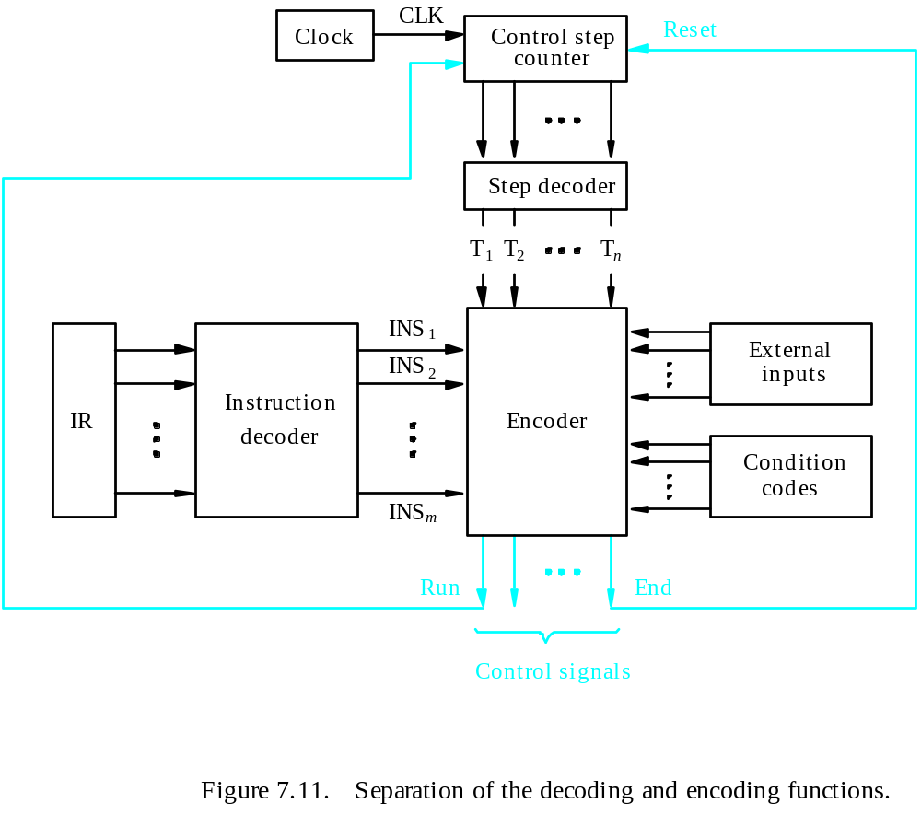
Detailed Block Description

Slide 21
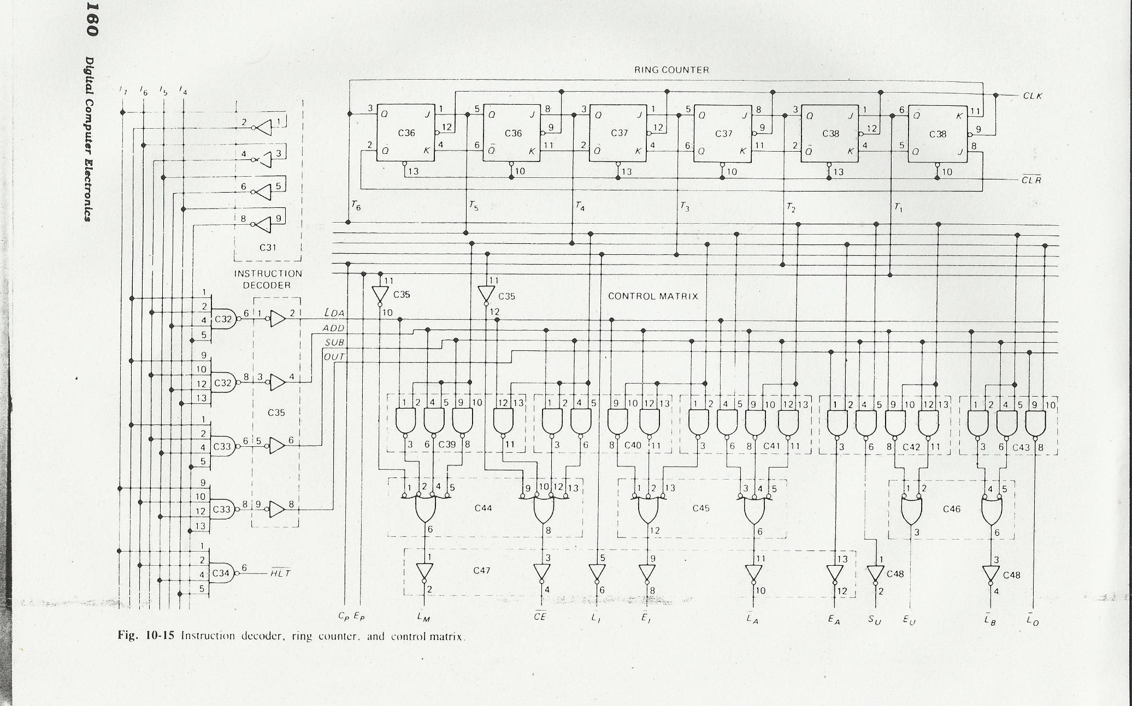
Hardwired Control Unit(for our simple example) From Malvino
Opcode Decoder
Control Step Counter
Encoder

Slide 22
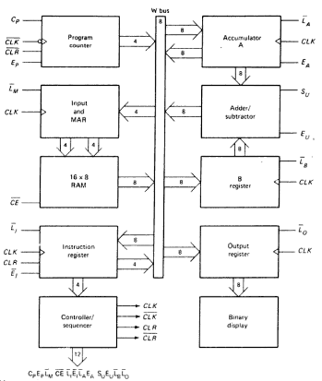
From Malvino
No input
from
outside:
It is assumed
all instruction
and data
already
stored in
RAM.

Slide 23
The above 2 slides are just to illustrate what goes into the blocks (shown in the detailed block descrition slide) for a very simple processor with Single bus Organization of Datapath
  NOT for your exam purposes

Slide 24
Generating Z_{in}
Z_{in} = T₁ + T₆ • ADD + T₄ • BR + …
Branch
Add
T
4
T
6
T
1
Figure 7.12. Generation of the Z_{in} control signal for the processor in Figure 7.1.

Slide 25
Performing an Arithmetic or Logic Operation
The ALU is a combinational circuit that has no internal storage.
ALU gets the two operands from MUX and bus. The result is temporarily stored in register Z.
For Assembly code ADD R1,R2,R3 //R3 destination
Internal
Processor bus
R
i
in
R
i
R
i
out
Y
in
Time | (ActionsNeeded) Micro-operations | Control Signals Needed
Tn: | Y<- R1 | R1out, Yin
Tn+1: | Z<- R2+ Y | R2out, SelectY, Add, Zin
Tn+2: | R3 <- Z | Zout, R3in
Y
Constant 4
Select
MUX
A
B
ALU
Z
in
Z
Z
out
Input and output gating for
the registers in Figure 7.1.

Slide 26
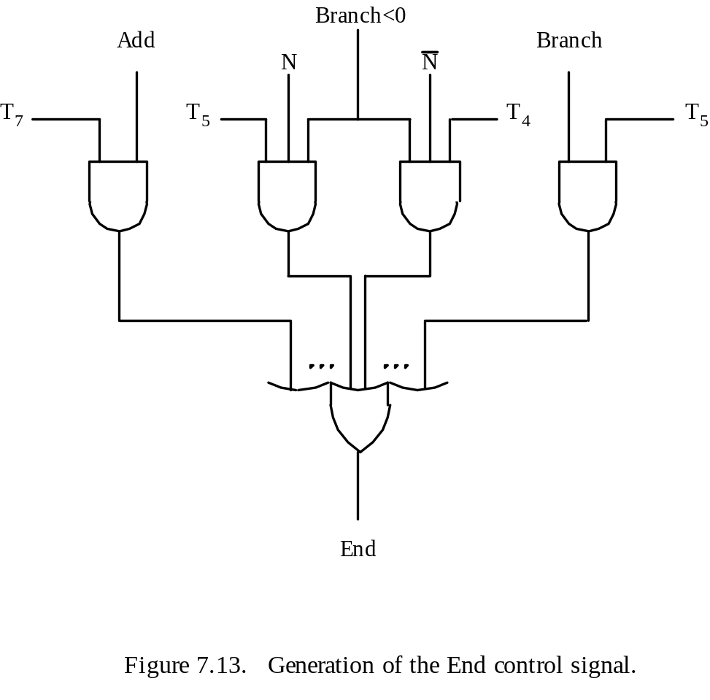
Generating End
End = T₇ • ADD + T₅ • BR + (T₅ • N + T₄ • N) • BRN +…

Slide 27
States of a Simple Accumulator based Processor from Hayes Page 328
Notice the states are finite in number

Slide 28
Describe how the processor generates the control signals needed in the proper sequence to execute instructions using following Detailed Block Description of Hardwire

Slide 29
Microprogrammed Control Unit

Slide 30
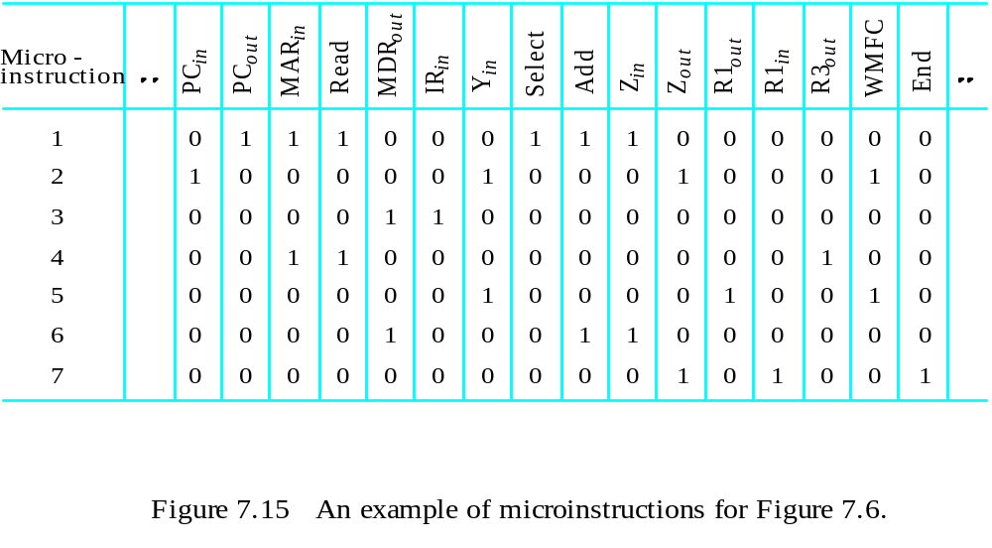
Control signals are generated by a program similar to machine language programs.
Control Word (CW); microroutine; microinstruction

Slide 31
Reference-Fig 7.5 in previous slide
1 control word(CW) is 1 row of above table
  Each bit responsible for Activating some micro-oprations
  1 CW contains 1 micro-instruction.
7 microinstructions in Fig 7.5 called micro-routine
All micro-routines required to code a computer instruction set are stored on control memory ROM

Slide 32
States of a Simple Accumulator based Processor from Hayes Page 328
Notice the states are finite in number

Slide 33
Control Sequencer
Sends out control words (16 bit in example)
  One during each T state or clock cycle
Each is a microinstruction , stored in control memory(ROM)
Each bit of these 16 bits 1 s and 0s are the set of control signals required for all the microoperations(register input/output enable,arithmetic/login operation) required at that state.

Slide 34
Control Memory(ROM)
Address | Control Word
0 H | …………………
1 H | …………………….
2H | …………………….
3H | …………………..
4H | ……………………
5H | ………………………..
6H | .
7H | .
8H | .
Fetch
LDA
ADD

Slide 35
Op Code | Starting Address
0000 (LDA) | 0011
0001 (ADD) | 0110
0010 (SUB) | 1001
 | ……………………
 | ………………………..
 | .
 | .
 | .
Address ROM

Slide 36
Next Address Decision
Depending on ALU flags and control buffer register:
  Get next instruction
    Add 1 to control address register
  Jump to new routine based on jump microinstruction
    Load address field of control buffer register into control address register
  Jump to machine instruction routine
    Load control address register based on opcode in IR

Slide 37
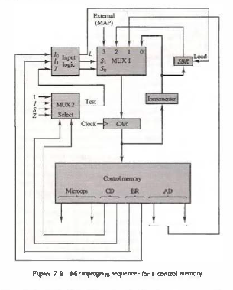
MUX1
S1 S0 | L
0 0
0 1
1 0
1 1 | 1

Slide 38
Control Memory(ROM)
Address | Control Word
0 H | …………………
1 H | …………………….
2H | …………………….
3H | …………………..
4H | ……………………
5H | ………………………..
6H | .
7H | .
8H | .
Fetch
LDA
ADD

Slide 39
Op Code | Starting Address
0000 (LDA) | 0011
0001 (ADD) | 0110
0010 (SUB) | 1001
 | ……………………
 | ………………………..
 | .
 | .
 | .
Address ROM

Slide 40
Horizontal Versus Vertical Microcode Schemes
In horizontal microcode, each control signal is represented by a bit in the μinstruction
  Fewer control store words of more bits per word
In vertical microcode, a set of true control signals is represented by a shorter code
  Vertical μcode only allows RTs in a step for which there is a vertical μinstruction code
  Thus vertical μcode may take more control store words of fewer bits

Slide 41
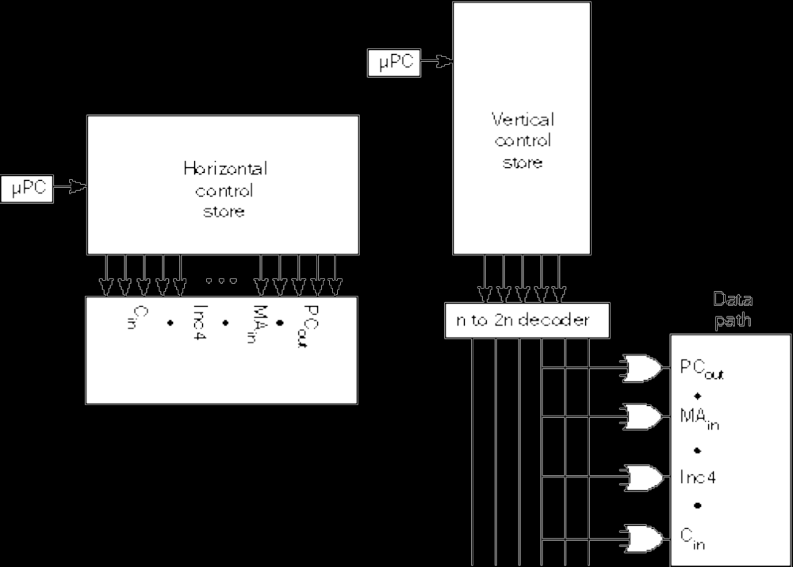
Completely Horizontal and Vertical Microcoding

Slide 42
Horizontal Micro-programming
Wide control memory word
High degree of parallel operations possible
Little encoding of control information
Fast

Slide 43
Vertical Micro-programming
Width can be much narrower
Control signals encoded into function codes – need to be decoded
More complex, more complicated to program, less flexibility
More difficult to modify
Slower

Slide 44
Difference between
Hardwired Control Unit Processor and
Microprogrammed Control Unit Processor

Slide 45
Microprogrammed Control System
Advantage:
  Simplifies design of control unit
    Cheaper
    Less error-prone
    Easier to modify
  (CISC)
Disadvantage:
  Slower
Hardwired Control system
Advantage
  can operate at high speed (RISC)
Disadvanage:
  Hardware error : difficult to rectify
  Too complex instruction set –impossible to implement
  Not easy to modify( very little flexibility)

Slide 46
Practice Exercises: Control Unit
1. State the difference between
Hardwired Control Unit Processor
and Microprogrammed Control Unit Processor.
2. Explain using block diagram the functioning of a
a. hardwired control unit
b. microprogrammed control unit

Slide 47
Practice Exercises: Control Unit
3. Explain with a block diagram how the next address for the control word to be fetched is found using a MUX.
4. Given a control memory of size 2048 and word size of 12 bits, how many bits each will be the 4 addresses that go into the MUX ?

