Slide 1
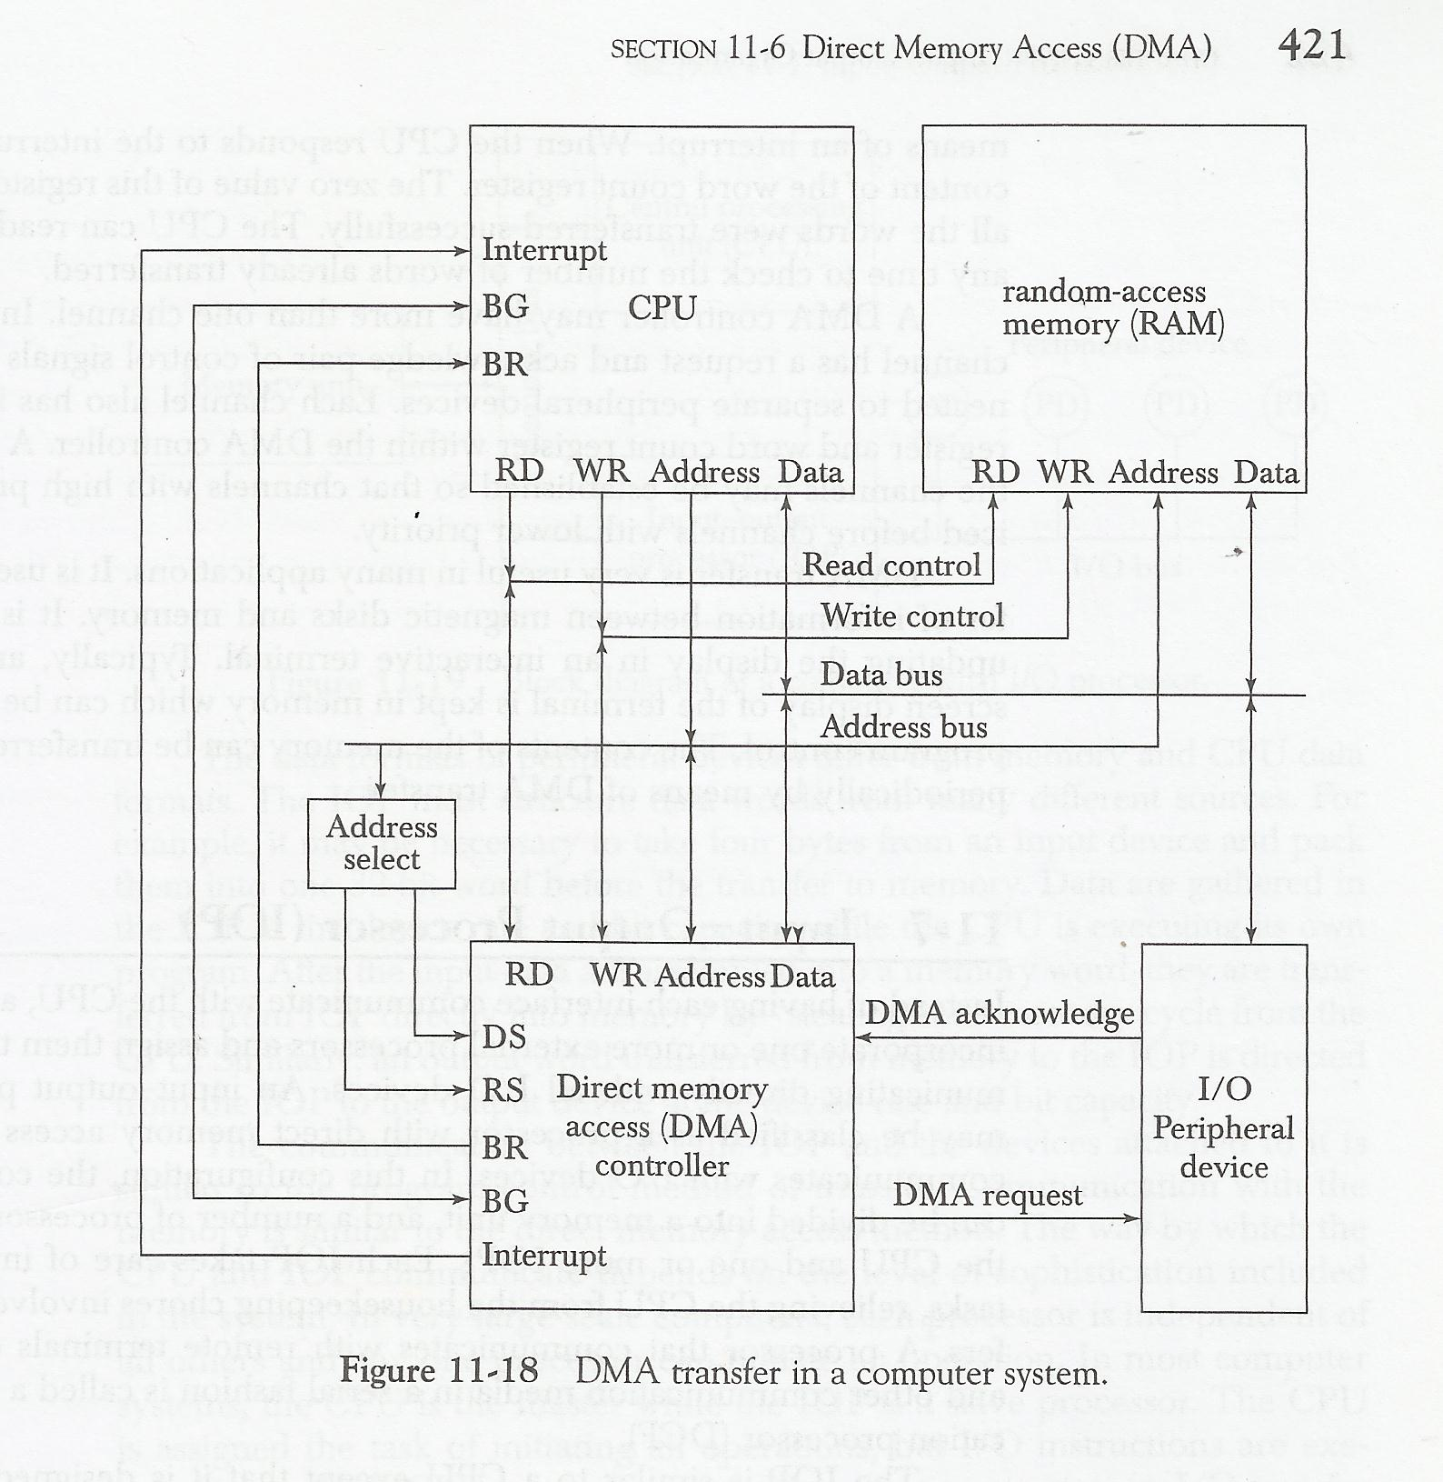
From Mano

Slide 2
Sequence Of DMA Operation
The DMA request CPU
  to handle control of buses bus request (BR) signal
CPU initializes the DMA by sending following information through the data bus.
  Starting address of memory block for read or write operation.
  The word count which is the no. of words in the memory block.
  Control to specify the mode of transfer such as read or write.
  A control to start the DMA transfer.

Slide 3
Sequence Of DMA Operation contd..
CPU places the address bus, data bus and read and write lines into high impedance state (which behave like open circuit)
Then CPU grants the control of buses to DMA using bus grant (BG) signal

Slide 4
Sequence Of DMA Operation contd..
The DMA takes control over the buses
  directly interacts with memory and I/O units
  transfers the data without CPU intervention
When the transfer completes,
  DMA disables the BR line.
  CPU disable BG line and takes control over the buses
  return to CPU normal operation.

