Slide 1
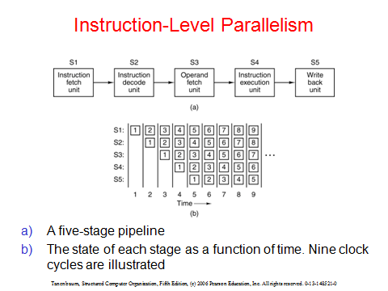

Slide 2
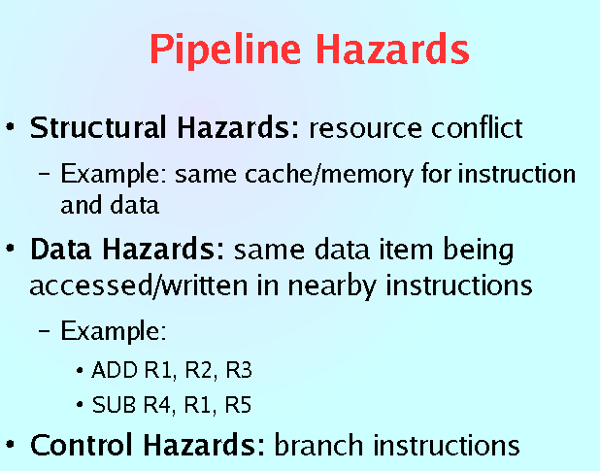

Slide 3

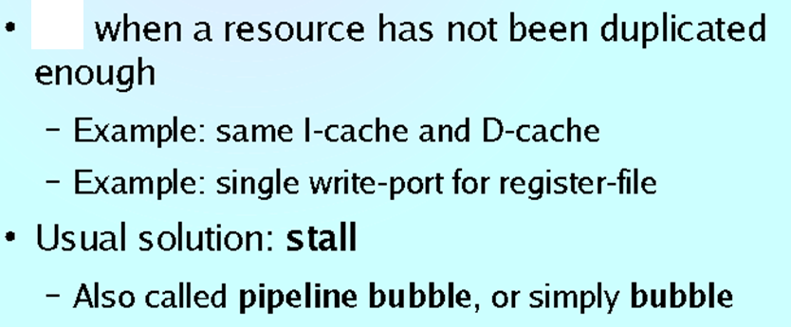

Slide 4
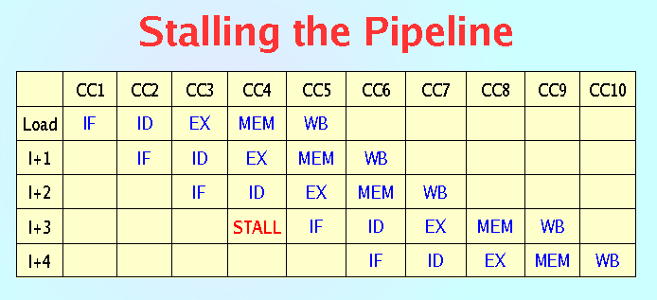
Structural Hazard

Slide 5
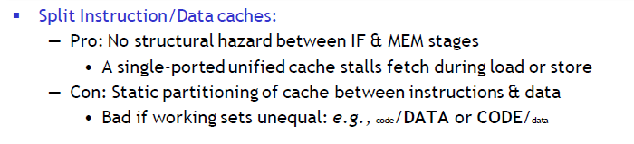
Solution : Structural Hazard
Increase number of functional units
that are simultaneously needed by
more than one instruction

Slide 6
Instruction or Control Hazard

Slide 7
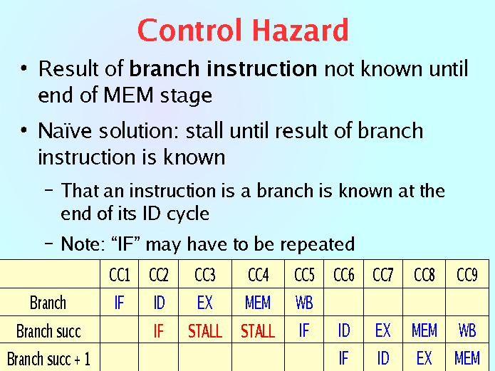

Slide 8
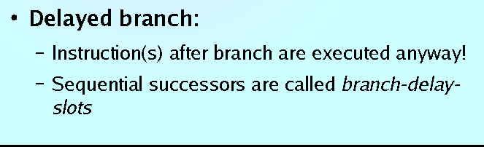
One way to
Reduce Control Hazard Delay

Slide 9
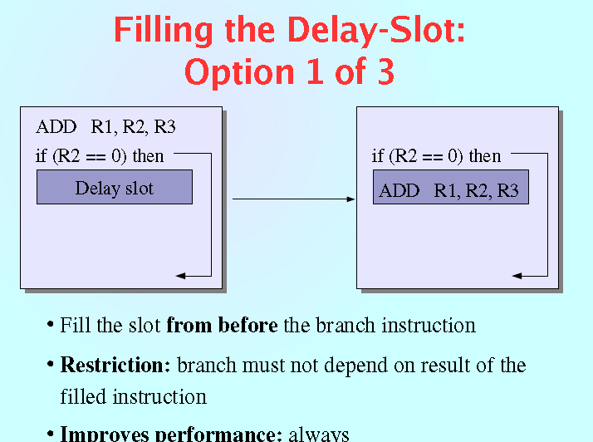

Slide 10
Data Hazard

Slide 11
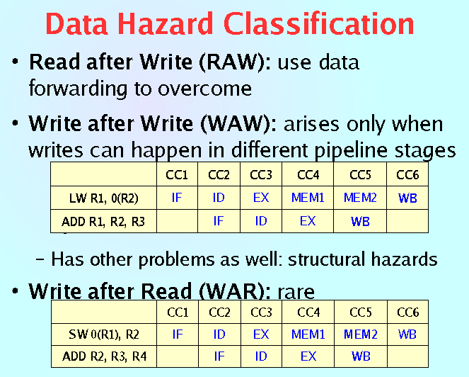
Destination source format of instruction

Slide 12
One Data Hazard Solutions
Compiler is made to change the order of execution of statements such that the out is not affected but the data dependency among consecutive statements is removed

