Slide 1
Monte-Carlo Tree Search
for the
Maximum Satisfiability Problem
Jack Goffinet • Raghu Ramanujan
Davidson College, Davidson NC • 09.06.2016 • CP’16
Notes:
Hello, my name is Jack Goffinet and this research, Monte-Carlo Tree for the Maximum Satisfiability Problem, was completed with Dr. Raghu Ramanujan at Davidson College in Davidson, NC.

Slide 2
Overview
Domain
MaxSAT
Motivation
Ingredients
Stochastic Local Search (SLS)
Monte-Carlo Tree Search (MCTS)
Our Approach
“UCTMAXSAT”
Results
Notes:
We developed an algorithm for the maximum satisfiability problem (MaxSAT) by combining a popular Monte-Carlo tree search algorithm with existing stochastic local search algorithms for MaxSAT. After describing the MaxSAT problem and the two ingredients of our solver, I’ll explain how we combine them into what we call UCTMAXSAT. Finally I’ll present the results of various experiments we performed.

Slide 3
Domain: MaxSAT
Notes:
So first, a quick description of MaxSAT.

Slide 4
MaxSAT
(x₁ ∨ x₂ ∨ ¬x₃)
(¬x₁ ∨ ¬x₂ ∨ x₃)
(x₁ ∨ ¬x₂)
(x₂ ∨ x₃)
(¬x₁ ∨ ¬x₃)
Notes:
In the MaxSAT problem we have variables and constraints. The variables are boolean, taking values of either true or false, and are denoted here by the x’s. A variable is presented as a “literal,” which is either negated or not negated, negative or positive. The constraints in the MaxSAT problem are called clauses, which are disjunctions of literals, meaning the clause is satisfied if at least one literal in the clause evaluates to true. So this top clause can be satisfied if x_1 is True, x_2 is True, or x_3 is False.
The MaxSAT problem asks “what maximum number of clauses can be satisfied by an assignment of truth values to the variables?”
In this case we can satisfy the first and third clauses by setting x_1 True because they both contain non-negated x_1 literals. Looking at the second clause, “not x_1” will evaluate as False, so that will not satisfy the clause. Then we can satisfy the second clause by setting x_2 to false so that “not x_2” evaluates as True. For this problem instance, then, the maximum number of satisfiable clauses is 3, or all of them.
Now if we add two more clauses we know we can satisfy at least 3 of them -- the ones we just satisfied. It’s also easy to see we can satisfy four clauses by keeping x_1 True, x_2 False, and setting x_3 either True or False. Is this the best we can do? It turns out it is -- for this case we can easily go through all 8 truth assignments to the 3 variables and check that each one satisfies at most 4 clauses, which leaves us with 1 unsatisfied clause.

Slide 5
Algorithms for MaxSAT
Complete Solvers
Systematic search
Provably Optimal Solutions
Incomplete Solvers
(Stochastic) Local Search
Cannot find provably optimal solutions
Notes:
It turns out MaxSAT is a useful problem to solve because many graph theoretic problems and useful problems in industry can be reduced to an instance of MaxSAT.
There are two general approaches to solving MaxSAT instances. Complete solvers search the space of variable assignments in a systematic way so that they can find provably optimal solutions whereas incomplete solvers perform local search, which allows them to find good upper bounds on the number of unsatisfied clauses very quickly, but cannot produce provably optimal upper bounds.
(Possible confusion about how MaxSAT is typically phrased as a minimization problem)
We’ll focus on incomplete solvers.

Slide 6
Stochastic Local Search
The WalkSAT Architecture
Choose a random unsatisfied clause.
Choose a variable from the cause according to some policy
Flip the variable
Repeat
Notes:
Almost all successful incomplete solvers are stochastic local search solvers use what’s called the WalkSAT architecture, named after the SLS solver WalkSAT. In this architecture the solver starts by randomly assigning truth values to all the variables. Then it repeats these three steps indefinitely. First it picks a clause uniformly at random from the set of all clauses not satisfied by the current truth assignment. Then the solver picks a variable found in the clause according to some policy. This is the key difference between different incomplete solvers: how they choose a variable in an unsatisfied clause. The last step is to simply flip the variable, meaning changing it from True to False or False to True.
Since the variable was chosen from an unsatisfied clause, flipping the variable satisfies the clause, possibly at the expense of unsatisfying previously satisfied clauses.
So the solver keeps flipping variables one at a time, keeping track of the least number of unsatisfied clauses it’s observed so far.
These solvers are able to find good upper bounds on the number of unsatisfiable clauses very quickly because they are essentially memoryless and can toggle through variable combinations very quickly.

Slide 7
Motivation
Notes:
So the key point is that what separates good and bad SLS algorithms is the policy they use to choose which variable to flip in an unsatisfied clause. This brings us to our motivation:

Slide 8
What makes a good policy?
Intensification
Greed
Biased Noise
Diversification
Noise
Configuration Checking
Taboo Variables
“Exploitation”
“Exploration”
Notes:
What makes a good variable selection policy? On one hand, you need intensification to find high quality solutions; the solver needs to somehow prefer satisfying more rather than fewer clauses. In SLS solvers this can mean preferring greedy flips and even, during a non-greedy flip, biasing the choice towards the greedier variable choices. But purely greedy strategies don’t work well because the solvers easily get stuck in local optima, not escaping because the greediest moves bring it back to the same local optimum.
The solution to this problem is diversification, or the tendency of a solver to consider novel areas of the search space. In practice this is often achieved by occasionally randomly choosing variables or preventing recently flipped variables from being flipped.
So to craft a good variable policy you have to balance these two opposing needs: intensification and diversification.
We observed that this constitutes what’s called an exploration/exploitation dilemma, exploitation being the need to focus search on the most promising areas of the search space and exploration being the need to discover new areas of the search space. The dilemma is that both ingredients are necessary but contradictory, so some sort of tradeoff has to be made.
The exploration/exploitation dilemma is well studied by the reinforcement learning community, but to our knowledge it hasn't been recognized as a dilemma SLS solvers face.
So our idea is to use an algorithm that’s specifically designed to tackle the exploration/exploitation dilemma and apply it to MaxSAT.

Slide 9
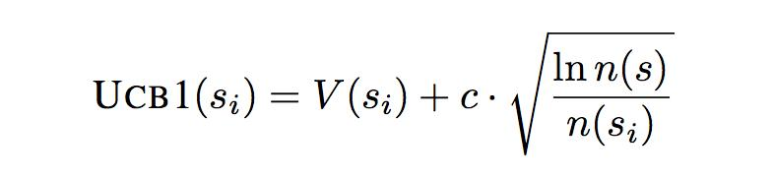
UCT
Tree Descent
Tree Growth
Value Estimation
Value Propagation
v
Notes:
A Monte-Carlo tree search algorithm called UCT, Upper Confidence bounds applied to Trees, is our weapon of choice. UCT was developed in 2006 and it’s most well-known for its success playing the board game Go.
UCT works by incrementally growing an asymmetrical search tree. So let’s assume this is the very top of a large binary search tree, and this is the subtree that UCT maintains. Each terminal node has an associated reward and the goal is to find the maximum terminal reward.
UCT repeats the following four steps until time has run out. In the first step we start at the root node and traverse down to a leaf node of our maintained subtree. At each junction we can travel to either the right or left child depending on which one has the larger UCB1 score (UCB stands for the upper confidence bounds in Upper Confidence Bounds applied to trees).
The UCB1 score of a child node s_i the sum of these two terms. One, V(s_i) is the estimated value of the node, which we’ll get to later. The second term is a bonus for underexplored nodes. ‘n(s)’ is the number of times the node s has been visited and the subscripted s_i’s are the children of node s. C is the exploration parameter, which determines the size of the bonus and therefore determines the exploration/exploitation tradeoff that UCT makes. Larger c values increase the bonus to under-explored nodes, resulting in more exploration and less exploitation.
In the next phase, we’ve finished traversing and we’ve landed at a leaf node of our maintained subtree. We randomly choose a child of the leaf node and add it to our maintained subtree.
Now we estimate the new node’s value. If this node is terminal we can take the value to be the reward, but if it’s not then the value is usually estimated by randomly traversing the rest of the tree and taking the reward of whatever terminal node the traversal ends up at.
Now in the backpropagation phase we have an estimated value for the new node, which we use use to adjust our estimated values of every node along the path from the root node to the new node. This is done to affect the direction of future tree traversals. Most often this is done by maintaining a running average in each node of the rewards seen so far.
Then UCT repeats the same four phases, incrementally growing it's subtree with a bias towards exploitation set by the c parameter.
E

Slide 10
Our Approach: UCTMAXSAT
Notes:
Our approach is to combine UCT and stochastic local search to so that UCT can manage the exploration/exploitation dilemma in a theoretically sound way while local search can quickly configure variables. We call it UCTMAXSAT.

Slide 11
UCTMAXSAT
Tree Descent
Variable Installation
Tree Growth
Value Estimation
Value Propagation
V_{l}
V_{r}
Notes:
In the MaxSAT search tree each node is assigned a corresponding variable. Traversing to the left subtree sets the variable false while traversing to the right subtree sets the variable true. The search terminates at a fixed depth where all the variables have been assigned a value, at which point the reward is a function of the portion of clauses satisfied by the resulting variable assignment. The goal is to find a traversal that maximizes the reward.
The tree descent phase is just as before -- we start at the root node and use the UCB1 formula to traverse to a leaf node of our maintained subtree, successively choosing variable truth assignments. But this time we can simplify the boolean formula as we descend. For example, we can delete all the clauses that are satisfied as we assign variables values. We can also delete all the literals that evaluate False. Then each node in the search tree has a corresponding simplified formula.
Once we hit a leaf node, we have to assign it a variable so that the variable is assigned false in the node’s left subtree and true in the right subtree. We experimented with a number of different variable selection methods found in the literature and several other simple heuristics based on the number of occurrences of positive and negative literals in the node’s simplified formula. We found no strong difference in performance between the different branching heuristics, so we stuck to choosing the variable with the largest number of occurrences, positive or negative, in the simplified formula.
So now we’ve chosen a variable for our leaf node. Then we add both children of this node to the tree -- one corresponding with setting the variable false and the other with setting it true.
The value estimation phase is where local search comes in. During the tree descent phase we’ve fixed the values of a portion of the variables and we’ve ended up with a simplified formula. We use two independent SLS runs to configure the rest of the variables for the two new nodes. The SLS run is restricted to flipping only the variables not already configured by the UCT descent, which reduces the search space considerably. Another crucial part of the SLS run is that the variables not already fixed by the tree descent are initialized at the beginning of the SLS run to their value in the global best solution found so far, not randomly as in a usual SLS run. This is necessary because we use very short SLS runs that may not perform enough flips to configure a good portion of the remaining variables.
After a fixed number of variable flips, each SLS run terminates and returns a reward that guides the tree growth. The most straightforward reward to use would be the maximum portion of satisfied clauses encountered during the SLS run. We experimented with this and other functions of this number and found that taking the reward to be the maximum portion of satisfied clauses squared had robust performance.
In the final phase we propagate the values up the tree, this time with two values, one for each new node. We experimented with using a max backup operator, one that sets the value of a node to the maximum of the incumbent and incoming values. This approach has been found to outperform the traditional averaging operator on problems where the value estimates are accurate. In our setting, however, we found keeping a running average to be superior to the max.
The last piece of our algorithm is a mechanism used to close nodes from further exploration when they will not produce new information. For example, when a terminal node is reached it’s marked as closed and during the propagation phase closed flags are propagated upwards to ensure that each traversal lands on an open node.
These five phases repeat until a time limit is reached. Then UCT returns the minimum number of unsatisfied clauses it’s seen during its run.
So that’s UCTMAXSAT -- UCT handles the exploration/exploitation dilemma while SLS quickly configures variables.

Slide 12
Results
Notes:
Testing our approach, we focused on comparing the performance of UCTMAXSAT with the performance of the SLS algorithm it uses for leaf node value estimation. We tested three SLS algorithms: WalkSAT, Novelty, and CCLS. WalkSAT was developed in 1994 and was one of the first effective local search algorithms for SAT and MaxSAT. Novelty was developed three years and greatly improved on WalkSAT. CCLS (Configuration Checking Local Search) was developed more recently and has won several of the most recent MaxSAT competitions in the unweighted crafted and random instance classes. All three use the WalkSAT architecture I described earlier.
We use the testing format of the annual MaxSAT competition -- a fixed computational budget of 300s for each instance.

Slide 13
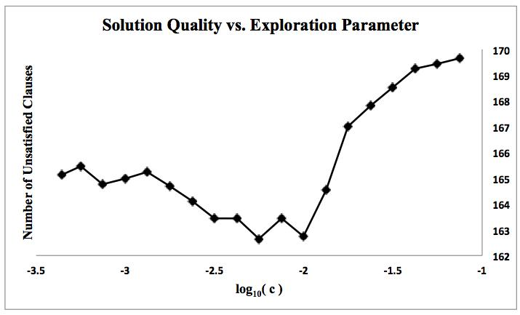
Notes:
The first thing to check is that UCTMAXSAT can make an exploration/exploitation tradeoff, that neither pure exploration nor pure exploitation outperforms some combination of the two. So in this plot we have number of unsatisfied clauses vs. c, the exploration/exploitation parameter. Each point is an average of 20 UCTMAXSAT runs. On both sides of the plot, where there is mostly exploitation or mostly exploration, UCTMAXSAT finds more clauses unsatisfied than in the middle region where UCTMAXSAT makes a nontrivial exploration/exploitation tradeoff. We found this trend across instance classes for all three SLS algorithms.

Slide 14
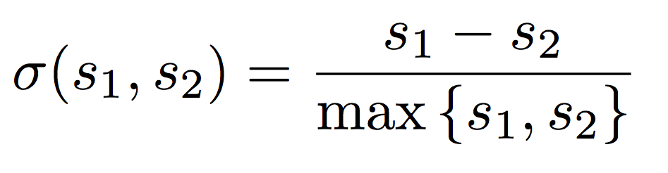
SLS Score
UCTMAXSAT Score
Notes:
For the rest of the results here we’ll compare UCTMAXSAT’s performance with the performance of its underlying SLS solver using instances from the 2015 MaxSAT evaluation. We tuned the noise parameters of the standalone SLS solvers on a per instance basis, taking the best performance from several values. For UCTMAXSAT we instead tuned the exploration/exploitation parameter on a per instance basis and kept the noise parameters at zero.
For each instance we report a normalized difference of the number of clauses satisfied by each solver. Here s_1 is the number of unsatisfied clauses found by SLS and s_2 is the number of unsatisfied clauses found by UCTMAXSAT. We take the difference and divide by the max to keep the result between plus and minus one. So positive is good and negative is bad. Zero is a tie.

Slide 15
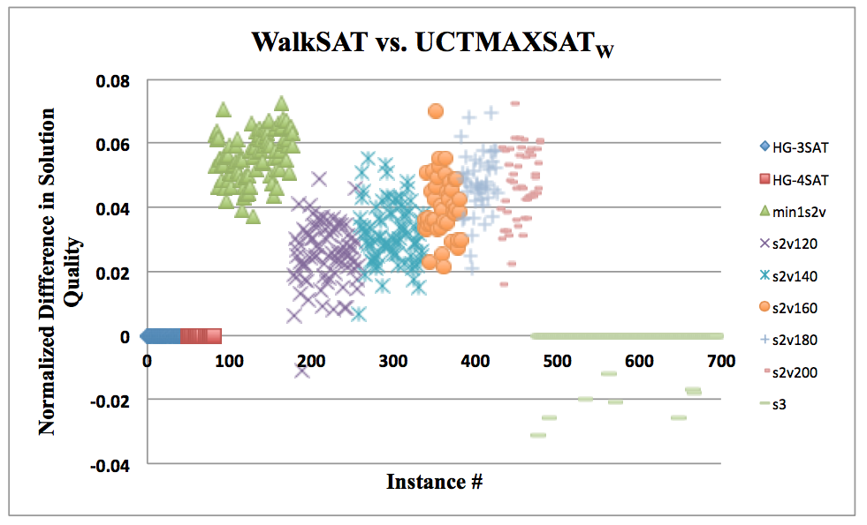
Random
Notes:
WalkSAT random
Here are the results comparing UCTMAXSAT using WalkSAT for leaf node value estimation with WalkSAT. The y-axis is the normalized difference and each point is a different instance from the random category of the 2015 evaluation. The different symbols represent different classes of random instances.
You can see a couple losses for UCTMAXSAT in one class and a good number of ties in a couple other classes, but mostly wins.

Slide 16
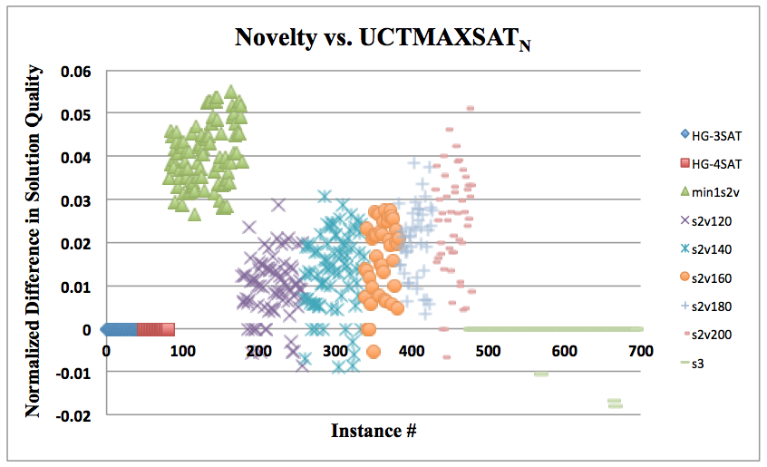
Random
Notes:
Novelty random
Here are the same random instances, but with Novelty instead of WalkSAT. Overall, the results are similar, but with a slightly lower margin of victory. Remember that Novelty is a superior algorithm to WalkSAT.

Slide 17
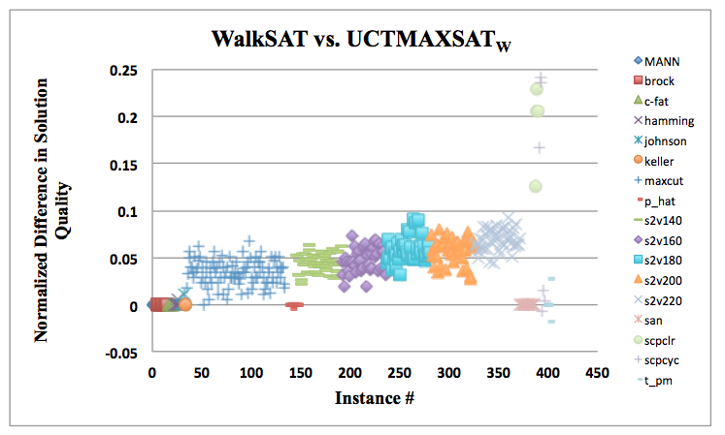
Crafted
Notes:
WalkSAT crafted
These are the WalkSAT results for the crafted category of the 2015 MaxSAT evaluation. There are almost no losses and much higher margins of victory.

Slide 18
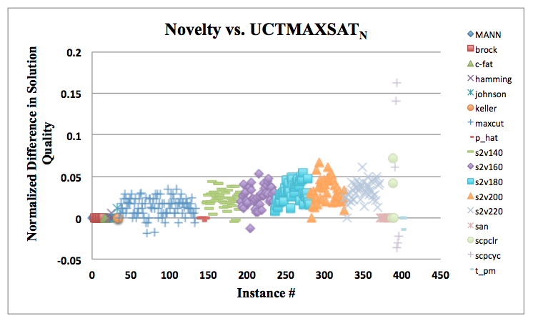
Crafted
Notes:
Novelty crafted
And here’s UCTMAXSAT versus Novelty. Still a clear win for UCTMAXSAT, but the margin of victory is smaller than with UCTMAXSAT versus WalkSAT. This is similar to what we saw with the random instances.
We didn’t compare UCTMAXSAT with CCLS on the random or crafted categories of the 2015 MaxSAT evaluation because CCLS found the optimal number of unsatisfied clauses for every instance, so UCTMAXSAT with CCLS leaf node value estimation wouldn’t have been able to compete.

Slide 19
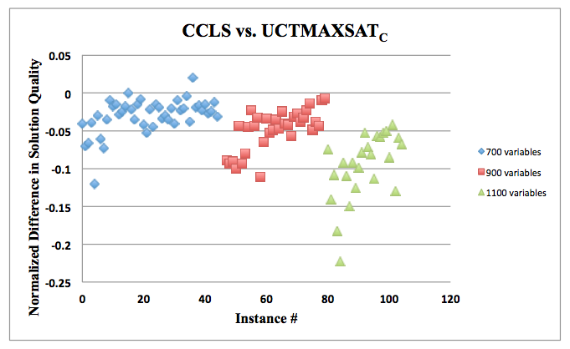
Random
3-SAT
Notes:
CCLS random 3-SAT
So to compare UCTMAXSAT and CCLS we made the instances harder. Here we have results from random 3-SAT instances we generated with the same clause to variable ratios as the evaluation, just ten times bigger.
You can see that UCTMAXSAT fares pretty poorly compared to CCLS, winning only one instance and tying another. Also, the losing margin widens as the instances become larger.

Slide 20
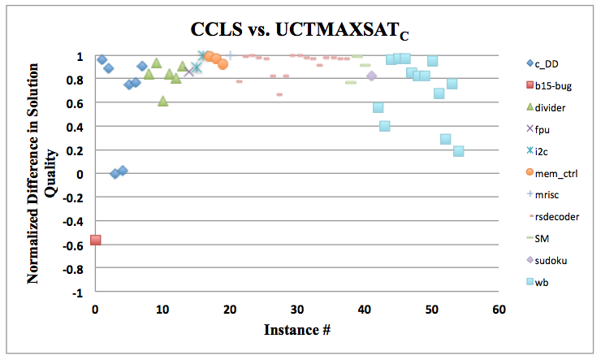
Industrial
Notes:
CCLS industrial
For our last test we compared UCTMAXSAT with CCLS on the industrial category of the 2015 evaluation. CCLS wasn’t designed to solve industrial instances, which are usually larger and more constrained than random or crafted instances, but we tested it on them to see if UCTMAXSAT could improve on CCLS’s weaker areas.
You can see we have only one loss and one tie. The normalized score for most instances is close to one, meaning UCTMAXSAT satisfies almost 100% of the clauses CCLS leaves unsatisfied.

Slide 21
Conclusions
UCTMAXSAT navigates the exploration/exploitation dillema effectively in the MaxSAT domain.
UCTMAXSAT significantly improves the performance of baseline SLS algorithms like WalkSAT and Novelty.
There is evidence that UCTMAXSAT makes the underlying SLS algorithm more “well-rounded”

Slide 22
Future Work
Extensions to partial and weighted MaxSAT
Develop a UCTMAXSAT-specific SLS algorithm

Slide 23
Questions?
github.com/jackgoffinet/UCTMAXSAT
Thanks to
Davidson College
Shaowei Cai and collaborators
Dave Tompkins and Holger Hoos

Slide 24
EXTRA SLIDES

Slide 25
Stochastic Local Search
The WalkSAT Architecture
Φ:{x_{i} : 1≤ i≤ n} ➝ {True, False}
c ≔ randomly selected unsatisfied clause
x ≔ variable in c selected according to some policy
Φ ≔ Φ’ where Φ’[x] = ¬Φ[x]
Observe # of unsatisfied clauses
Repeat
Return minimum # of unsatisfied clauses observed

Slide 26
Satisfiability (SAT)
variable
literal
clause
(x₁ ∨ x₂ ∨ ¬x₃) ∧ (¬x₁ ∨ ¬x₂ ∨ x₃) ∧ (x₁ ∨ ¬x₂)
formula
logical OR operator
negation operator
logical AND operator
Notes:
An instance of the satisfiability problem is a boolean formula in a particular form. We have boolean variables taking on values of True or False, 1 or 0. These variables are operated on by AND, OR, and negation operators. A literal is a variable or the negation of a variable. A clause is a disjunction of literal, a group of literals separated by OR operators -- the clauses are the constraints. SAT instances, or formulas, are conjunctions of clauses.
So SAT asks the question: given a formula, is there an assignment of the values True and False to the variables such that the the formula evaluates to true? ⇔ can each clause be satisfied? ⇔ can at least one literal in each clause evaluate simultaneously to True?

Slide 27
Satisfiability (SAT)
(x₁ ∨ x₂ ∨ ¬x₃) ∧ (¬x₁ ∨ ¬x₂ ∨ x₃) ∧ (x₁ ∨ ¬x₂)
^{Satisfiable?}
x₁ ≔ True
✔
x₂ ≔ False
Notes:
Let’s take this example and set x_1 to True. Now we have a true literal in the first and third clause, so those constraints are satisfied.
Then to satisfy the second clause we have two choices: x_1 is already fixed, but x_2 and x_3 are both free. Then setting x_2 to False make not x_2 evaluate to True and so we satisfy the second clause. We can set x_3 to whatever we’d like.
So is the formula satisfiable? Yes -- we’ve found a configuration of the variables that satisfy each clause. This is the SAT problem. SAT is NP-complete

Slide 28
Maximum Satisfiability (MaxSAT)
(x₁ ∨ x₂ ∨ ¬x₃) ∧ (¬x₁ ∨ ¬x₂ ∨ x₃) ∧ (x₁ ∨ ¬x₂)
∧ (x₂ ∨ x₃) ∧ (¬x₁ ∨ ¬x₃)
^{Satisfiable?}
❌
Notes:
Now for MaxSAT. The MaxSAT problem asks: given a boolean formula, what is the maximum number of clauses that can be simultaneously satisfied? Clearly, for a satisfiable formula the maximum number of satisfied clauses is all of them -- the total number of clauses. But for unsatisfiable instances is something less.
If we add these two more clauses to the formula it turns out it becomes unsatisfiable. But what maximum number of clauses can we simultaneously satisfy? We know we can satisfy the original 3 clauses, but it turns out we can do better -- the optimal number of unsatisfied clauses is 1 -- we can satisfy 4 of 5.
That’s the MaxSAT problem -- it’s an NP-hard generalization of SAT.

Slide 29
UCTMAXSAT
Tree Descent
2) Variable Installation
3) Tree Growth
4) Value Estimation
5) Value Propagation
V_{l}
V_{r}

Slide 30
UCT
Tree Descent
2) Tree Growth
3) Value Estimation
4) Value Propagation
V

Slide 31
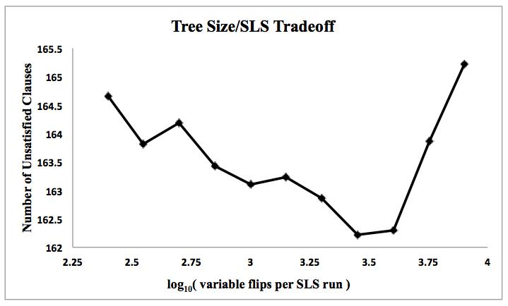
Notes:
(Get rid of this slide?)
The next thing to check is that there’s a balance to strike between the amount of time UCTMAXSAT spends performing UCT versus the amount of time spent performing SLS. This is controlled by the number of variable flips during the SLS runs. Here we have the number of unsatisfied clauses versus the number of variable flips per SLS run and there’s an optimal spot at around 2000 flips per run. We found 1000 flips per run to perform well across a range of instances, so we fixed the flips per run at 1000.

