Slide 1
What Have We Learned?
Sequential elements (flops & latches) should be inferred using non-blocking statements ( <= operator used )
Combinational should be inferred with continuous assigns, but if you insist on doing it in a always block then use blocking “=“ statements
Blocking and non-Blocking statement should not be combined in the same always block.
A signal should not be assigned from two different blocks.

Slide 2
Counters are commonly needed blocks:
rst_n
Increment logic & mux are combinational ➔ blocking
Flop is seqential. ➔ non-blocking
0
R
+1
comb
cnt[7:0]
1
en
clk
8-bit counter with reset & enable

Slide 3
Counter That Follows the Rules
module pill_cnt(clk,rst_n,en,cnt);
input clk,rst_n;
output [7:0] cnt;
reg [7:0] nxt_cnt,cnt;
always @(posedge clk, negedge rst_n)
if (!rst_n)
cnt <= 8’h00;
else
cnt <= nxt_cnt;
always @(en or cnt)
if (en)
nxt_cnt = cnt + 1; // combinational
else
nxt_cnt = cnt; // so use blocking
endmodule
Nothing wrong with this code
Just a little verbose. Use DF?
module pill_cnt(clk,rst_n,en,cnt);
input clk,rst_n;
output [7:0] cnt;
reg [7:0] cnt;
wire [7:0] nxt_cnt;
always @(posedge clk, negedge rst_n)
if (!rst_n)
cnt <= 8’h00;
else
cnt <= nxt_cnt;
assign nxt_cnt = (en) ? cnt+1 : cnt;
endmodule

Slide 4
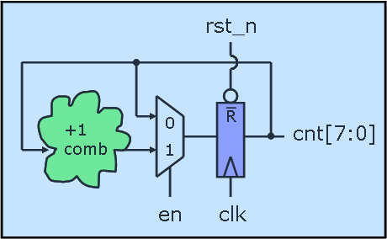
Rules Can Be Broken If…
module iq_cnt(clk,rst_n,en,cnt);
input clk,rst_n;
output [7:0] cnt;
reg [7:0] cnt;
always @(posedge clk or negedge rst_n)
if (!rst_n)
cnt <= 8’h00;
else if (en)
cnt <= cnt + 1; // combinational
endmodule
What 2 rules are broken here?
Code infers combinational using a non-blocking assignment
We are using an if statement without a pure else clause
Is this OK?

Slide 5
Ring Counter
module ring_counter (count, enable, clock, rst_n);
output reg [7: 0] count;
input enable, rst_n, clock;
always @ (posedge clock or negedge rst_n)
if (!rst_n) count <= 8'b0000_0001;
else if (enable == 1’b1) begin
case (count)
8’b0000_0001: count <= 8’b0000_0010;
8’b0000_0010: count <= 8’b0000_0100;
…
8’b1000_0000: count <= 8’b0000_0001;
default: count <= 8’bxxxx_xxxx;
endcase
end
endmodule
What do you think of this code?

Slide 6
Ring Counter (a better way)
module ring_counter (count, enable, clock, rst_n);
output reg [7: 0] count;
input enable, rst_n, clock;
always @ (posedge clock or negedge rst_n)
if (!rst_n) count <= 8'b0000_0001;
else if (enable) count <= {count[6:0], count[7]};
else count <= count;
endmodule
Use vector concatenation in this example to be more explicit about desired behavior/implementation
  More concise
  Does not rely on synthesis tool to be smart and reduce your logic for you.

Slide 7
Class Exercise: (Program Counter)
rst_n
1
+1
0
addr[15:0]
pc[15:0]
0
16
IM
dst_ID_EX
1
clk
stall
Needed for BR instr
flow_change_ID_EX
Implement a program counter block in verilog
Submit to the drop-box on moodle
0
pc_IM_ID
pc_ID_EX
pc_EX_DM
Needed for JAL instr
1
clk
clk
clk

Slide 8
For branch
rst_n
1
+1
Address to
Instruction memory
0
pc[15:0]
0
Branch Target
From EX
16
1
dst_ID_EX
clk
branch
stall

Slide 9
rst_n
+1
0
1
Address to
Instruction memory
16
1
0
pc[15:0]
0
1
branch
Recover_address_ID_EX
clk
stall
flush
Branch predictor
Recover_address
Predicted address
Instruction
Branch result

