Slide 1
Benchmarking RDS as a Service with comparison to traditional deployment of RDS to virtual computing machines - Update
OR: BRD-SAS-vs-TaDRDS-VMs - Update
John Goza Zeshan Ather
https://github.com/spexican924/cloud-provider-rds-benchmarks

Slide 2
AWS Benchmarking
Instance:
t2-small-200k
mySQL 5.7
1 and 20 tables
AWS system benchmarking:
AWS-RDS-RW-200k for
AWS-RDS-RW-200k-1T
AWS-RDS-RW-200k-2T
AWS-RDS-RW-200k-4T
AWS-RDS-RW-200k-8T
AWS-RDS-RW-200k-16T

Slide 3
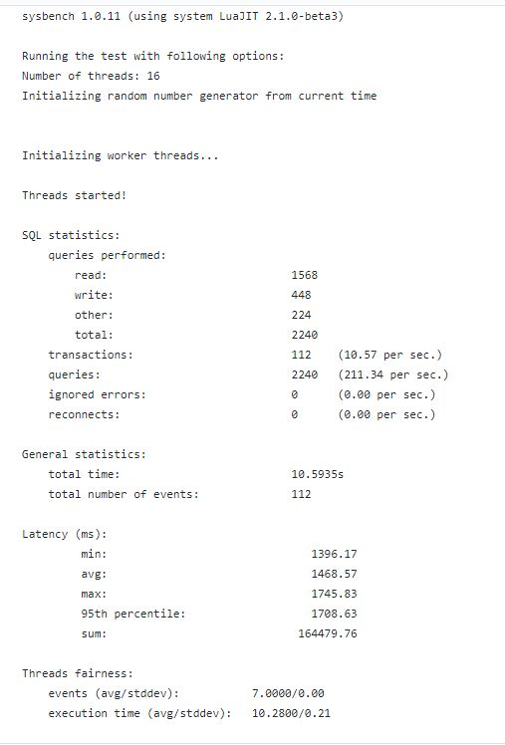
AWS-RDS-RW-200k-16T

Slide 4
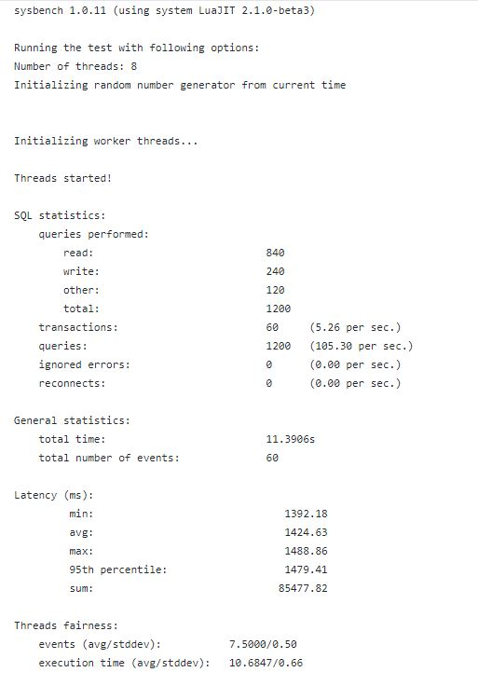
AWS-RDS-RW-200k-8T

Slide 5
AWS Benchmarking
Instance:
t2-small-2M
mySQL 5.7
AWS system benchmarking:
Same thread differences!
More rows.
Test against 1 and 20 tables

Slide 6
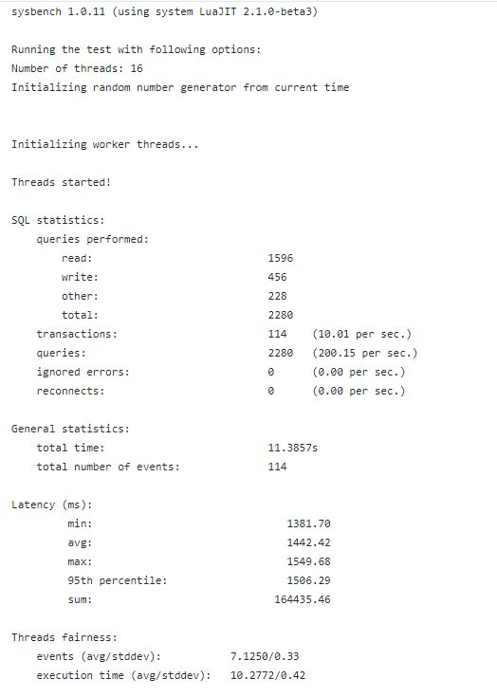
AWS-RDS-RW-2M-16T

Slide 7
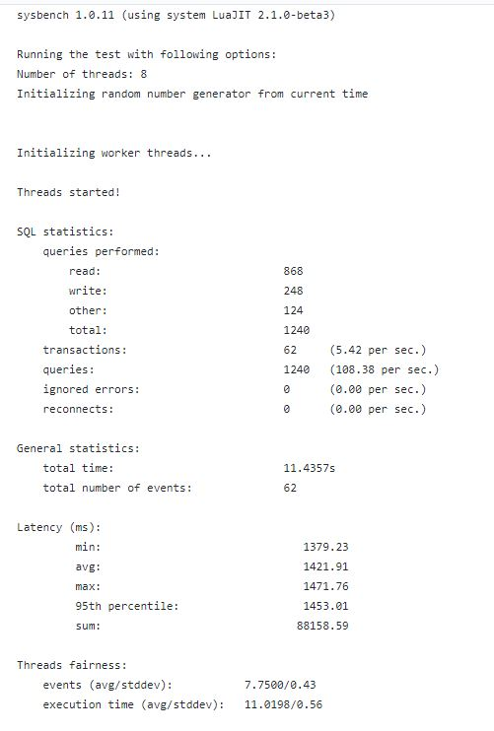
AWS-RDS-RW-2M-8T

Slide 8
GCP Benchmarking
Instance:
t2-small-2M
mySQL 5.7
GCP system benchmarking:
20 tables of 1M records
20 tables of 200K records
1 table 2M records
1 table 200K records

Slide 9
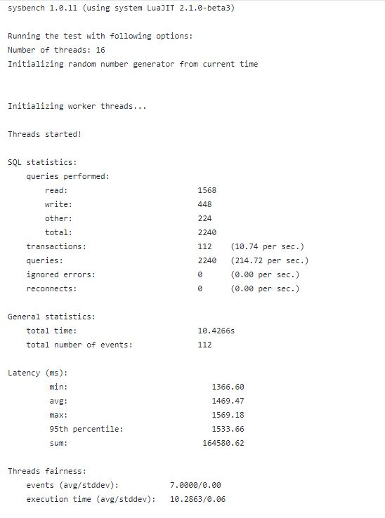
20 tables of 1M records GCP-RDS-RW-20TABLE-1M-16T

Slide 10
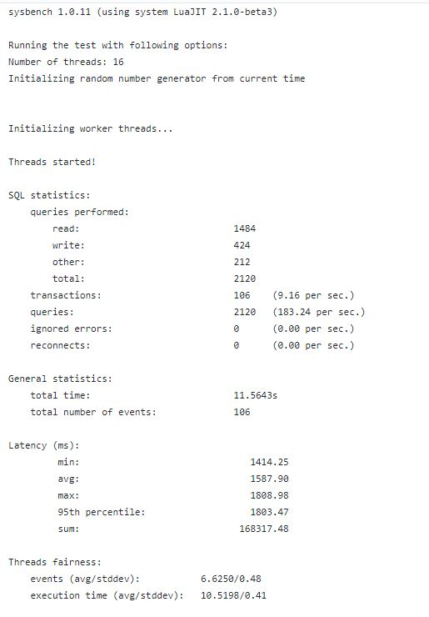
1 table of 2M records GCP-RDS-RW-1M-16T

Slide 11
Observations

