Slide 1
Neutral Party Benchmarking of Cloud Relational Database Offerings Contrasted to Same-Provider Virtual Machine Based Databases
OR: NPB-CRBO-vs-SPVMDB

Slide 2
Imagine you’re founding a new company. Where is your database?
With the advent of cloud computing, localized databases are a thing of the past.
The question becomes:
Given your choice of Cloud service provider, are you better off standing up your own database on a virtual machine?
Is it easier and cheaper to use a pre-configured database as a serivce (DaaS*)?
*not to be confused with Desktop as a Service.

Slide 3
What if we told you that no-one really knows?*
* at least not from a numeric/evaluatory standpoint

Slide 4

Facts:
DaaS is everywhere AWS, GCP, AZURE, IBM cloud
Many cloud providers don’t advocate DaaS as the solution AWS, for example, says that for many a EC2 based database is a better solution.
Independent benchmarks for DaaS are scarce. How do YOU know DaaS is the right solution for your company?

Slide 5
Enter TPC-DS based DaaS/VC benchmarks.
The preferred measure for SQL based big data systems.

Slide 6
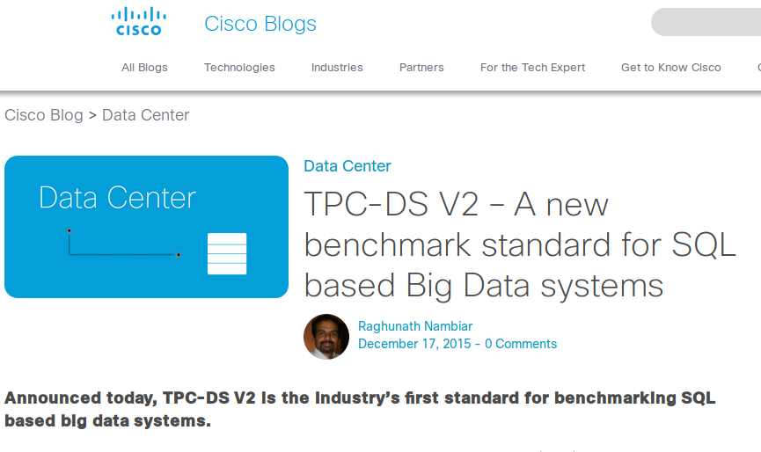

Slide 7
Why TPC-DS?
Industry recognition and acceptance
Wide assortment of different complex query types
Data scalability from 1 Gig -> 100 Gigs
Low(ish) overhead to stand up and run on any SQL database variant.

Slide 8
Why SQL? What about MongoDB, CouchDB, Cassandra, etc?
While No-SQL databases continue to grow in popularity, a benchmarking standard with the acceptance and proven history of TPC-DS just doesn’t exist yet.
Comparing No-SQL benchmarks to TPC-DS on SQL = Apples vs Oranges
Worthy of investigation! Just not by us.

Slide 9

Why should we care?
Meet George. He is the CTO of the new tech company BigDataOrBust. Every millisecond that company’s db calls takes costs him money, and his customers their time. He, like all tech CTOs, wants the fastest, most reliable RDS for his money.

Slide 10
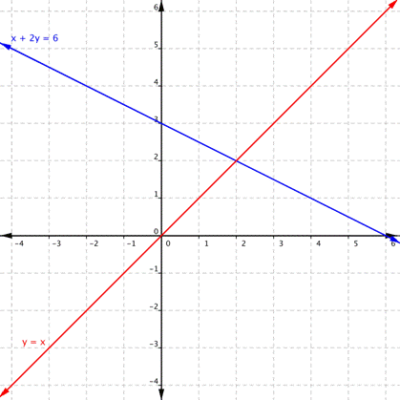
What’s our cross point for a database in a VM vs a given DaaS?

Slide 11
Thank you

