Slide 1
Budgeteer Budgeting and Savings Application
CS 470
Group 8 – The Drop Tables
Nick, Jack, Sasha, Max

Slide 2
Introduction
Goal: To develop a budgeting and savings application that could be used by a bank to help their customers better manage and track their spending
Based on the final project for the Software Engineering Capstone (CS451R) course

Slide 3
Desired Functionality
Create and view budgets and spending for multiple accounts
Create and edit budgets to track spending by transaction type
Comparison between budgeting and actual spending
Provide a visual (graphical) representation of budgeting and actual spending

Slide 4
Application Architecture
Basic two-tier architecture
Data Tier
Microsoft SQL Server
C#
ASP .NET
Client Tier
HTML/CSS/JavaScript
Bootstrap Framework

Slide 5
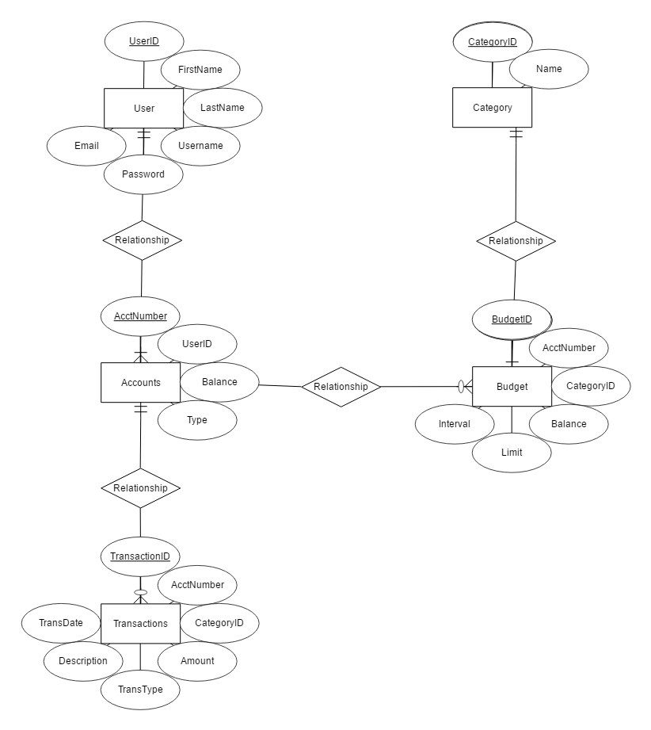
ER Diagram
Five Entities: User, Account, Transaction, Budget, and Category
_ to _ relationship between User and Account
_ to _ relationship between Account and Transaction
_ to _ relationship between Account and Budget
_ to _ relationship between Budget and Category

Slide 6
CREATE SCHEMA bank
CREATE TABLE bank.users(
user_id integer NOT NULL,
user_first_name text COLLATE pg_catalog."default",
user_last_name text COLLATE pg_catalog."default",
user_username text COLLATE pg_catalog."default",
user_email text COLLATE pg_catalog."default",
user_password text COLLATE pg_catalog."default",
CONSTRAINT user_id_pkay PRIMARY KEY (user_id)
)
TABLESPACE pg_default;
CREATE TABLE bank.accounts(
account_number integer NOT NULL,
user_id integer NOT NULL,
balance integer DEFAULT 0 NOT NULL,
account_type text COLLATE pg_catalog."default",
CONSTRAINT account_number_pkey PRIMARY KEY (account_number),
CONSTRAINT account_user_id_fk FOREIGN KEY (user_id)
REFERENCES bank.users (user_id) MATCH SIMPLE
ON UPDATE NO ACTION
ON DELETE NO ACTION
)
TABLESPACE pg_default;
CREATE TABLE bank.transactions(
transaction_id integer NOT NULL,
account_number integer NOT NULL,
category_id integer NOT NULL,
amount integer DEFAULT 0 NOT NULL,
transaction_type text COLLATE pg_catalog."default",
description text COLLATE pg_catalog."default",
transaction_date date,
CONSTRAINT transaction_id_pkey PRIMARY KEY (transaction_id),
CONSTRAINT account_number_fk FOREIGN KEY (account_number)
REFERENCES bank.accounts (account_number) MATCH SIMPLE
ON UPDATE NO ACTION
ON DELETE NO ACTION,
CONSTRAINT category_id_fk FOREIGN KEY (category_id)
REFERENCES bank.transaction_category (category_id) MATCH SIMPLE
ON UPDATE NO ACTION
ON DELETE NO ACTION
)
TABLESPACE pg_default;
CREATE TABLE bank.transaction_category(
category_id integer NOT NULL,
name text COLLATE pg_catalog."default",
CONSTRAINT category_pkey PRIMARY KEY (category_id)
)
TABLESPACE pg_default;
CREATE TABLE bank.budget(
budget_id integer NOT NULL,
account_number integer NOT NULL,
category_id integer NOT NULL,
balance integer DEFAULT 0 NOT NULL,
budget_limit integer DEFAULT 500 NOT NULL,
budget_interval integer DEFAULT 30 NOT NULL,
CONSTRAINT budget_id_pkey PRIMARY KEY (budget_id),
CONSTRAINT account_number_fk FOREIGN KEY (account_number)
REFERENCES bank.accounts (account_number) MATCH SIMPLE
ON UPDATE NO ACTION
ON DELETE NO ACTION
)
TABLESPACE pg_default;

Slide 7
Database Queries - Budget
Query Description | SQL Statement
Get the budgets for an account | SELECT * FROM Budget WHERE AcctNumber = X
Get the category name for a transaction | SELECT Name FROM Transaction AS T JOIN Category AS C ON T.CategoryID = C.CategoryID
Get the balance of a budget | SELECT Balance FROM Budget WHERE Name = N
Set the balance of a budget | UPDATE Budget SET Balance = X Where Name = N
Set the limit of a budget | UPDATE Budget SET Limit = L WHERE Name = N
Set the interval of a budget | UPDATE Budget SET Interval = I Where Name = N

Slide 8
Database Queries - Transaction
Query Description | SQL Statement
Get all transactions that occurred within a certain time period | SELECT * FROM Transactions WHERE AcctNumber = num AND TransDate >= d1 AND TransDate <= d2
Get all transactions of a specific type that occurred within a certain time period | SELECT * FROM Transactions WHERE CategoryID = X AND TransDate >= d1 AND TransDate <= d2

Slide 9
Database Queries – Graph Data
Query Description | SQL Statement
Get the sum of all transactions of the same type for a given period | SELECT SUM(Amount) as Total FROM Transactions WHERE CategoryID = X AND TransDate >= d1 AND TransDate <= d2
Get the amount budgeted for a transaction type for a given period | SELECT Balance, Interval FROM Budgets WHERE BudgetID = X

Slide 10
Future Scope

